Slide 1
Session 4

Slide 2
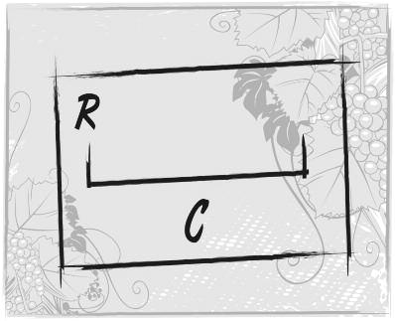
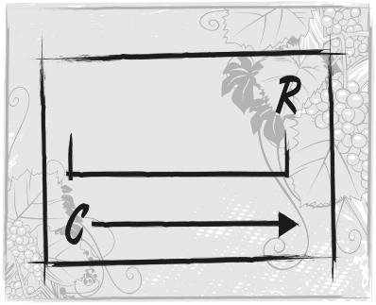
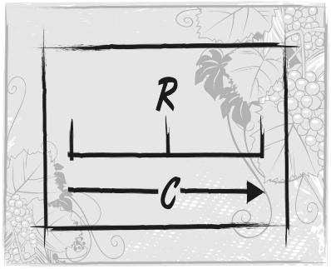
C = conversion/change
R = regeneration
Session 5

Slide 3
Think of a friend or family member who needs Christ.
Place that person on the matrix.
Is that person open or closed to hearing the gospel?
Does that person know a lot about the gospel or little?
Know much
Know little
Session 5

Slide 4

Pull-Quote on page 82:
“Unbiblical elements
exist in a person’s
worldview that may
confuse his under-
standing of words
I use to communicate
a message.”
Can you think of some concrete examples of this?
Session 6

Slide 5

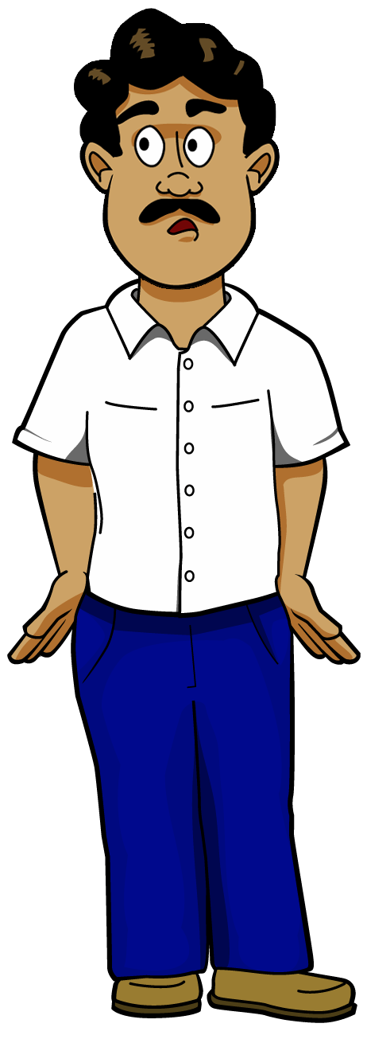
6.
True Meaning
of John 3:16
1.
Meaning of
John 3:16
or
message
2.
Encode
3.
Transmit
5.
Decode
4.
Worldview
“Noise”
The Gospel
Communication Process
Session 6

Slide 6
Pull-Quote on page 97:
“Since the target
audiences had different
understandings of
biblical content, the
evangelists started at
different points in
God’s redemptive
story and gave more
information as was needed. We need to learn from these examples.”
Think of an example of this from your evangelism efforts.
Session 7

Slide 7

12-03-09
What is Good Soil Evangelism & Discipleship (E&D)?
Let’s let Jesus define it:
Matthew 13:23
Mark 4:20
Luke 8:15
But he who received seed on the good ground is he who hears the word and understands it*, who indeed bears fruit and produces: some a hundredfold, some sixty, some thirty.
But these are the ones sown on good ground, those who hear the word, accept it*, and bear fruit: some thirtyfold, some sixty, and some a hundred.
But the ones that fell on the good ground are those who, having heard the word with a noble and good heart, keep it* and bear fruit with patience.
*Greek suniemi =
*Greek paradechomai =
*Greek katecho =
συνίηmι (soon-ee'-ay-mee)
παραδέχomαι (par-ad-ekh'-o-mi)
κατέχω (kat-ekh'-o)
The word literally means to send or bring together, thus in this case
to mentally put things together so as to comprehend or make sense of it.
The word dechomai (receive) is intensified by the prefix para
(near or by one’s side), thus it conveys the idea of embracing.
The word literally means to hold something down; in a positive
sense it means to hold it tightly so as to protect it from being taken away.
Match Passages to Statements
Match Passages to Statements
Match Passages to Statements
___ Matthew 13:19
___Luke 24:44-45
___ Acts 15:4
___1 Timothy 5:19
___ 1 Corinth. 11:2
___1 Corinth. 15:2
___ Acts 28:26
___ Acts 28:27
___ Hebrews 12:6
___ Hebrews 10:23
1a. Sometimes people hear and see but do not understand.
1b. Sometimes people with a lot of Bible knowledge do not understand it (“put it all together” so as to make clear sense).
1c. Sometimes lack of understanding is a “calloused or dull
or hard heart” problem.
1d. People who hear but don’t understand are spiritually vulnerable.
2a. This word carries the idea of welcoming
something or someone into one’s
presence—a warm and friendly reception.
2b. This word is also used to describe the
act of adoption, when a father lovingly acknowledges a child as his own.
2c. This word is also used to describe the
action of accepting something as being true and valid.
3a. Our human role is to “hold fast” but the encouraging thing to know is that God’s role is to remain faithful to the promises He has given us.
3b. Those who are truly saved will hold firmly to God’s Word.
3c. It’s a praiseworthy thing for believers to hold on to the teachings that have been passed on to them by the person who discipled them.
Regeneration (new birth) occurs instantaneously at a single point in time, but
there is a sense in which conversion is a gradual process that leads up to regeneration.
Session 7
Discuss: In what sense is conversion a gradual process leading to regeneration?
2007 Sow and Harvest International – Info@SowAndHarvest.com

Slide 8
Matthew 13:19
¹⁹ When anyone hears the word of the kingdom, and does not understand it, then the wicked one comes and snatches away what was sown in his heart. This is he who received seed by the wayside.
1 Timothy 5:19
¹⁹ Do not receive an accusation against an
elder except from two or three witnesses.
Luke 24:44-45
⁴⁴ Then He said to them, “These are the words which I spoke to you while I was still with you, that all things must be fulfilled which were written in the Law of Moses and the Prophets and the Psalms concerning Me.” ⁴⁵ And He opened their understanding, that they might comprehend the Scriptures.
Hebrews 12:6
⁶ For whom the LORD loves He chastens, and scourges every son whom He receives.”
Acts 28:26
1 Corinthians 11:2
²⁶ saying, ‘ Go to this people and say:“ Hearing you will hear, and shall not understand; And seeing you will see, and not perceive;.
² Now I praise you, brethren, that you remember me in all things and keep the
traditions just as I delivered them to you.
Acts 28:27
1 Corinthians 15:2
²⁷ For the hearts of this people have grown dull. Their ears are hard of hearing, and their eyes they have closed, lest they should see with their eyes and hear with their ears, lest they should understand with their hearts
and turn, so that I should heal them.”’
² by which also you are saved, if you hold fast that word which I preached to you—unless you believed in vain.
Acts 15:4
Hebrews 10:23
⁴ And when they had come to Jerusalem, they were received by the church and the apostles and the elders; and they reported all things that God had done with them.
²³ Let us hold fast the confession of our hope without wavering, for He who promised is faithful.
Session 7

Slide 9
Matthew 13:19 When any one heareth the word of the kingdom, and understandeth it not, then cometh the wicked one, and catcheth away that which was sown in his heart. This is he which received seed by the way side.
1d. People who hear but don’t understand are spiritually vulnerable.
Session 7

Slide 10
Luke 24:44-45 He said unto them, These are the words which I spake unto you...which were written in the law of Moses...concerning me. Then opened he their understanding, that they might understand the scriptures.
1b. Sometimes people with a lot of Bible knowledge do not understand it (“put it all together” so as to make clear sense).
Session 7

Slide 11
Act 28:26 Saying, Go unto this people, and say, Hearing ye shall hear, and shall not understand; and seeing ye shall see, and not perceive...
1a. Sometimes people hear and see but do not understand.
Session 7

Slide 12
Acts 28:27 For the heart of this people is waxed gross, and their ears are dull of hearing, and their eyes have they closed; lest they should see with their eyes, and hear with their ears, and understand with their heart, and should be converted, and I should heal them.
1c. Sometimes lack of understanding is a “calloused/dull/hard heart” problem.
Session 7

Slide 13
Acts 15:4 And when they were come to Jerusalem, they were received of the church, and of the apostles and elders, and they declared all things that God had done with them.
2a. This word carries the idea of welcoming something or someone into one’s presence—a warm and friendly reception.
Session 7

Slide 14
1 Timothy 5:19 Against an elder receive not an accusation, but before two or three witnesses.
2c. This word is aso used to describe the action of accepting something as being true and valid.
Session 7

Slide 15
Hebrews 12:6 For whom the Lord loveth he chasteneth, and scourgeth every son whom he receiveth.
2b. This word is also used to describe the act of adoption, when a father lovingly acknowleges a child as his own.
Session 7

Slide 16
1 Corinthians 11:2 Now I praise you, brethren, that ye remember me in all things, and keep the ordinances, as I delivered them to you.
3c. It’s a praiseworthy thing for believers to hold on to the teachings that have been passed on to them by the person who discipled them.
Session 7

Slide 17
1 Corinthians 15:2 By which also ye are saved, if ye keep in memory what I preached unto you, unless ye have believed in vain.
3b. Those who are truly saved will hold firmly to God’s Word.
Session 7

Slide 18
Hebrews 10:23 Let us hold fast the profession of our faith without wavering; for he is faithful that promised.
3a. Our human role is to “hold fast” but the encouraging thing to know is that God’s role is to remain faithful to the promises He has given us.
Session 7

Slide 19
2007 Sow and Harvest International – Info@SowAndHarvest.com
The Good Soil E&D Scale – The Vertical Dimension
+
+
Serves in leadership roles
+12
Level 3:
Leadership
Development
Spiritual giftedness confirmed
+11
Disciples new & immature believers
+10
Level 2:
Deepens Bible/theology knowledge
+9
Equipping
Discipleship
Luke 8:15
Participates in Christian service
+8
Identifies with Christ in baptism
+7
Identifies with other believers
+6
The Way to Joy
Witnesses to unbelievers
+5
Level 1:
Follow up
Discipleship
Experiences sin & confession
+4
Begins Bible reading & prayer
+3
Gains assurance of salvation
+2
Experiences initial life changes
+1
Sanctification
Repents and trusts Jesus
Regeneration
Counts cost of a faith response
-1
Level 3:
Reaping
Evangelism
Mark
4:20
Confronted with a faith response
-2
Senses personal spiritual conviction
-3
Persuade
Personalize
Clarify
Understands some gospel concepts
-4
Interested in Jesus and the gospel
-5
Level 2:
Planting
Evangelism
Exposed to other Christian concepts
-6
The Story of Hope
Realizes there is only one true God
-7
Establish uniqueness of Jesus
Teach gospel concepts
Matthew 13:23
Vulnerable to false religious beliefs
-8
Seeks to fill personal spiritual void
-9
Level 1:
Tilling
Evangelism
Senses personal spiritual emptiness
-10
Aware of higher Power or powers
-11
Challenge core worldview
Model, love, & pray
Conviction
Born with a God-Vacuum
-12
General & Special
Revelation
Human Spiritual Responses
Our Roles
God’s Roles
*Basic gospel concepts = God, man, sin, death (as divine judgment), Christ, cross (including resurrection), faith, & (spiritual, eternal) life.
The original concept for this scale was created by Viggo Sogaard and later revised by James F. Engel and called the Engel Scale.

Slide 20

Session 8

Slide 21
I’m an Onion – You’re an Onion
Peeling the
Worldview Onion
Human Commonalities
5
Entry
Conversations
Behavioral Patterns
4
Work
Personal Choices
3
Investigative
Questions
Health
Travel
Hobbies
Internalized Values
2
Weather
World events
Core Beliefs
1
Personal history
Conversion
Discussions
Initially influenced by culture
Local interests
Changed through crisis and/or
confrontation
Education
Family
Other

Slide 22
Deficiencies in Essential Gospel Knowledge
Counts cost of a faith response
-1
Once I trust Jesus as my Savior I will never regret it
I must choose to receive or to reject God’s provision
The new “tug in my heart” is God drawing me to Himself
My sins will be forgiven if I trust Jesus alone as Savior
None of my “good deeds” brings me into favor with God
Jesus truly arose from the dead—He conquered death!
Jesus died in my place, to pay the penalty for my sins
Jesus is not “one way” but the “only way” to God
Confronted with a faith response
-2
Senses personal spiritual conviction
-3
Understands some gospel concepts
-4
Interested in Jesus and the gospel
-5
Jesus was innocent but evil people crucified Him
Jesus Christ is God’s special Son
God has a plan to provide for the forgiveness of my sins
After death, I will face God in judgment for my sins
Disobedience to God offends Him greatly—it is “sin”
The Bible is God’s Word to mankind
Exposed to other Christian concepts
-6
Realizes there is only one true God
-7
-8
Vulnerable to false religious beliefs
-8
What and in whom I believe does matter--eternally
There is life after death and I must prepare for it
There is hope for me that I can possess, here & now
There are no human efforts that will fill this void
Alienation from this God has caused my emptiness
This God is the Creator of the world & all that’s in it
This God is eternal, personal, holy, just, & loving
The highest power is God—only one true living God
Seeks to fill personal spiritual void
-9
Senses personal spiritual emptiness
-10
Aware of higher Power or powers
-11
Born with a God-Vacuum
-12
What Unbelievers Do NOT Know
Session 10

Slide 23
Bernard asked:
“How much Bible content
and biblical context
does each unbeliever
need in order to make a
‘good soil’ faith response?”
Discuss what Bernard meant by Bible content and biblical context.
Session 10

Slide 24
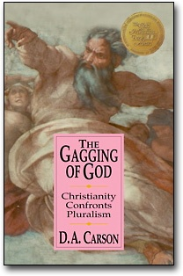
“The Bible as a whole document
tells a story, and properly used,
that story can serve…to shape
our grasp of the entire Christian
faith. In my view it is increasingly
important to spell this out to
Christians and to non-
Christians alike—to Christians,
to ground them in Scripture,
and to non-Christians, as part of our
Proclamation of the gospel.”
Session 10

Slide 25
Systematic
Theology Proper
Anthropology
Christology
Pneumatology
Angelology
Bibliology
Hamartiology
Soteriology
Ecclesiology
Eschatology
Systematic
Systematic
Theology
Theology
Session 10

Slide 26
Biblical Theology
God
Man
Sin
Death
Christ
Cross
Faith
Life
Session 10

Slide 27
Narrative (story)
Metanarrative (Big Story)
Session 10

Slide 28
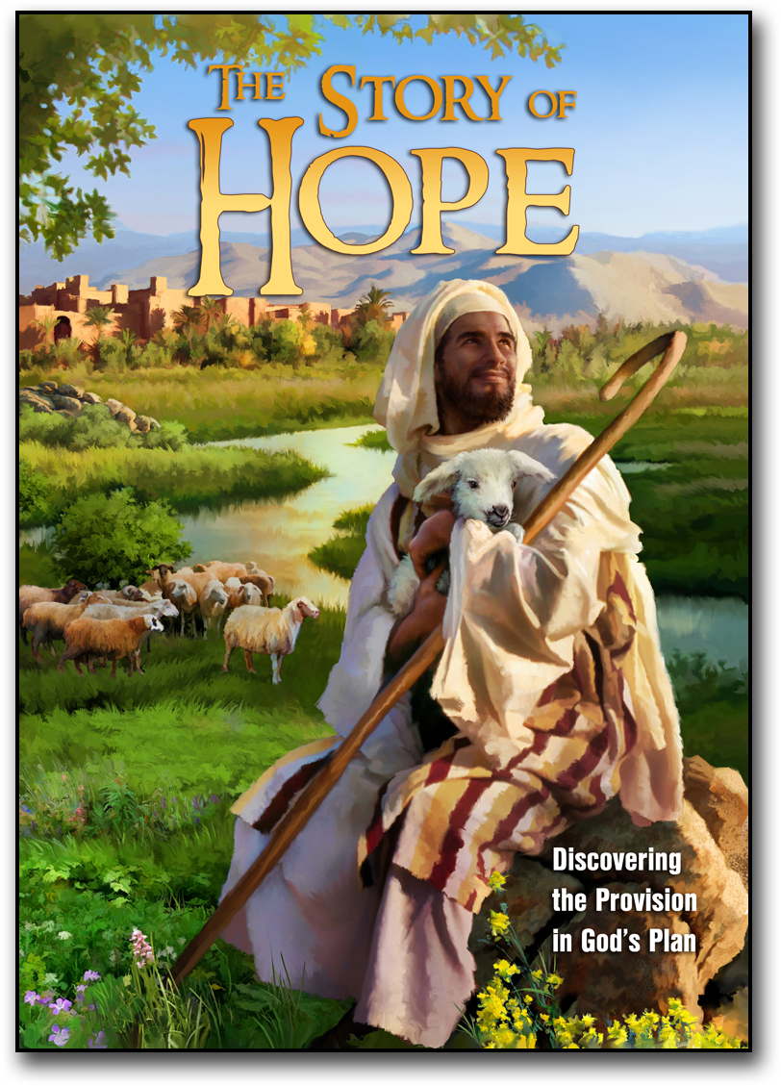
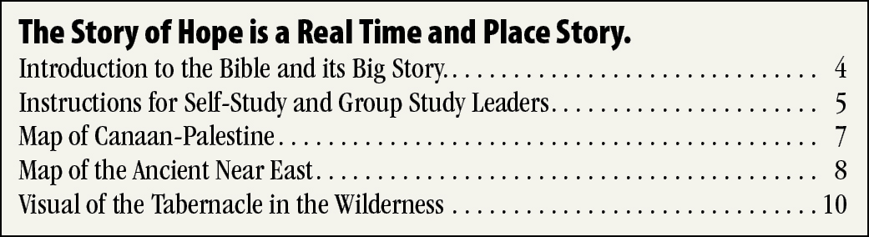
2007 Good Soil E&D – Info@GoodSoil.com
The Story of Hope: Discovering the Provision in God’s Plan
Browse through The Story of Hope.
Make a list of at least five positive distinctives.
Read through the Introductory Material –
Pages 4-10 – before next session.
Initiate conversations that
may become redemptive
relationships. Col. 4:2-6
Session 11

Slide 29
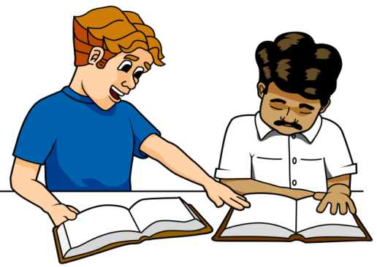
2007 Good Soil E&D – Info@GoodSoil.com
Helping Believers to Retain the Gospel
But the ones that fell on the good ground are those who, having heard the word with a noble and
good heart, keep it*and bear fruit with patience. Luke 8:15
*Greek katecho = hold firmly to something so that it will not be snatched away, to cling to it tightly, to grip it
Just as evangelism is a combined divine-human process, so it is with discipleship.
True believers will persevere in the faith as disciples of Jesus Christ because God secures them.
But, it is also true that God has chosen to use us to “make disciples.”
“Not that we have dominion over your faith, but are fellow workers for your joy; for by faith you stand.” –Paul (2 Corinthians 1:24)
Pursuing Basic Steps to Discipleship
+
+
+12
You
+11
+10
+9
Luke 8:15
Participates in Christian service
+8
Identifies with Christ in baptism
+7
Identifies with other believers
+6
Level 1:
Witnesses to unbelievers
+5
Follow up
Discipleship
The Way to Joy
Experiences sin & confession
+4
Begins Bible reading & prayer
+3
Gains assurance of salvation
+2
Experiences initial life changes
+1
Sanctification
The order in which new believers progress through the first eight steps on the discipleship scale varies greatly from one person to another. What about your own experience?
In the column on the left, write the numbers that identify the order in which these new
believer experiences occurred in your early Christian life.
Session 12

Slide 30

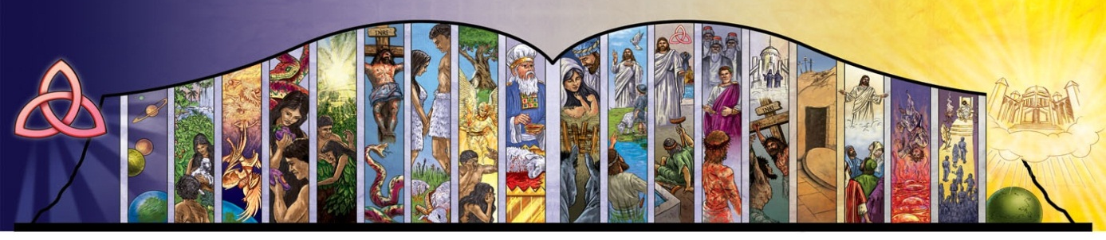
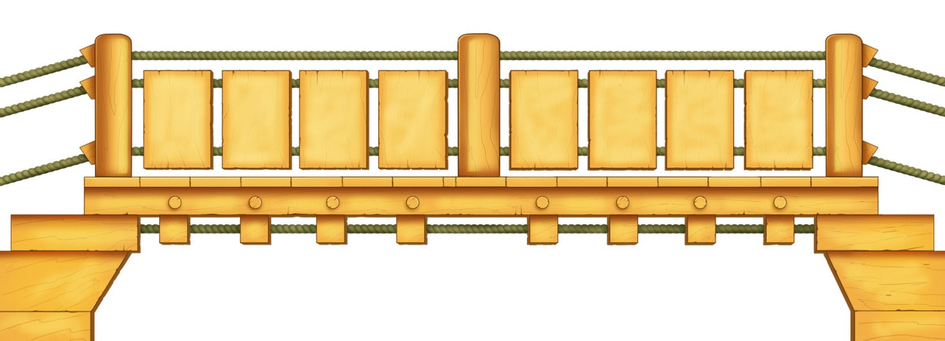
2007 Good Soil E&D – Info@GoodSoil.com
Read pages 4 & 5 in The Way to Joy and respond to the following True-False statements:
1. T or F – The follower should sign the covenant in the leader’s book and the leader should sign the covenant in the follower’s book.
2. T or F – Memorizing the verses associated with this study is not something that the leader should feel obligated to do.
3. T or F – The Way to Joy is designed for follow-up discipleship, not some other deeper, more extensive type of discipleship.
4. T or F – The memory verse assignment for each lesson is given at the beginning of the session.
5. T or F – The website www.GoodSoil.com is a support site for users of The Way to Joy.
6. T or F - The Personal Bible Reading Plan is on page 32.
1
The Joy of Eternal Life: Salvation
In what ways are these two lessons similar to
pages 12-31, and 32-39 of The Story of Hope?
2. In what ways does the material in this lesson
differ from pages 12-31, and 32-39 of
The Story of Hope?
God
Man
Death
Hebrews
11:6
Genesis
2:7
Hebrews
9:27
2
The Joy of Hope: God’s Eternal Plan
3. What are some reasons for making these the first
two lessons in our basic discipleship study?
4. Read the “Options” on the bottom-left of page 6
of The Way to Joy, then look at pages 26-29.
Session 12

