Slide 1



Slide 2

And also for me, that words may be given to me in opening my mouth boldly to proclaim the mystery of the gospel . . . that I may declare it boldly as I ought to speak.
Ephesians 6:19 (ESV)

Slide 3

Mingle-Mingle!
Get up and move around the room, randomly mumbling, “Mingle, mingle” as you do.
When you hear the signal, stop moving, turn to the person you are closest to and answer the question on the screen.
Lather. Rinse. Repeat.
Image: Unsplash.com

Slide 4

“What does the Bible say about suffering?”
Image: Crosswalk.com

Slide 5

“Why do you think God allows suffering?”
Image: ar.inspiredpencil.com

Slide 6
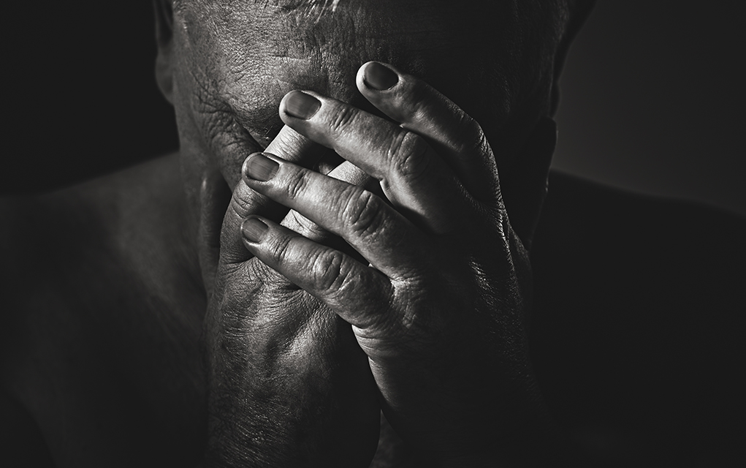
“What would you tell someone who is suffering?”
Image: quotesthoughtsrandom.wordpress.com

Slide 7
Google “What does the Bible say about suffering?” and, among many other sites that will pop up,
www.openbible.info will show you 172 Bible verses (if I counted correctly) related specifically to suffering.

Slide 8
Let’s just look at a few using our
Observation
Interpretation and
Application tools.

Slide 9
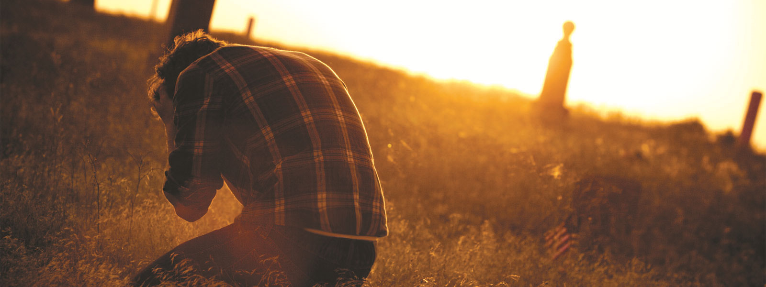
1 Peter 5:10 Romans 8:18 2 Timothy 3:12
Philippians 1:29 Romans 5:3-5 James 1:2-4
Romans 8:28 Revelation 21:4
Image: blogspot.com

Slide 10

Principles gained from the study of the above verses:
1.
2.
3.
4.
Image: blogspot.com

Slide 11
Now let’s read Isaiah 52:12-53:12 and 1 Peter 3:8-18 and make observations, interpretations, and applications.

Slide 12
Principles gained from the study of Isaiah and 1 Peter:
1.
2.
3.
4.
Image: blogspot.com

Slide 13
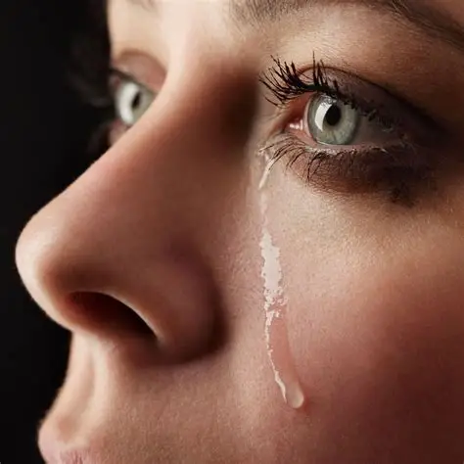
Peter said that “it is better to suffer for doing good, if that should be God’s will, than for doing evil.”
As we look at persecution next time, we’ll see someone else who suffered for doing good.

Slide 14

Talk with your table group about what you learned today about suffering and then pray for each other in two and threes.
Image: vecteezy.com

Slide 15
And after you have suffered a little while, the God of all grace, who has called you to his eternal glory in Christ, will himself restore, confirm, strengthen, and establish you.
1 Peter 5:10 (ESV)

