Slide 1
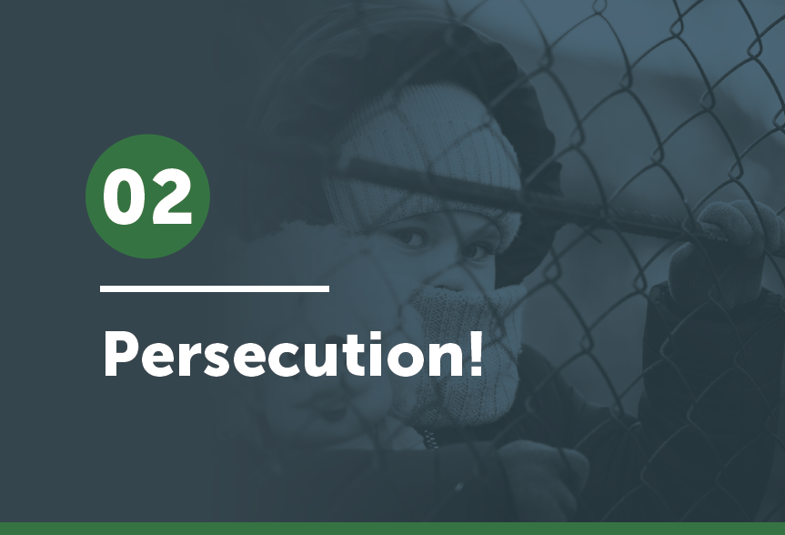


Slide 2
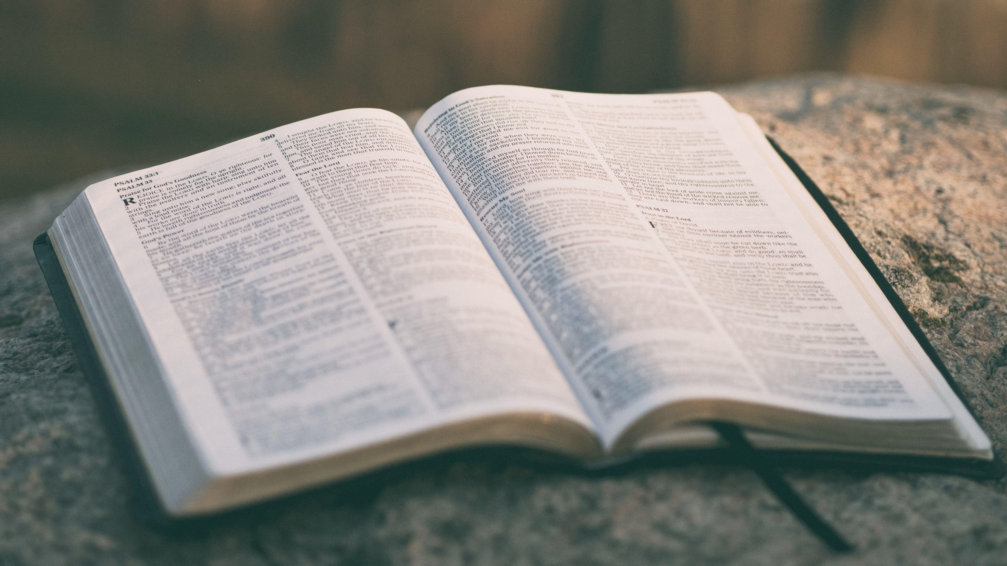
And after you have suffered a little while, the God of all grace, who has called you to his eternal glory in Christ, will himself restore, confirm, strengthen, and establish you.
1 Peter 5:10 (ESV)

Slide 3
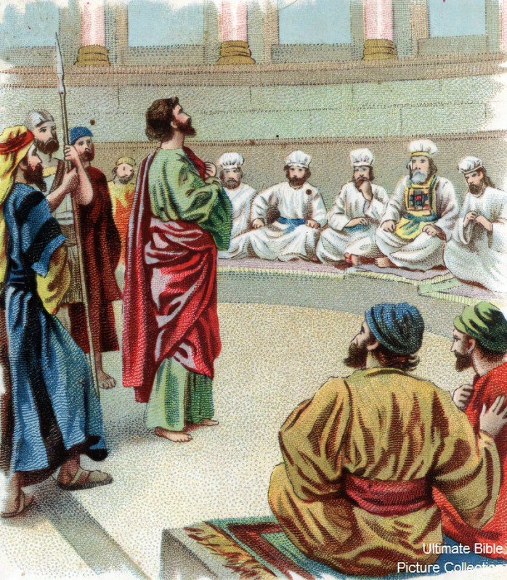
Read and listen to the event found in Acts 6:8-8:3 by participating in the Reader’s Theater.
What do we learn from Stephen?
bibleencyclopedia.com

Slide 4
Read these verses which deal with persecution and develop some principles that could guide and encourage you during persecution.
1 John 3:13 1 Pet 3:12-17
Rom 12:17-21 Mt 5:43-44
2 Cor 4:8-12 1 Pet 4:12-14
John 15:18 Mt 5:10-12
Luke 6:22 2 Cor 4:17-18
2 Timothy 3:10-12

Slide 5
Principles that could guide and encourage you during persecution.
1.
2.
3.
4.

Slide 6
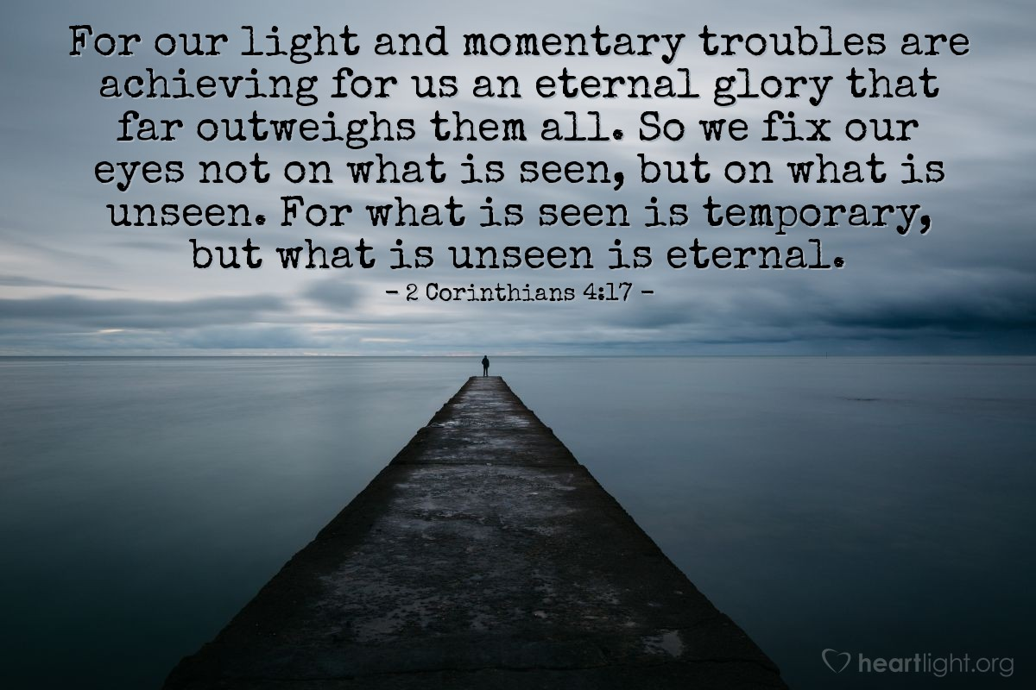

Slide 7

Get up and stand with two others (groups of three ) . . .
. . . and share what you learned today about persecution that you want to take with you.
Pray for each other before you leave.

