Slide 1



Slide 2

For this light momentary affliction is preparing for us an eternal weight of glory beyond all comparison, as we look not to the things that are seen but to the things that are unseen. For the things that are seen are transient, but the things that are unseen are eternal.
2 Corinthians 4:17-18

Slide 3
Several years ago, a missionary set out to learn principles of leadership from the life of Paul. To do so he read and reread the book of Acts and the Epistles of Paul . . .

Slide 4
. . . these 20 principles are the characteristics of people that we are looking for and want to develop in the Walk as Wise level of discipleship.

Slide 5
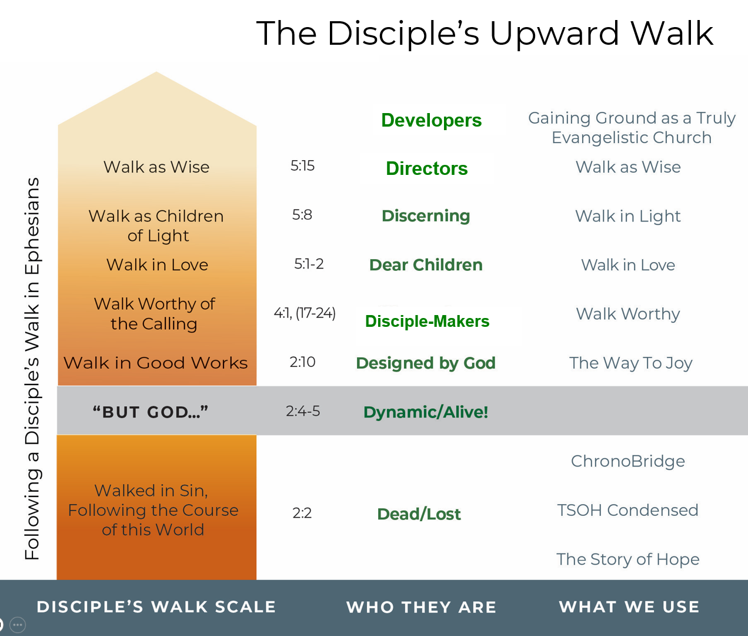

We use
The Story of Hope or other tools hoping to bring someone from dead to life.

Slide 6

The Way to Joy starts them on their path of discipleship.

Slide 7

We use
Walk Worthy seeking to help them continue on the path as disciple makers.

Slide 8


Walk in Love and Walk in Light continue that process in which, by now, they are making disciples as they serve in their local church.

Slide 9

Now, in
Walk as Wise, we want to help disciple-makers look for and develop key partners who may become leaders . . .

Slide 10
. . . and deacons in the church . . . pastor(s) in your church and others . . . and missionaries.

Slide 11
Overriding Principle in Paul’s Life:
Mentoring
On-the-Job Training

Slide 12

“. . . we have no model or path for raising up or equipping leaders.”
“I believe Paul gave us a model.”
— Gil Thomas

Slide 13
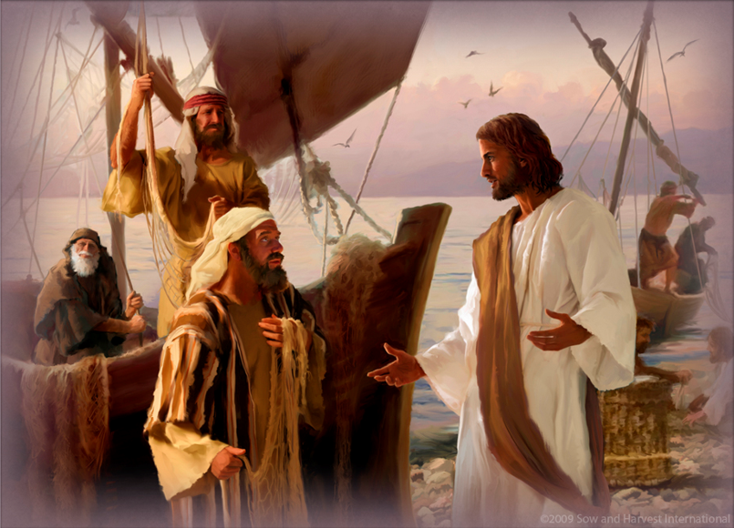
Mark 3:14: And he appointed twelve (whom he also named apostles) so that they might be with him and he might send them out to preach
Acts 4:13 …they recognized that they had been with Jesus.
“Being with Him is
the Power of
Proximity . . .
“Sending them
forth is the
Purpose of
Proximity. . .”
—Ron Berrus

Slide 14
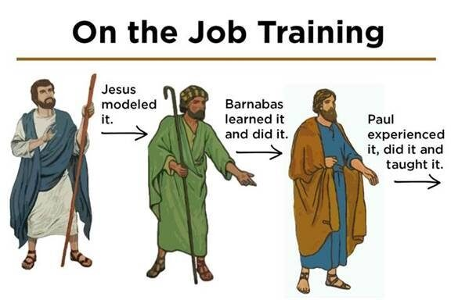

Slide 15
Barnabas
John Mark
Paul
???
Tychicus
Silas
Sopater
Timothy
Gaius
Etc.

Slide 16
Paul
“chose”
“taking”
‘brings
“accompanied by”
“leaves”
“sent”

Slide 17
2 Timothy 2:2
you
me
“... the things that you have heard me say in the presence of many witnesses entrust to reliable men who will also be qualified to teach others.”
men
others

Slide 18
Barnabas
John Mark
Paul
???
Tychicus
Silas
Sopater
Timothy
Gaius
Etc.
Faithful men
Others

Slide 19
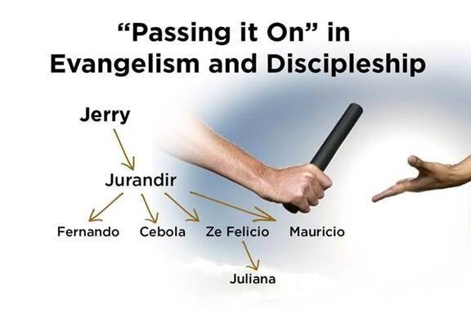
Gil

Slide 20

Was on-the-job training important to Paul? Outside of the mystery of the church that is possible through the wondrous grace of God, I believe this to be Paul’s most important message for two reasons:
ar.inspiredpencil.com

Slide 21
1. Because of the sheer amount of material that
deals with it.
128 verses!
2. Because, without this basic concept functioning,
the communication of the mystery, the grace,
and the mercy of God could not have reached the
21st century.
ar.inspiredpencil.com

Slide 22

The 20 Principles from Paul’s Life and Ministry can be divided into 4 Categories.
Developing Discipleship Eyes
Mentalize
Mobilize
Minimize
Maximize

Slide 23
You then, my child, be strengthened by the grace that is in Christ Jesus,
and what you have heard from me in the presence of many witnesses entrust to faithful men, who will be able to teach others also.
- 2 Timothy 2:1-2

Slide 24

Get up and stand with two others (groups of three ) . . .
. . . and share something from the lesson you want to remember this week.
Pray for each other before you leave.
Unicesumar.edu.br

Slide 26


