Slide 1


Part 1

Slide 2
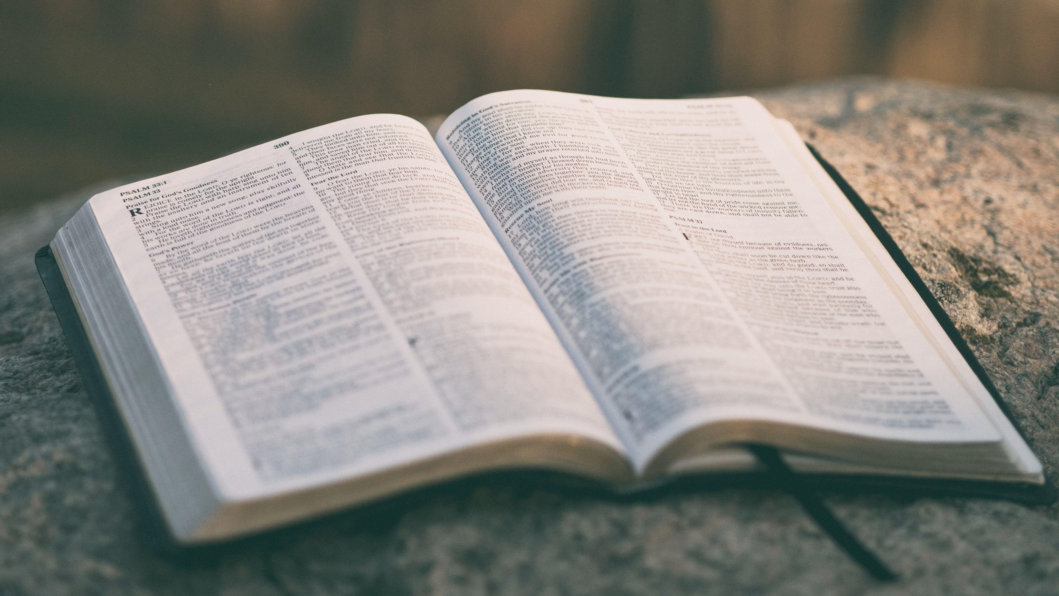
You then, my child, be strengthened by the grace that is in Christ Jesus, and what you have heard from me in the presence of many witnesses entrust to faithful men, who will be able to teach others also.
2 Timothy 2:1-2 (ESV)

Slide 3

If you look in your dictionary for the word “mentalize” you may not find it. As this session was developed on the computer, red, squiggly lines showed up all over the place!
The word is transliterated from the Portuguese word mentalizar, which simply means to develop a mind-set.

Slide 4

As we begin to work with new believers and continue to work with older brothers and
sisters in the Lord, it is imperative
that they develop a mind-set for
God, a mind-set for ministry—
in essence a mind like Christ’s.
Philippians 2:5-8
“Let this mind be in you which was also in Christ Jesus.” (verse 5)
mind-berry.com

Slide 5
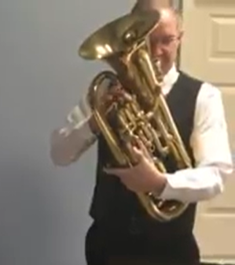
One Sunday after a euphonium player had finished playing his horn in church, a singer got up and said, “We’ve all had this happen—a bright flash of light, all we see is dots. We close our eyes—all we see is dots. It has kind of burned itself into our eyes for a moment. As Gil played just now . . .
That’s what we need in disciples and disciple-makers—the cross burned into their vision; the selfless cross-bearing example of Christ burned into their hearts and ours. Then we will be “mentalized”.

Slide 6

Let’s look at each “Mentalize” principle.
Mentalize

Slide 7



Treat disciples and trainees
as vital, important to the
work, even as equals.

Slide 8
Even though Paul was clearly (far and away) the authority and leader, he treated his co-workers as equals and referred to them as such.
Listen to how Paul refers to his disciples in some of these passages:
“Priscilla and Aquila, my fellow workers…”
Romans 16:3

Slide 9
Even though Paul was clearly (far and away) the authority and leader, he treated his co-workers as equals and referred to them as such.
Listen to how Paul refers to his disciples in some of these passages:
“Timothy, my fellow worker…”
Romans 16:21

Slide 10
Even though Paul was clearly (far and away) the authority and leader, he treated his co-workers as equals and referred to them as such.
Listen to how Paul refers to his disciples in some of these passages:
“As God’s fellow workers we urge you…”
2 Corinthians 6:1

Slide 11
Even though Paul was clearly (far and away) the authority and leader, he treated his co-workers as equals and referred to them as such.
Listen to how Paul refers to his disciples in some of these passages:
“As for Titus, he is my partner and fellow worker among you…”
2 Corinthians 8:23-24

Slide 12
Even though Paul was clearly (far and away) the authority and leader, he treated his co-workers as equals and referred to them as such.
Listen to how Paul refers to his disciples in some of these passages:
“Epaphras, our dear fellow servant,…a faithful minister of Christ on our behalf…”
Colossians 1:7

Slide 13
Even though Paul was clearly (far and away) the authority and leader, he treated his co-workers as equals and referred to them as such.
Listen to how Paul refers to his disciples in some of these passages:
“Tychicus…is a dear brother, a faithful minister and servant in the Lord.”
Colossians 4:7

Slide 14
Even though Paul was clearly (far and away) the authority and leader, he treated his co-workers as equals and referred to them as such.
Listen to how Paul refers to his disciples in some of these passages:
“Timothy, who is our brother and God’s fellow worker in spreading the gospel of Christ, to strengthen and encourage you in your faith...”
1 Thessalonians 3:2

Slide 15
Even though Paul was clearly (far and away) the authority and leader, he treated his co-workers as equals and referred to them as such.
Listen to how Paul refers to his disciples in some of these passages:
Also, look at how Paul treats Philemon and others in 1, 2, and 24 of the book by his name.

Slide 16
Even though Paul was clearly (far and away) the authority and leader, he treated his co-workers as equals and referred to them as such.
To Philemon our beloved fellow worker…
…and Apphia our sister and Archippus our
fellow soldier…
…Mark, Aristarchus, Demas, and Luke, my
fellow workers.

Slide 17
When so many these days would like to “lord it over them” this is a good lesson for us to learn.
Let’s treat them like equals.
(They are, you know!)

Slide 18


Encourage your people;
tell them for what you are thankful for in their lives.

Slide 19
Not only do our people need to feel that they are with us in this thing called ministry, but they also need to be encouraged.
Time after time in his epistles Paul thanked God for his addressees. We also have evidence of him encouraging (instilling courage in) people in person.
After the uproar ceased, Paul sent for the disciples, and after encouraging them, he said farewell and departed for Macedonia.
Acts 20:1

Slide 20
Not only do our people need to feel that they are with us in this thing called ministry, but they also need to be encouraged.
Time after time in his epistles Paul thanked God for his addresses. We also have evidence of him encouraging (instilling courage in) people in person.
“I urge you to take some food. For it will give you strength…” And when he had said these things, he took bread, and giving thanks to God in the presence of all he broke it…they all were encouraged and ate some food themselves.
Acts 27:31-37

Slide 21
Maybe you say, “It’s not my personality to be ooshy-gooshy, or warm and fuzzy.”
We’re talking about rough-and-tumble-former-church-persecutor Paul here. I don’t think it was part of his personality profile either but listen to what he says. Do we sound like this?
“I have great confidence in you; I take great pride in you. I am greatly encouraged; in all our troubles my joy knows no bounds.”
2 Corinthians 7:4

Slide 22
Maybe you say, “It’s not my personality to be ooshy-gooshy, or warm and fuzzy.”
We’re talking about rough-and-tumble-former-church-persecutor Paul here. I don’t think it was part of his personality profile either but listen to what he says. Do we sound like this?
“How can we thank God enough for you in return for all the joy we have in the presence of our God because of you?”
1 Thessalonians 3:9

Slide 23
All through the epistles, we see Paul thanking people and commending them for their work.
Read the following verses and find . . . for what Paul is thankful . . . and for what he commends people.
Romans 1:8
Romans 16:3-16
1 Corinthians 7:4-7
Ephesians 1:15-16
Philippians 1:3
Colossians 1:3-8
1 Thessalonians 2:13-14
1 Thessalonians 3:8-9
2 Thessalonians 1:3
2 Thessalonians 2:13-15

Slide 24
He is thankful for . . . He Commends them for . . .
Their faith
Saving his life
The first convert in Asia
God’s grace in them
Spiritual gifts
Their concern for Titus and Paul
Accepted Word as from God
Faith growing
Love increasing
Working very hard
Being outstanding
Being tested and approved in Christ
Remembering his teachings
Their faith in Jesus
Their love for the saints
Their faith and love
Their partnership in the Gospel
Gospel is spreading through them
Standing firm

Slide 25
How about it?
Do we sound like that?
Are we encouraging people?
Are we thanking them for the ministry they’ve had in our lives and the lives of others?
Are we commending them before others?

Slide 26
Sometimes we get the idea that if we speak too highly of others, we are downplaying our own importance.
That is tragic.
Be happy when others shine; thank God for it and let them know that they are appreciated.
We also need to be praying for our people.

Slide 27

Pray for your trainees
and let them know of
prayers.

Slide 28
Almost as often as he encouraged his disciples, Paul told them of his prayers for them. There is a lot to be gained by studying the content (the what) of Paul’s prayers.
He prays . . .
that his people would gain the spirit of wisdom and revelation so that they might know Him better...

Slide 29
Almost as often as he encouraged his disciples, Paul told them of his prayers for them. There is a lot to be gained by studying the content (the what) of Paul’s prayers.
He prays . . .
that the eyes of their heart would be enlightened so they might know the hope of their calling, the riches
of their inheritance and the power God expends for them...

Slide 30
Almost as often as he encouraged his disciples, Paul told them of his prayers for them. There is a lot to be gained by studying the content (the what) of Paul’s prayers.
He prays . . .
…that they would be strengthened with power through the Spirit in their inner being so that Christ would dwell in them in love.

Slide 31
His prayers are so rich. Our prayers need to emulate them.
But today, don’t think about “the what” of Paul’s prayers. Instead, for just a few moments, think about the when and how.

Slide 32
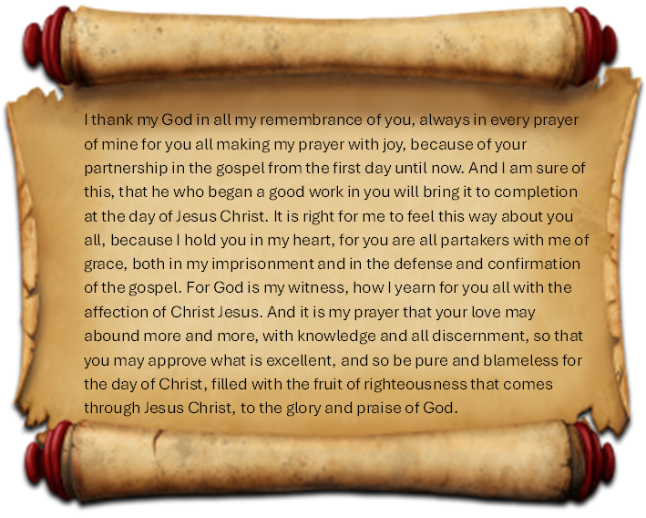
Look at Philippians 1:3-11. Notice adjectives and adverbs and highlight them. What does this tell you about how often Paul prayed for his disciples and about the intensity of those prayers?

Slide 33
We learn at least two things:
Paul prayed a lot and he prayed fervently.
Check out these passages as well:
Paul prayed “constantly…at all times…”
Romans 1:9-10

Slide 34
We learn at least two things:
Paul prayed a lot and he prayed fervently.
Check out these passages as well:
He said, “I keep asking…”
Ephesians 1:17-22

Slide 35
We learn at least two things:
Paul prayed a lot and he prayed fervently.
Check out these passages as well:
“since the day we heard…
we have not stopped praying…”
Colossians 1:9-14

Slide 36
We learn at least two things:
Paul prayed a lot and he prayed fervently.
Check out these passages as well:
“Night and Day we pray most earnestly…”
1 Thessalonians 3:10

Slide 37
We learn at least two things:
Paul prayed a lot and he prayed fervently.
Check out these passages as well:
“…we constantly pray for you…”
1 Thessalonians 1:1

Slide 38
Why did Paul pray so much and so fervently for his disciples? Because he cared so much about them.
There’s the fourth principle . . .
. . . which we’ll look at next week.

Slide 39
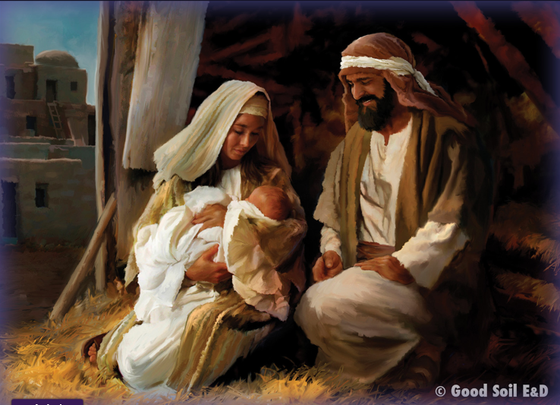
Have this mind among yourselves, which is yours in Christ Jesus, ⁶ who, though he was in the form of God, did not count equality with God a thing to be grasped,
Philippians 2:5-6 (ESV)

Slide 40

Get up and stand with two others (groups of three ) . . .
Which of the three Mentalize principles do you want to work on this week?
Share and pray for each other before you leave.
Unicesumar.edu.br

Slide 41
Treat disciples and trainees as vital,
important to the work, even as equals.
Encourage your people; tell them for what you are thankful in their lives.
Pray for your trainees and let them know of prayers.

