Slide 1


Part 2

Slide 2

Have this mind among yourselves, which is yours in Christ Jesus, who, though he was in the form of God, did not count equality with God a thing to be grasped,
Philippians 2:5-6

Slide 3
“Let this mind be in you
which was also in Christ Jesus.”
- Philippians 2:5 (KJV)

Slide 4
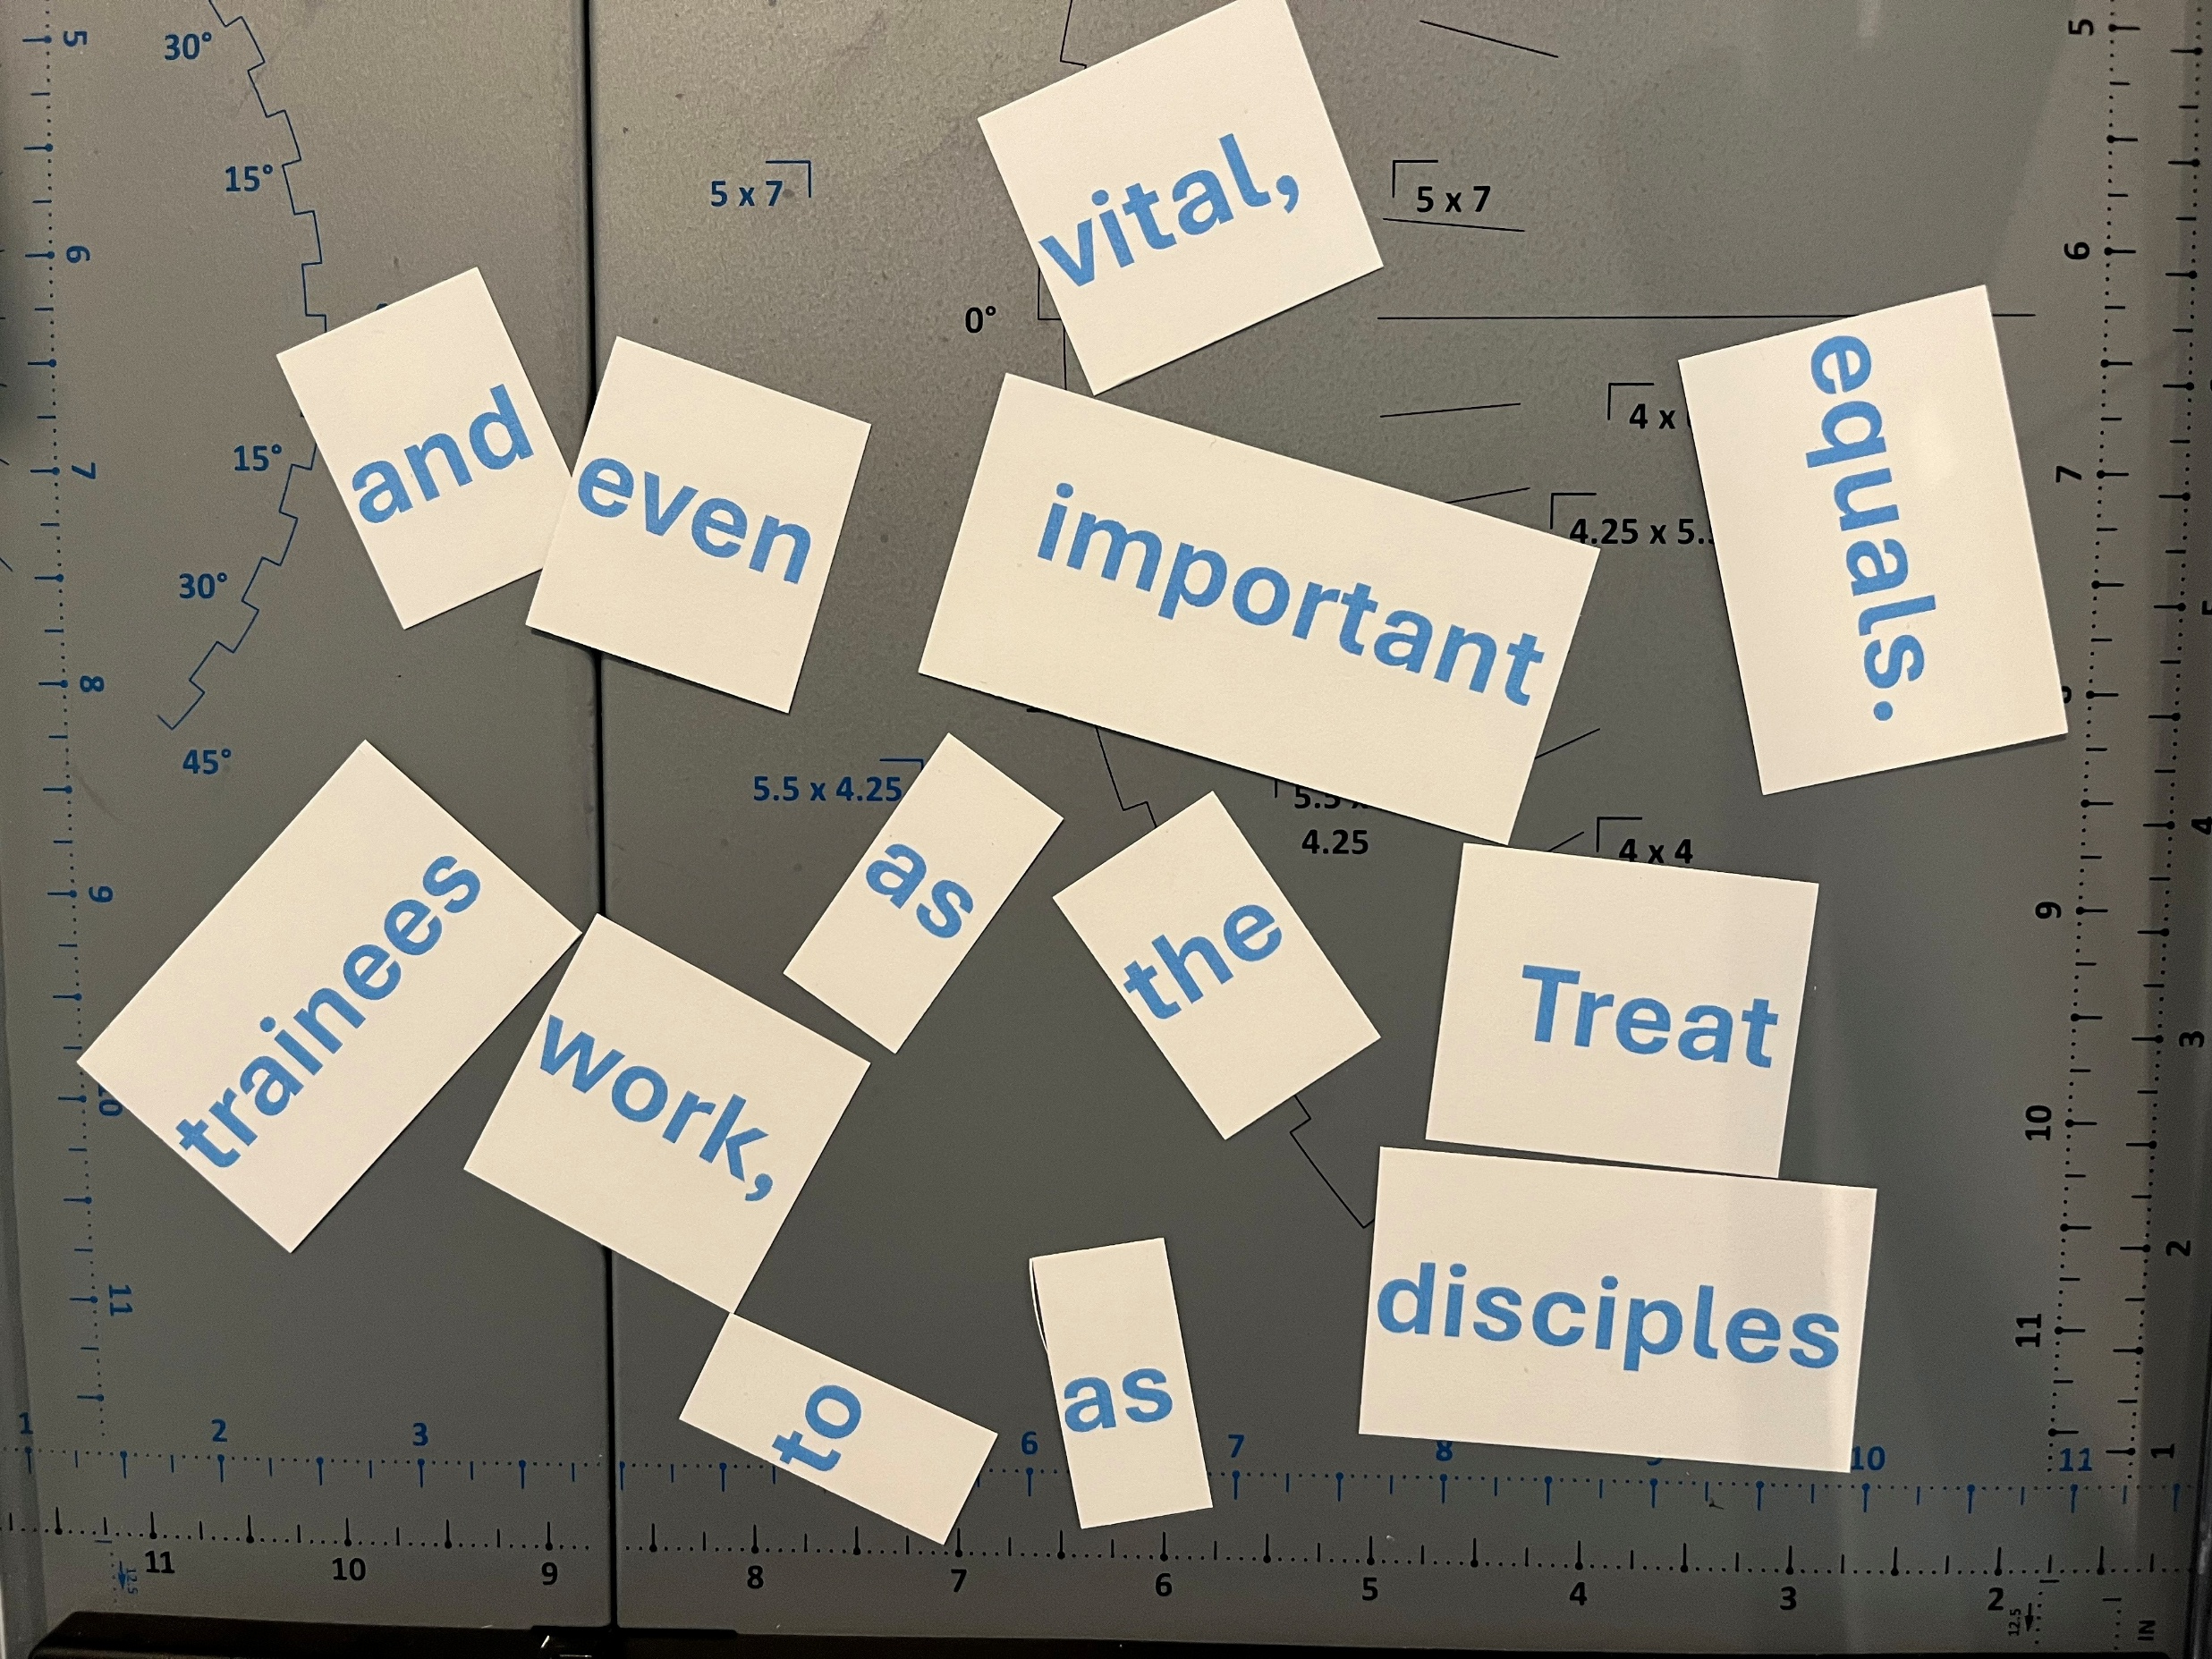
Put the words together to form the Mentalizing Saints principles we learned
last week.
Let’s see who
can get it done first.

Slide 5



Treat disciples and trainees as vital,
important to the work, even as equals.
Encourage your people; tell them for what you are thankful in their lives.
Pray for your trainees and let them know of prayers.

Slide 6
Show a caring spirit toward
your people.

Slide 7
Paul, aggressive and motivated as he was, still cared for people, and he showed it.
Again, personality is not in question here.
Love is.
Take a few minutes and observe Paul’s caring spirit in action.

Slide 8
Read your passages and create a statement describing how Paul showed a caring spirit in action.
Acts 27:33-36
Romans 9:1-4; 10:1
2 Corinthians 2:1-4
Galatians 4:20
Colossians 2:1-5
1 Thessalonians 2:7-9
Encouraged and led sailors to eat
Expresses desire to give self for his people
Considered their pain in decision-making
Expressed desire to be with them
Expressed agonizing concern for them
He was gentle with them like a mother

Slide 9
Can you say you care for people like Paul did?
What can you do this week to show more care to the people to whom you minister?

Slide 10



Make instruction of the Word a priority.
Image: aet1.dohostinguk.com

Slide 11
The majority of ‘mentalizing’ comes from right here. It is only the Word of God getting into people’s hearts and lives that will change them. The only way people can keep from being conformed to this world and be transformed is through what?
. . . be transformed by the renewing of your mind . . .
Romans 12:2 (NIV)

Slide 12
After Paul proclaimed the Gospel (and even as he proclaimed the Gospel!), he taught his new converts how to live.
Then he sent back letters full of instruction to continue the mentalizing process.
We need to do the same. From the verses that reveal this vital discipleship principle, I believe we can derive four mini or sub-principles.

Slide 13
Read the sub-principle and the verses and
produce a key word for each.
Dispel ignorance of God’s Word and Plan.
1 Cor. 10:1; 12:1; 1 Thess. 4:13
Share what you have already learned.
1 Cor. 11:3, 23
Remind, review.
Rom. 15:15; 1 Thess. 4:1-2
Build on it.
1 Cor. 11:34b; 12:31

Slide 14
How about it?
Are we dispelling ignorance?
Are we sharing what we’ve learned with people?
Are we reminding them of and reviewing important concepts?
Are we building on what we’ve already taught them?

Slide 15



Lead your trainees into new
areas of growth and new heights of spirituality by example.

Slide 16
If, as we said, the majority of mentalizing occurs through the teaching of the Word, then the introduction and the conclusion are read right here.
What even sparked that eager young man’s
interest in the first place?
Your life.
The difference he saw in you made
him want to know more.

Slide 17
Why will she give up old habits, keep trying to do something that seems impossible?
Because she has seen that it is possible
by watching you.
“Follow my example, as I follow the example
of Christ.”
1 Corinthians 11:1

Slide 18
Paul led by example. He didn’t force people to do something or lay down the law even though he could have. He appealed to them based on love and a Spirit-controlled life. He did first what he expected of others.
Three quick examples:

Slide 19
Read your passage . . .
. . . and create a statement which demonstrates that Paul did first what he expected of others.
2 Timothy 1:5-14
Paul boldly proclaimed the gospel just as he was encouraging Timothy to do!
2 Timothy 2:1-10
Paul showed how to disciple even in difficulty!
Philemon 8-18
Paul gave unselfishly!

Slide 20
Remember that this principle is:
Lead your trainees into new areas of growth and heights of spirituality by example.
We, as leaders, have got to be developing our spiritual lives.
It doesn’t come automatically.
And it’s not just maintaining an emotional “high-on-Jesus” attitude.

Slide 21
It takes work.
Note these five disciplines for godly leaders from Blanchard and Hodges:
Solitude
Prayer
Storing up God’s Word
Faith in God’s Unconditional Love
Involvement in Accountability Relationships

Slide 22
Think about your spiritual life now and in the past.
What are you doing now that you didn’t do five years ago?
What’s helping?
What isn’t?
Let’s commit ourselves to working at
developing our spiritual lives . . .
and mentalizing our disciples as well.

Slide 23
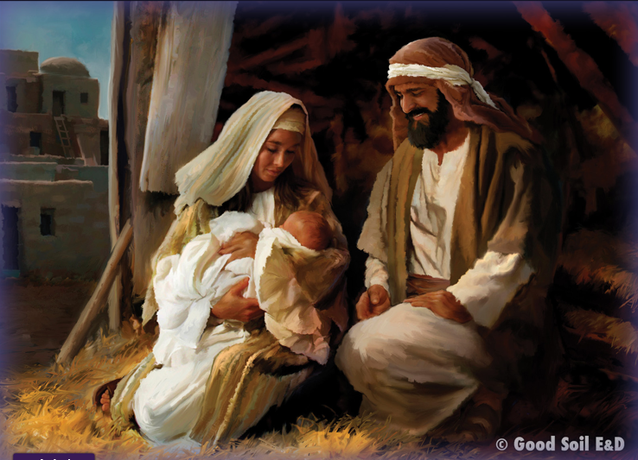
Have this mind among yourselves, which is yours in Christ Jesus, who, though he was in the form of God, did not count equality with God a thing to be grasped, emptied Himself, by taking the form of a servant, being born in the likeness of men. Philippians 2:5-7 (ESV)

Slide 24

Get up and stand with two others (groups of three ) . . .
Which of these three Mentalize principles do you want to work on this week?
Share and pray for each other before you leave.
Unicesumar.edu.br

Slide 25
Show a caring spirit toward
your people.
Make instruction of the Word
a priority.
Lead your trainees into new
areas of growth and new heights of spirituality by example.

Slide 27


Slide 28

The 20 Principles from Paul’s Life and Ministry can be divided into 4 Categories.
Developing Discipleship Eyes
Mentalize
Mobilize
Minimize
Maximize

