Slide 1



Slide 2

Have this mind among yourselves, which is yours in Christ Jesus, who, though he was in the form of God, did not count equality with God a thing to be grasped, But emptied Himself, by taking the form of a servant, being born in the likeness of men.
Philippians 2:5-7 (ESV)

Slide 3
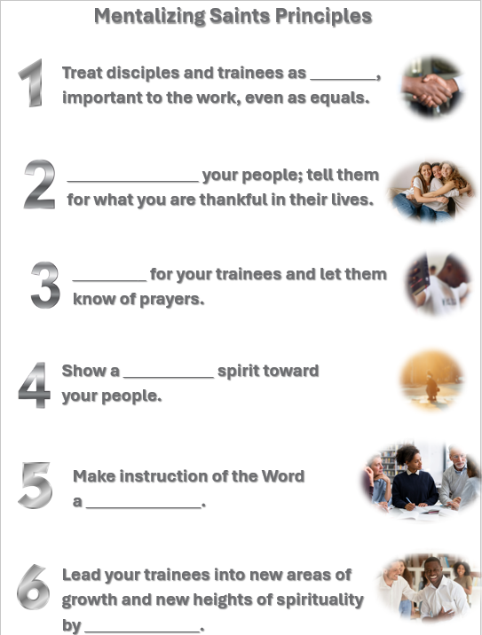
Move around the room in dyads,
trying to find the words which will
complete each principle.
If you find a word, make sure you leave it how you found it!
The first dyad finished w/all the correct answers wins a prize!
vital
Encourage
Pray
caring
priority
Let this mind be in you which was also in Christ Jesus.
example

Slide 4

The 20 Principles from Paul’s Life and Ministry can be divided into 4 Categories of . . .
Developing Discipleship Eyes
Mentalize
Mobilize
Minimize
Maximize

Slide 5
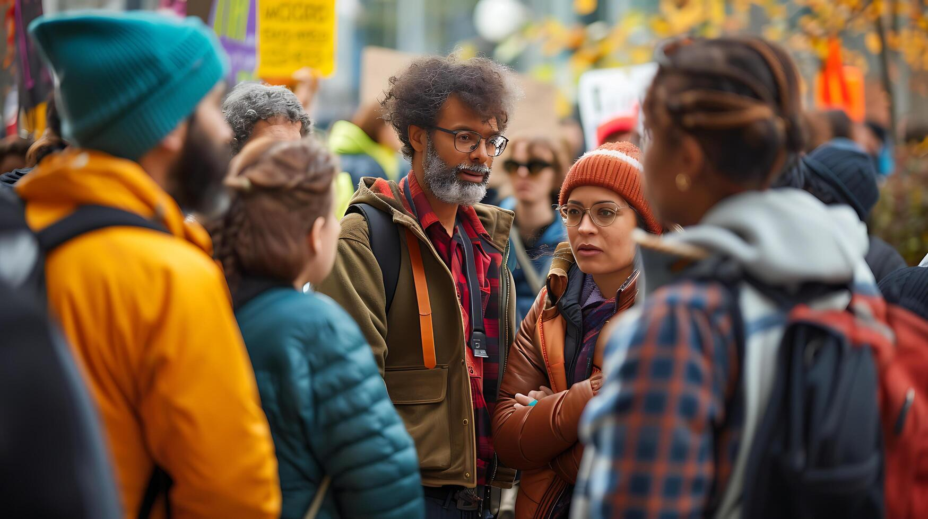
Agree Disagree
Mobilization of servants is not as important
as the mentalizing of saints.
vecteezy.com

Slide 6
Agree Disagree
Mobilization comes after leaders are taught and are maximized for ministry.
vecteezy.com

Slide 7
Agree Disagree
Mobilizing servants is sending people
to the mission field.
vecteezy.com

Slide 8
Agree Disagree
We should get people mobilized
and then equip them for the task.
vecteezy.com

Slide 9
Agree Disagree
Care should be taken not to mobilize
too many people all at once.
vecteezy.com

Slide 10
The 20 Principles from Paul’s Life and Ministry can be divided into 4 Categories.
Developing Discipleship Eyes
Mentalize
Mobilize
Minimize
Maximize

Slide 11


Choose key men/women to
work beside you, train and
put to the task (where you
are or in another location).
freepik.com

Slide 12
Work with your table group . . .
Read the passages.
Decide in which category to put each passage. Did Paul . . .
. . . Have people accompany him/Bring them along?
. . . Give us an example of the process—OTJ training?
. . . Send people with a task?

Slide 13
Have people accompany him/Bring them along?
Give us an example of the process—on-the-job training?
Acts 13:5; 15:40; 16:1-3; 20:4-6
Acts 18:1-3; 18-24; 19:1
Rom. 16:3-5; Phil. 2:19-30
Col. 4:10-15
Send people with a task?
1 Cor. 4:17-18; 16:10-12; Col. 4:7-9; Eph. 6:21-22; 1 Thess. 3:1-5

Slide 14

As you delegate, give the
equipment necessary for the
delegated task.
pixabay.com

Slide 15
As you read these passages, notice how Paul worked with his people, treating them as sons, so that they would do the same.
In the 2 Timothy 3:10-14 passage,
we can see how Timothy and Titus
learned what they needed through
on-the-job experience.

Slide 16
Read your assigned passages and tell how . . .
Paul’s men were equipped through their on-the-job training.
2 Tim 2:2 with 1 Tim 1:2-7
2 Tim 1:2-3 with 2:1-2
Titus 1:4; 2 Tim 3:10-17
Paul gave special equipment for special tasks.
1 Tim 1:3-4 w/ Chapter 3
(All of 1 & 2 Timothy)
Titus 1:5-6; 2:1 with 2:15

Slide 17


Use people (and other
resources) creatively
and extensively.
freepik.com

Slide 18
Earlier, we saw how Paul had people with him, sent them on ahead, or back to a former work. Many of those verses would apply here as well. But notice a few more examples here.
Read Acts 19:22.
What did Paul do with two of his helpers and why?

Slide 19
Read 2 Timothy 1:15-18.
Any insights from this passage?
The fact that many had deserted Paul indicates that many were there at one time.
Paul needed refreshing and he allowed
some of his people to do that for him.
Onesiphorus helped in so many ways!

Slide 20
Read your passage . . .
2 Timothy 4:9-13, 19-20
Titus 3:12-15
. . . and draw a graph indicating all the
movement of people in your passage.

Slide 21
So how are you doing?
Are you using people like Paul did?
Are you training them to do the same?
Who could you ask to do what this week?

Slide 22

Get up and stand with two others (groups of three ) . . .
Which of these three Mentalize principles do you want to work on this week?
Share and pray for each other before you leave.
Unicesumar.edu.br

Slide 23
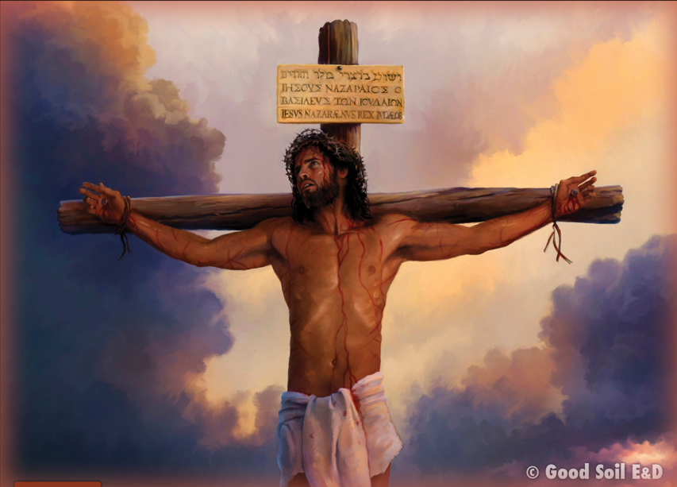
“And being found in human form, he humbled himself by becoming obedient to the point of death, even death on a cross. Therefore, God has highly exalted him and bestowed on him the name that is above every name.” Philippians 2:8-9 (ESV)

Slide 25


