Slide 1



Slide 2

And being found in human form, he humbled himself by becoming obedient to the point of death, even death on a cross. Therefore, God has highly exalted him and bestowed on him the name that is above every name.
Philippians 2:8-9

Slide 3

Right, Left, or Wrong!
Everyone stand in a straight line.
Look at and listen to the principle.
Close your eyes and move one step to the right if you think it is a Mentalizing Saints principle or one step to the left if you think it is a Mobilizing Servants principle.
Listen as a couple individuals tell why they chose R or L.

Slide 4

Choose key men/women to work beside you, train, and put to the task where you are or in another location.

Slide 5
Treat disciples and trainees as vital, important to the work, even as equals.

Slide 6
Pray for your trainees and let them know of prayers.

Slide 7

As you delegate, give the equipment necessary for the delegated task.

Slide 8

Part of “mentalizing saints” and “mobilizing servants” is helping them to grow spiritually.
A significant part of that growth process is minimizing self.
We can minimize self in our own lives and help others to do the same by putting these four principles into practice.

Slide 9

The 20 Principles from Paul’s Life and Ministry can be divided into 4 Categories of . . .
Developing Discipleship Eyes
Mentalize
Mobilize
Minimize
Maximize

Slide 10

Don’t be afraid to
address problems.
pixabay.com

Slide 11
Paul did not shy away from problems. He dealt with sin and other difficulties in ministry when necessary.
Have you ever thought about why we avoid problems?
Why did I not share the Gospel with that gas station attendant?
Why did I avoid conflict with that colleague?
Why do people dodge going to the mission field?
It’s because number one is on the throne. We’re looking out for ourselves and our own comfort. We don’t want to suffer.

Slide 12
Paul had self in the right position. Look at Acts 19:28-31.
He wanted to face the crowd knowing that physical harm could come to him.
Read 23:1—
He stared them down! Why?
The answer is in Acts 20:24—
“none of these things move me, neither count I my life dear unto myself, so that I might finish my course with joy, and the ministry, which I have received of the Lord Jesus, to testify the gospel of the grace of God.”

Slide 13
Facing difficulties courageously helps us demote self and promote Christ.
Acts 19:28-31; 21:30-40; 23:1-5; 25:8-11
Confronting about sin helps others to demote self and promote Christ.
Acts 15:2; 1 Cor 3:1-9; 5:1-12: 6:1-8; 11:17-18
“none of these things move me, neither count I my life dear unto myself, so that I might finish my course with joy, and the ministry, which I have received of the Lord Jesus, to testify the gospel of the grace of God.”

Slide 14

self
Christ
Confronting others about sin helps them demote and promote as well.
Paul confronted unbelievers about their sin—Acts 13:6-11.
(Sometimes we’re hesitant to do this because we don’t want to lose our contact with them.)
Paul confronted church folks—even big wigs when necessary (Gal 2:11-16).
Here’s a little formula
that helps with confronting. It’s called . . .

Slide 15
O. I. C.
“Oh, I see!” (O. I. C.)
Share an Observation (O) with non-threatening language.
“I’ve noticed that . . .”
Follow up with an Interpretation (I).
“I interpret that to mean . . .”
Follow with Clarification (C).
“Could you clarify that for me?”

Slide 16
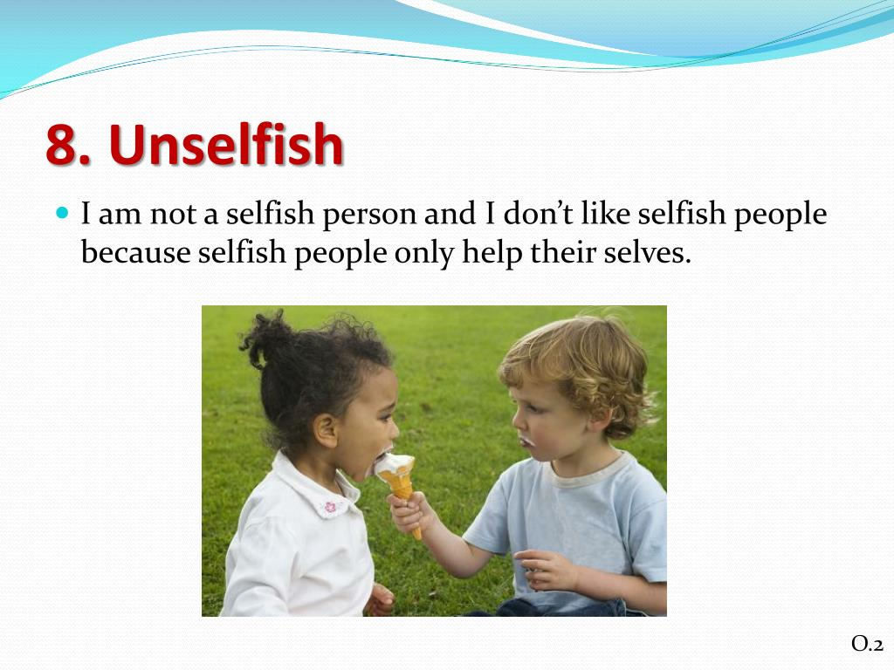
Be unselfish in all your dealings.
slideserve.com

Slide 17
By being an example in this area, we can help others minimize self and the world’s hold on them.
Follow the directions on your worksheet to learn how Paul was unselfish in his dealings.
slideserve.com

Slide 18
Read 1 Cor. 10:31-33 and/or Philippians 1:12-26.
Answer the questions:
What was Paul’s motivation?
What did he do? What happened to him?
What are some modern-day applications for us?
slideserve.com

Slide 19


Develop a learning spirit.
pixabay.com

Slide 20
Paul was trained by Gamaliel and had already experienced fruit, yet he humbled himself and learned from Barnabas—a lay preacher. (Look at Acts 11:26, 30; 13:1-3.)

Slide 21
Remember John the Baptist’s credo:
“He must increase, I must decrease.”

Slide 22
And how about Barnabas—he was enjoying the lead role, but after Acts 14 the roles flip-flopped. That may have been hard to take, but he didn’t appear to have a problem with it.
We need to develop a humble, learning spirit like those two.

Slide 23

Be open, transparent about your own struggles.
Finally, it is so important that we admit (first to ourselves!) that we are weak creatures. Even as the great spiritual leader that Paul was, he admitted he had struggles (Rom 7:14-24).
pixabay.com

Slide 24
Having a person with whom we can be transparent and accountable is a must.
Who is your accountability partner?
Admitting our weaknesses emphasizes the first principle under Maximize Service— the final category of principles.
We’ll look that next time.
pixabay.com

Slide 25
So . . . are you addressing problems?
Are you being unselfish?
Are you developing a learning spirit?
Are you being open and transparent about your own struggles?

Slide 26
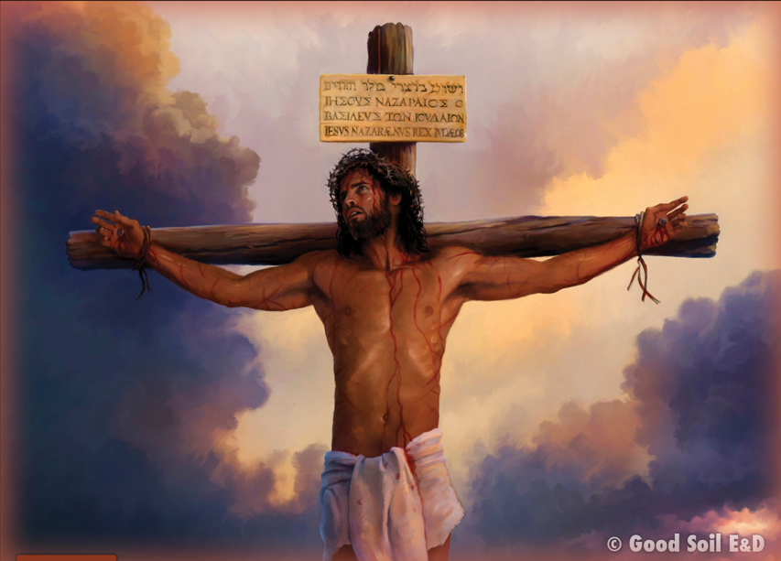
“So that at the name of Jesus every knee should bow, in heaven and on earth and under the earth, and every tongue confess that Jesus Christ is Lord, to the glory of God the Father.”
Philippians 2:10-11 (ESV)

Slide 27

Get up and stand with two others (groups of three ) . . .
Which of these four Minimizing Self principles will you work on this week?
Share and pray for each other before you leave.
Unicesumar.edu.br

