Slide 1
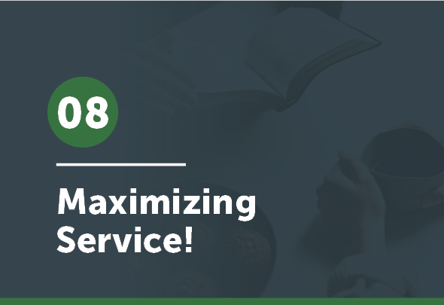


Slide 2
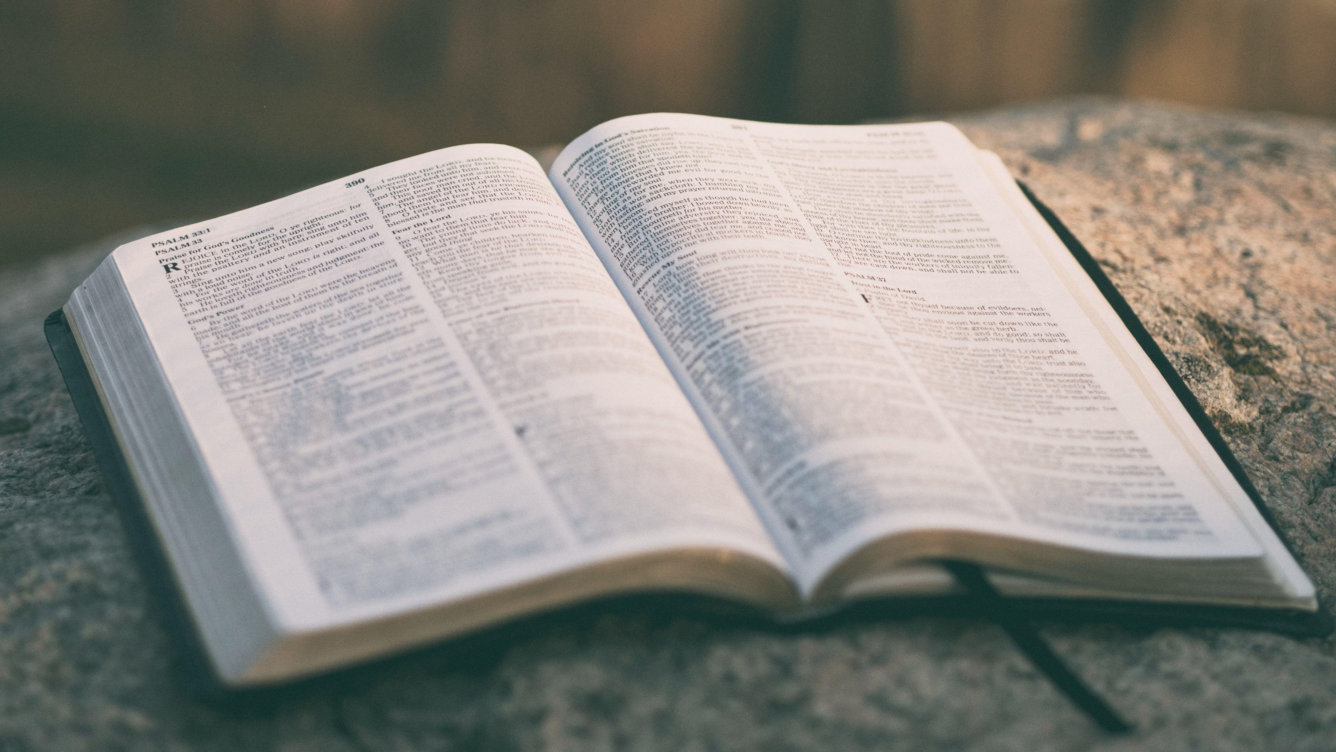
So that at the name of Jesus every knee should bow, in heaven and on earth and under the earth, and every tongue confess that Jesus Christ is Lord, to the glory of God the Father.
Philippians 2:10-11

Slide 3
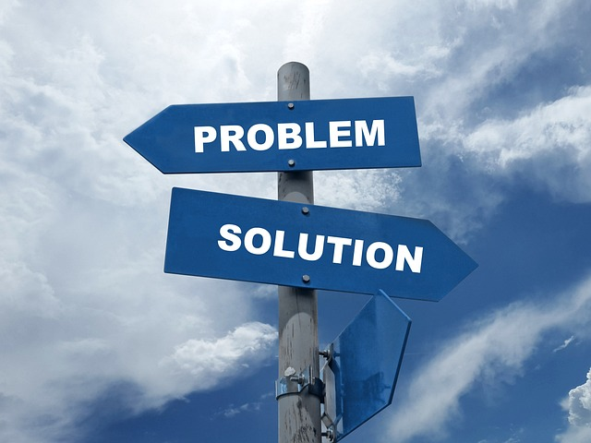
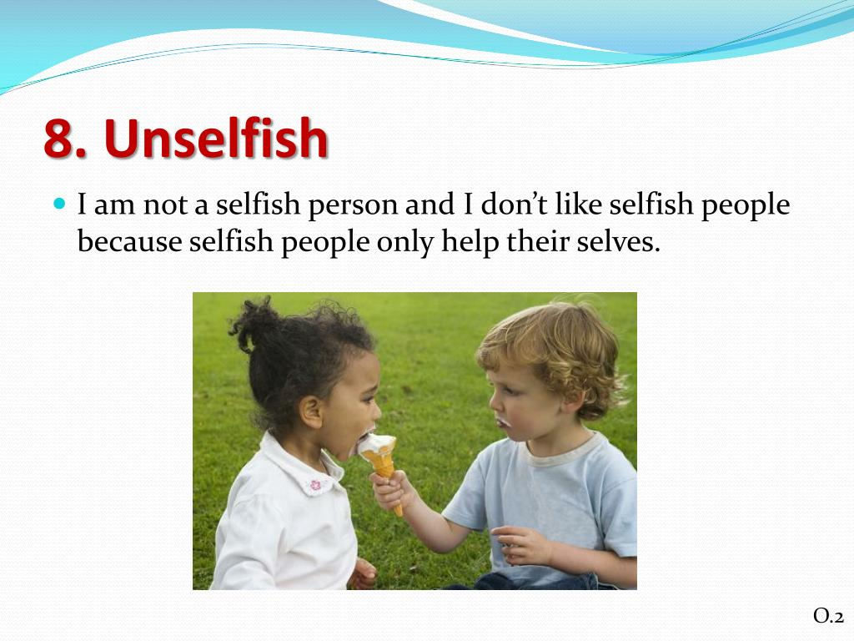

How did you do this week . . .
. . . in your pursuit of Minimizing Self principles?
Form a dyad/triad & share with each other.
Share either how you did or which one of the principles on the next slide you would like to improve on and why.
slideserve.com

Slide 4

How did you do this week?
Don’t be afraid to address problems.
Be unselfish in all your dealings.
Develop a learning spirit.
Be open, transparent about your own struggles.
slideserve.com

Slide 5
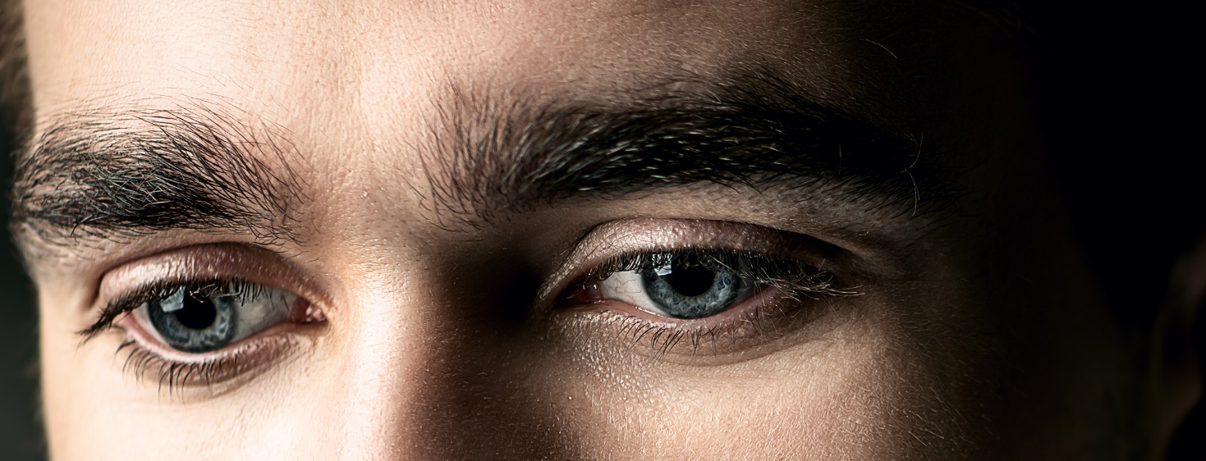
The 20 Principles from Paul’s Life and Ministry can be divided into 4 Categories of . . .
Developing Discipleship Eyes
Mentalize
Mobilize
Minimize
Maximize

Slide 6
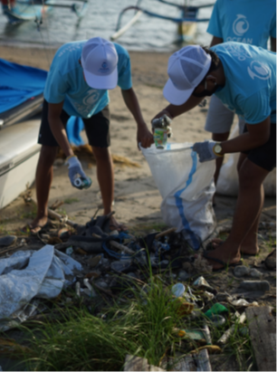
We are not only helping our disciples learn and do these things, but we must be sure that we are consistently growing in these areas as well.

Slide 7
Admitting our weaknesses emphasizes the first principle under Maximizing Service—the category of principles we are looking at today.

Slide 8
Maximize Service
1. Depend upon God.
2. Set goals and plan your work.
3. Be assertive.
4. Know your culture/use it for ministry.
5. Learn to be orderly and methodical
in your reporting and teaching.
6. Be determined, seeing through the
problems to the prize.
7. Seek out fruit.

Slide 9
1 Depend upon God.
Paul gives us 7 principles that can help us Maximize our Service
to God and that of our trainees.
The first thing we see is that Paul had a humble trust in God that He would do the work.

Slide 10
1 Depend upon God.
Notice how . . .
E.
___ He came without eloquence. A. 2 Tim 4:16-18
___ He felt he was nothing, realizing that God gives the fruit. B. Phil 1:1; Col 1:23
___ He felt that only through God’s grace he was least of the apostles. C. Eph 6:19
___ He knew not competent in self—only through God. D. 2 Cor 10:12- 18; 11:30
___ He gave no room for boasting. E. 1 Cor 2:1-5
___ God’s grace/power—sufficient/made perfect in Paul’s weakness. F. 1 Cor 3:7
___ He desired the prayers of all believers. G. 1 Cor 15:9-11
___ He considered himself a servant. H. 2 Cor 12:1-10
___ He realized that it was God who gave him strength. I. 2 Cor 3:4-6
F.
G.
I.
D.
H.
C.
B.
A.

Slide 11
Why was Paul able to maintain this dependency on God and not self?
First, he really did have a proper view of who he was—nothing without God.
Second, look at 1 Corinthians 2:1-5—
Paul resolved not to go in human wisdom . . . To know only Christ . . . to go only in the Spirit’s power.
We need that kind of resolve. Then we will depend on God as we should.

Slide 12
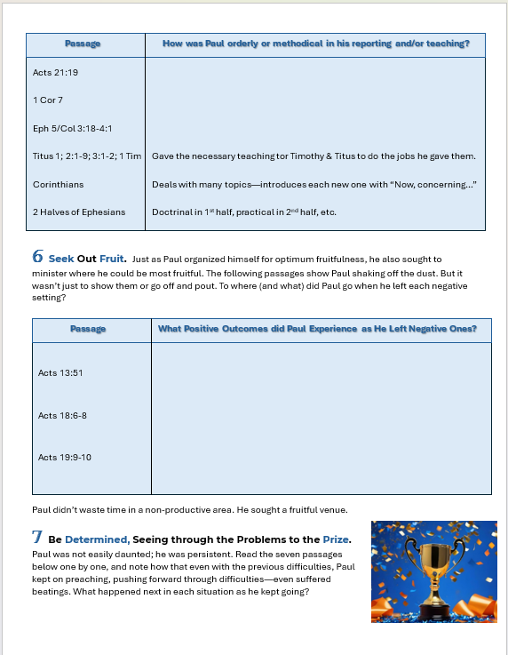
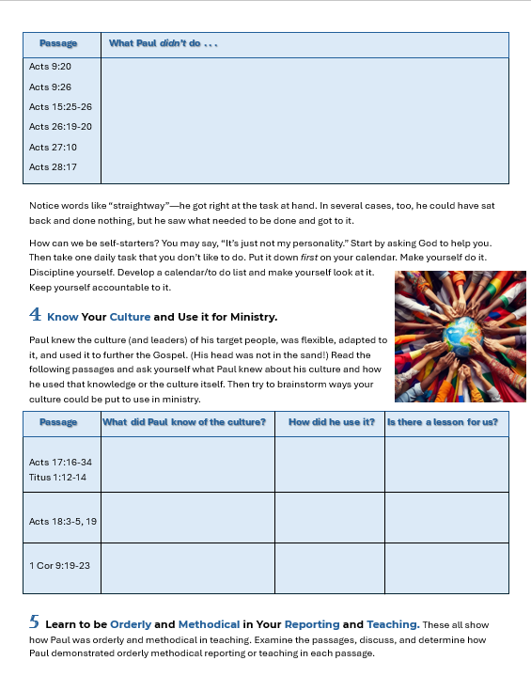
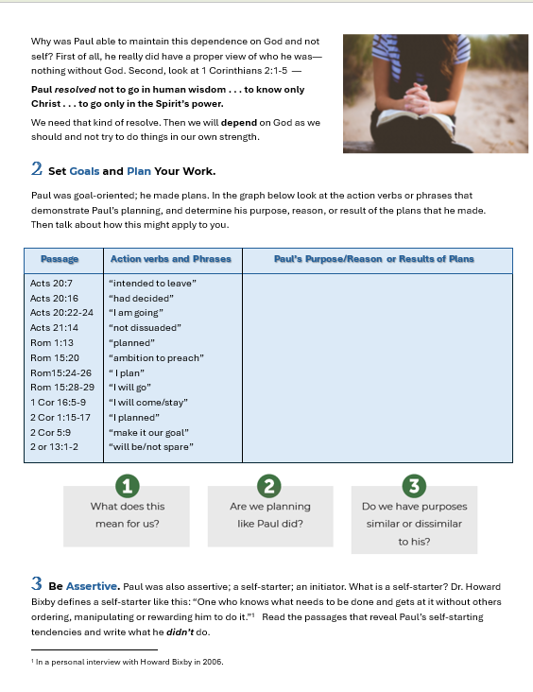
4
6
2
3
5
In dyads and triads work on your assigned principle—
Do the work described on the worksheet for that principle and prepare to report to the larger group.

Slide 13

2 Set Goals and Plan Your Work.
Paul was goal-oriented; he made plans. Tell us what you learned.
3 Be Assertive.
Paul was assertive, a self-starter. Tell us what you learned.
4 Know Your Culture and Use it for Ministry.
Paul knew the culture of his target people, was flexible, adapted to it, and used it to further the gospel. Tell us what you learned.

Slide 14

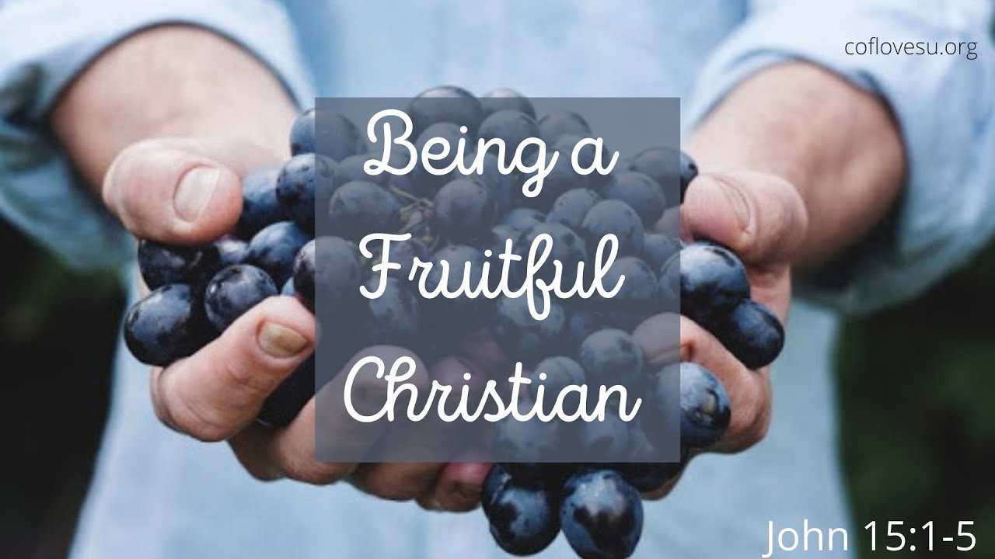
5 Learn to be Orderly/Methodical in Reporting & Teaching.
Several passages show how Paul was orderly and methodical. Tell us what you learned.
6 Seek Out Fruit.
inspiredpencil.com
Just as Paul organized himself for optimal fruitfulness, he also sought to minister where he could be most fruitful. Tell us what you learned.

Slide 15

7 Be Determined, Seeing through Problems to the Prize.
Paul was not easily daunted; he was persistent. Read the seven passages and note how that even with the previous difficulties, Paul kept on preaching, pushing forward through difficulties—even though he suffered beatings.
What happened next in each situation as he kept going?
inspiredpencil.com

Slide 16
7 Be Determined, Seeing through Problems to the Prize.
Passage | What Happened Next?
Acts 14:4-6 Acts 14:19-20 Acts 14:21-23 Acts 16:6-10 Acts 16:25 1 Thes 2:1-3, 17-18 Philippians 4:12-16 | Went where they could continue to preach the gospel. Got up and went to other cities. Went back to where already suffered & preached! Kept trying new places/had vision. Undeterred, sang, others heard. Went to new place, had fruit. Taught others to be faithful.
inspiredpencil.com

Slide 17
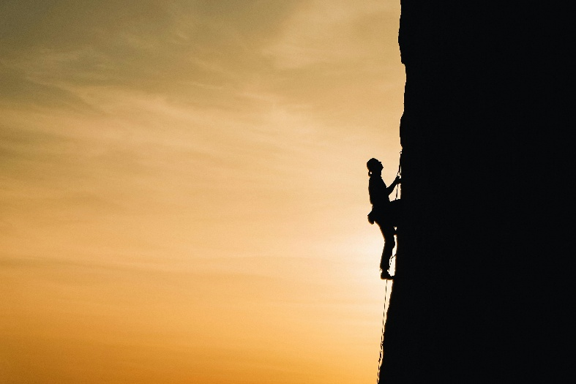
Paul was determined, seeing through the problems to the prize! He and his colleagues even went back to previous towns where they had been persecuted—chased out of town—so that they could strengthen the believers.
These men would not quit! Why? Why did Paul keep going? How could he keep at it even though he faced so many difficulties?
The answer is in Romans 8:18, 22-25.

Slide 18
Paul was convinced that the present sufferings could not compare with the future glory, and so he waited patiently.
That’s not the type of waiting we normally think of. What it means is that he hung in there. He kept at it even in adverse conditions, waiting (looking forward to) the time when he would be with Jesus.

Slide 19

This week put all of Philippians 2:5-11 together and work on the whole passage—let the Word of Christ dwell in you richly.

