Slide 1
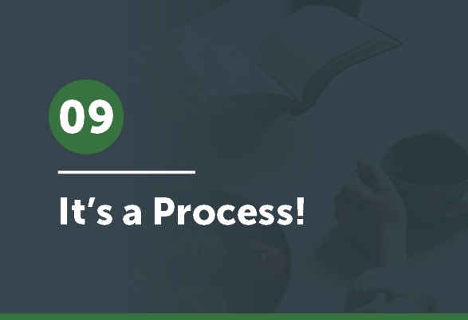


Slide 2

Who can quote Philippians 2:5-11?

Slide 3

The 20 Principles from Paul’s Life and Ministry can be divided into 4 Categories of . . .
Developing Discipleship Eyes
Mentalize
Mobilize
Minimize
Maximize

Slide 4
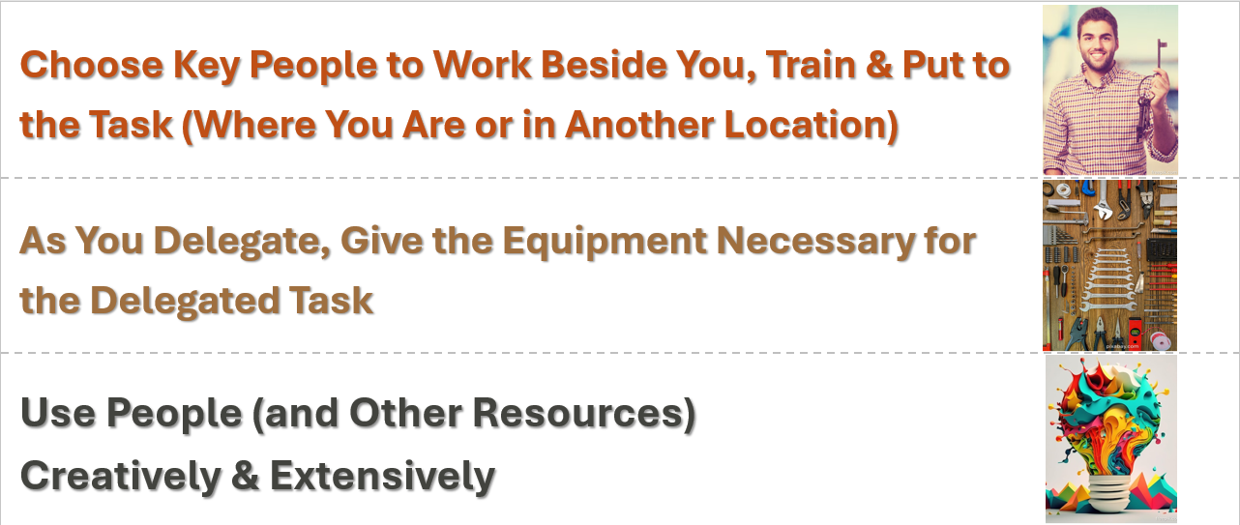
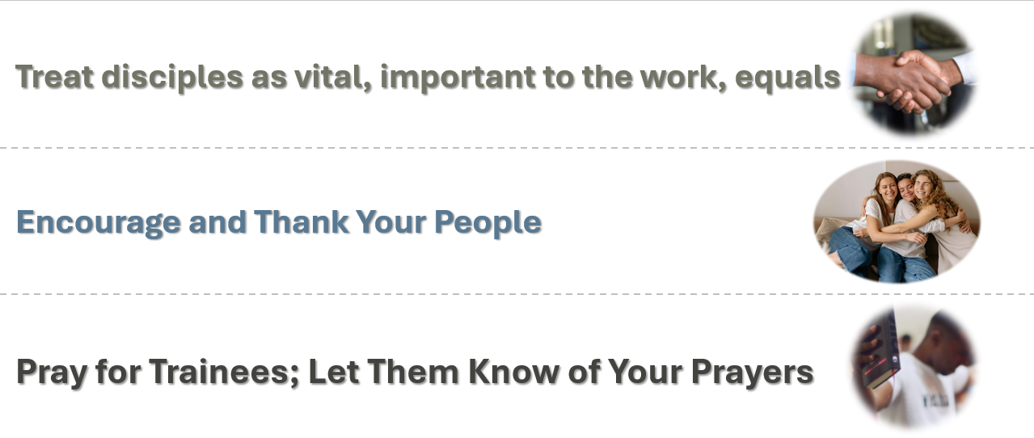
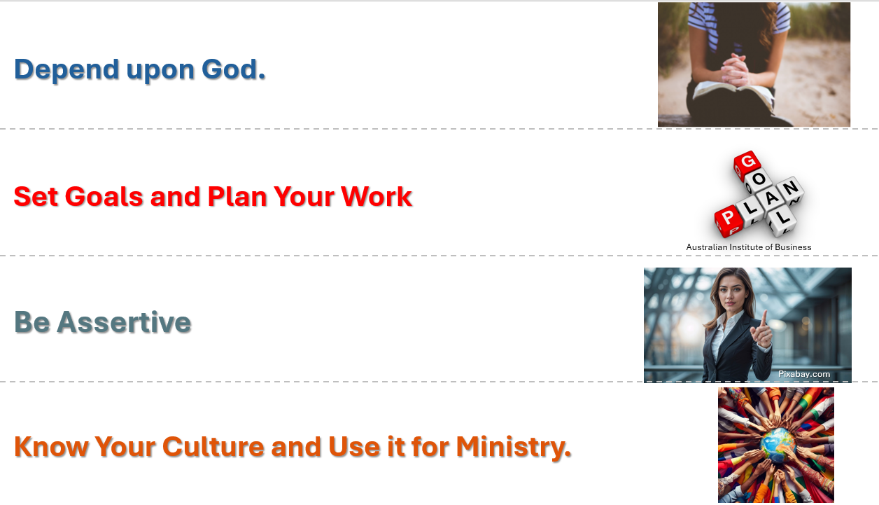
Pick a Principle!
Pick one principle from the Mentalizing Saints, Mobilizing Servants, Minimizing Self, or Maximizing Service principles
Share with a colleague why that one is the most important to you, or the hardest, or the one you want to work on most.

Slide 5
We’ve been learning and growing for quite some time now. How exciting it is to see your growth and how God is already using you! We want to give you a tool to use—a process to walk a person through in any area of ministry which will help him/her to become a leader in that area:
The Leadership Development Process.

Slide 6
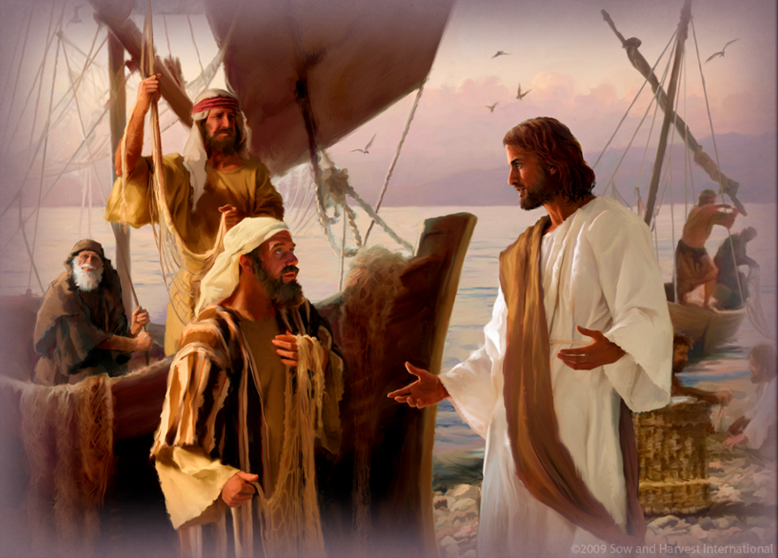
Before we look at that tool, let’s look at these verses . . .
Mark 3:13-14 & Acts 4:13 . . . and answer this question:
What do you see in each passage that likely changed these men and made a difference in their lives?

Slide 7
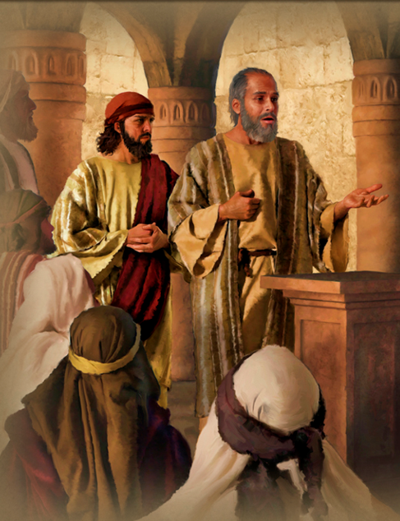
Paul also believed that spending time with disciples was significant in preparing them for ministry. Read another passage:
Acts 20:1-5
How many people did Paul have with him on this ministry trip?
From how many different ministry locations were these men from?

Slide 8
So, spending time with people, modeling what leaders are to do and watching them grow and develop, is necessary. This tool will help you do just that.
We’ll spend some time getting to know the chart, talking through what each symbol and phrase means. The major concept is that you, the disciple-maker start out doing a lot while your disciple is doing very little in a particular leadership role.
Then, as you both move through the chart, you will do less while your disciple does more.

Slide 9

Leader Development Process

Slide 10




Leader Development Process
Demonstration by Disciple-Maker
Responsibility of Disciple
Discipler Disciple

Slide 11
Leader Development Process
Modeling
“Watch Me”
Principles Unknown
Low Skills
Low
Leadership
Experience
Teacher &
Example
Demonstration by Disciple-Maker
Responsibility of Disciple
Discipler Disciple

Slide 12
Leader Development Process
Modeling
“Watch Me”
Principles Unknown
Low Skills
Low
Leadership
Experience
Teacher &
Example
Coaching
“Try it With Me”
Principles learned
Limited Skills
Limited
Leadership
Experience
Coach
Demonstration by Disciple-Maker
Responsibility of Disciple
Discipler Disciple

Slide 13
Leader Development Process
Modeling
“Watch Me”
Principles Unknown
Low Skills
Low
Leadership
Experience
Teacher &
Example
Coaching
“Try it With Me”
Principles learned
Limited Skills
Limited
Leadership
Experience
Coach
Supporting
“I’ll Watch You”
Principles applied
Developed
Skills
Leadership
Evaluated
Barnabas/
Encourager
Demonstration by Disciple-Maker
Responsibility of Disciple
Discipler Disciple

Slide 14
Leader Development Process
Modeling
“Watch Me”
Principles Unknown
Low Skills
Low
Leadership
Experience
Teacher &
Example
Coaching
“Try it With Me”
Principles learned
Limited Skills
Limited
Leadership
Experience
Coach
Supporting
“I’ll Watch You”
Principles applied
Developed
Skills
LLeadership
Experience
Barnabas/
Encourager
Unleashing
“I’ll be a Resource”
Developed
Skills
Confidence
in Leadership
Consultant
Principles used to develop new forms
Demonstration by Disciple-Maker
Responsibility of Disciple
Discipler Disciple

Slide 15
Worship Leader
Small Group Leader
SS Teacher
Pastor
Intern
SS Superintendent
Deacon
Elder
Usher
Other

Slide 16
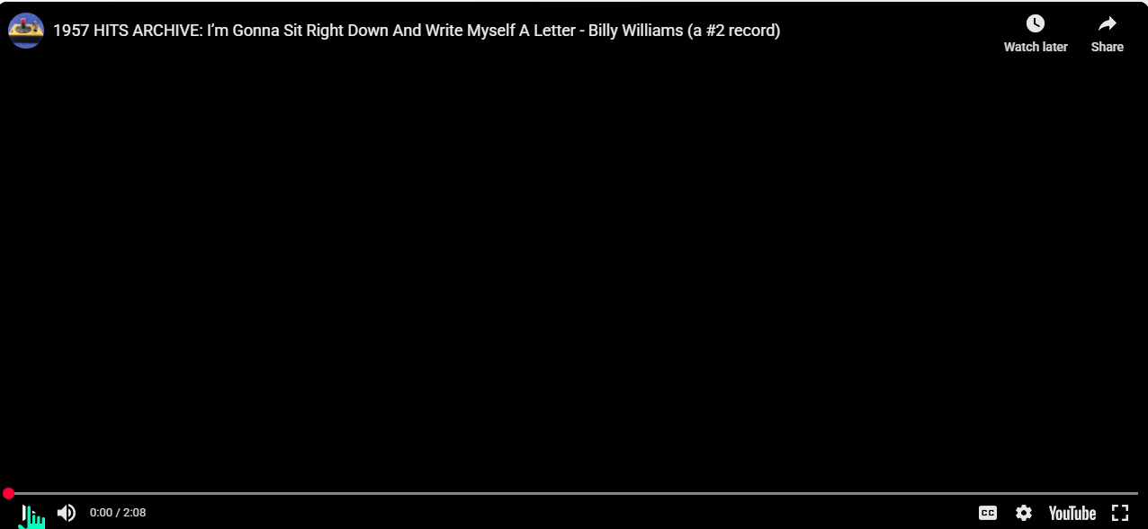


“I’m going to sit right down and write myself a letter!”
Write and tell yourself what you plan to do with what you have learned through this series.
We’re all going to write ourselves a letter . . . er, post card!

