Slide 1
Walking the
Path from Lost
to Leading
Walk Series—
Introduction

Slide 2
Walking the
Path from Lost
to Leading
Walk Series—
Introduction

Slide 4
A great place to start…
The Story of Hope
…guides you through God’s redemptive plan in the Bible.

Slide 5
You see, whether you are feeling like you are “lost” or not, God’s Word says that we are lost, (“for the Son of Man came to seek and to save the lost”-Luke 19:10)

Slide 6
You see, whether you are feeling like you are “lost” or not, God’s Word says that we are lost, (“for the Son of Man came to seek and to save the lost”-Luke 19:10)
Find the words that indicate “lostness” in the verses to follow.

Slide 7
Remember that you were at that time separated from Christ, alienated from the commonwealth of Israel and strangers to the covenants of promise, having no hope and without God in the world. But now in Christ Jesus you who once were far off have been brought near by the blood of Christ.
Ephesians 2:12-13

Slide 8
Remember that you were at that time separated from Christ, alienated from the commonwealth of Israel and strangers to the covenants of promise, having no hope and without God in the world. But now in Christ Jesus you who once were far off have been brought near by the blood of Christ.
Ephesians 2:12-13

Slide 9
Find the words that indicate Jesus did something about our lostness in the verses to follow.

Slide 10
For he himself is our peace, who has made us both one and has broken down in his flesh the dividing wall of hostility by abolishing the law of commandments expressed in ordinances, that he might create in himself one new man in place of the two, so making peace, and might reconcile us both to God in one body through the cross, thereby killing the hostility.
Ephesians 2:14-16

Slide 11
For he himself is our peace, who has made us both one and has broken down in his flesh the dividing wall of hostility by abolishing the law of commandments expressed in ordinances, that he might create in himself one new man in place of the two, so making peace, and might reconcile us both to God in one body through the cross, thereby killing the hostility.
Ephesians 2:14-16

Slide 12
Find the words that indicate “hope” in the verses to follow.

Slide 13
And he came and preached peace to you who were far off and peace to those who were near. For through him we both have access in one Spirit to the Father. So then you are no longer strangers and aliens, but you are fellow citizens with the saints and members of the household of God, built on the foundation of the apostles and prophets, Christ Jesus himself being the cornerstone,
Ephesians 2:17-20

Slide 14
And he came and preached peace to you who were far off and peace to those who were near. For through him we both have access in one Spirit to the Father. So then you are no longer strangers and aliens, but you are fellow citizens with the saints and members of the household of God, built on the foundation of the apostles and prophets, Christ Jesus himself being the cornerstone,
Ephesians 2:17-20

Slide 15
Next step on your journey— “First Steps” discipleship.

Slide 16
Then you would proceed to the Walk Series to see what your next steps in walking from lost to leading should be.

Slide 17
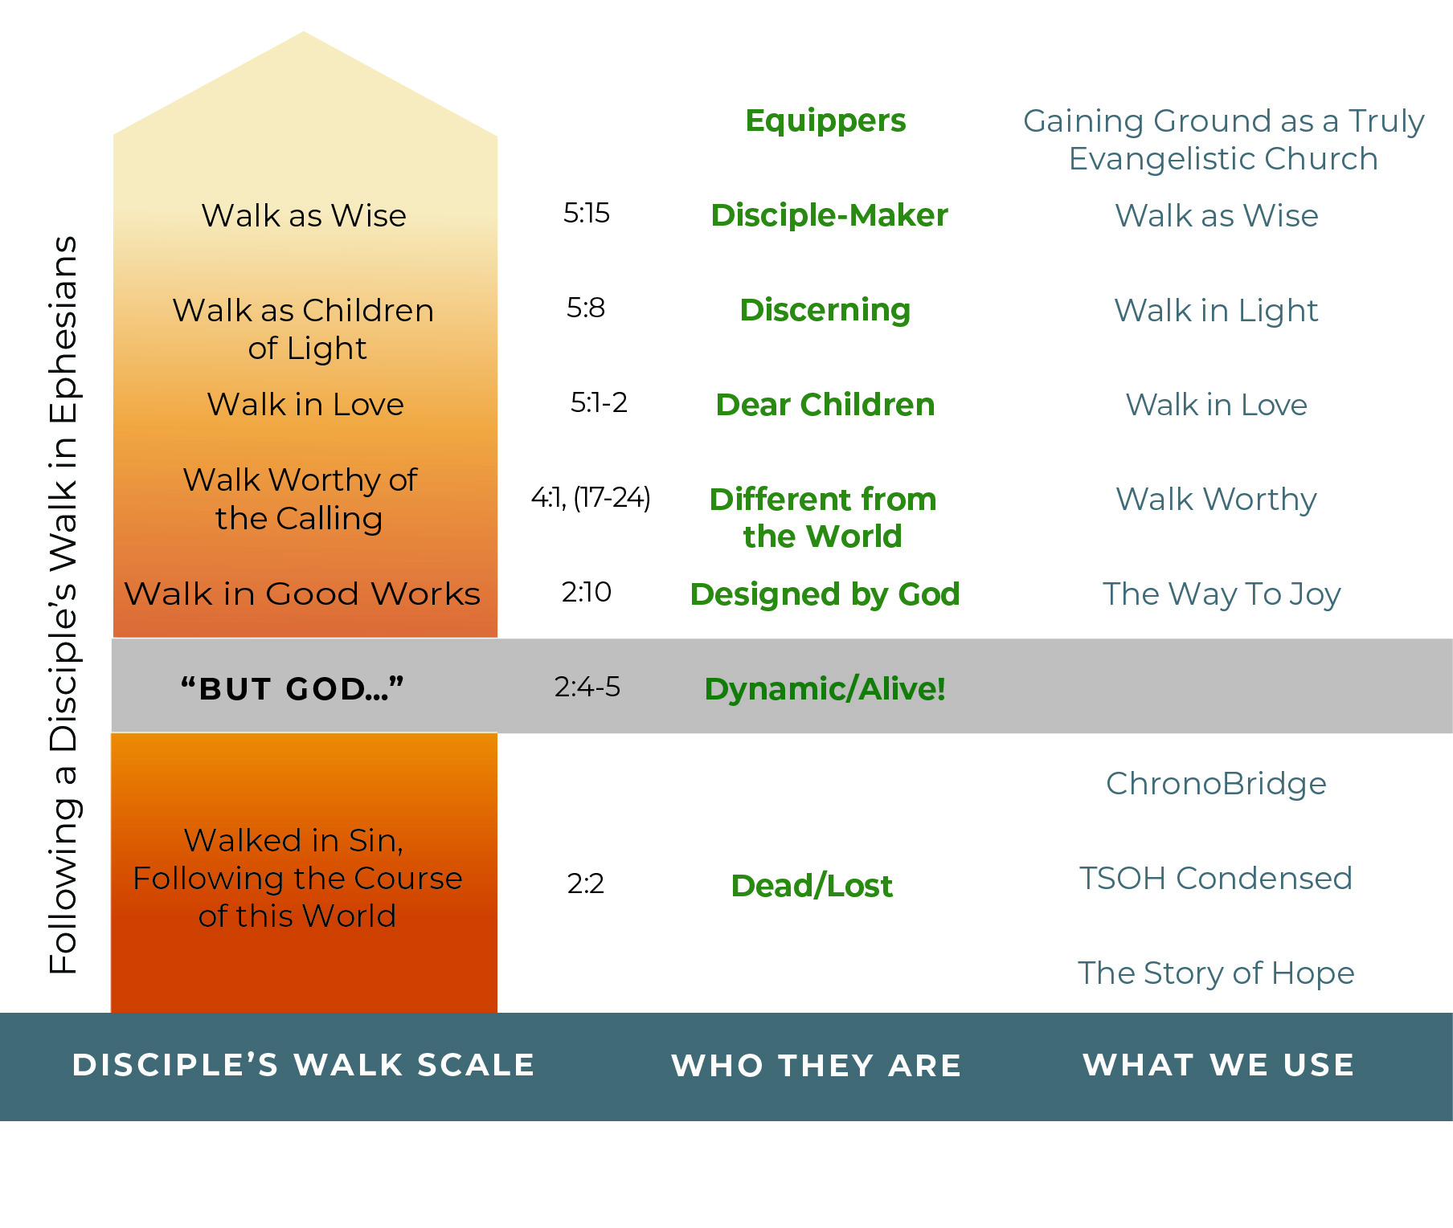
The Disciple’s Upward Walk
People with whom we work (evangelizing & discipling)
Tools we might use in the E&D process
Place the Cards in the Columns
to make sense of the Graph.

Slide 20
Ephesians 2:10 says that when you trusted Jesus as your personal Savior, you became God’s masterpiece!
“For we are God’s masterpiece. He has created us anew in Christ Jesus, so we can do the good [works] he planned for us long ago.” —Eph. 2:10

Slide 21
Look at these verses from Titus and discover an emphasis in that book.
“And you yourself must be an example to them by doing good works of every kind. Let everything you do reflect the integrity and seriousness of your teaching.”
Titus 2:7

Slide 22
Look at these verses from Titus and discover an emphasis in that book.
“He gave his life to free us from every kind of sin, to cleanse
us, and to make us his very own people, totally committed to doing good deeds.”
Titus 2:14

Slide 23
Look at these verses from Titus and discover an emphasis in that book.
“Remind the believers to submit to the government and its officers. They should be obedient, always ready to do what is good.”
Titus 3:1

Slide 24
Look at these verses from Titus and discover an emphasis in that book.
“Everything is pure to those whose hearts are pure. But nothing is pure to those who are corrupt and unbelieving because their minds and consciences are corrupted. Such people claim they know God, but they deny him by the way they live. They are detestable and
disobedient, worthless for
doing anything good.”
Titus 1:15-16

Slide 25
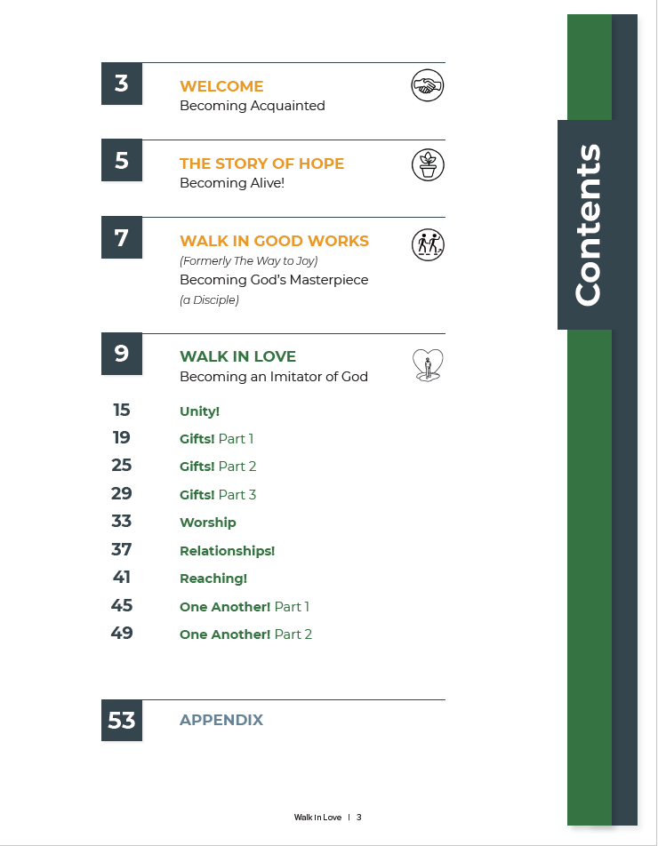
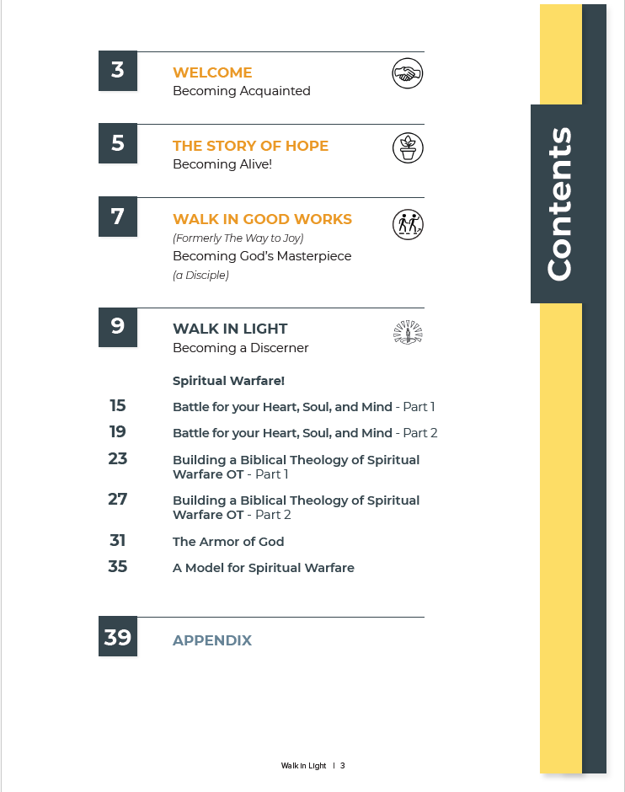
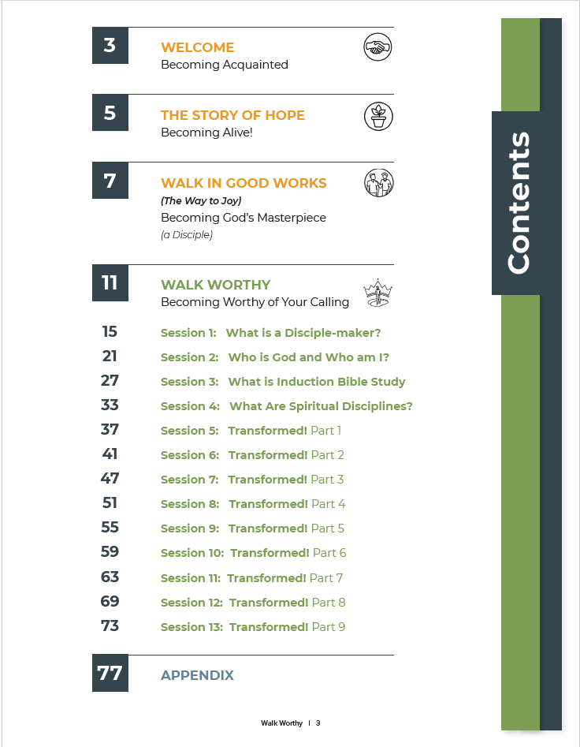
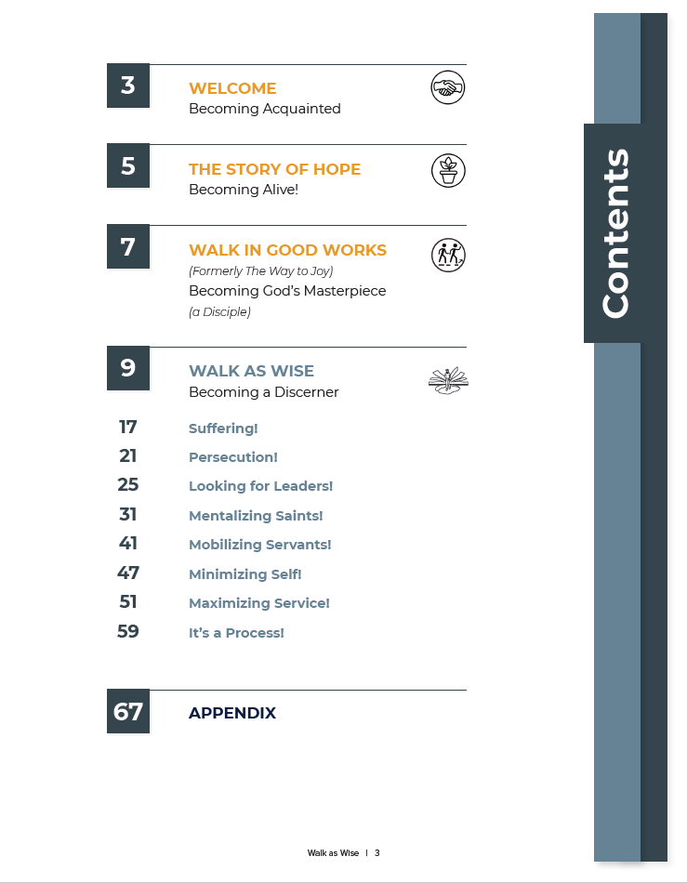
Compare and Contrast the Contents Pages
Walk Worthy
Walk in Love
Walk in Light
Walk as Wise

Slide 26
In Which Topic(s) Do You Have the Most Interest?
Walk Worthy
Walk in Love
Walk in Light
Walk as Wise

Slide 27
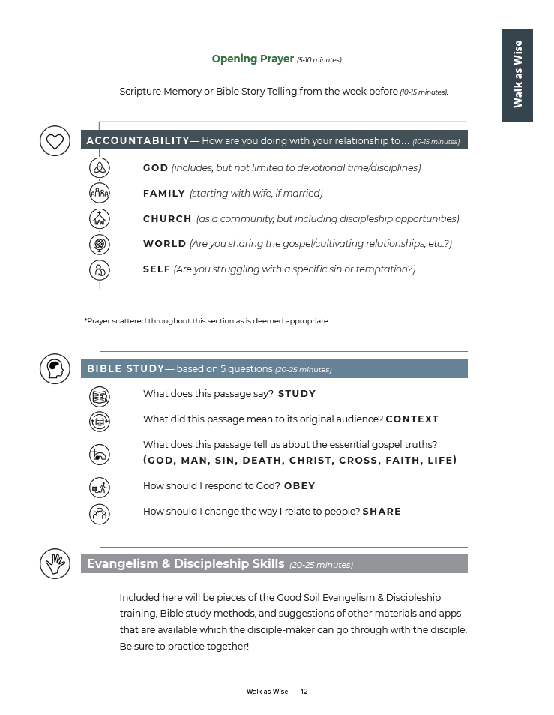
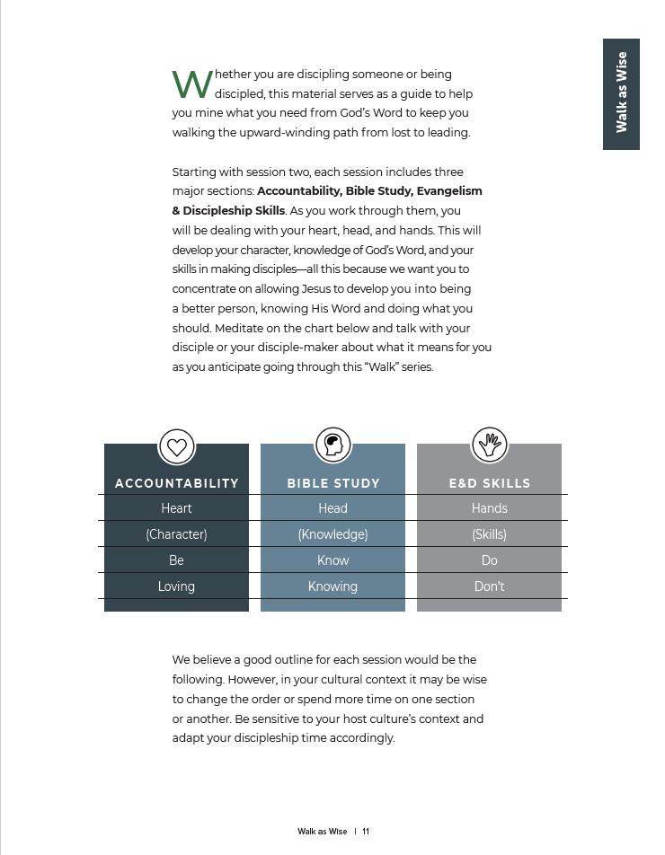
Look at Pages 11-12 (handout) . . .
Everyone gets a copy . . .

Slide 28
Look at Pages 11-12 (handout) . . .
Doing
Talk with your table group about what you think might be most helpful to you as you anticipate going through this “Walk” Series.

