Slide 2
Review Galatians 5:20
idolatry, sorcery, enmity, strife, jealousy, fits of anger, rivalries, dissensions, divisions,

Slide 3
Are you walking worthy of your calling (Eph. 4:1)?
And are you being transformed, not walking as you
once did (Eph. 4:17)?
As we continue learning
about the fruit of the Spirit, today we contrast goodness with indecent behavior.

Slide 4
The Greek word ἀγαθωσύνη carries with it the idea
of “goodness, virtue,
beneficence, or generosity.”
Observe how the people in today’s story demonstrated either generosity or indecent behavior.

Slide 5
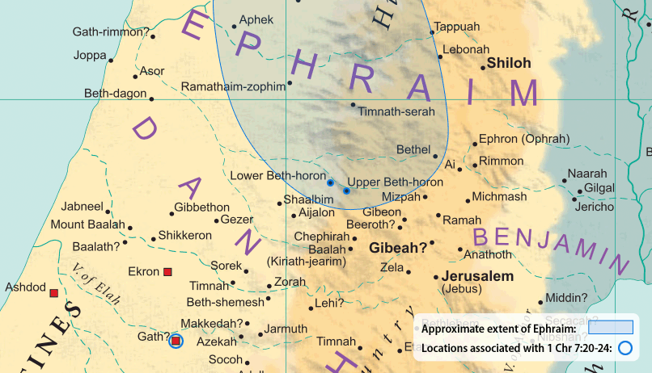
Read 1 Samuel 1:1-3

Slide 6
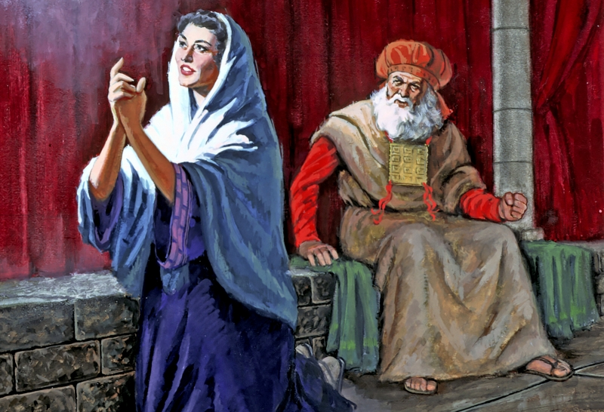
Read 1 Samuel 1:4-28
Who demonstrated generosity in Chapter one?
How was
generosity or goodness shown?
Who demonstrated what you could consider the opposite
of generosity?

Slide 7
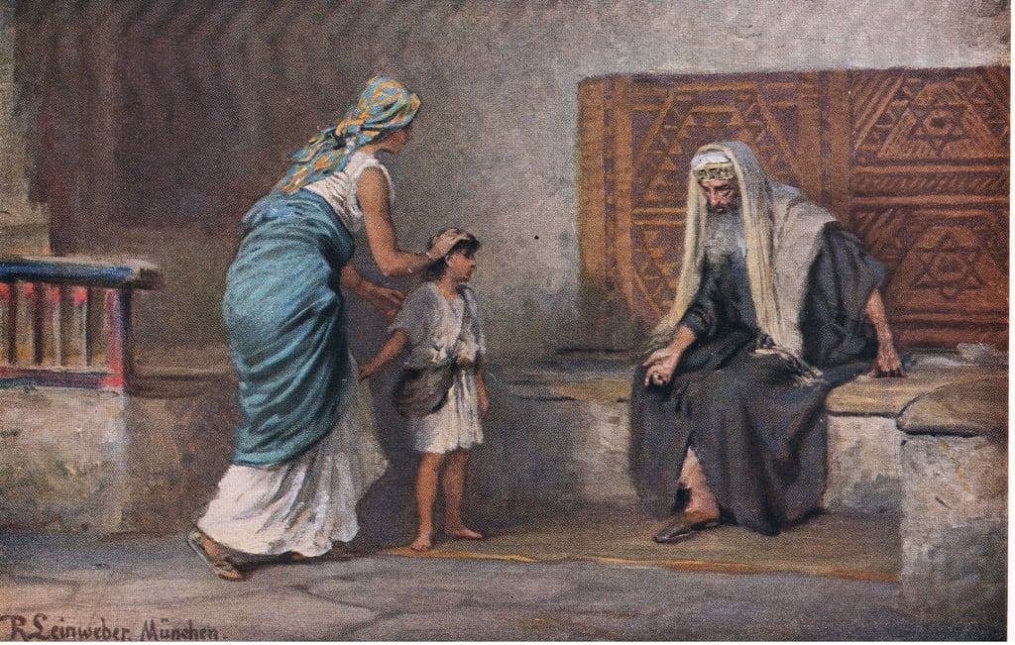
Read 1 Samuel 2
What about in Chapter two?
Who demonstrated generosity?
Indecent behavior?

Slide 8
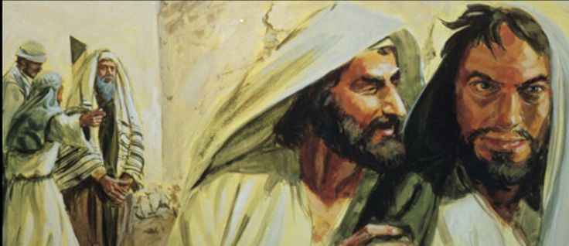
Read 1 Samuel 2
The sons of Eli were called “worthless” men.
How are their actions (considered worthless or indecent) the opposite of generosity?

Slide 9
Read Galatians 5:22
Ask God to help you demonstrate generosity to people around you.
What can you do to demonstrate generosity?
Name at least one action or attitude you might change this week to be more generous

Slide 10
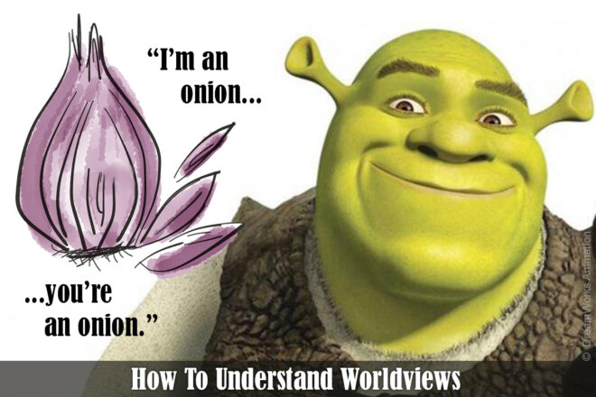
Shrek said, “Ogres are like onions . . . They have layers.”
We all have layers, too, and if you want to share the gospel effectively, it
helps to peel back the layers of a person’s “worldview onion.”

Slide 11
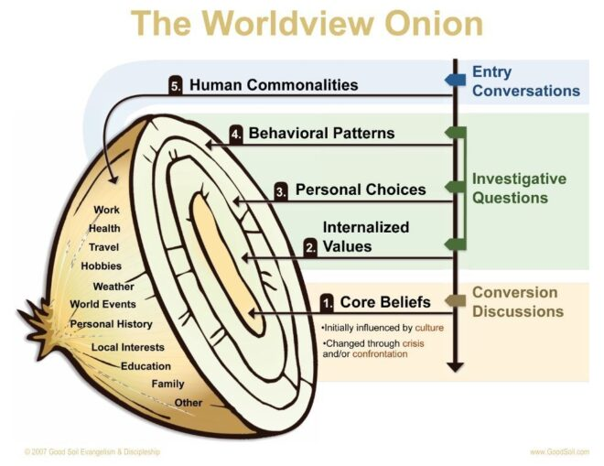
Learn about worldview onions and how to peel them at . . .

Slide 12
Good Soil Evangelism & Discipleship Seminar: at Calvary Baptist, Simpsonville August 16-17, 2024
Today is the last day to register!

Slide 13
Memorize Galatians 5:21 envy, drunkenness, orgies, and things like these. I warn you, as I warned you before, that those who do such things will not inherit the kingdom of God.

