Slide 2
Review Galatians 5:21
envy, drunkenness, orgies, and things like these. I warn you, as I warned you before, that those who do such things will not inherit the kingdom of God.

Slide 3
The fruit of the Spirit should be helping you to walk
worthy of your calling (Ephesians 4:1) and should be
transforming you so you do not walk as we once did
(Ephesians 4:17).
As we continue learning about the fruit of the Spirit, today we contrast faithfulness with idolatry (one of the works of the flesh listed in Galatians 5:20). Observe how the people in today’s story were either faithful or idolatrous in their behavior.

Slide 4
Before we read the story of Exodus 32, let’s remember a few key points of historic background:

Slide 5
Elohim (powerful self-existent, self-sufficient God) created the universe. (Gen 1)
He also created humankind and cultivated a relationship with them. (Gen 2)
Humankind progressively turned away from God. (Genesis 3-9)

Slide 6
People began to create their own gods. (Genesis 11). History tells us that the purpose of ziggurats like the one built in Babel was to allow the gods (plural) to come down to the temple at the base of the tower.

Slide 7
The father of the Hebrew nation had lived in two major hubs of moon worship before God called him to leave that behind and to follow Him. (Genesis 11-12)
The Hebrew people (descendants of Abraham) spent 400 years in bondage in Egypt where they were exposed to (and may have participated in) polytheism.

Slide 8
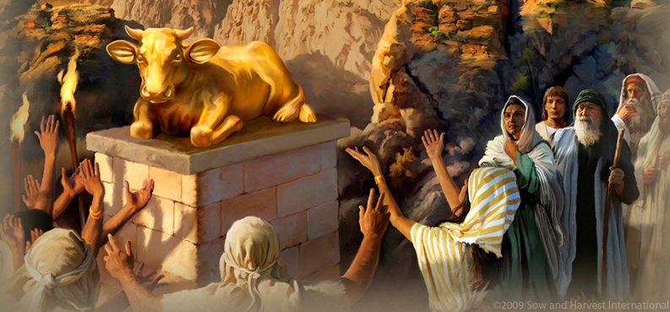
Read Exodus 32:1-10
Why was God so upset with the people?
Do you think He was justified in His anger? Why?

Slide 9
Read Exodus 32:11-29
Notice the difference between Moses’ response in verses 11-13 and his response in verses 19-20 and 25-27. What made the difference? Why did Moses
change his mind?

Slide 10
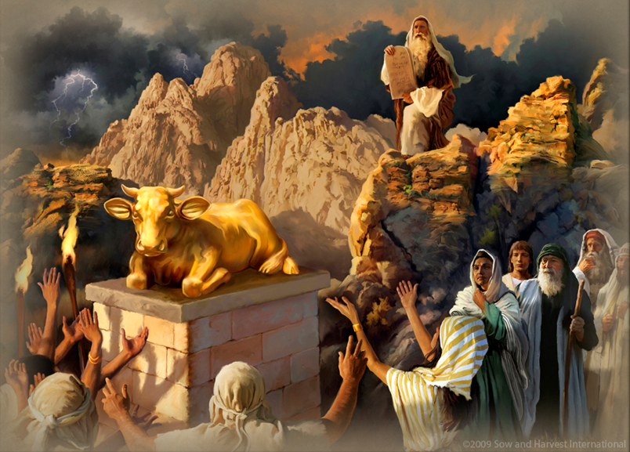
This sin of idolatry was serious. Many people died.
Remember that idolatry is one of
the works of the flesh (Galatians 5:18-20).

Slide 11
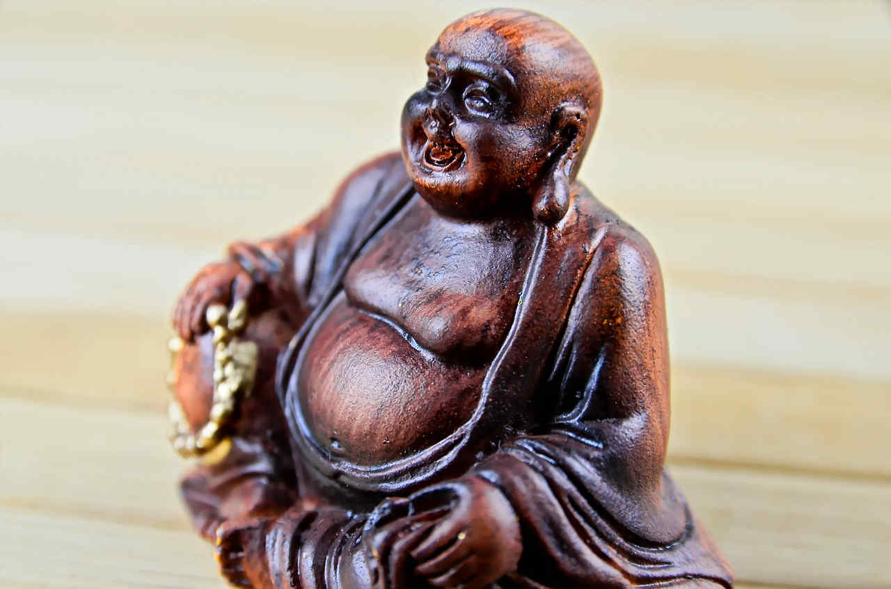
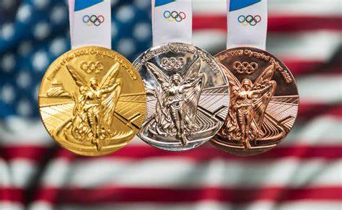
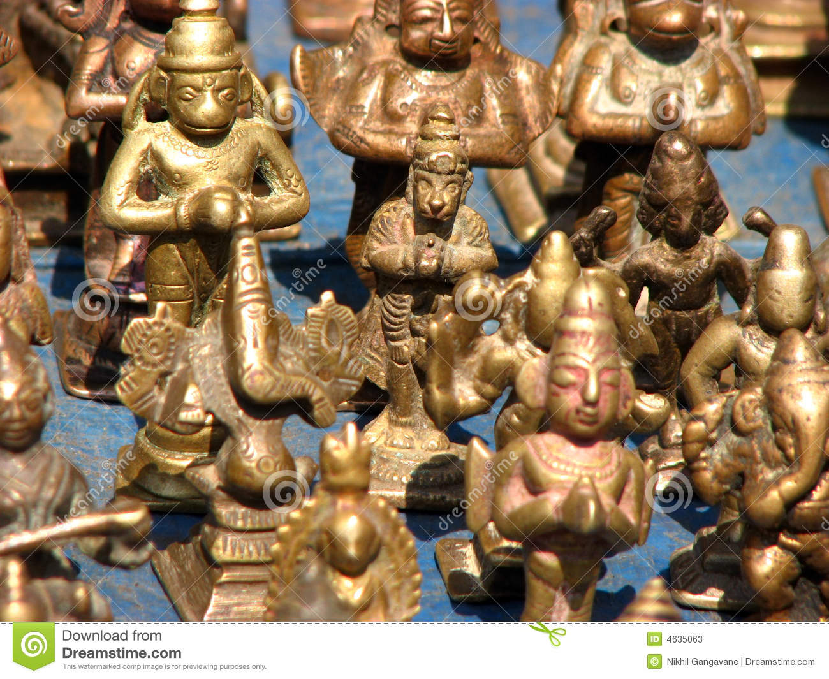
What does idolatry look like in your part of the world?
Read Ephesians 5:1-6, also, as you answer this question.

Slide 12
Ask God to help you remain faithful; cultivating the fruit of the Spirit, and not allowing idolatry to sidetrack you in any way.

Slide 13
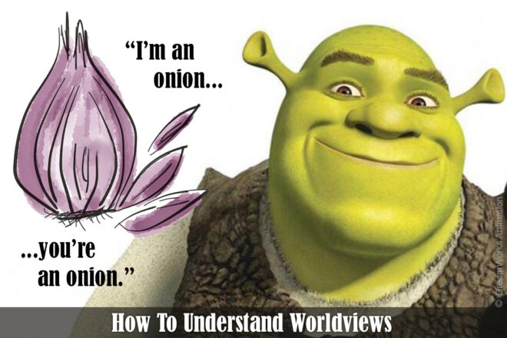
Entry Point from the other person: “What a beautiful sunset!”
Investigative Question from you: “Do you ever look at a beautiful scene in nature and wonder how this all got here?”

Slide 14
Here are some additional investigative questions to keep in mind:
If your son or daughter asked you, what happens when somebody dies, what would you say?

Slide 15
Have you ever read much of the Bible? What do you think about it?
Did you ever wonder, “How did this world get into such a mess?

Slide 16
Were your parents religious people?
Have you ever asked yourself,
“What is the meaning of life?”
“Why am I here?”

Slide 17
If someone asked you,
“Do think there is a God?,” what would you say?
What do you think
about “faith”?

Slide 18
Memorize Galatians 5:22 But the fruit of the Spirit is love, joy, peace, longsuffering, gentleness, goodness, faith, meekness, temperance;

