Slide 2
Review Galatians 5:22-23
But the fruit of the Spirit is love, joy, peace, longsuffering, gentleness, goodness, faithfulness, meekness, temperance. Against such things there is no law.

Slide 3
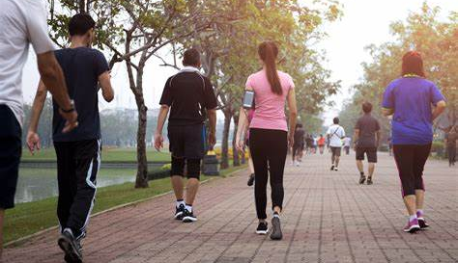
Remember that we are to be walking worthy of our calling (Ephesians 4:1) and transformed, not walking as we once did (Ephesians 4:17).
Since many of the Corinthians were converted gentiles, they needed to remember this and leave their
old ways behind. Today we are contrasting dissensions/divisions with gentleness.
We’ll also contrast drunkenness with self-control.

Slide 4
Remember that when Paul got to Corinth, he first tried to
reach Jews in the synagogues (Read Acts 18:5), but then
seemed to have a lot of fruit with gentiles (Read 18:6-11).
Let’s go to 1 Corinthians 1:10-17.

Slide 5
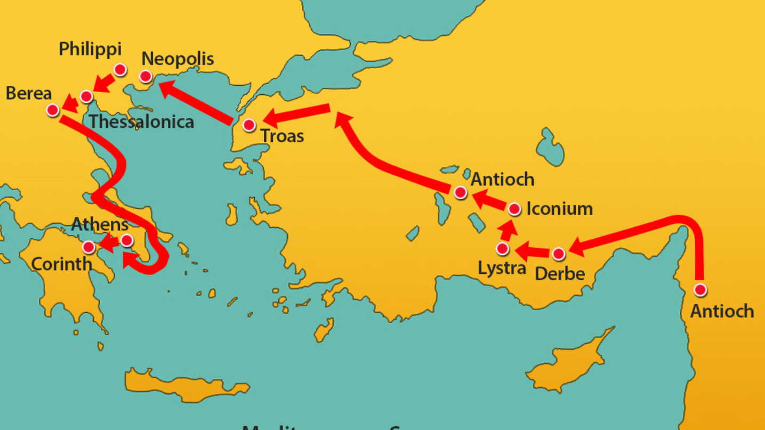

Slide 6
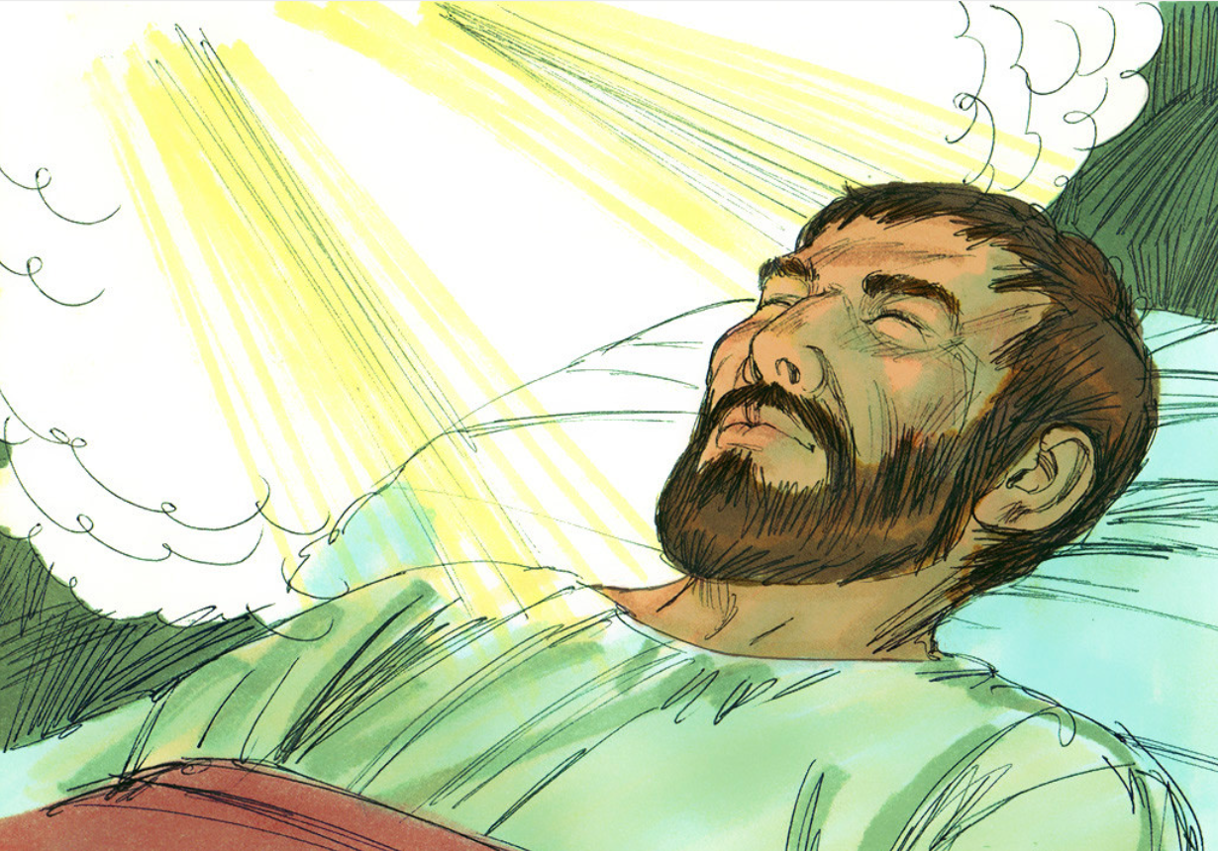
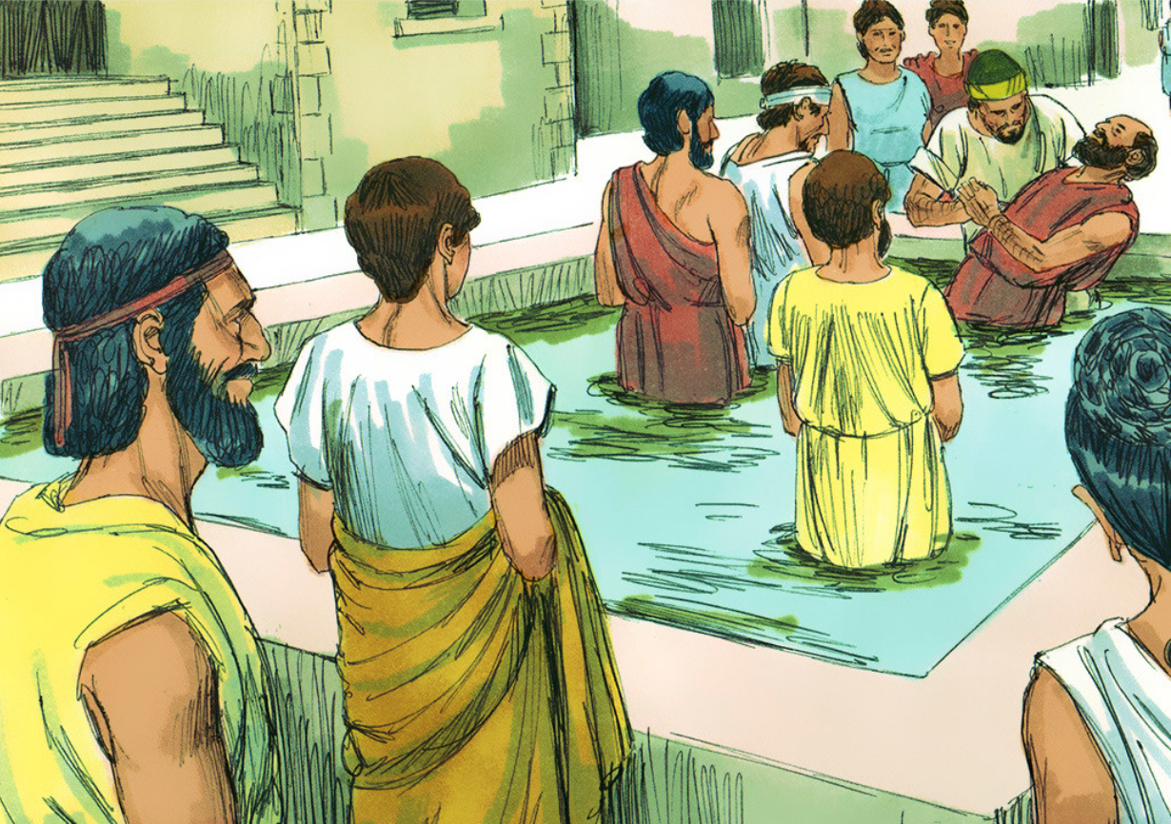
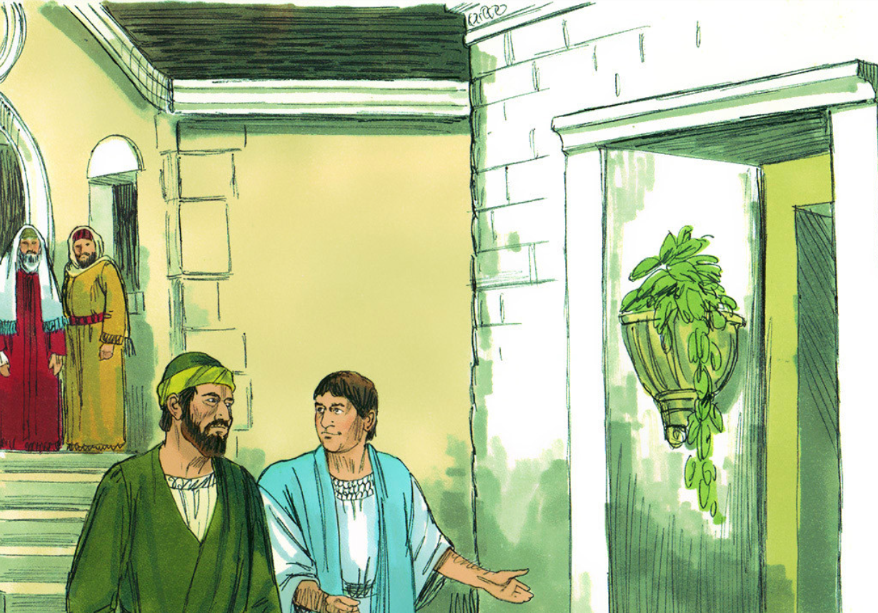
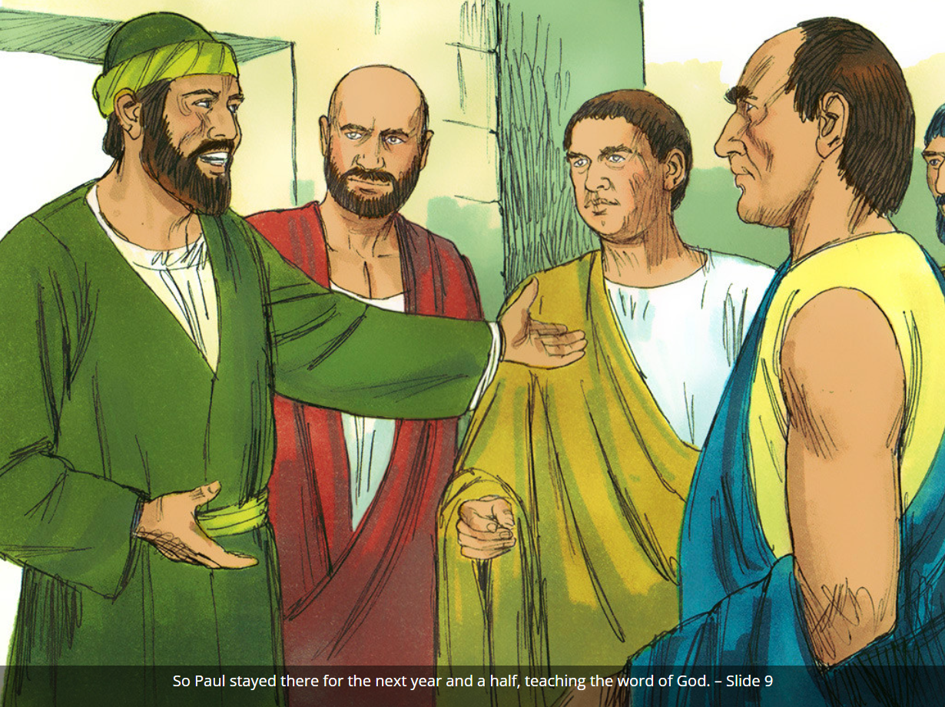
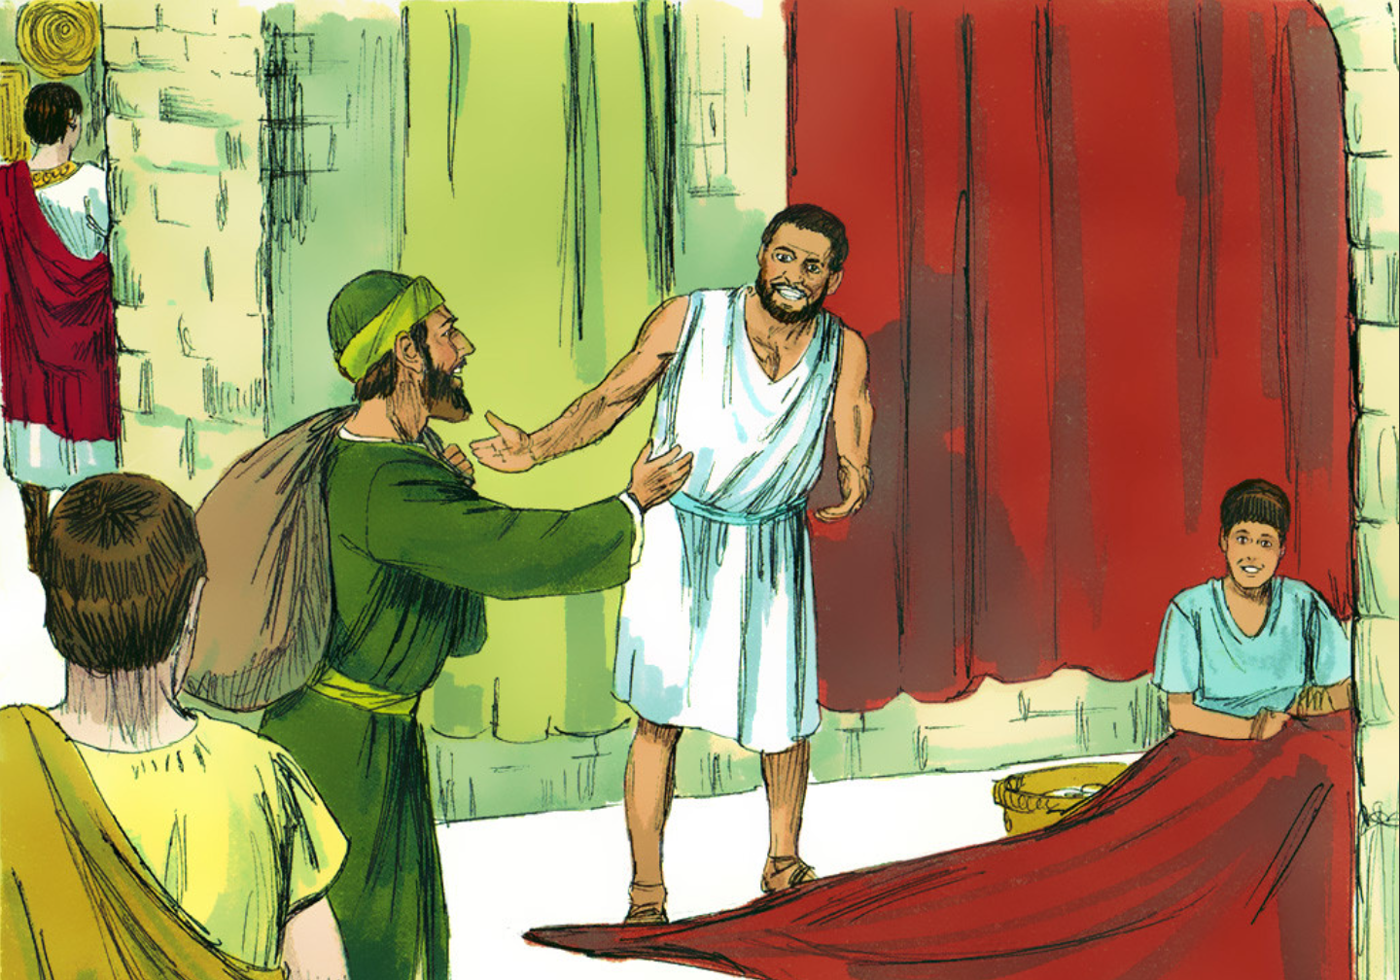
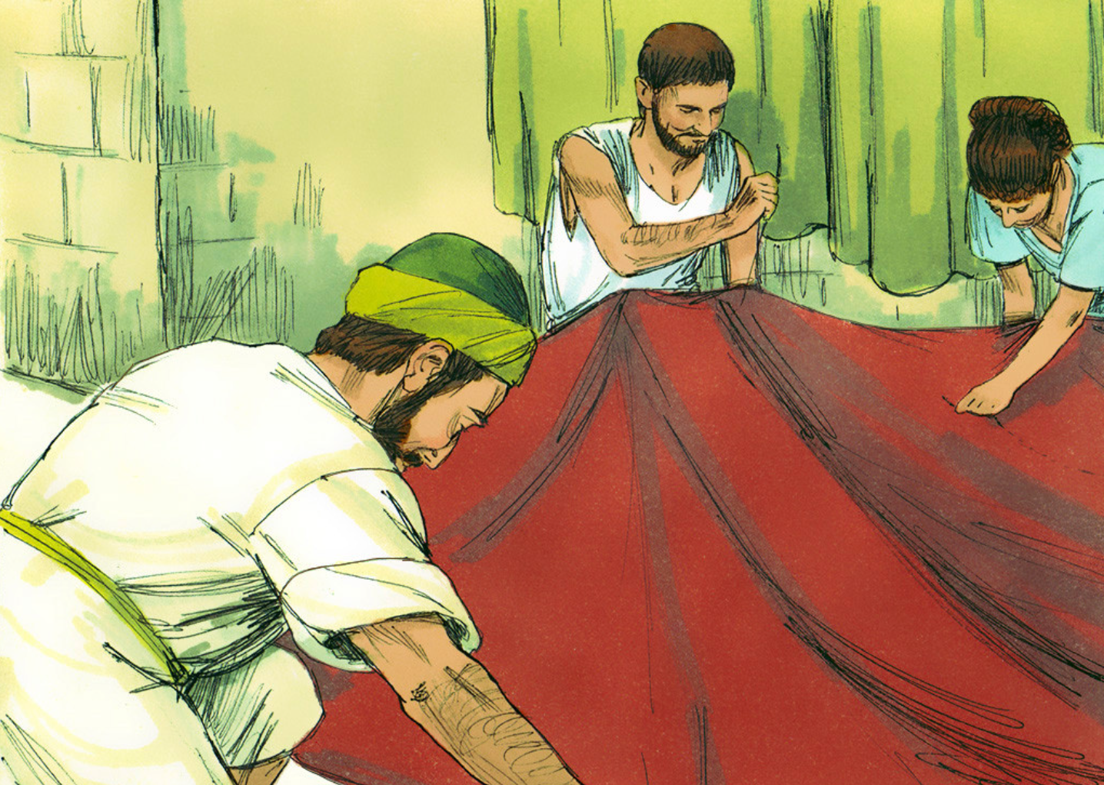
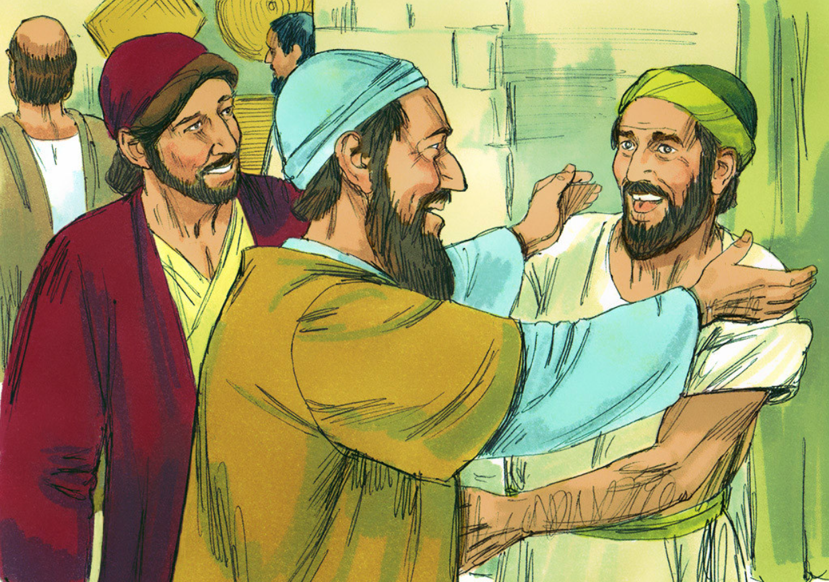
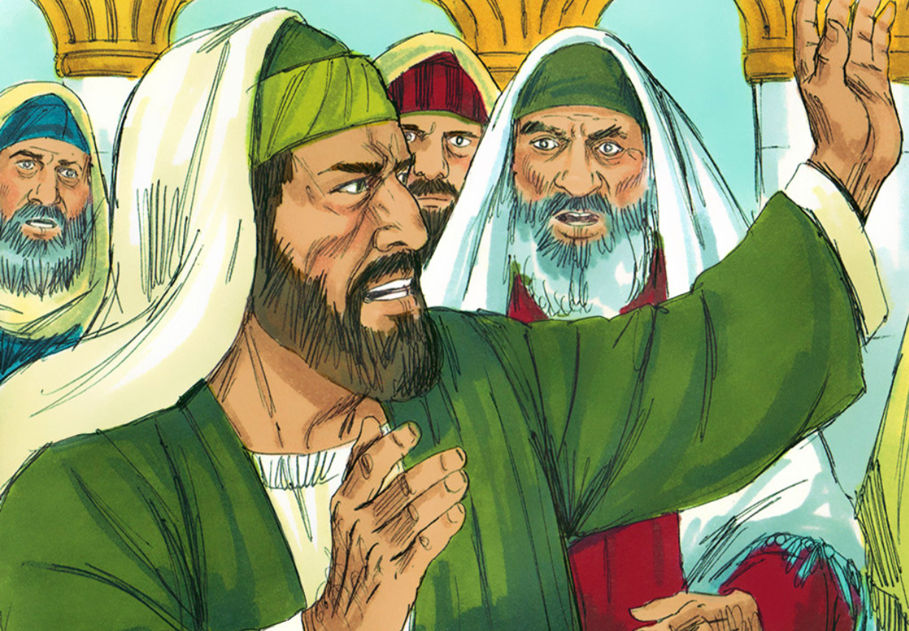

Slide 7
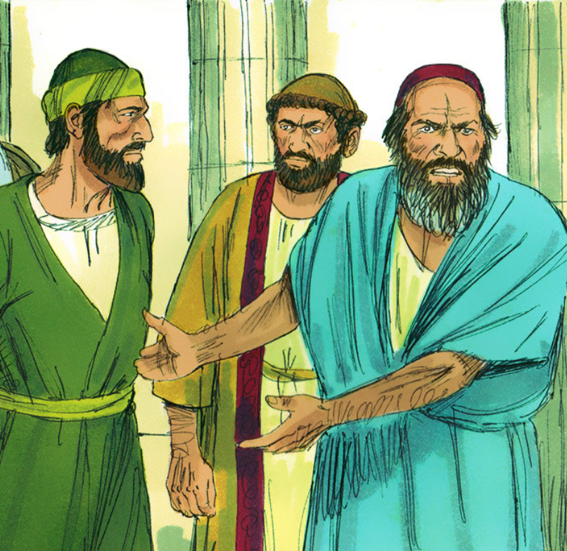
Read 1 Corinthians 1:10-17
What does this passage say? Summarize what was happening and what could be the lesson here.

Slide 8
According to Proverbs 15:1,
if gentleness were cultivated and displayed in a situation
like 1 Corinthians 1, what would happen?
A soft answer turns away wrath, but a harsh word stirs up anger. Proverbs 15:1

Slide 9
What else can gentleness
do if displayed in our lives? (Gal. 6:1; Eph. 4:1-2)

Slide 10
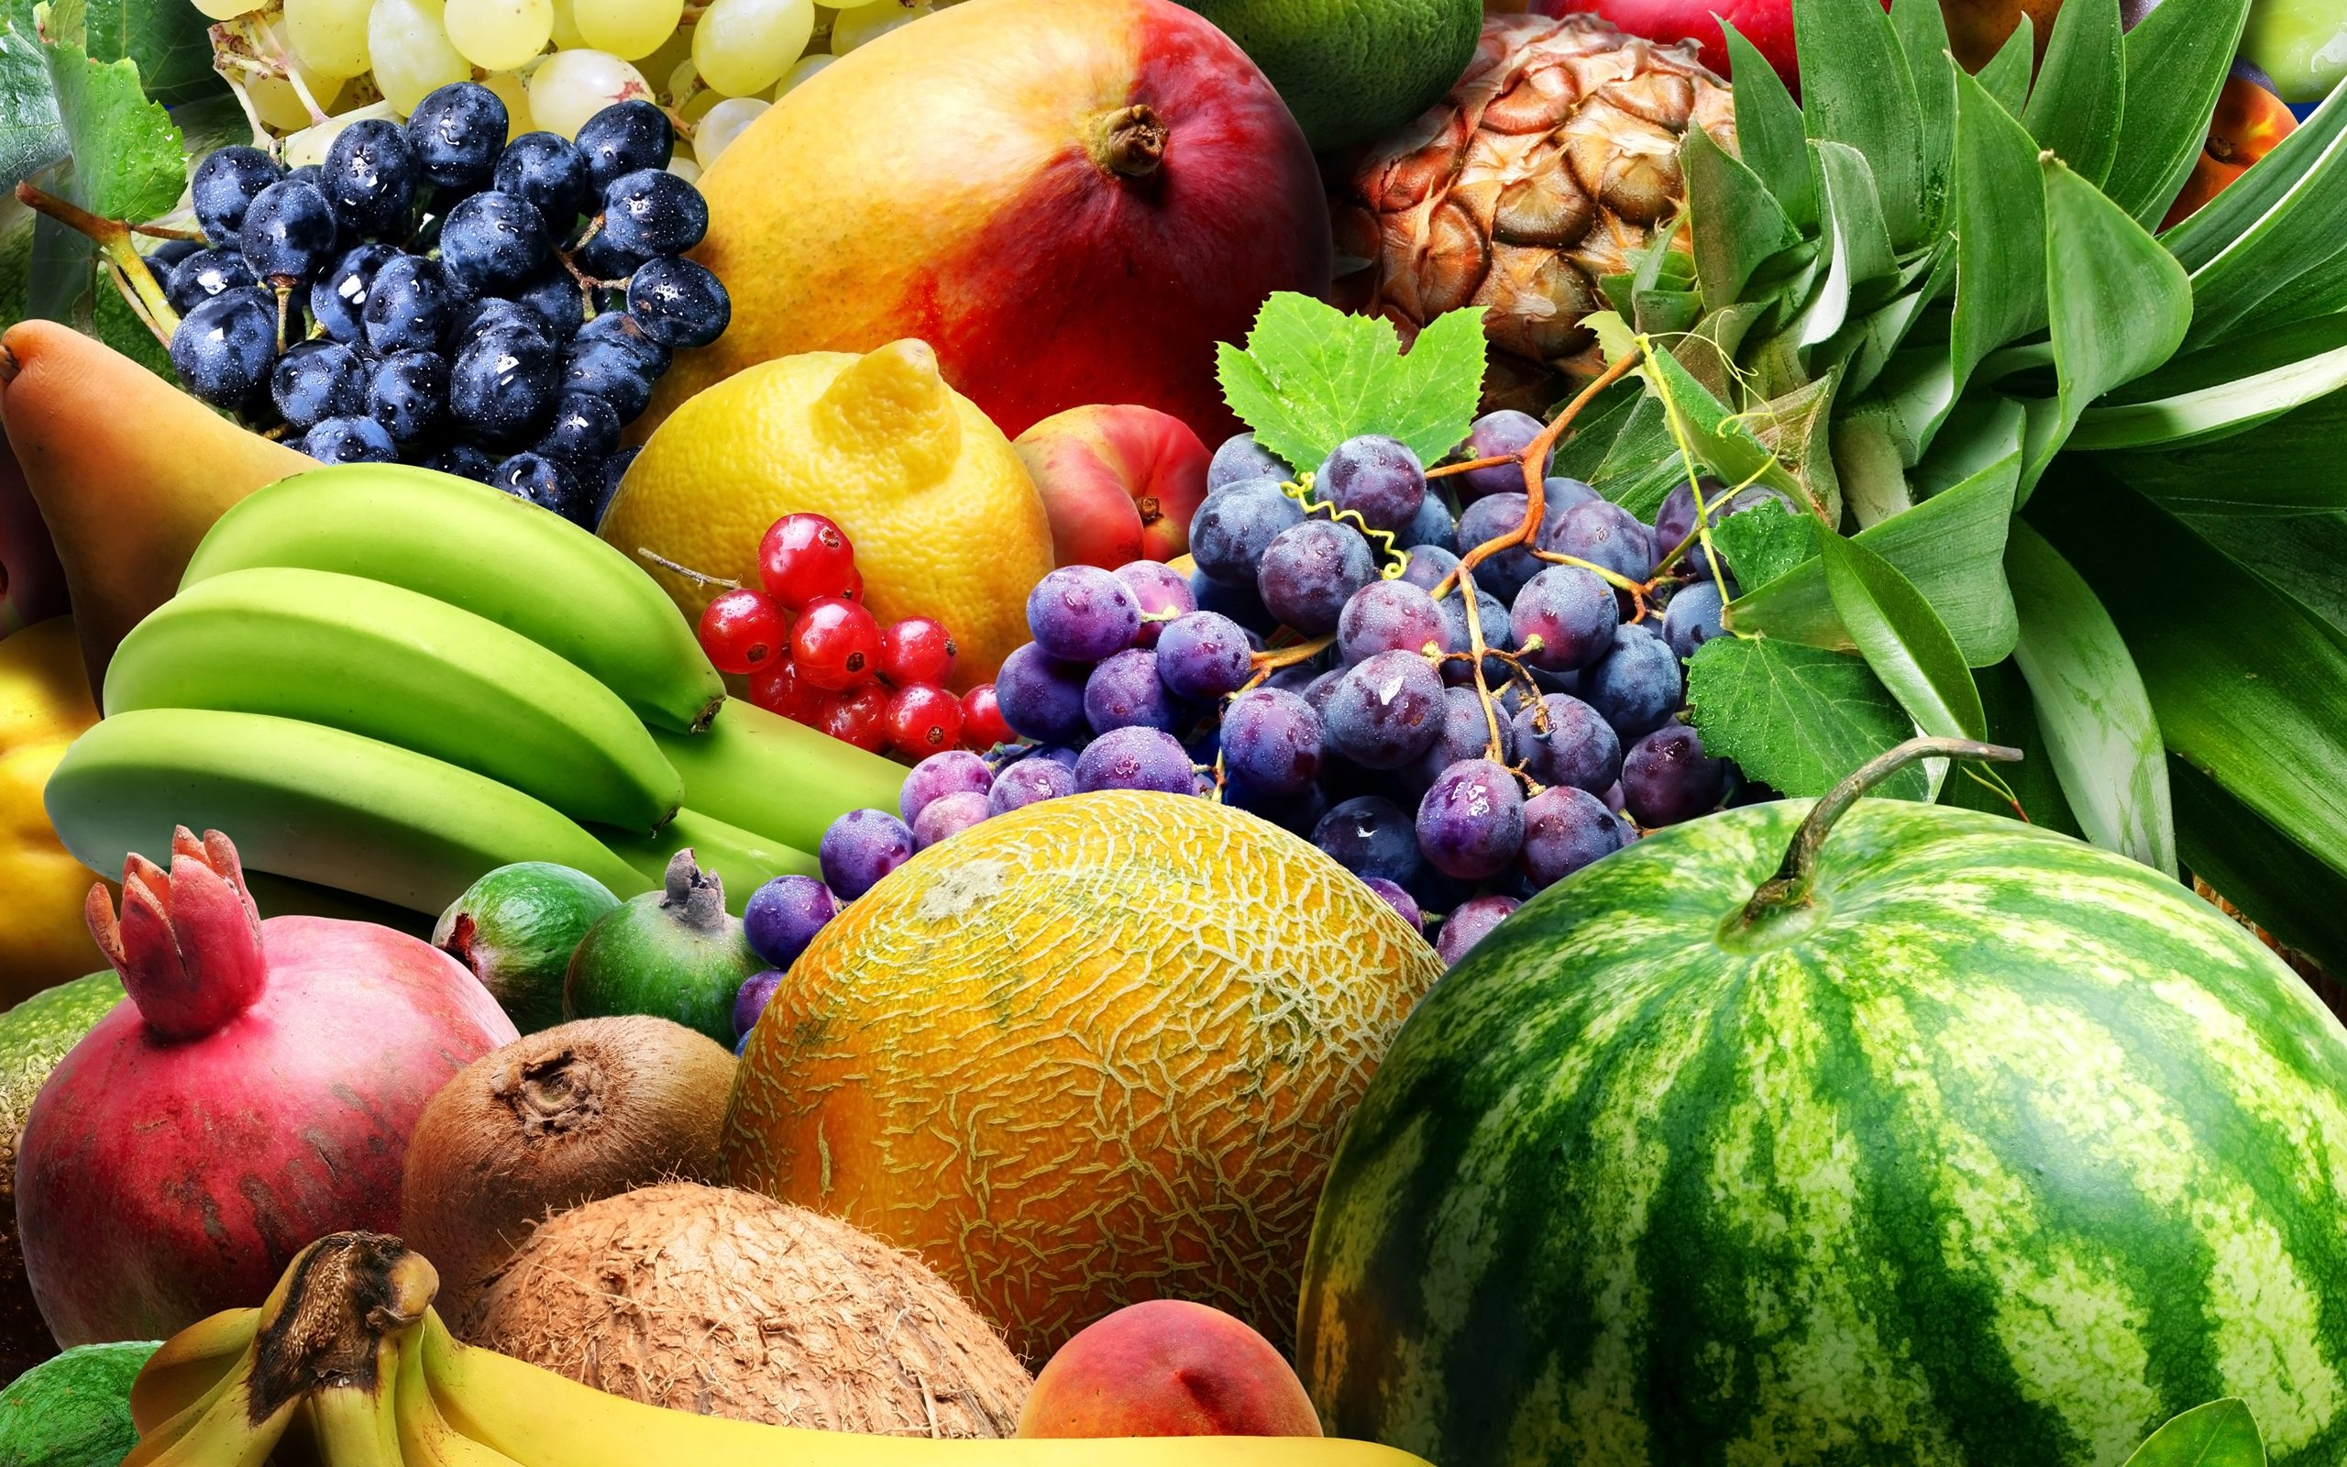
The final part of the fruit of the Spirit is self-control.
Galatians 5:21 lists drunkenness as one of the works of the flesh. It is certainly the opposite of self-control.
1 Corinthians 11:17-22 & Ephesians 5:15-21 may give us more insight.
Read these two passages and respond.

Slide 11
Judging from what is said in these passages, how important do you think self-control is for the believer?
Are there other areas besides alcohol in which one might need to exercise self-control? What are
some of those areas?
Do you struggle with self-control in any of these areas?

Slide 12
And those who belong to Christ Jesus have crucified the flesh with its passions and desires. Galatians 5:24

