Slide 2
Review Galatians 5:24
And those who belong to Christ Jesus have crucified the flesh with its passions and desires.

Slide 3
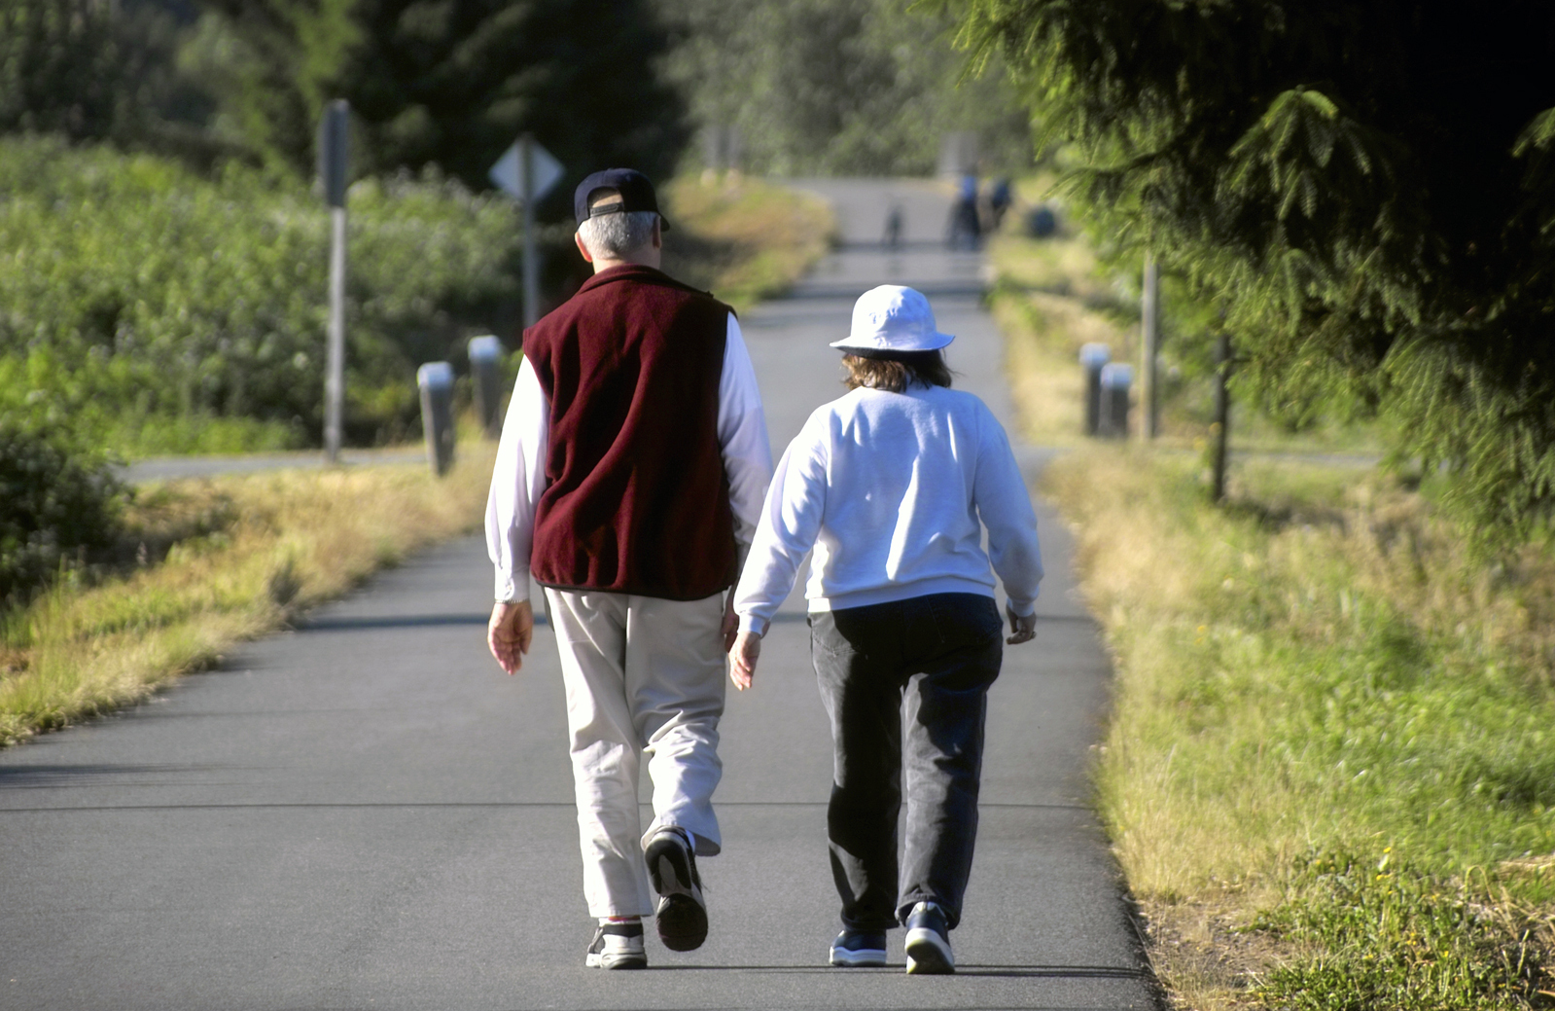
This is our final Walk Worthy session. When we looked at the Fruit of the Spirit, we contrasted it to the works of the flesh. By walking by means of the Spirit, depending on Him, we can manifest the Fruit of the Spirit and not produce the works of the
flesh and thus, walk worthy.

Slide 4
Ephesians, Philippians, and Colossians have similar positive and negative models.
Group One:
Look at Philippians 2:1-16 and contrast what our lives should look like as opposed to what they should not look like.

Slide 5
Group Two: In Ephesians we have already been talking about how we should walk as opposed to how we should not walk. Glance over the book of Ephesians and list some of the contrasting ways of walking.

Slide 6
Group Three, look at Colossians 2 & 3. List what the Colossians were to put to death (νεκρόω) or render useless—take off—and what they were to put on (ἐνδύω) as if they were putting on clothing.

Slide 7
Philippians 2:1-16
Don’t Live Like This:
Live Like This:
Selfish Ambition
Conceit
Look only after your own interests
Grumbling, disputing
Be of the same mind
Humility
Other-mindedness (2:5-8)
Hold fast to the Word

Slide 8
Don’t Walk:
Ephesians
Anger
Stealing
Corrupt talk
Bitterness
Wrath/anger/clamor
Malice
Sexual immorality/impurity
Covetousness, etc.
Like Gentiles/futility of mind
Darkened understanding
Alienated from God/ignorant
Hard of heart/calloused
Given to sensuality/greedy
Corrupt through deceitful desires.
Falsehood

Slide 9
Walk:
Ephesians
Worthy
As children of light
Carefully/wisely
Humbly/Forgive
With gentleness
With patience/Submit
Labor (instead of stealing)
Kindness/tenderhearted
Bearing w/one another in love
Maintaining unity in the bond of peace
Renewed in spirit of our mind
W/ new self, created after
likeness of God in true
righteousness & holiness
Speaking truth in love

Slide 10
Put Off:
Put On:
Colossians
Compassionate hearts
Kindness
Humility
Meekness
Patience
Bear w/one another
Forgive one another
Love above all (overcoat)
Let Peace rule in hearts
Let word of Christ dwell
Teaching
Singing
Sexual immorality
Impurity/Passion
Evil Desire
Covetousness (Idolatry)
Anger/Wrath/Malice
Slander
Obscene talk
Lying

Slide 11
Because we have been raised with Christ!
What’s the main reason to put off the earthly & put on the heavenly?

Slide 12
Name practical ways you can
“put off” and “put on”.

Slide 13
If we live by the Spirit, let us also keep in step with the Spirit. Let us not become conceited, provoking one another, envying one another. Galatians 5:25-26

