Slide 2
Let’s begin answering that question by looking at how one of Jesus’ greatest disciple-makers described himself in Titus 1:1
Paul,
a servant of God and
an apostle of Jesus Christ,
for the sake of
the faith of God’s elect and
their knowledge of the truth,
which accords with godliness,
Name
Status
Profession
Existing to
Bring people to Jesus (E)
Make them disciples (D)
The ultimate objective: godly lives

Slide 3
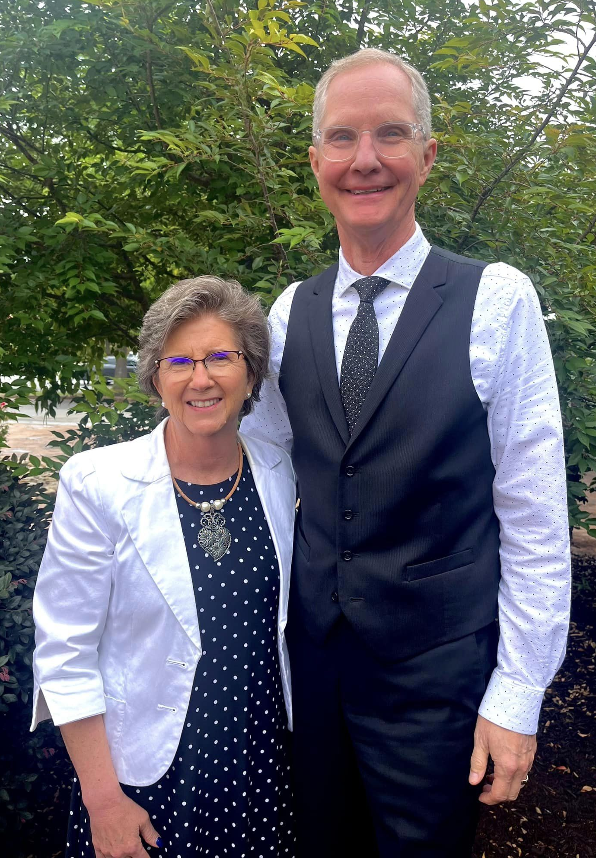
If we put our own name in the blank, take out the big words and use modern language, we have this:
Gil & Denise
________________,
God’s servants
Sent by Jesus Christ
to proclaim faith to God’s chosen and
teach them to know the truth that
shows them how to live godly lives.

Slide 4
Can you put your name in the blank? Can you describe yourself in that way? Why or why not? Would you like to be a disciple-maker like Paul?
________________,
God’s slave
Sent by Jesus Christ
to proclaim faith to God’s chosen and
teach them to know the truth that
shows them how to live godly lives.

Slide 5
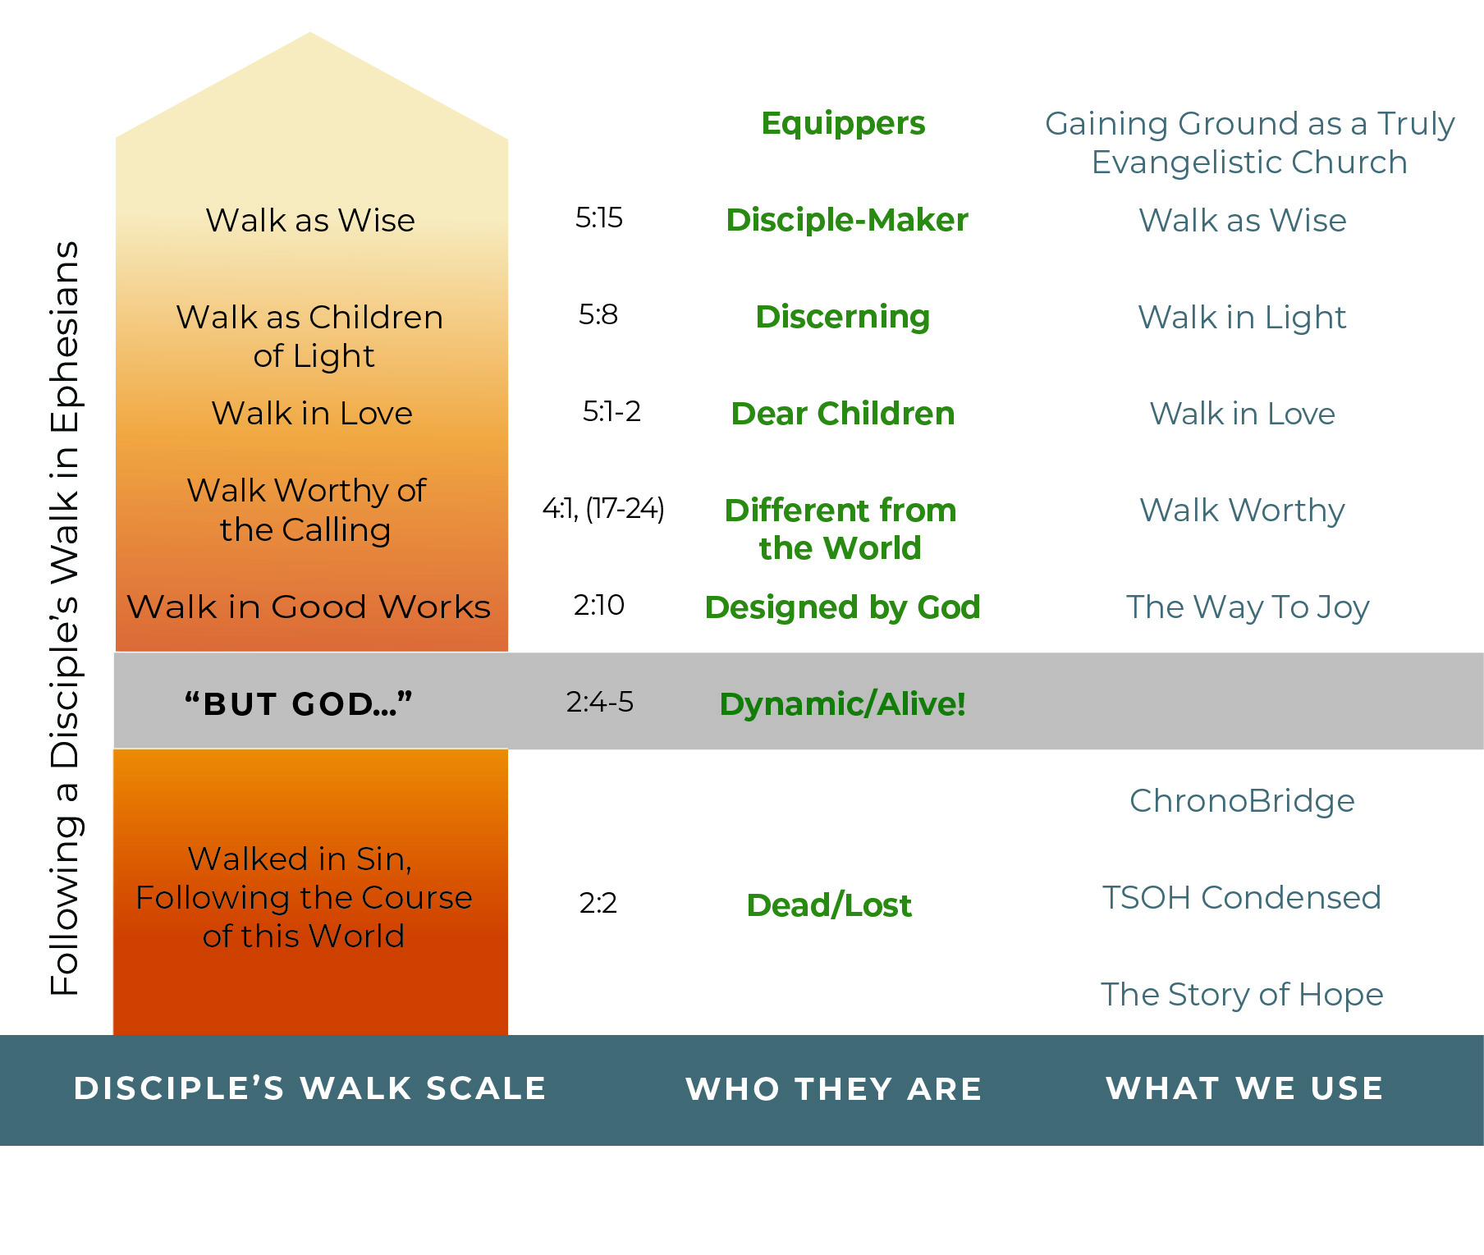
The Disciple’s Upward Walk
Ephesians 4:11-16

Slide 6
Now look at Titus 1:5 Why did Paul leave Titus in Crete? What was he supposed to do?
This is why I left you in Crete, so that you might put what remained into order, and appoint elders in every town as I directed you.
Titus 1:5

Slide 7
The Disciple’s Upward Walk
Titus 1:5
Titus 1:6-16
Qualifications and
Instructions
Titus 2:1-5
Instructions for
Leaders
Titus 2:6-10
Instructions for
disciple-makers
Titus 2:11-3:3
Discipleship Topics
Titus 3:4-7
How they came to
be alive!

Slide 8
Titus 3:4-7
But when the goodness and lovingkindness of God our Savior appeared, he saved us, not because of works done by us in righteousness, but according to his own mercy, by the washing of regeneration and renewal of the Holy Spirit, whom he poured out on us richly through Jesus Christ our Savior, so that being justified by his grace we might become heirs according to the hope of eternal life.

Slide 9
Titus
Equippers (Preparing Elders)
Directors (Leaders)
Disciple-Makers
Discipleship Topics
Salvation
1:5-16
2:1-5
2:6-10
2:11-3:3
3:4-7

Slide 10
Or another tool
Equippers (Preparing Elders)
Directors (Leaders)
Disciple-Makers
Discipleship Topics
Salvation

Slide 11
The Disciple’s Upward Walk

Slide 12
SO, WHAT ARE
(What are we working towards?)
Titus 2:7
One who is a model of good works . . .
One who teaches his/her disciples to do good works.
Titus 3:1-2

Slide 13
Those good works which a disciple-maker teaches his/her disciples to participate in are found in Titus 2:6-10—character traits of a disciple:
Living self-controlled, upright, godly lives/renouncing ungodliness & worldly passions
Living in anticipation of Jesus’ return
Submissive
Obedient
Ready for good works
Courteous/speaking kindly
Living in unity (Avoid controversy and division)

Slide 14
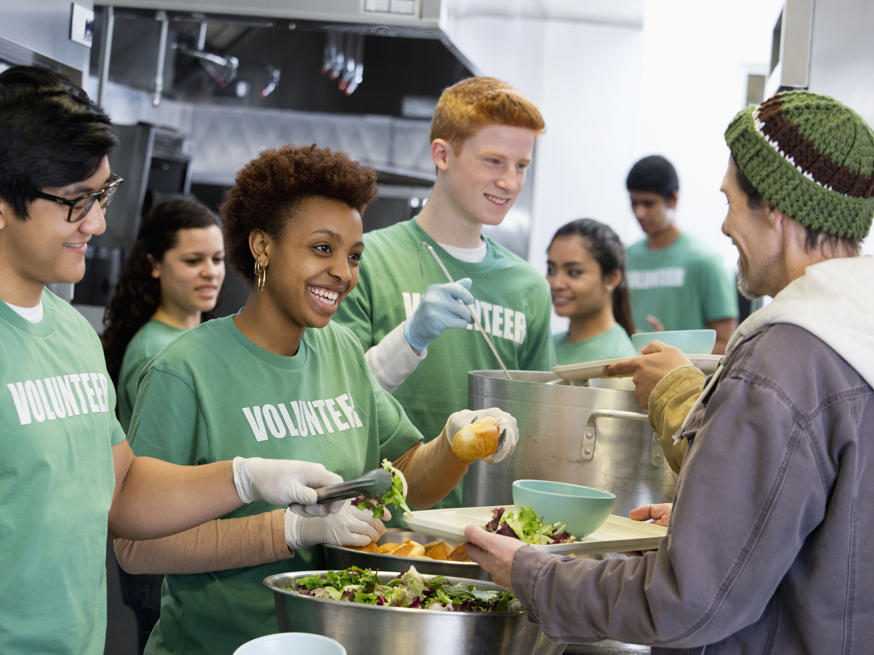
Which of these character traits of a disciple have you worked on or discussed as you were discipled or discipling someone?
Which of these do you feel you need to work on more and/or need more insight?

Slide 15
Confession and Assurance

Slide 16
Not by works of righteousness
Which we have done
But according to His mercy, He saved us,
By the washing of regeneration
And renewing of the Holy Spirit,

Slide 17
Which was shed abroad on us abundantly
Through Jesus Christ our Savior
That being justified by His grace
We should be made heirs
According to the hope of eternal life!

Slide 18
Not by works of righteousness
Which we have done
But according to His mercy, He saved us,
By the washing of regeneration
And renewing of the Holy Spirit,

Slide 19
Which was shed abroad on us abundantly
Through Jesus Christ our Savior
That being justified by His grace
We should be made heirs
According to the hope of eternal life!

