Slide 1



Slide 2
Confession and Assurance

Slide 3
Not by works of righteousness
Which we have done
But according to His mercy, He saved us,
By the washing of regeneration
And renewing of the Holy Spirit,

Slide 4
Which was shed abroad on us abundantly
Through Jesus Christ our Savior
That being justified by His grace
We should be made heirs
According to the hope of eternal life!

Slide 5
Not by works of righteousness
Which we have done
But according to His mercy, He saved us,
By the washing of regeneration
And renewing of the Holy Spirit,

Slide 6
Which was shed abroad on us abundantly
Through Jesus Christ our Savior
That being justified by His grace
We should be made heirs
According to the hope of eternal life!

Slide 7

Listen for what you might learn or are reminded about God from this narrative based on these passages:
Genesis 1:1-2; Exodus 3;
Psalm 50; 146:6; Job 41:11;
John 1; Acts 17; Romans 11:35-36;
2 Corinthians 13:14.

Slide 8


Slide 9
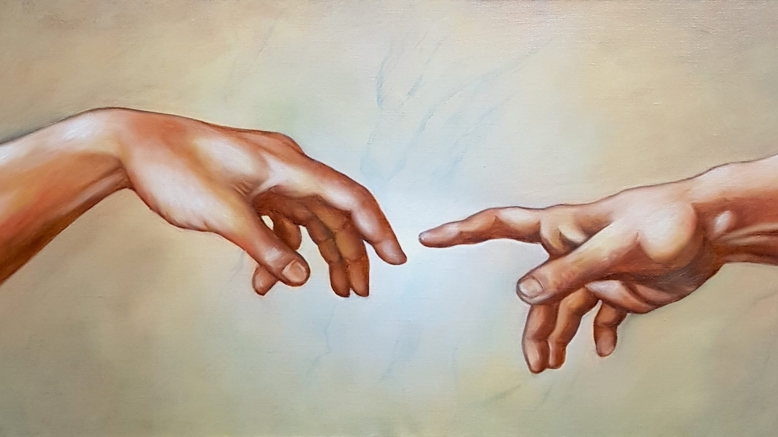
What did you learn about God from this story/event?

Slide 10
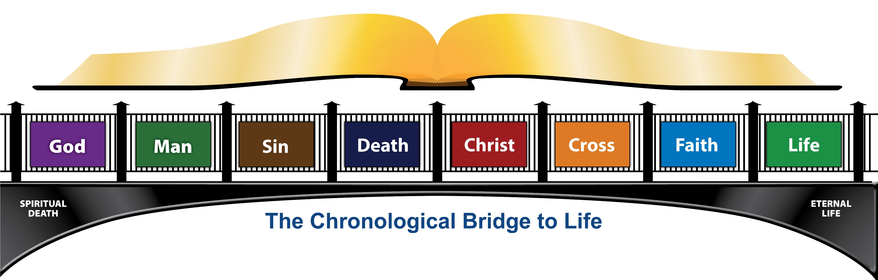
What do you know about these concepts?
Produce at least one Scripture verse for each:

Slide 11

Based on what you reviewed about God and about yourself (as part of humankind) how should you/we respond to God today as you/we move past this study?

Slide 12
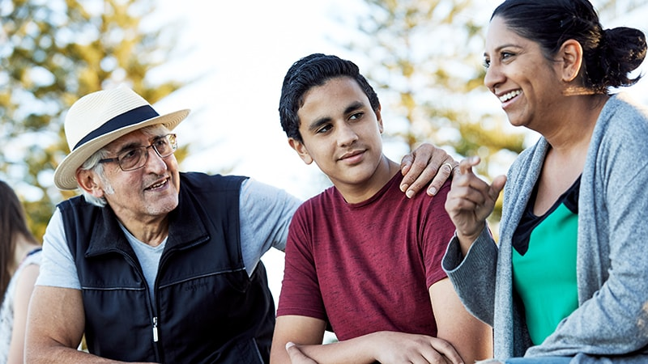
How should these truths change the way you relate to people?

Slide 13
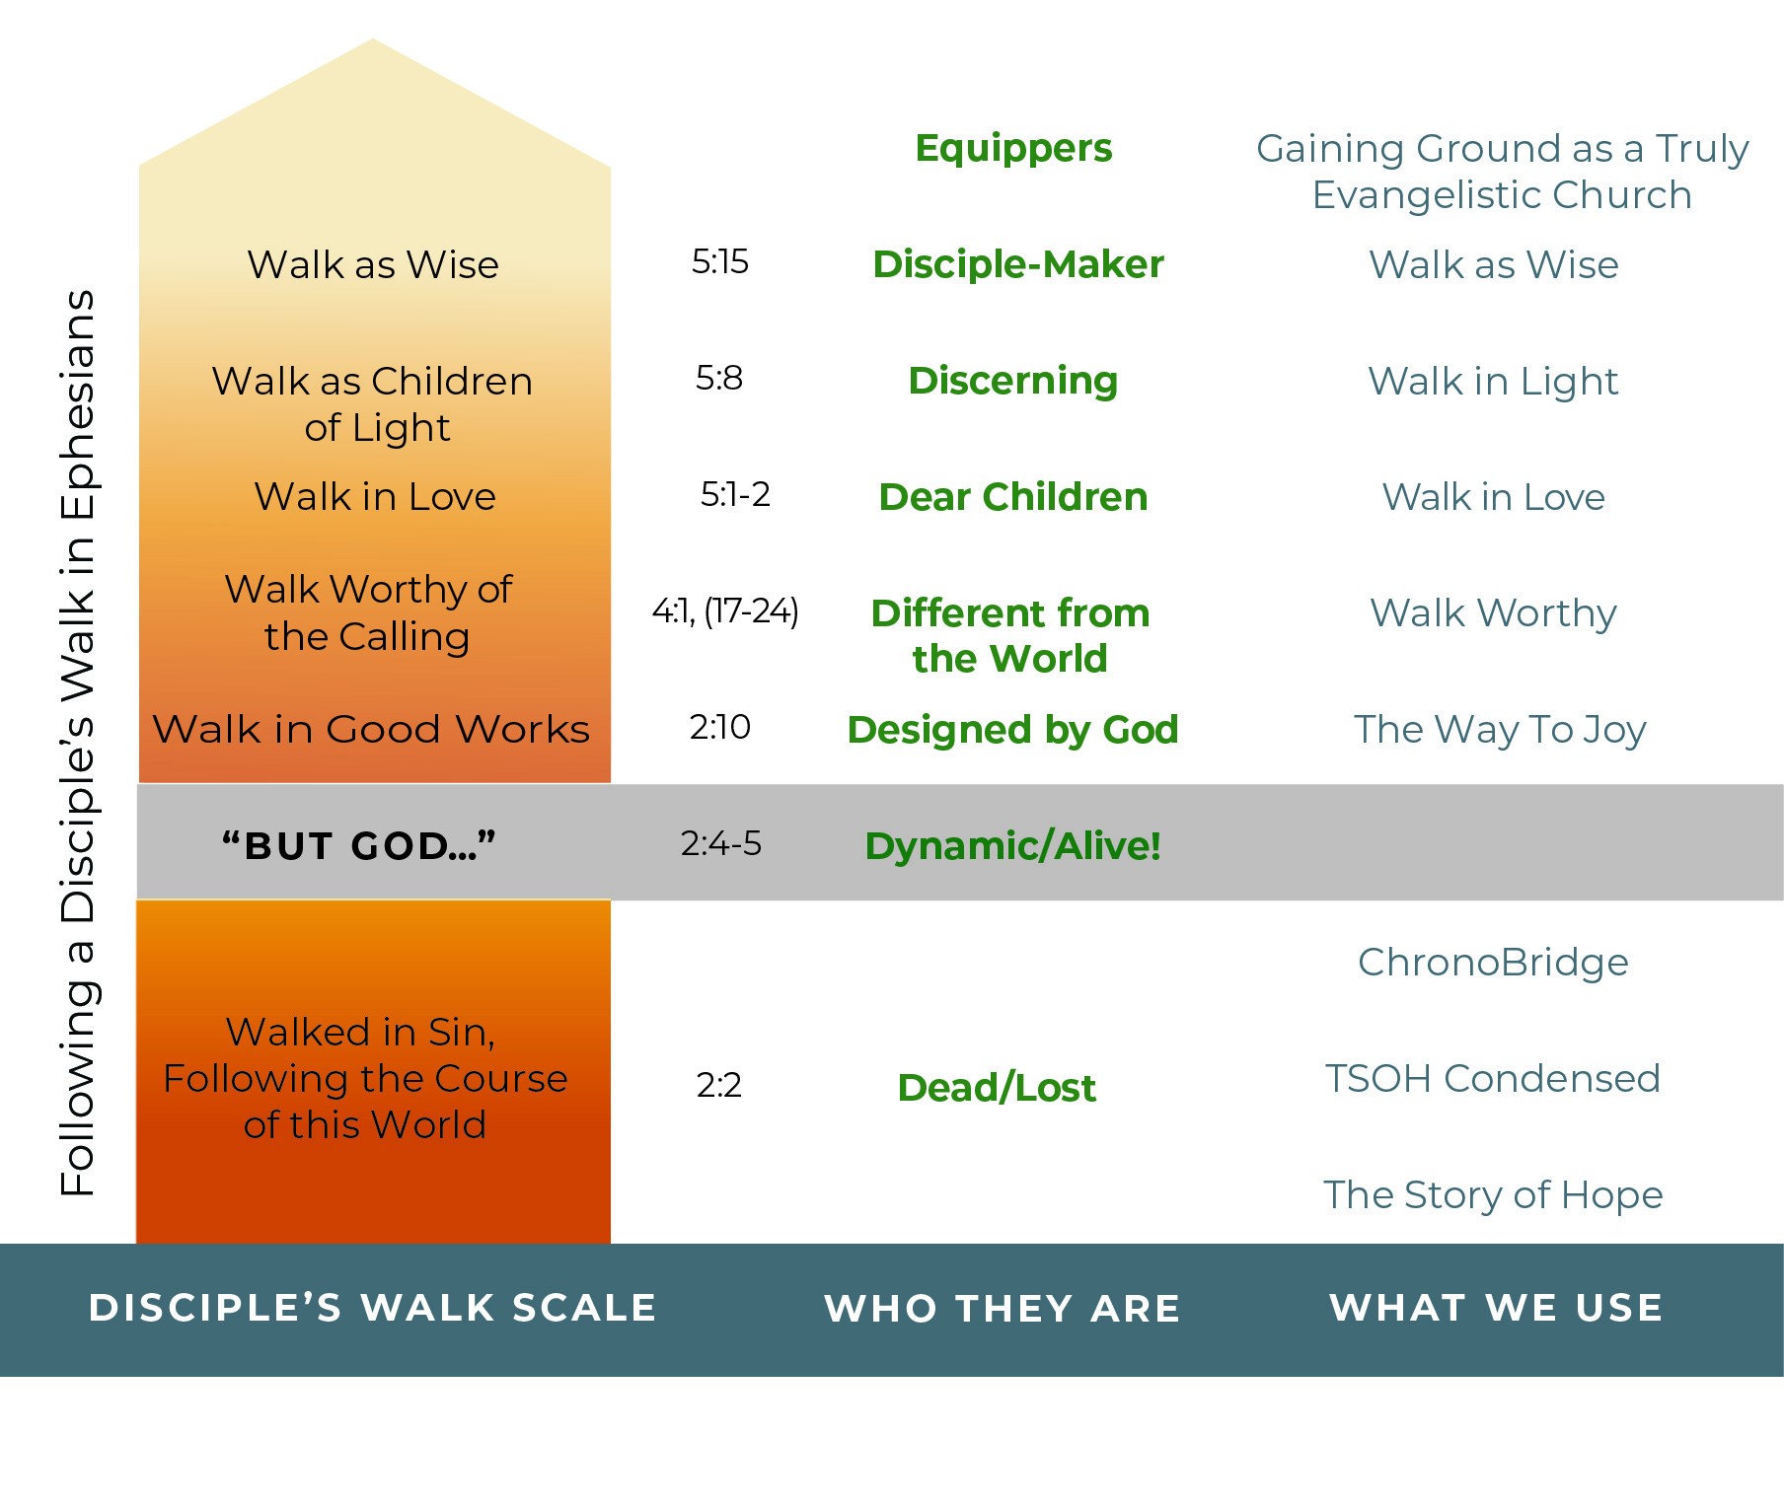
Realizing that it is God who moves people along in this process and remembering all we reviewed about God, what should we do as we begin to be disciple-makers?

Slide 14
Realizing that it is God who moves people along in this process and remembering all we reviewed about God, what should we do as we begin to be disciple-makers?
1. Depend upon Him.
2. Pray (a lot!) for Him to work.
3. Be an example in all this.
4. Not push. Let Spirit work.
5. Be available.

Slide 15
Using the E&D card provided, ask God who He would have you pray about reaching for Him (E side) and who He might have you consider discipling (D side).
Once you’ve written at least one name, share with a partner and then pray together.

Slide 16

Memorize Ephesians 4:1-2
I therefore, a prisoner for the Lord, urge you to walk in a manner worthy of the calling to which you have been called, ² with all humility and gentleness, with patience, bearing with one another in love,

