Slide 1
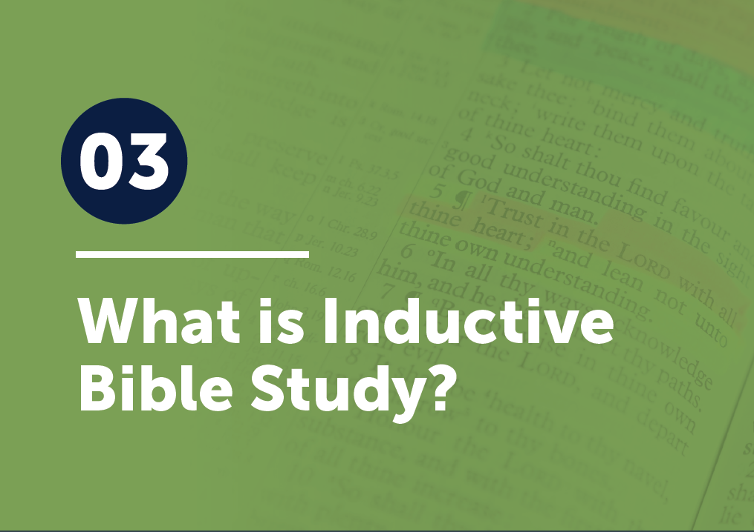

Slide 2
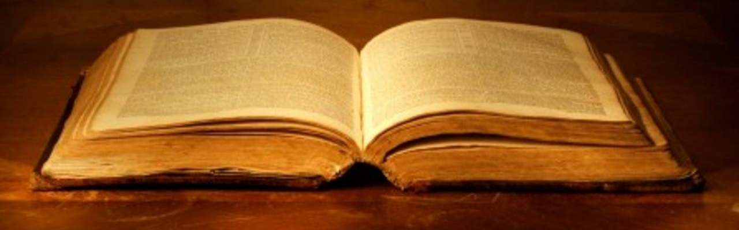
Review Ephesians 4:1-2
I therefore, a prisoner for the Lord, urge you to walk in a manner worthy of the calling to which you have been called, ² with all humility and gentleness, with patience, bearing with one another in love,

Slide 3
in•duc•tive

Slide 4
in•duc•tive
“Inductive Bible study is an approach to God’s Word focusing on three basic steps that move from a focus on specific details to a more general, universal principle.” www.GotQuestions.org

Slide 5
in•duc•tive
The three basic steps are Observation,
Interpretation, and
Application.

Slide 6
The Questions
OBSERVATION asks: What does the text we’re studying say?
INTERPRETATION asks: What does the text we’re studying mean?
APPLICATION asks: How should I respond to God or how should I change the way I relate to people based on this text?

Slide 7
Before we look at a Bible text today, let’s just fill out those steps a little.
During the OBSERVATION step,
we should answer basic reporter questions: who, what, when, where, why, and how. Also, look for words that seem to be repeated or seem particularly significant.
who, what, when, where, why, how

Slide 8
Before we look at a Bible text today, let’s just fill out those steps a little.
During the INTERPRETATION step,
we are trying to determine what the
Bible story or text meant to its original audience.
Try to put yourself in their place.

Slide 9
Interpretation
What might they be thinking? Feeling? Experiencing at that time?
Try it!
Table 1 – Abraham (Genesis 22:1-19)
Table 2 – Samuel (1 Samuel 3:1-18)
Table 3 – Mary (Luke 1:26-38)
determine what the Bible story or text meant to its original audience.

Slide 10
Interpretation
Then, ask, what does this passage tell us
about . . .
God, man, sin, death,
Christ, cross, faith, and life?
This can help us build our theology.
determine what the Bible story or text meant to its original audience.

Slide 11
Before we look at a Bible text today, let’s just fill out those steps a little.
During the APPLICATION step,
Try to determine how we should respond based on the meaning we discovered in steps one and two. Certainly, people will have different responses, but our different applications should come from a singular, non-contrived meaning.
How we should respond

Slide 12
Application
We want our application to have a response to the God Who gave us His word and a response to the people around us.
A text may demand a response to both— or not—but we want to ask ourselves the questions to be sure.
How we should respond

Slide 13
Now, read your assigned passage and apply your observation, interpretation, and application skills to the passage by asking the five questions. Matthew 13:1-8 Mark 8:1-20 Luke 8:4-15

Slide 14
What does it say? STUDY What did it mean to its original audience? CONTEXT What does it tell us about God, Man, Sin, Death, Christ, Cross, Faith, Life? THEOLOGY How should I respond to God? OBEY How should I change the way I relate to people? SHARE

Slide 15
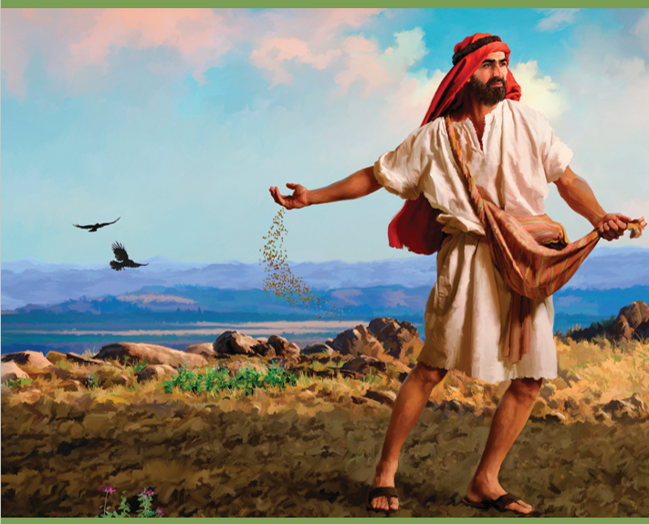
Listen to the midrash for more insights on the parable.

Slide 16
If the midrash gives any insights, what do you think the main point of the parable might be?

Slide 17
If the midrash gives any insights, what do you think the main point of the parable might be?
It could very well be that Jesus wants us to realize that the
soil of the heart needs to be prepared—tilled—to be able to produce fruit.

Slide 18
What does the ‘Good Soil’ person do in each passage? (Hint: it’s stated a little differently in each.)

Slide 19
What does the ‘Good Soil’ person do in each passage? (Hint: it’s stated a little differently in each.)
The good soil person understands the gospel, embraces it, and
hangs on to it.

Slide 20
We want to present the gospel in ways that people can clearly understand it and sincerely embrace it. If that happens, they will hold fast to it and not allow it to be taken away. Disciple-makers must also teach new believers God’s Word to help them hold fast and grow.

Slide 21
Memorize Colossians 3:1-2 If then you have been raised with Christ, seek the things that are above, where Christ is, seated at the right hand of God. ² Set your minds on things that are above, not on things that are on earth.

