Slide 1

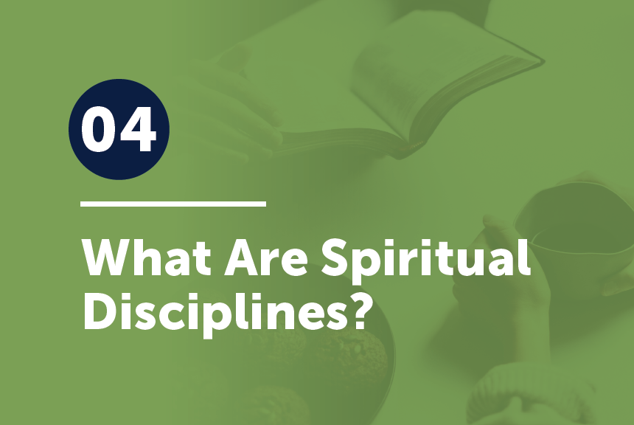

Slide 2
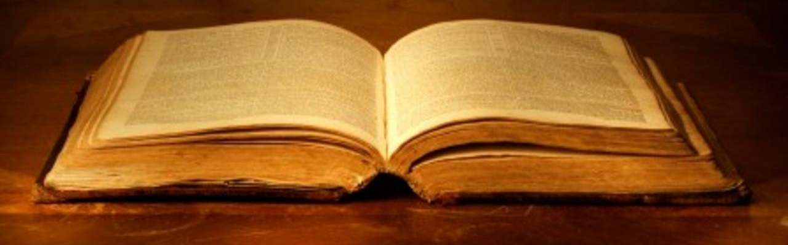
Review Colossians 3:1-2
If then you have been raised with Christ, seek the things that are above, where Christ is, seated at the right hand of God. ² Set your minds on things that are above, not on things that are on earth.

Slide 3
spiritual disciplines
Come up with a list of what you think could be called ‘spiritual disciplines.’
You have one minute.

Slide 4
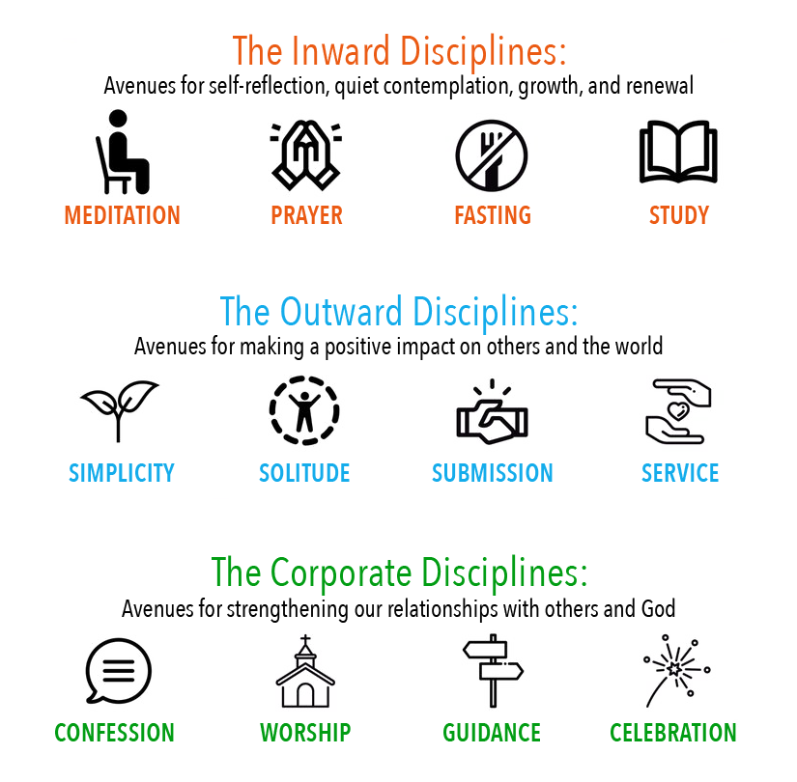
spiritual disciplines
Come up with a list of what you think could be called ‘spiritual disciplines.’
You have one minute.

Slide 5
spiritual disciplines
“The spiritual disciplines are those practices found in Scripture that promote spiritual growth among believers in the gospel of Jesus Christ. They are habits of devotion, habits of experiential Christianity that have been practiced by God’s people since biblical times.”
Don Whitney

Slide 6
Spiritual Disciplines . . .
. . . are actions modeled in the Bible in which believers engage both personally and corporately to promote godliness.

Slide 7

Read 1 Timothy 4:7.
Have nothing to do with irreverent, silly myths. Rather train yourself for godliness.

Slide 8
Down through the years many spiritual disciplines have
been practiced.
For our purposes, we will only mention six. The first four all have to do with God’s Word:
Reading
Studying
Meditating on
Memorizing

Slide 9
Spiritual Disciplines of the Word
If a disciple-maker is not getting into the Word and getting the Word into him/her, there can be little growth.
Talk about the differences you see in these four disciplines:
Reading, Studying, Meditating, Memorizing.

Slide 10
Discuss in your group:
Which are you already practicing?
Which might you find difficult?
What can you do to begin practicing these four disciplines?

Slide 11
Prayer
We could divide prayer up into several unique disciplines as well:
Thanksgiving
Adoration
Confession
Supplication
Petition

Slide 12
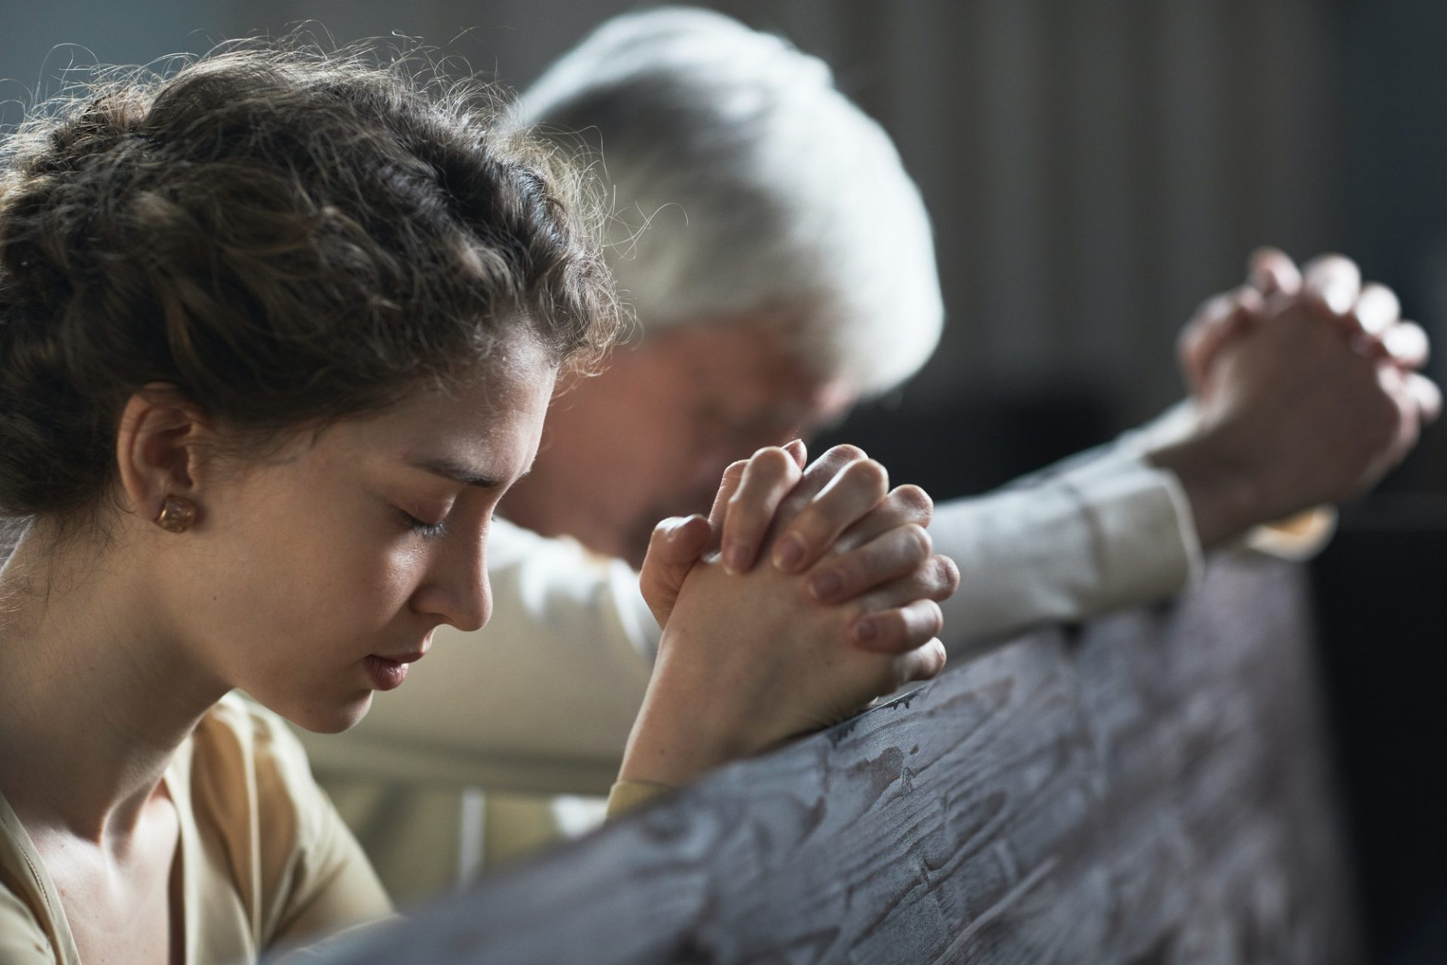
Make a chart demonstrating the difference using only these 5 words and pictures you create.
Thanksgiving
Adoration
Confession
Supplication
Petition

Slide 13


Prayer
Bible reading, study, and memorization is God
speaking to
us;
Prayer is one of our major responses to Him.

Slide 14
Fasting
While types of fasting (e.g., intermittent fasting) are popular today to lose weight or cleanse the body of toxins, the purpose of spiritual fasting is to abstain from food for a period with the purpose of concentrating on prayer and Bible study, hearing from God. Instead of answering our hunger with physical food, we are choosing to hunger after God.

Slide 15
Blessed are those who hunger and thirst for righteousness, for they shall be satisfied. (Matthew 5:6)

Slide 16
But seek first the kingdom of God and his righteousness, and all these things will be added to you. (Matthew 6:33)

Slide 17
Read 2 Peter 1:3-15 and make observations.

Slide 18
Read 2 Peter 1:3-15 and make observations.
The word translated “things” in verse 3 is the same Greek word translated “qualities” in verses 8, 9, 10, and 12. So what can we deduce from this passage?

Slide 19
Read 2 Peter 1:3-15 and make observations.
The word translated “things” in verse 3 is the same Greek word translated “qualities” in verses 8, 9, 10, and 12. So what can we deduce from this passage?
That God has given us what we need to grow, but we must appropriate what He has given us and work at it, using spiritual disciplines.

Slide 20
God has given us all things pertaining to life and godliness
=
Qualities
Brotherly
Affection
Love
Godliness
Faith
Steadfastness
Virtue
Self-control
Knowledge

Slide 21
What appears to be at least one of the responsibilities of a disciple-maker according to verse 12?

Slide 22
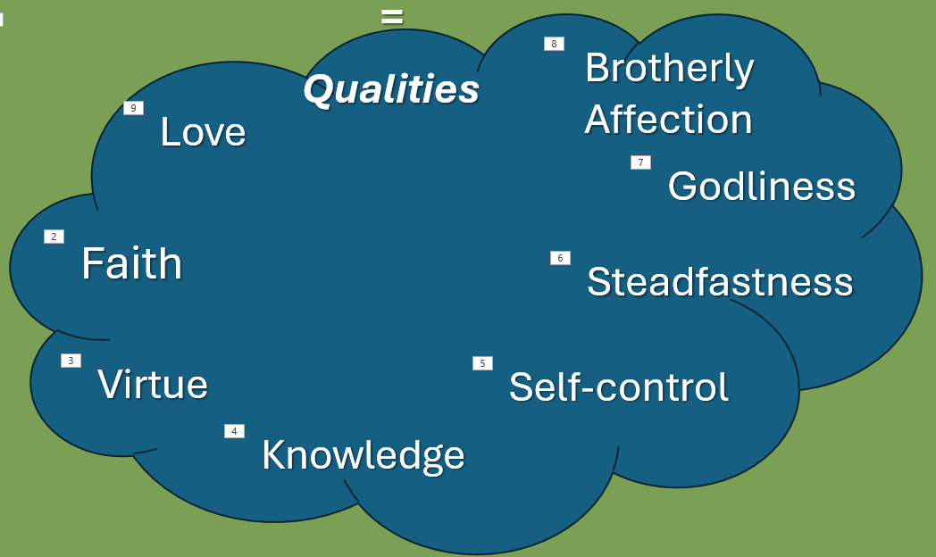
What appears to be at least one of the responsibilities of a disciple-maker according to verse 12?
Disciple-makers are to “remind” disciples to continue developing the qualities that pertain to life and godliness.

Slide 23
How Does One Assess A Non-Christian’s Worldview?
How clearly and completely does someone understand the gospel of Jesus Christ?

Slide 24
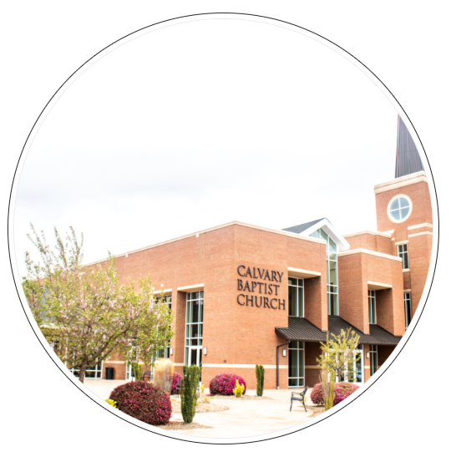

Good Soil Evangelism & Discipleship Seminar: at Calvary Baptist, Simpsonville
August 16-17, 2024

Slide 25
Memorize 2 Peter 1:3
His divine power has granted to us all things that pertain to life and godliness, through the knowledge of him who called us to his own glory and excellence.

