Slide 2
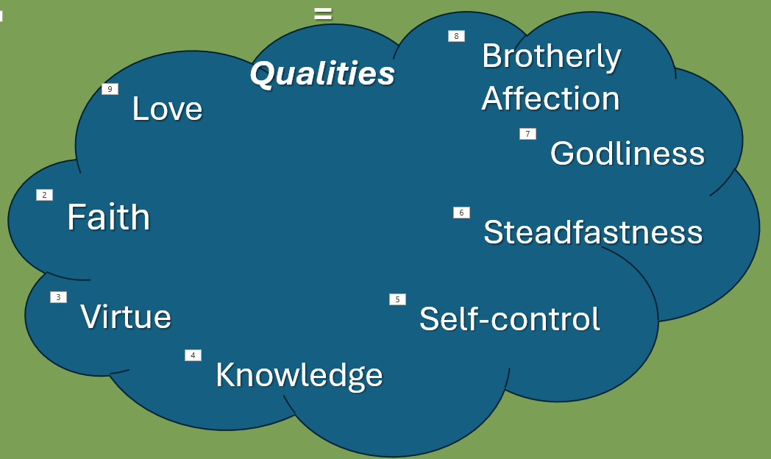
Review 2 Peter 1:3
His divine power has granted to us all things that pertain to life and godliness, through the knowledge of him who called us to his own glory and excellence.

Slide 3
According to Ephesians 4:1 we should be walking worthy of our calling.
Ephesians 4:17 indicates that we should be transformed, no longer walking in the futility of our minds/as gentiles.
That’s not what we learned in Christ! We should be renewed in the spirit of our minds.

Slide 4
Read Galatians 5:17-26
This passage will help us renew ourselves in the spirit of our minds . . .

Slide 5
Match the Opposites . . .
. . . the works of the flesh and the fruit of the Spirit.
In other words, when exercised, which part of the fruit of the Spirit extinguishes which work of the flesh listed on the next slide? Some pieces of the Fruit of the Spirit extinguish more than one work of the flesh.
You will be matching the “fruit of the Spirit” cards that naturally extinguish or work against particular “works of the flesh” cards

Slide 6
Match the Opposites . . . (the answers)
Orgies, Sexual Immorality, etc.
Goodness
Idolatry, Sorcery
Self-control
Strife, Enmity
Gentleness
Envy, Jealousy
Faithfulness
Fits of Anger
Peace
Rivalries
Kindness
Dissensions
Love
Divisions
Patience
Drunkenness
Joy

Slide 7
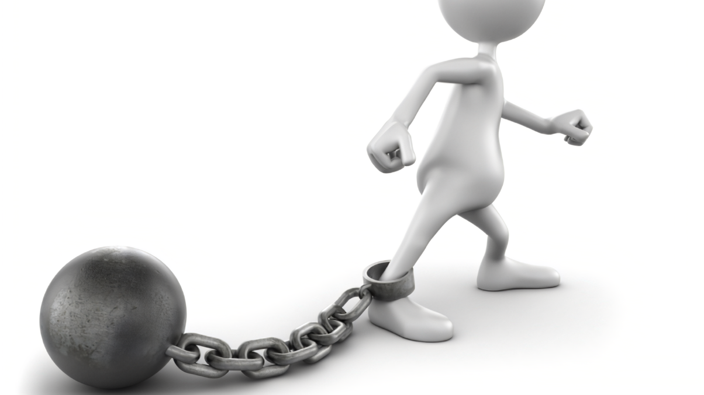
Think for a moment: “Which one(s) do I see as a weakness in my life?”
Would you like to share with your group?
Take time to pray for each other.

Slide 8
Read Ephesians 4:15-32. Then answer the questions.
Who loves? Why?
Who is hostile? Why?
What makes the difference?
How can you be more loving?

Slide 9
What will help an unbeliever move across the Scale to being more open to the gospel?
Love them unconditionally.
2. Model Christlikeness consistently.
3. Pray for them persistently.
4. Watch opportunistically for
“entry points” to share gospel truth.
5. Be patient optimistically! Wait for
God to work in their hearts to draw
them to Himself.)

Slide 10
Think of one or more unbelieving friends. Where would you place them on the Scale?
Given where your friend is on the Scale, what do you need to do first to start to reach him/her?
2. Does he/she need to move across
(be more receptive to the gospel)? If
so, what will you do?
3. Does he/she need to move up? If
so, what will you do?

Slide 11
Good Soil Evangelism & Discipleship Seminar: at Calvary Baptist, Simpsonville August 16-17, 2024
This slide should be substituted for one telling of a training event for people in your church (or hidden).

Slide 12
Memorize Galatians 5:16 But I say, walk by the Spirit, and you will not gratify the desires of the flesh.

