Slide 2
Review Galatians 5:16
But I say, walk by the Spirit, and you will not gratify the desires of the flesh.

Slide 3
We have been learning to walk worthy of our calling (4:1) and transformed—not walking as we once did (4:17).
Last week we learned that God has granted us all things (qualities) we need to live godly lives.
Well, let’s apply some of those qualities!

Slide 4
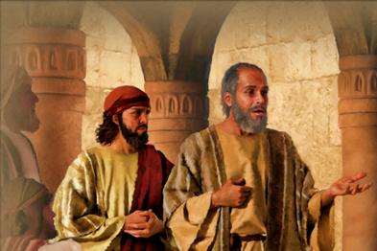
Read Acts 16:11-40

Slide 5
Read Acts 16:11-40
Who is joyful? Why?
Who is envious? Why?
What makes the difference?
How can you be more joyful in difficult circumstances?

Slide 6
But how can you have joy instead of being envious (the work of the flesh which is the opposite of joy)?
Or how can you love instead of being hostile (the work of the flesh which is the opposite of love)?

Slide 7
We can talk about it, and we can try to muster it up in our lives, but the key is in verse 16. The full meaning of the term “by” in the phrase “walk by the Spirit” is this: “to walk by means of” the Spirit.

Slide 8
Picture a growing baby . . .
. . .who is beginning to walk. By hanging on to mommy or daddy’s fingers, the youngster can walk all over!
But as soon as those fingers are no longer available, baby plops down.

Slide 9
Or picture baby . . .
. . . hands leaning on the couch—then the table next to the couch—then the chair—baby is walking all over the room by means of the furniture. But without it, he goes down.

Slide 10
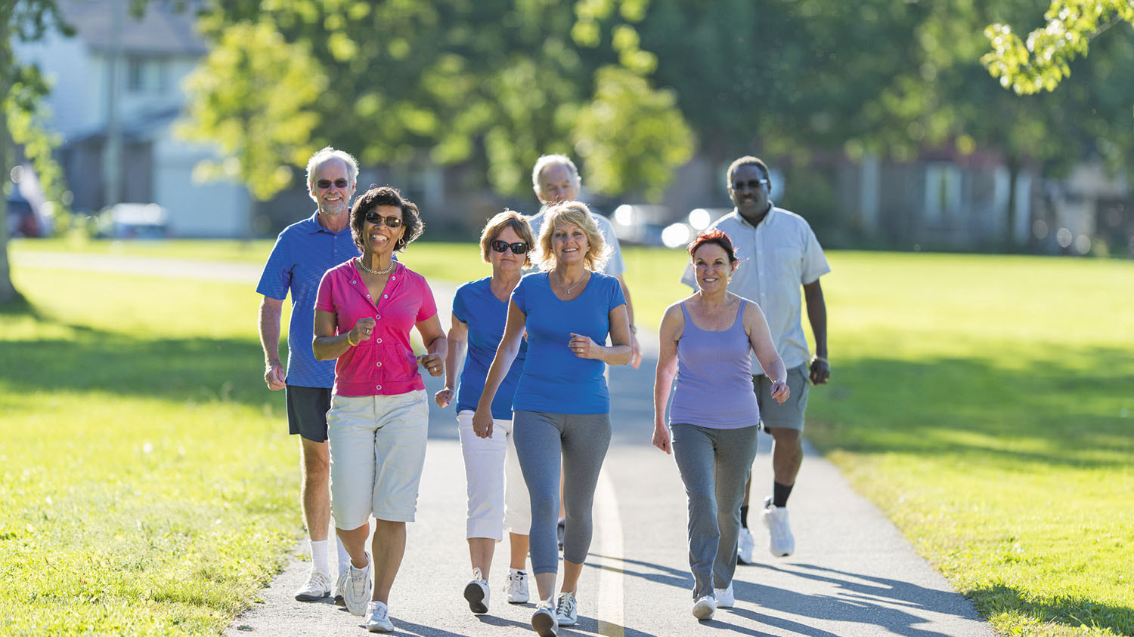
Let’s apply this to our lives.
If we walk by means of the Spirit, depending on Him, we can love, have joy, etc. If we try to do it on our own, we’ll fall.

Slide 11
But what does “walking by means of” the Spirit mean? Discuss at your table and report.
Take time to pray for each other.

Slide 12
Walking “by means of” the Spirit is an utter dependence on Him. It means acknowledging our inability, praying, and asking for help constantly. Walking by means of the Spirit (this dependence on Him that we are describing) will produce the fruit of the Spirit.
Take time to pray for each other.

Slide 13
Initial Contact Evangelism?
or
Relational Evangelism?

Slide 14
Initial Contact & Relational Contact Evangelism
10
Continue to proclaim and
teach the gospel, with ongoing appeals for a faith response
Continue to proclaim
and teach the gospel,
with ongoing appeals
for a faith response
Initial Contact Evangelism
emphasizes one climactic point
in evangelism.
Continue to focus on
overcoming the unbeliever’s
points of gospel resistance
Share the gospel in its
entirety in a ripe opportunity and encourage a faith response
Choose a step which is hardest for you and tell why.
Continued contacts with the
unbeliever where possible
Continue to share more of the gospel in a loving and factual manner
Refocus evangelistic
communication as per the
unbeliever’s response
Sow gospel seeds by appropriately introducing spiritual issues
Share the gospel in its
entirety with a challenge
for faith response
Develop a genuine
caring friendship through reoccurring contacts
Relational Evangelism
emphasizes the entire process
of evangelism.
Establish initial contact through an unexpected or planned encounter
Establish initial contact through an unexpected or planned encounter

Slide 15
Good Soil Evangelism & Discipleship Seminar: at Calvary Baptist, Simpsonville August 16-17, 2024
This slide should be substituted for one telling of a training event for people in your church (or hidden).

Slide 16
Memorize Galatians 5:17 For the desires of the flesh are against the Spirit, and the desires of the Spirit are against the flesh, for these are opposed to each other, to keep you from doing the things you want to do.

