Slide 2
Review Galatians 5:17
For the desires of the flesh are against the Spirit, and the desires of the Spirit are against the flesh, and these are opposed to each other, to keep you from doing the things you want to do.

Slide 3
We have been learning to walk worthy of our calling (4:1) and transformed—not walking as we once did (4:17).
As we learned that the fruit of the Spirit (Gal. 5:22) should be evident in our lives instead of the works of the flesh, we contrasted love with hostility and joy with envy. Today we will contrast peace with enmity and strife.

Slide 4
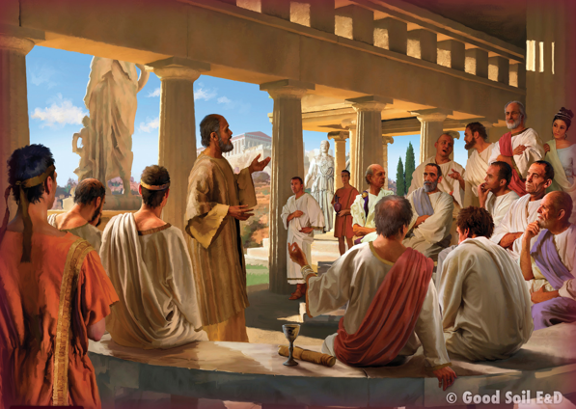
Read Acts 18:1-18
What impresses you from this story?

Slide 5
Now read . . . 1 Corinthians 1:10-17.
. . . 1 Corinthians 3:1-12,
Philippians 1:12-18, and
Philippians 4:1-9.
Contrast the strife you see in the church at Corinth with the peace you see Paul says they should have in Philippians 4.

Slide 6
Strife or Peace and Joy?
Remember: Paul was in prison when he was writing about peace and joy.

Slide 7
Why does Paul have peace and joy . . .
. . . even though he is in prison, and some (believers??) are even trying to inflict more suffering on him?

Slide 8
How can you gain peace . . .
. . . In difficult circumstances?
(See Philippians 4:6-9)

Slide 9
The Problem of Gospel Static
Imagine a phone call with a lot of static (“noise”) on the line—so much that you are only understanding part of what you hear.
That’s what the gospel of Jesus Christ can sound like to people whose worldviews are strongly influenced by non-Biblical belief systems.

Slide 10
The Problem of Gospel Static
We call this problem “worldview noise.”
And if we do not understand the worldview noise in our communication of the gospel and do not find a way to penetrate it with clarity, our evangelistic efforts will likely produce spurious fruit.

Slide 11
Good Soil Evangelism & Discipleship Seminar: at Calvary Baptist, Simpsonville August 16-17, 2024
This slide should be substituted for one telling of a training event for people in your church (or hidden).

Slide 12
Who are some unbelievers God has brought into your life recently?
What unbelieving friend are you building a relationship with? How?
Think of one or two of your unbelieving friends. How does worldview noise affect your friends’ interest in the Bible?

Slide 13
Memorize Galatians 5:18 But if you are led by the Spirit, you are not under the law.

