Slide 2
Review Galatians 5:18
But if you are led by the Spirit, you are not under the law.

Slide 3
Remember: we are to be walking worthy of our calling (Eph. 4:1) and transformed, not walking as we once did (Eph. 4:17).
As we continue learning about the fruit of the Spirit, today we contrast patience with outbursts of anger.

Slide 4
Remember: we are to be walking worthy of our calling (Eph. 4:1) and transformed, not walking as we once did (Eph. 4:17).
As we continue learning about the fruit of the Spirit, today we contrast patience with outbursts of anger. Many times, our outbursts of anger towards people have their roots in dissatisfaction or anger towards God.

Slide 5
Remember: we are to be walking worthy of our calling (Eph. 4:1) and transformed, not walking as we once did (Eph. 4:17).
As we continue learning about the fruit of the Spirit, today we contrast patience with outbursts of anger. Many times, our outbursts of anger towards people have their roots in dissatisfaction or anger towards God. Observe how the people in today’s stories responded toward God—in patient acceptance and bitter anger.

Slide 6
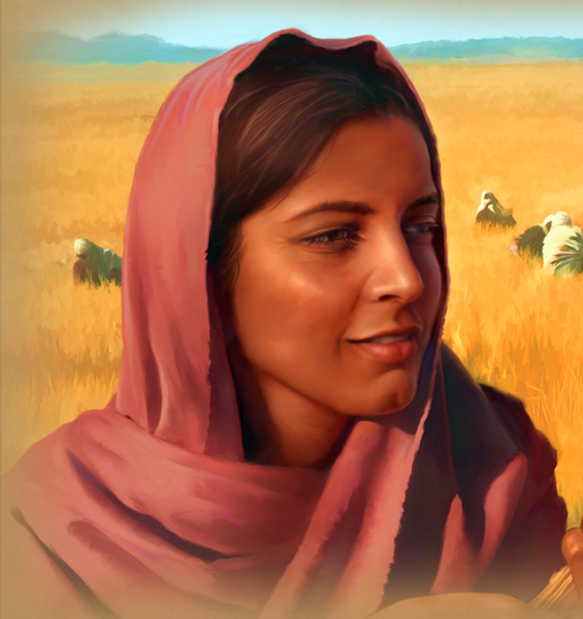
Read Ruth 1:1-5
How difficult would this be for you?

Slide 7
Read Ruth 1:6-21
Finish reading the rest of the chapter (Ruth 1:6-21) and answer the questions on your flipchart (and on your worksheet).

Slide 8
Read Ruth 1:6-21
1. What does this passage say?
2. What did this passage mean to its original audience?
3. What do we learn about the essential gospel truths? (God, man, sin, death, Christ, cross, faith, life)
4. How should I respond to God?
5. How should I change the way I relate to people?

Slide 9
Ruth 1:6-21 Contrasted with Job 1:9-10
Contrast Naomi and Ruth’s attitude with Job’s wife’s attitude (Job 1:9-10).
Why do you think they were so different?
What can you do to cultivate the calm, patience, and acceptance of Naomi?

Slide 10
The Problem of
Gospel Static
Just as we have “static” on a phone call, sometimes we have “Worldview Noise Static”—the gospel of Jesus Christ can sound staticky to people whose worldviews are strongly influenced by non-Biblical belief systems. The Bible has examples of this!

Slide 11
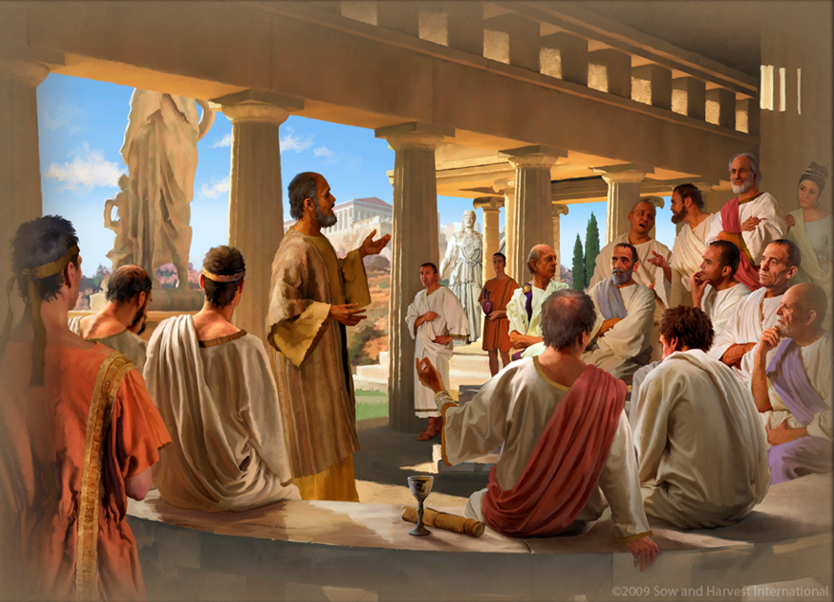
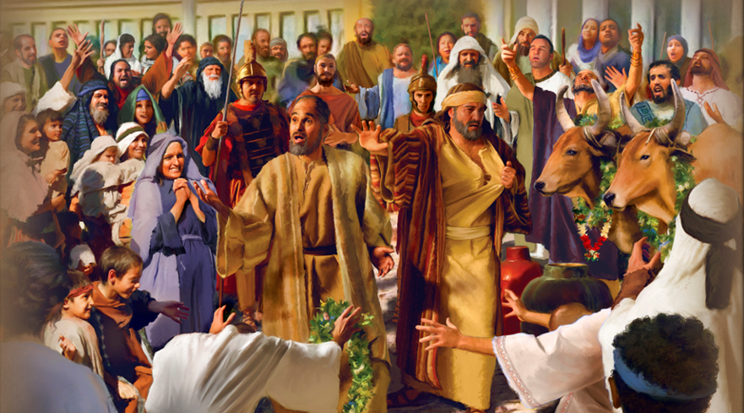
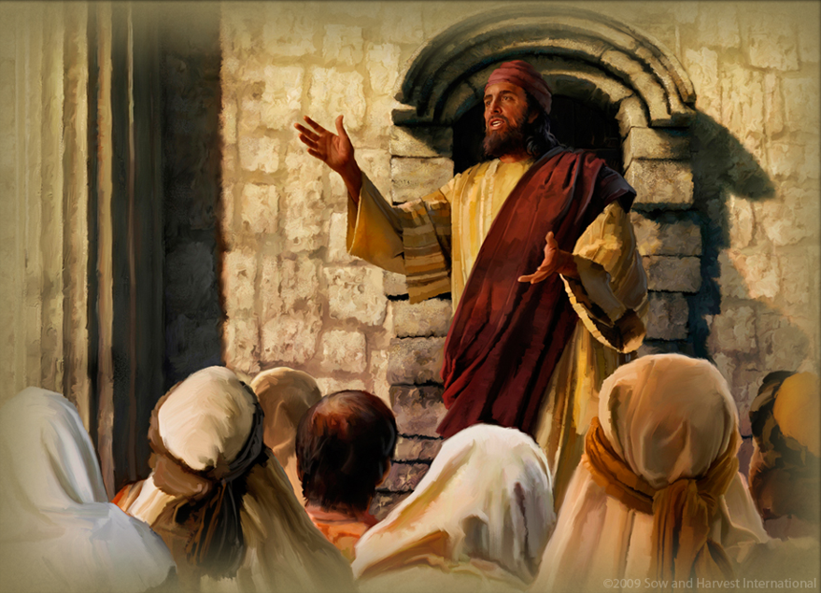

Slide 12
Good Soil Evangelism & Discipleship Seminar: at Calvary Baptist, Simpsonville August 16-17, 2024

Slide 13
Memorize Galatians 5:19 Now the works of the flesh are evident: sexual immorality, impurity, sensuality,

