Slide 2
Review Galatians 5:19
Now the works of the flesh are evident: sexual immorality, impurity, sensuality,

Slide 3
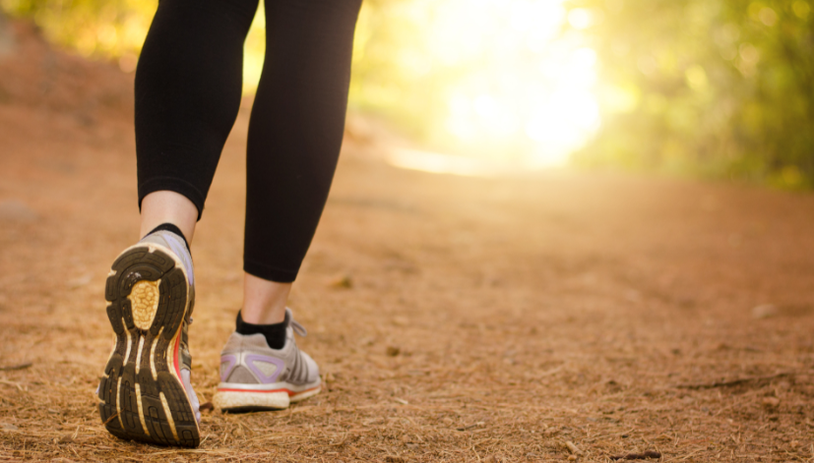
As we walk worthy of our calling (Eph. 4:1) and are transformed,
not walking as we once did (Eph. 4:17), we continue learning
about the fruit of the Spirit.
Today we contrast kindness with selfish ambition.
Observe how the people in today’s event responded toward God—with kindness or
selfish ambition.

Slide 4
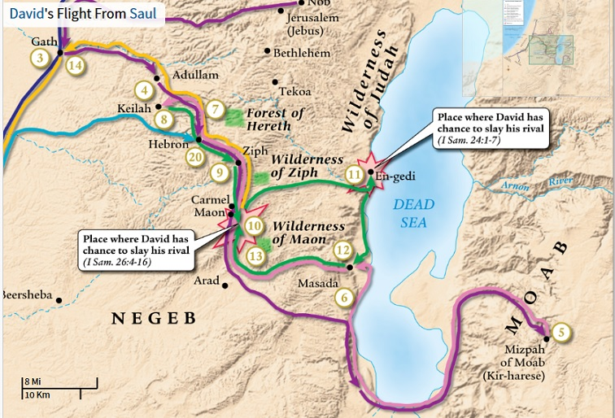
Read 1 Samuel 25:1-2

Slide 5
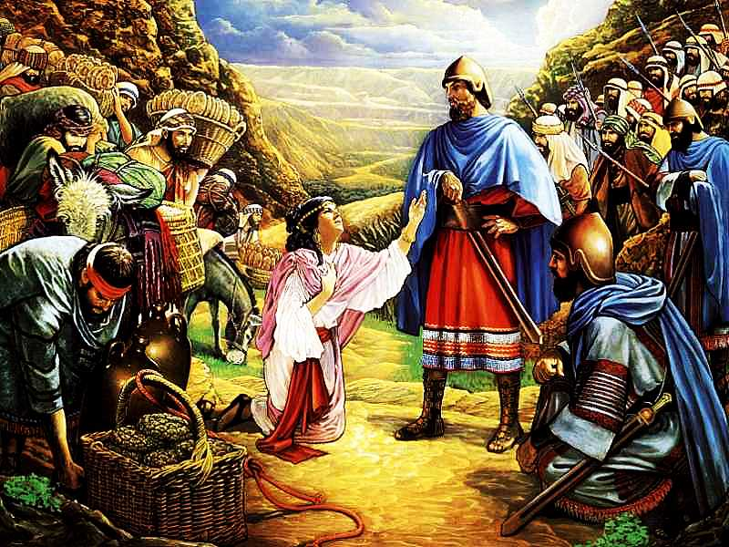
Read 1 Samuel 25:3-42
Contrast Nabal’s
attitude with Abigail’s
attitude.
Why do you think they were so different?

Slide 6
Read 1 Samuel 25:3-42
Where was David on the kindness/
selfishness pendulum before
Abigail met him?

Slide 7
Read Ephesians 4:25-32
What help do you find in this passage to grow kindness in your life?
What will you do this week to develop kindness toward others?

Slide 9
In the North America “Leave it to Beaver” world of the 1950s, it was just assumed that all the neighbors were church-going folks who took their kids to Sunday School where they were taught Bible stories and memorized the ten commandments and the Golden Rule.
While that was an unrealistic portrayal of American family life even for that time, today we might feel fortunate just to have one other Bible-believing Christian in our neighborhood.

Slide 10
What is the dominant worldview in the area where you are living?
Thinking of your “neighbors” who are part of that worldview, how well do you think they know and understand the Bible?
Which of the essential gospel concepts do they understand and how clearly do they understand them?
God Man Sin Death Christ Cross Faith Life

Slide 11
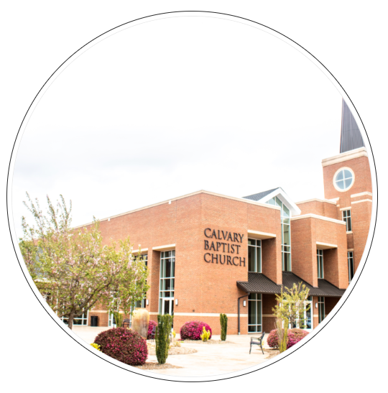
Good Soil Evangelism & Discipleship Seminar: at Calvary Baptist, Simpsonville August 16-17, 2024

Slide 12
Memorize Galatians 5:20 idolatry, sorcery, enmity, strife, jealousy, fits of anger, rivalries, dissensions, divisions,

