Slide 1



Slide 2

Review 1 John 3:18
Little children, let us not love in word or talk but in deed and in truth.

Slide 3
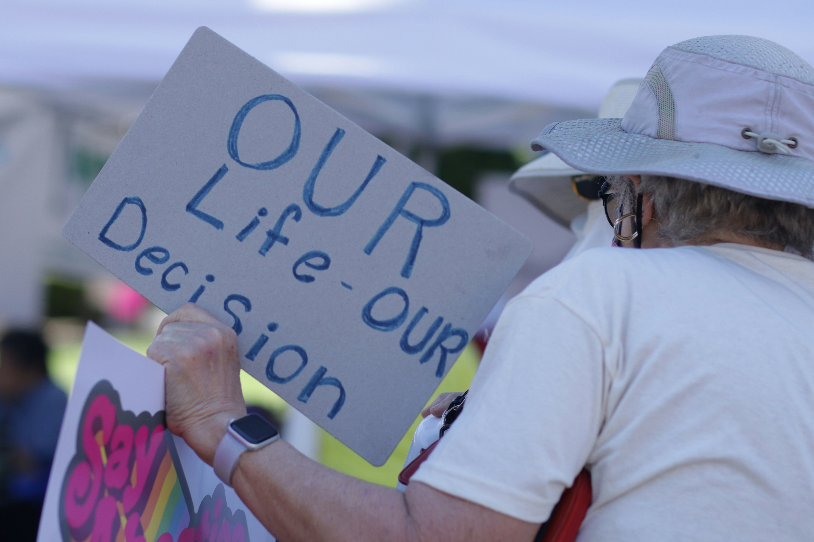
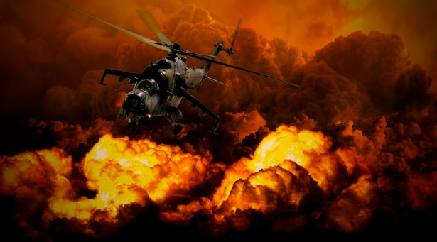
On your worksheet . . .
Jot down at least three manifestations of evil in the world today.
Share with your table group.
Groups, share the most
common answers.

Slide 4

Three enemy partners are battling against you. Can you find them in Ephesians 2:1-3?
The World
The Devil
The Flesh

Slide 5
Each group, look up the verses below related to your assigned enemy and prepare to report to the rest of the class on what you learn.
Group 1: Mk 16:15; Ps 96:13; Jn 17:14
Group 2: Ecc. 12:12; Gal. 5:17
Group 3: Ez. 28:11-19; Jn. 8:44
Group 4: Rev. 12:1-13

Slide 6

Read Genesis 3:1-6.
Respond to the
3 questions:
What does this
passage tell us?
How should I respond to God?
How should I change the way I relate to people?

Slide 7
In the boxes below, write the five downward steps in this story.
Suggestion
Challenge
Gen. 3:1
Temptation
Gen. 3:4
Doubt/
Denial
Gen. 3:5
Sin
Gen. 3:6
Gen. 3:6
Can you think of a time in your life
when this 5-step process took place?
These steps will defeat you in spiritual warfare
if you are not careful.

Slide 8
Sin is a process before it becomes an event in your life!
You may disagree with this statement . . .
However, the fact is, once we get proficient at sinning (a sad situation!), we may go through the steps very quickly,
possibly not even noticing them.

Slide 9
Look at 1 John 2:15-17 on your worksheet.
Circle each reference to the world and underline
the three allurements of the world.
Do not love the world or the things in the world. If anyone loves the world, the love of the Father is not in him. For all that is in the world – the desires of the flesh and the desires of the eyes and the pride of life – is not from the Father but is from the world. And the world is passing away along with its desires, but whoever does the will of God abides forever.

Slide 10
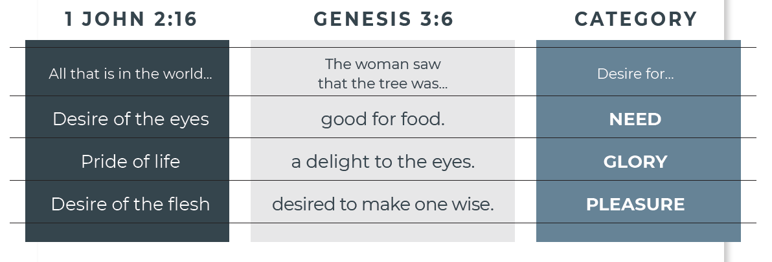
Draw an arrow from the left and right columns to the corresponding statements in the central column.
Do you see temptation(s) in your life related to these verses and desires?

Slide 11
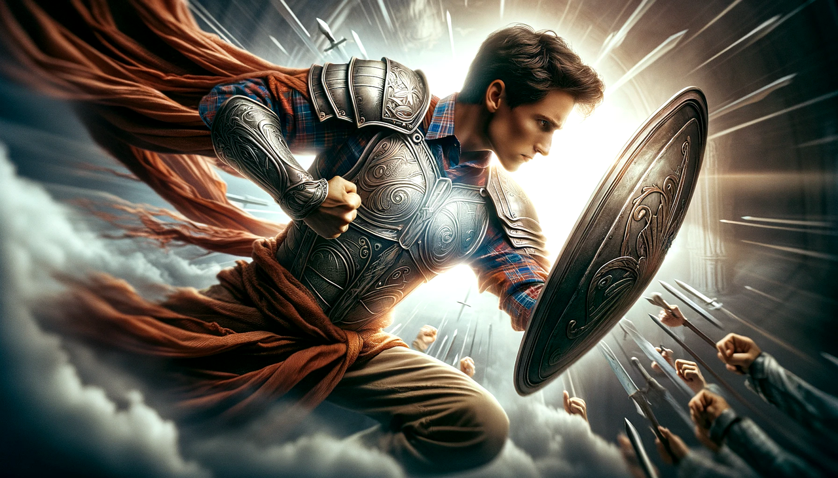
Talk with your table group about how what you learned today helps you do spiritual warfare.

Slide 12
Finally, be strong in the Lord and in the strength of his might. Put on the whole armor of God, that you may be able to stand against the schemes of the devil.
Ephesians 6:10-11

