Slide 1



Slide 2

Finally, be strong in the Lord and in the strength of his might. Put on the whole armor of God, that you may be able to stand against the schemes of the devil.
Ephesians 6:10-11

Slide 3
Last time, we looked at Eve’s temptation by the serpent. Do you remember the three partner enemies and the five downward steps?
Suggestion
Challenge
Gen. 3:1
Temptation
Gen. 3:4
Doubt/
Denial
Gen. 3:5
Sin
The partner enemies:
The World The Flesh The Devil
Gen. 3:6
Gen. 3:6

Slide 4
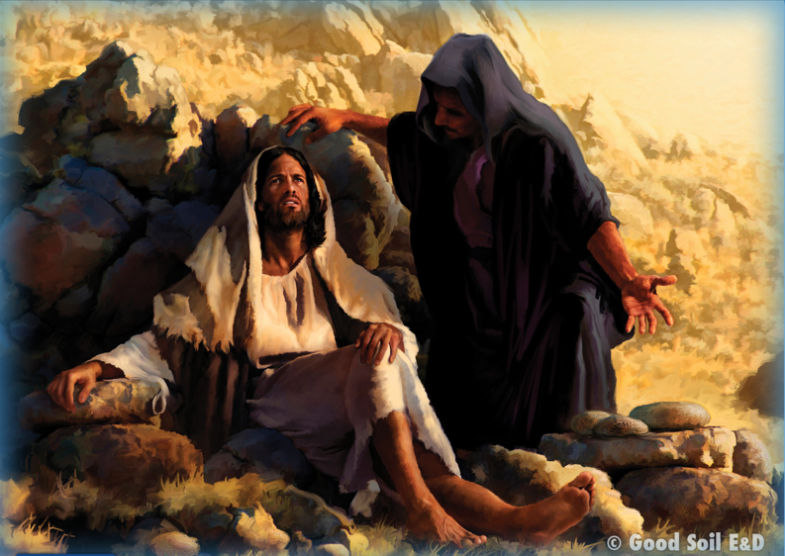
Today, we will look at Jesus’ temptation by Satan. Read the event in Matthew 4:1-11. Where do you see the three enemies?
. . . to be tempted by the devil.
4:1
. . . to become loaves of
bread. 4:3
. . . all the kingdoms of the
world and their glory.
4:8

Slide 5
Now, read the temptation of Jesus on your worksheet and . . .
Highlight or underline the three temptations of the devil.
  Then . . .

Slide 6
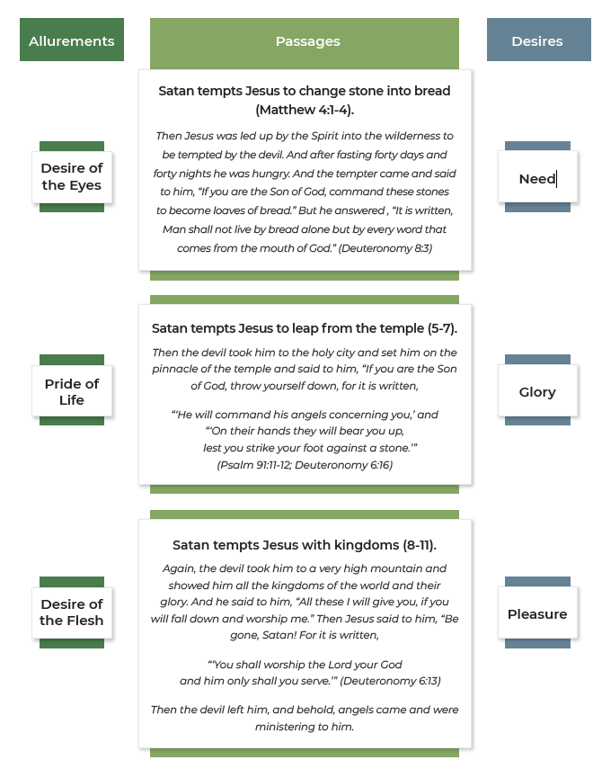
2. Draw a line from the allurement
of the world in the left column to
the corresponding temptation of
Jesus in the middle column.
3. Draw a line from the desire in the
right column to the corresponding
temptation of Jesus in the middle
column.

Slide 7

What are the similarities and differences between the temptation of Eve and Jesus?
Considering the similarities and differences between Eve and Jesus, how can you have the victory that Jesus experienced when you are tempted by sin?

Slide 8
Listen to this story . . .
What are elements you heard that made up my story?
The “Before” – Your life before Jesus changed it.
The “How” – How you came to faith in Jesus Christ.
The “After” – Your life since you were saved.

Slide 9
Sharing the Gospel Through Your Faith Story
I once had lunch with a highly educated young man who told me, “I’m an atheist and you are a Christian. The difference between you and me is that your life is based on faith and mine is based on facts.”

Slide 10
Sharing the Gospel Through Your Faith Story
My response: “No, you have as much or more faith as I do, but my faith is in God, and your faith is in atheistic evolution.”
When I asked him if he could scientifically prove that the universe was not divinely created and that humans evolved from non-living matter, he admitted that he could not prove these and reluctantly agreed that his worldview was also rooted in faith.

Slide 11
Everybody has a “Faith Story”
Sometimes, we, who are Christians, talk about sharing our “testimonies.” If we are specifically talking about sharing our testimonies with unbelievers, we may call them our “evangelistic testimonies.” But the terms “testimony” and “evangelistic testimony” may frighten unbelievers.
Whereas most people, even non-Christians, will be receptive to hearing your “story,” even if it is your faith story.

Slide 12
Everybody has a “Faith Story”
The likelihood of people being receptive to your faith story will increase significantly if it is brief (four minutes or less), non-preachy, and logically ordered. In “Crafting Your Faith Story,” we suggest including the following:
• The “Before” – Your life before Jesus changed it.
• The “How” – How you came to faith in Jesus Christ.
• The “After” – Your life since you were saved.

Slide 13
Top Ten Tips for Crafting Your Faith Story
Make your story sound informal, conversational and not memorized.
2. As much as possible, try to connect your story
to what you know about the person with whom
you are sharing—life background, pre-Christian
concerns, and your faith journey prior to becoming a true believer in Jesus
as Savior.
3. Avoid sounding “preachy” by keeping it personal and conversational.
4. Use “I” and “me,” avoid using “you.” Remember, this is YOUR faith story.
5. Even if you were saved as a child, make your story sound grown-up and
not childish.

Slide 14
Top Ten Tips for Crafting Your Faith Story
6. Avoid dogmatic and mystical statements that
might entice the recipient to debate them,
especially if he or she is somewhat skeptical.
7. Avoid a “happily ever after” ending to your story,
implying that the Christian life is problem-free.
8. Keep the story simple. Too many names/details make it difficult to
understand your story.
9. Casual humor/interesting anecdotes are helpful, if they can be woven
naturally into your story in a non-distracting manner.
10. Avoid religious terms and Christian jargon used freely with other Christians, but that are unknown to the recipient of your story. Think of ways to express salvation-related truths in common terminology.

Slide 15
Getting into and out of Your Faith Story
Look for opportunities (“entry points”) that make it natural for you to ask permission to share your faith story, something like this:
“Would you be interested in hearing my personal faith story?” Or
“Would it be OK if I shared with you
the story of how I became a sincere
follower of Jesus Christ?”

Slide 16
Getting into and out of Your Faith Story
When you have finished sharing your story, you might ask,
“Does that make sense to you?” or “Does that bring up any questions in
your mind?”
When you have addressed your friend’s questions, if he or she has some, (and you did not start by “peeling your friend’s worldview onion”), you might say something like this:
“Now, I’d love to hear your personal faith story—would you mind telling me about your spiritual journey?”

Slide 17
Getting into and out of Your Faith Story
If your conversation reveals an interest to know more about Jesus and the gospel, you might ask if he or she would be interested in doing a Bible study together, using The Story of Hope or God’s Story/Your Story.

Slide 18

Write on a 3”x 5” card one thing you learned today that will help you do spiritual warfare.
Share with your table mates.

Slide 19
For we do not wrestle against flesh and blood, but against the rulers, against the authorities, against the cosmic powers over this present darkness, against the spiritual forces of evil in the heavenly places.
Ephesians 6:12

