Slide 1



Slide 2

For we do not wrestle against flesh and blood, but against the rulers, against the authorities, against the cosmic powers over this present darkness, against the spiritual forces of evil in the heavenly places.
Ephesians 6:12

Slide 3
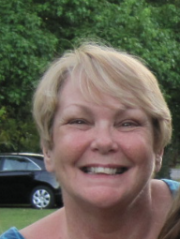
Today, we have the privilege of
hearing _____ faith story.
Listen for the three major sections . . .
The Before
The How, and
The After . . .
. . . And listen for elements of the Gospel.

Slide 4
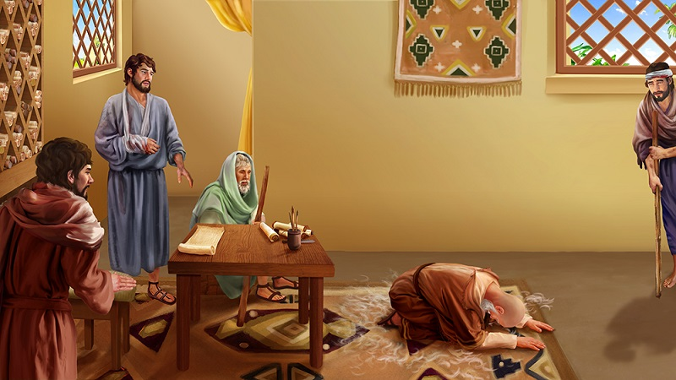
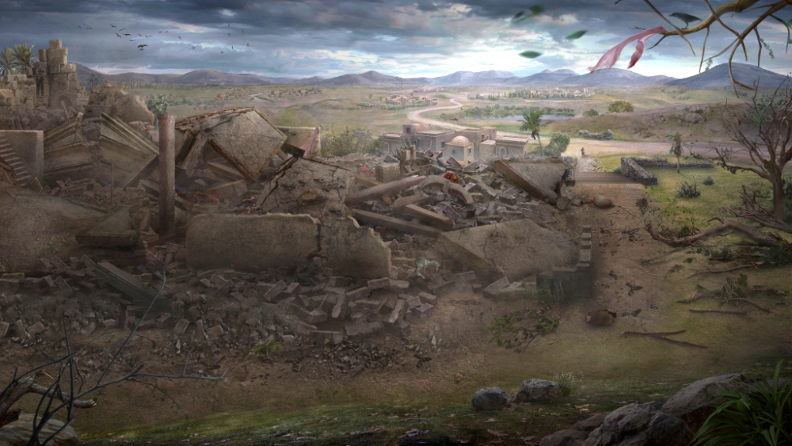
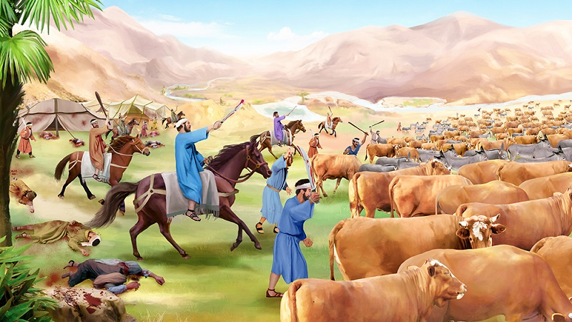
Read Job 1: 6 – 2:10 and answer the questions below.
What are God’s actions?
What are people’s actions?
What are Satan’s actions?

Slide 5
Work at your table to create key points you would put into your theology based on these passages.
1.
2.
3.
4.

Slide 6
Consider these points:
Spiritual warfare is portrayed as a celestial battle in which Satan opposes the plan and purposes of God.
2. This is not a battle for power but for human allegiance.
The battleground is your mind and heart for your obedience
and trust.
3. Satan uses the righteousness of God to argue against the
people of God.

Slide 7

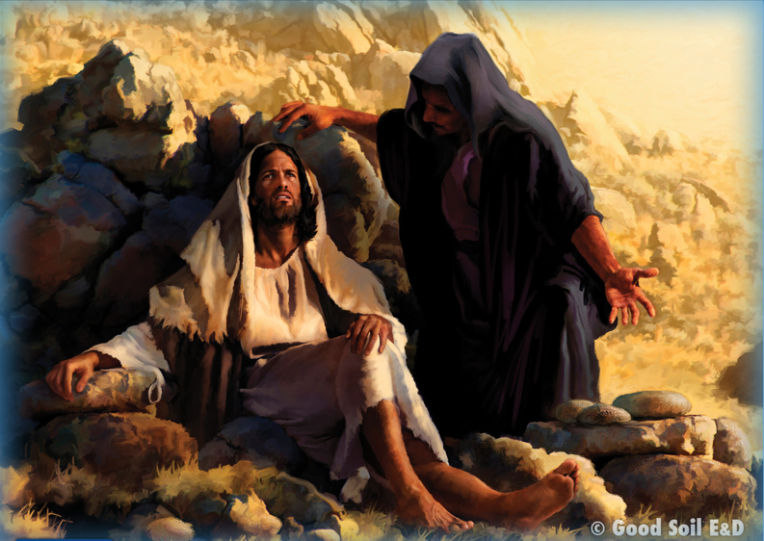
Consider these points:
4. These passages demonstrate that the Lord is sovereign over
Satan and evil spirits. They do His bidding. The conflict is not
undecided.
5. People are affected by but not directly involved in this
supernatural discourse.

Slide 8

It’s time for . . .

Slide 9
Many of us make “To Do” lists . . .
What’s more important than sharing the gospel and making disciples?
Our Good Soil Personal E-List and D-List Card was created to help us keep our focus on these two Great Commission tasks.

Slide 10
How to use the E-List side of the card:
1. Think of a person you have some kind of relationship
with . . . an unbeliever.
2. Try to determine where
he/she is on the vertical
dimension . . .
3. . . . and on the horizontal
dimension.

Slide 11
How to use the E-List side of the card:
4. Locate the cell where those two come together—level of understanding and degree of receptivity. Write his/her initials in that cell.
5. Add names of other unsaved contacts (up to five) and follow the same procedure for each.
6. Use this card to pray for them and for opportunities . . .

Slide 12
How to use the D-List side of the card:
Follow a similar procedure for your D-List (other side of the card)—names of people you know who are, to
your knowledge, true Christians but need to be discipled.
The “Vertical” dimension here is spiritual maturity. And the “Horizontal” dimension is involvement in church
and ministry.

Slide 13
Praying for People & Opportunities . . .
You can purchase these Personal E&D Cards from this site: www.GoodSoil.com/Resources (or make your own!).
We hope they will help you to make evangelism and discipleship a higher priority in your life.

Slide 14
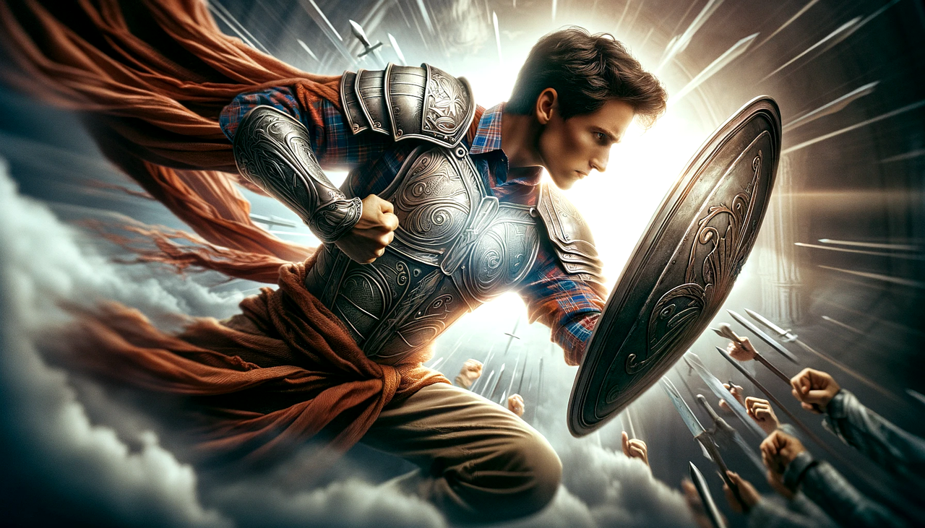
Write on a 3”x 5” card one thing you learned today that will help you do spiritual warfare.
Share with your table mates.

Slide 15
Therefore take up the whole armor of God, that you may be able to withstand in the evil day, and having done all, to stand firm.
Ephesians 6:13

