Slide 1


N

Slide 2

Therefore take up the whole armor of God, that you may be able to withstand in the evil day, and having done all, to stand firm.
Ephesians 6:13

Slide 3

Today, we have the privilege of
hearing _______ faith story.
Listen for the three major sections . . .
The Before
The How, and
The After . . .
. . . And listen for elements of the Gospel.

Slide 4
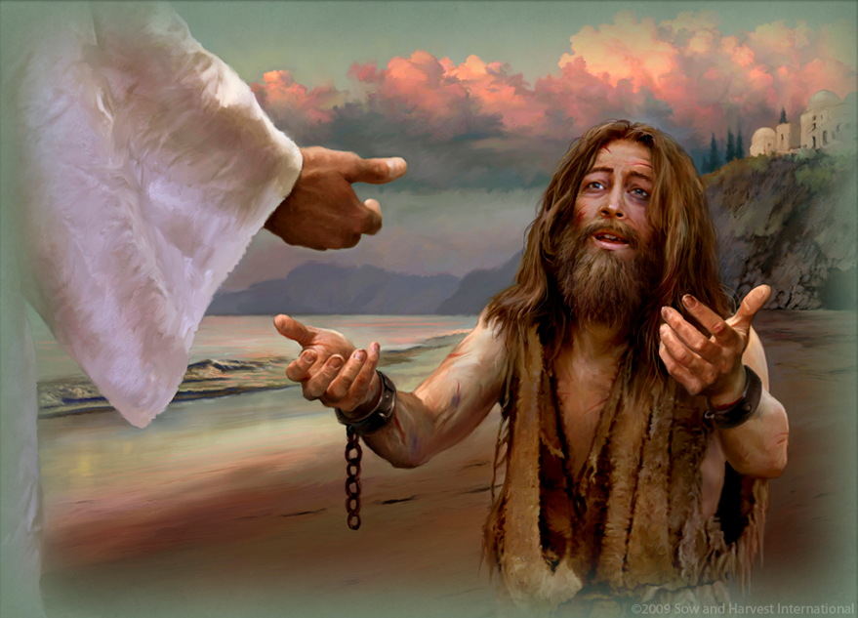
Read Mark 1:21-28 and Luke 8:26-39 and answer the questions on your worksheet.
Mark 1:21-28 (2:44)
Luke 8:26-39 (4:06)

Slide 5
What is the relationship of the unclean spirits to Jesus?

Slide 6
What do the evil spirits recognize about Jesus?

Slide 7
Notice: They call Him “The Holy One of God” - This is the only event in the Bible where this title is used. (Mark 1 and Luke 4 are parallel passages, recording the same event.)
The demons automatically went into the mode for which they were created—worship. They couldn’t help but bow. When we ultimately see Jesus, we will do the same.

Slide 8
In the Mark passage, how do the people respond?

Slide 9
In the Luke passage, what do the disciples say, and what role do they have in this event?

Slide 10
Notice: The disciples don’t say anything and don’t seem to
have any role in this event. The point here is that they were observing and learning from the Master.

Slide 11
What do we learn about Jesus and demons in these two passages?

Slide 12
Why do you think Jesus asked the demon his name? Because He didn’t know?
Of course, He knew the demon’s name!
Every time Jesus asks questions of people in the New Testament, it is for instructional purposes.

Slide 13
Who is He instructing here?
His disciples.
This was a very unusual case,
And Jesus was using it to help
His disciples learn from this
experience.

Slide 14
Work at your table to create key points you would put into your theology based on these passages.
1.
2.
3.
4.

Slide 15

It’s time for . . .

Slide 16
What Must I REALLY Do to be Saved?
The gospel of Jesus Christ is simple and easy to understand.
But we complicate things!

Slide 17
Some Actions Unbelievers Are Often Told to Take
in Order to Be Saved:
Cleanse your heart
Reach out to Jesus
Come to Jesus
Drink the water of life
Take up your cross
Give your heart to Jesus
Enter the narrow gate
Pray “the prayer”
Be washed in the blood
Follow Jesus
Look to Jesus
Invite Jesus into your heart

Slide 18

Suppose you went through this list and checked off the actions that you think have legitimate Biblical support as actions that result in salvation. Let’s say that you selected 20 of them.
Image: pixabay.com

Slide 19
Would you think of these as separate action steps to salvation?
Or would you think of these simply as different ways to describe a single heart-action that results in salvation?
Image: pixabay.com

Slide 20
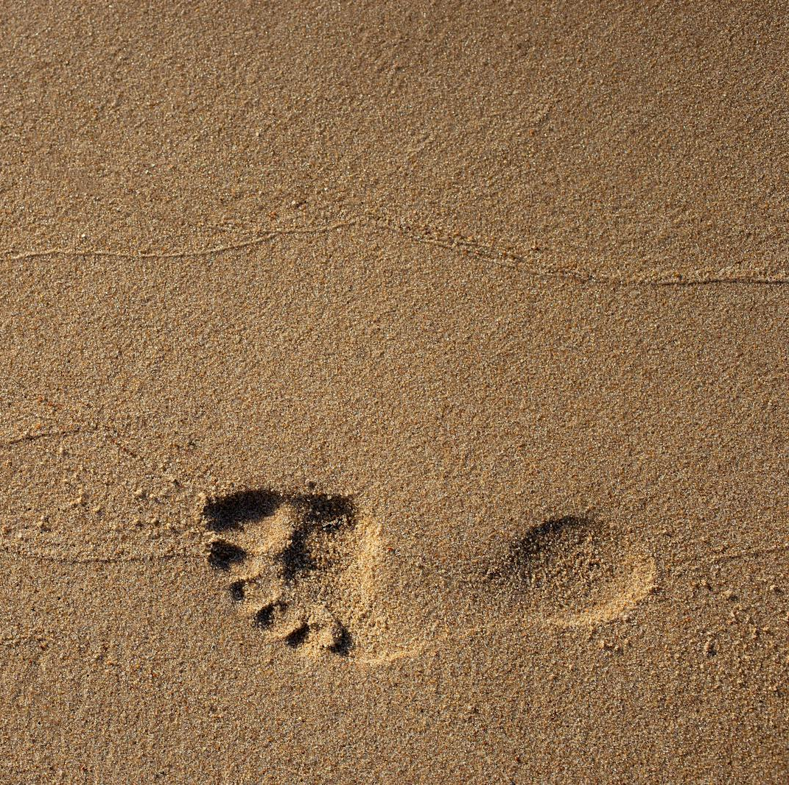
Wouldn’t you agree that the simple “believes in Him” truth of John 3:16-18 is sufficient, even though this heart-action might be expressed in the New Testament using a variety of metaphors and synonyms?
Image: pexels

Slide 21

John 3:16-18
¹⁶ For God so loved the world that He gave His only begotten Son, that whoever believes in Him should not perish but have everlasting life. ¹⁷ For God did not send His Son into the world to condemn the world, but that the world through Him might be saved. ¹⁸ He who believes in Him is not condemned; but he who does not believe is condemned already, because he has not believed in the name of the only begotten Son of God.

Slide 22

Why is this issue so important?
“Faith” (believing/trusting) is the heart-action step that results in the salvation of a sinner.
More specifically, it is faith that is focused on God’s provision for man’s spiritual needs—the death and resurrection of God’s Son, Jesus Christ.
Image: finwise.edu.vn

Slide 23
But What About . . . ?
Turning from sins?
Calling upon the name of the Lord (praying the prayer)?
Receiving God’s gift of salvation?
These actions (and others) are mentioned in some passages in the NT. But the NT clearly teaches that there is one single heart-action that brings salvation, and it is “faith” in Jesus Christ.
Image: finwise.edu.vn

Slide 24

Ephesians 2:8-9
⁸ For by grace you have been saved through faith, and that not of yourselves; it is the gift of God, ⁹ not of works, lest anyone should boast.
Image: haynescreek.com

Slide 25
Because of the various synonyms and synonymic metaphors used in the Bible to describe the act of “saving faith,” some people seem to think that (genuine) faith in Christ is only one step that must be preceded or followed by other steps—
turning from sins,
praying a prayer,
receiving a gift of salvation,
and so forth . . .
Image: pixabay.com

Slide 26
They fail to differentiate between the synonyms (and synonymic metaphors) for “faith in Christ” and the heart-action of (saving) faith in Christ itself.
Consequently, the synonyms are misunderstood to be separate steps to salvation.
Image: pixabay.com

Slide 27
Does it not make better biblical sense to think that a sinner
is turning from his/her sins,
calling upon the Lord in
his heart,
receiving God’s gift
of salvation,
when he or she sincerely
places his or her trust in
Jesus Christ as Savior?
Image: pexels

Slide 28
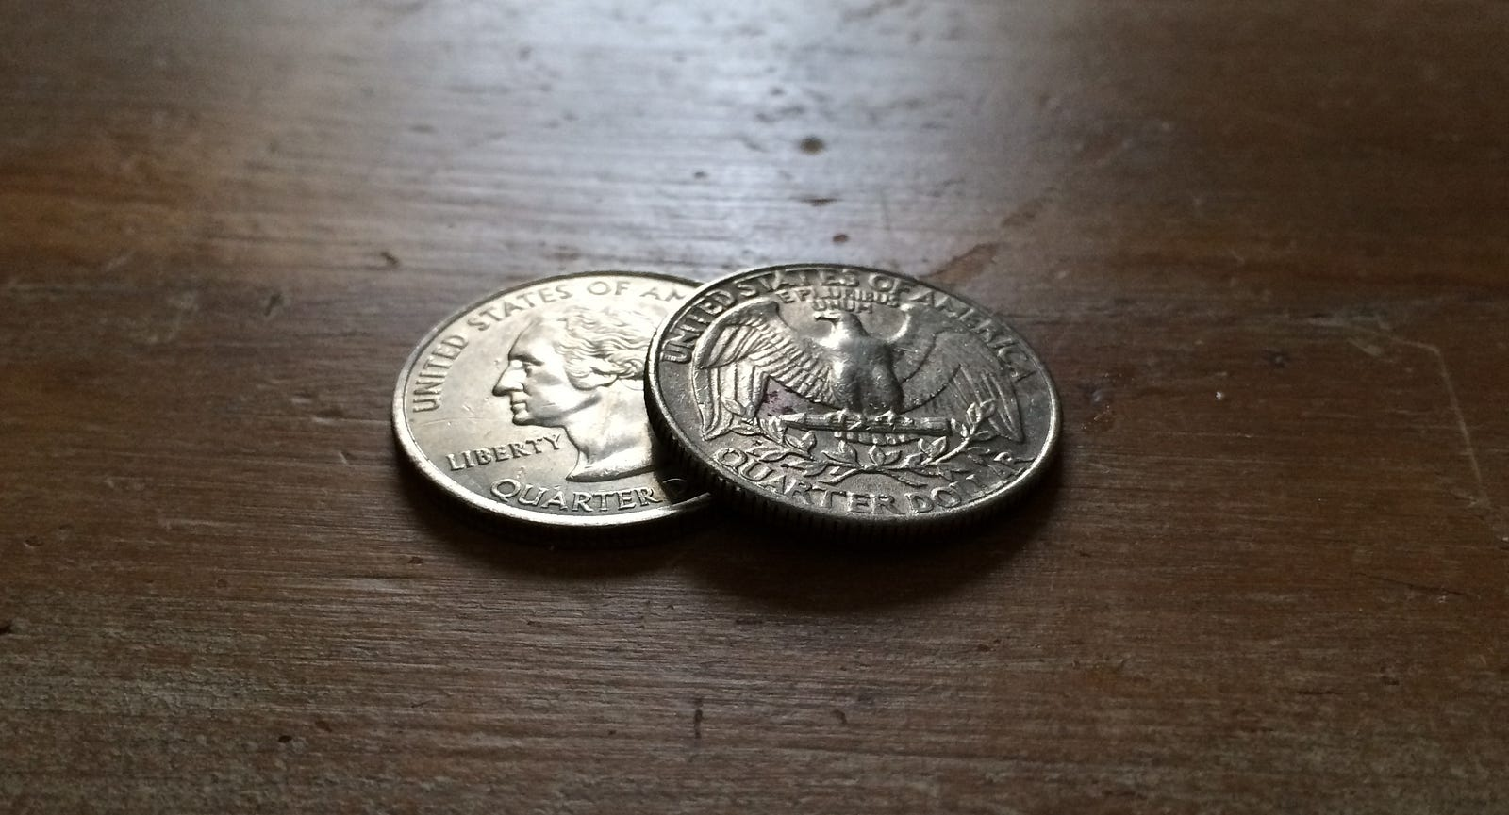
Think of . . .
placing your trust in Jesus and
repentance (turning from sin)
as two sides of a coin—
When you place you trust in Jesus, you are
turning from your sin and
what you were placing your
trust in before.
Image: Medium

Slide 29
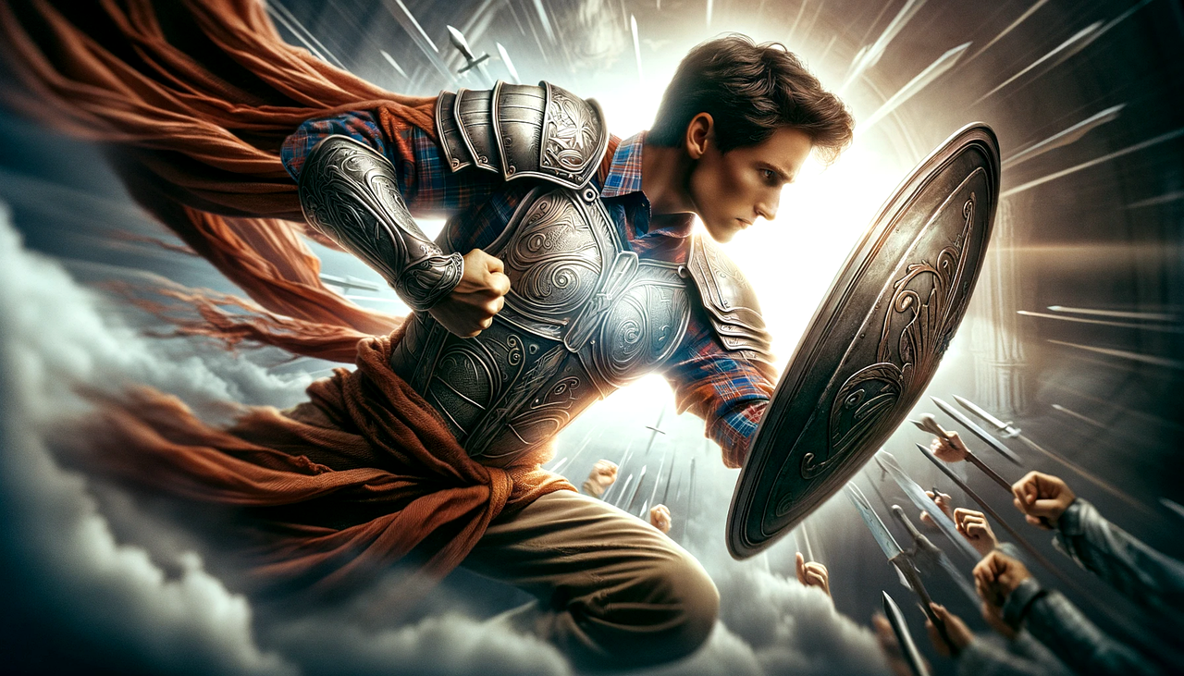
Write on a 3” x 5” card one thing you learned today that will help you do spiritual warfare.
Share with your table mates.

Slide 30
¹⁴ Stand therefore, having fastened on the belt of truth, and having put on the breastplate of righteousness, ¹⁵ and, as shoes for your feet, having put on the readiness given by the gospel of peace.
Ephesians 6:14-15

