Slide 1

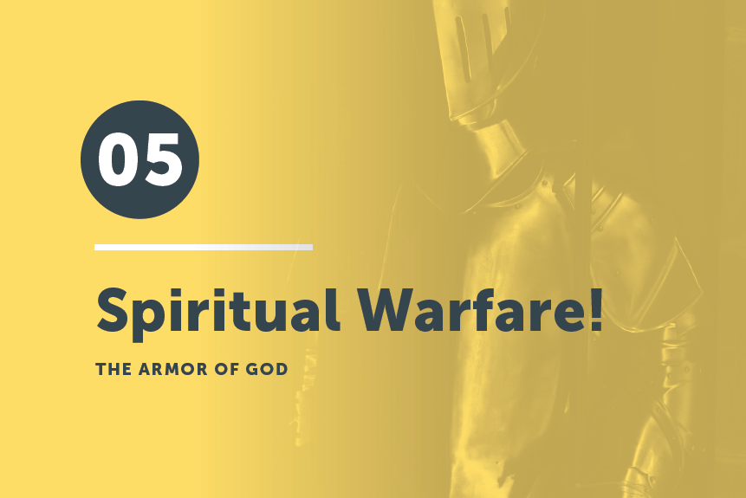
Part 1

Slide 2

As a group, draw the armor of God without looking at Ephesians 6:10-18.

Slide 3
¹⁴ Stand therefore, having fastened on the belt of truth, and having put on the breastplate of righteousness, ¹⁵ and, as shoes for your feet, having put on the readiness given by the gospel of peace.
Ephesians 6:14-15

Slide 4
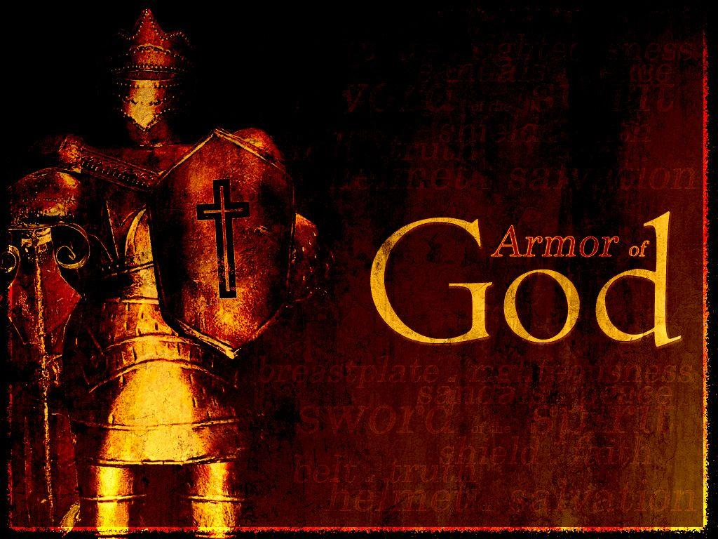
Read Ephesians 6:10-18 and answer
the questions on your worksheet.

Slide 5
Against whom are we fighting (using this armor)?
The Devil, rulers, cosmic powers of darkness, etc.

Slide 6
How does God expect you to use the armor?
Prayerfully.

Slide 7
Is any one piece or any instruction key to all of it?
“...take up the whole armor of God.”

Slide 8
Compare the armor in Eph. 6 with Gen. 15:1;
Psalm 17:13; 18:2; 91:4; 93:1; Isaiah 11:5.

Slide 9
At your table, talk about each piece of the armor.
What is the purpose of each piece?
Belt of Truth
To stand firm
Breastplate of Righteousness
To stand (against the Devil and his minions)
Gospel Shoes
To be ready/prepared
Shield of Faith
To extinguish Satan’s darts
Helmet of Salvation
To protect most important part of body/
Sword of the Spirit
To defend (like Jesus did)
How can you use each piece practically?

Slide 10
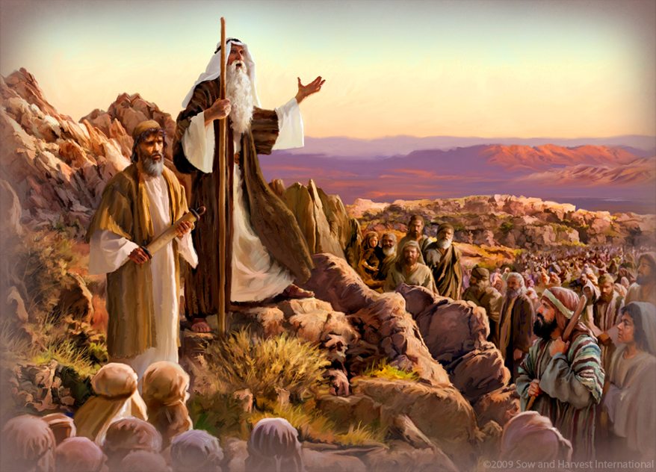
Paul reiterates in the New Testament what people had an inkling about in the Old Testament
Do not be afraid of them; the Lord your God himself will fight for you”
Deuteronomy 3:22

Slide 11
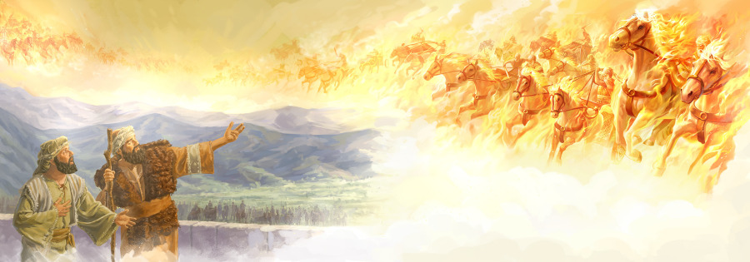
Paul reiterates in the New Testament what people had an inkling about in the Old Testament
"When the servant of the man of God got up and went out early the next morning, an army with horses and chariots had surrounded the city. ‘Oh no, my lord! What shall we do?’ the servant asked. ‘Don’t be afraid,’ the prophet answered. ‘Those who are with us are more than those who are with them.’ And Elisha prayed,

Slide 12
Paul reiterates in the New Testament what people had an inkling about in the Old Testament
‘Open his eyes, Lord, so that he may see.’ Then the Lord opened the servant’s eyes, and he looked and saw the hills full of horses and chariots of fire all around Elisha.
2 Kings 6:15-18
Ifiwalkedwithjesus.com

Slide 13
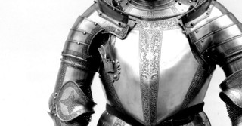
Jesus knows Satan’s desire is to “steal, kill, and destroy” us. He did battle against Satan and demons during His ministry and told His disciples to do the same.
"I have given you authority to trample on snakes and scorpions and to overcome all the power of the enemy; nothing will harm you" Luke 10:19
Photo credit:
Crosswalk.com

Slide 14

The ability to battle the enemy is extended to all believers, but we must make sure we don’t do it with our own power, but through God's power working in us.
"For though we live in the world, we do not wage war as the world does. The weapons we fight with are not the weapons of the world. On the contrary, they have divine power to demolish strongholds. We demolish arguments and every pretension that sets itself up against the knowledge of God…”
2 Corinthians 10:3-5
Photo credit:
Unsplash/Miguel Bruna

Slide 15
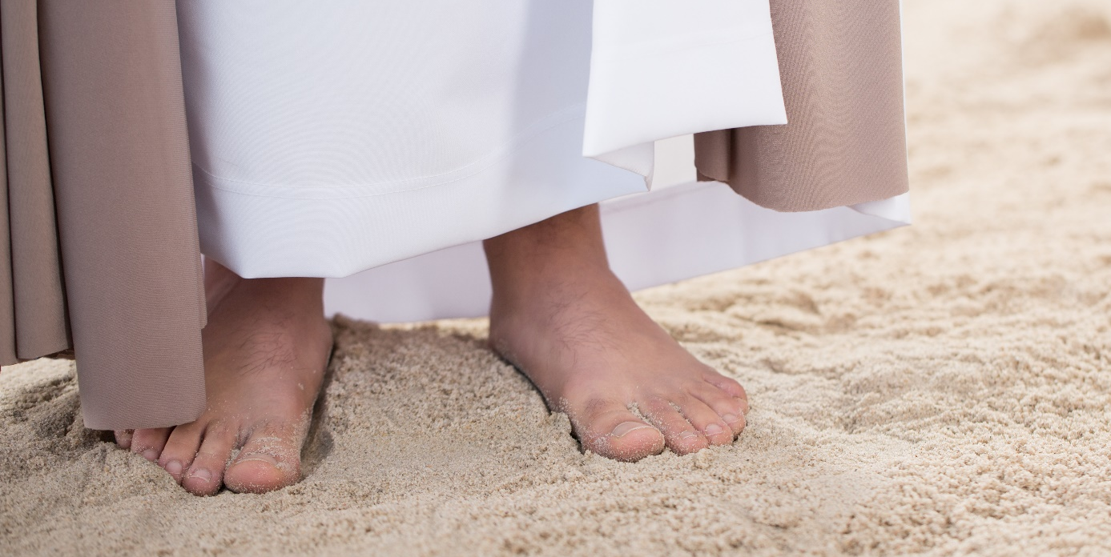
Paul’s imagery of the armor of God came from Isaiah
who used the same imagery describing the Messiah
who fights for His people!
“Righteousness will be his belt and faithfulness the sash around his waist” Isaiah 11:5
And listen to this imagery:
"How beautiful on the mountains are the feet of those who bring good news…" Isaiah 52:7

Slide 16
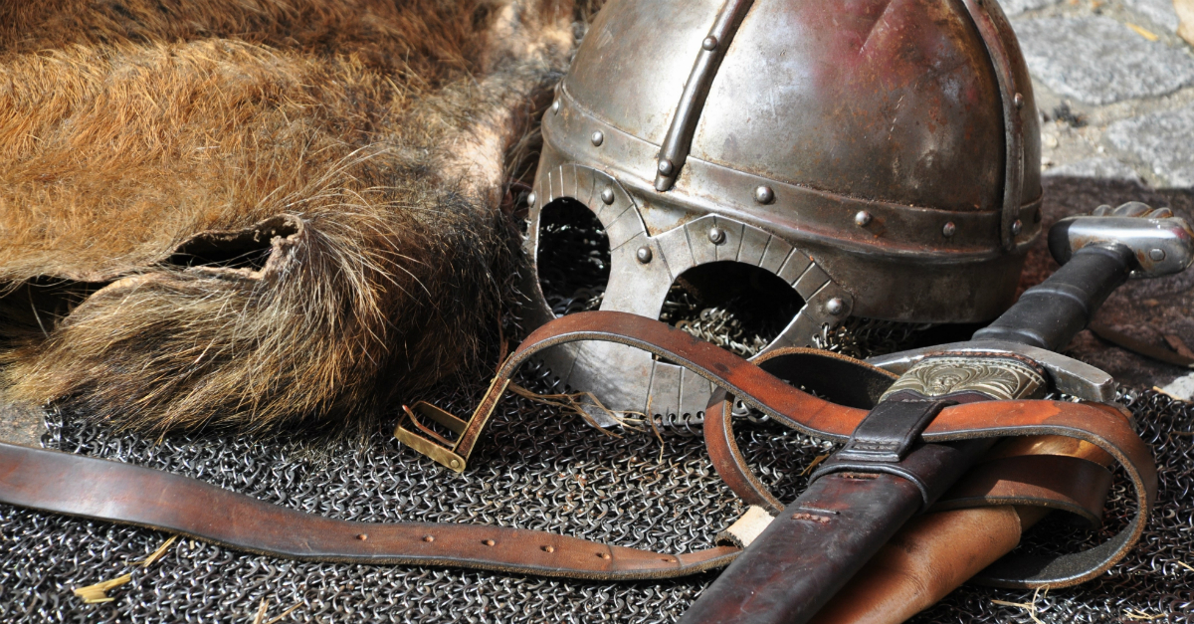
And this imagery describing God bringing judgment and redemption to an evil and oppressed people:
“He put on righteousness as his breastplate, and the helmet of salvation on his head, he put on the garments of vengeance and wrapped himself in zeal as in a cloak" will be his belt and faithfulness the sash around his waist” Isaiah 59:17
Photo credit: Pexels/Pixabay

Slide 17
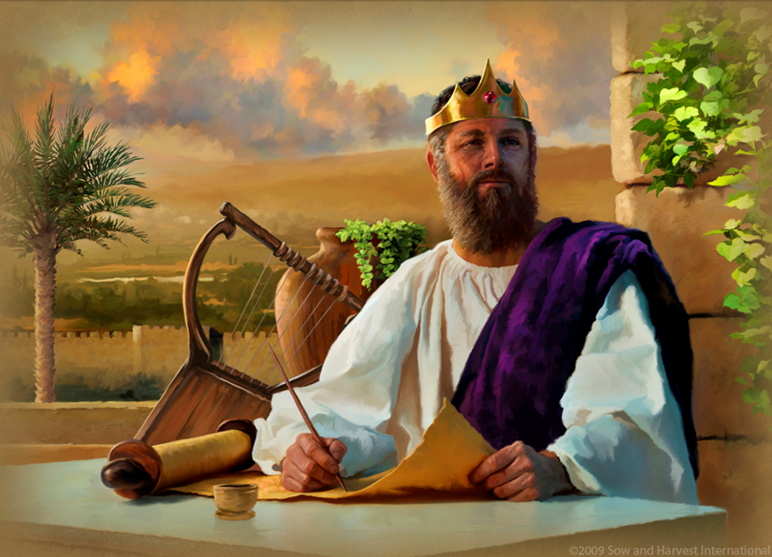
King David, who fought the enemy in the sheep fields before doing the same on the battlefield, wrote:
“He put on righteousness as his breastplate, and the helmet of salvation on...he shields all who take refuge in him” Psalm 18:30
“It is God who arms me with strength…” Psalm 18:32
“He trains my hands for battle…”
Psalm 18:34

Slide 18
“Whose armor is it and whose fight is it?”
Yes, the armor is God’s armor, and it is God’s fight.
But that doesn’t mean we are to be passive.
God wants us to participate in the fight or
He wouldn’t have clothed us for the fight.

Slide 19
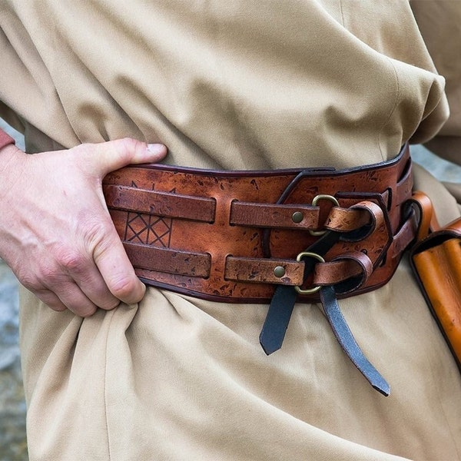
Can we look a little deeper at each piece?
Belt of Truth
What is one of Satan’s favorite weapons?
Lies. Many times, he distorts the truth making it difficult to distinguish fact from falsehood, truth from
untruth, reality from dishonesty.
But when we ask, God will give us
discernment and wisdom to know His
truth above all the other noise.
Photo credit: Etsy

Slide 20
Can we look a little deeper at each piece?
Belt of Truth
NASB: “having girded your loins with truth”.
Not a vernacular term today . . .
Includes lower back and groin area.
Robe and purpose of belt in battle— “girding one’s loins.”
Paul knew we needed our center of gravity—our identity—wrapped in truth . . . all other pieces are attached to the belt.
Photo credit: Etsy

Slide 21
David Chadwick in Moments of Hope:
“The first piece of the armor is the belt of truth. Truth, by its very definition, is exclusive. It means something is true, and other things are lies. The evil one is the father of lies (John 8:44). Every lie finds its origin in him. “Every other piece of the full armor of God is attached to the belt of truth. If you don’t begin with truth, you’ll never defeat the enemy. . . Jesus said God’s Word is true (John 17:17).”
Photo credit: Etsy

Slide 22
Practical Application
Pursue the truth, study God’s Word, work at it.
Pray the Bible back to God. Use the Word as a pattern to guide
you as you pray.
Memorize the verses from the Bible—that way you will have it at
hand when needed.
Put the truth (God’s Word) on Post-it notes, screen savers, pillows, décor—anything that will help you remember God’s Word in the
spiritual battle in which you are engaged.

Slide 23
Pray to Put On the Belt of Truth
Almighty God, I put on your full armor, so I can withstand against the schemes of the enemy. I know I don’t fight against flesh and blood, but against evil spiritual forces. I stand firm, planted in you, my Savior. Putting on the belt of truth, I affirm and believe in your truth alone, Lord, and will not fall into the trap of believing the lies of the world. Guide me in your truth and help me not to lose sight of it. Help me know your truth vs. the deceitfulness of the enemy.

Slide 24
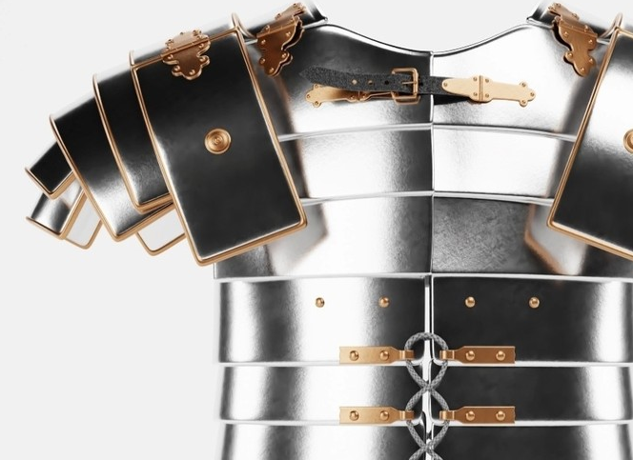
Looking a little deeper . . .
Breastplate of Righteousness
Righteousness means being made right.
Does Scripture refer to righteousness that Christ gives us – His righteousness? Or does Scripture refer to righteousness that God carries out through us?
Look at these verses:
Revelation 19:8
2 Corinthians 5:21
One? Or the other? Or both?
Photo: Christianity.com

Slide 25
Looking a little deeper . . .
Breastplate of Righteousness
In daily spiritual battles, both varieties of righteousness protect the heart. We need the complete righteousness of Christ but also the continuing righteousness that comes as a response to God’s gift.
Photo: Christianity.com

Slide 26
Looking a little deeper . . .
Breastplate of Righteousness
The enemy tempts us with all kinds of sinful entanglements, but God’s righteousness protects our hearts.
God’s instructions may be viewed as killjoys or burdens.
But obedience to God protects your heart from being wounded by sin.
Photo: Christianity.com

Slide 27
Practical Application
Let biblical instruction soak in. Obey it. If a certain sin entangles you easily, ask a church leader to share some scriptural truths that can help you walk in the Lord’s plan more fully.
Ask a trusted friend to pray for you if you’re struggling to obey.
All Christians struggle, but we were
not meant to struggle alone. We make
easy targets for the enemy when we
don’t obey God.
Photo: Christianity.com

Slide 28
Pray to Put On the Breastplate of Righteousness
Lord, knowing that I have been forgiven and freed from death because of Jesus, I put on the breastplate of righteousness. I live in Christ as a new creation and pursue righteousness instead of the sinful desires of my flesh. Help me walk in your love, humility, and kindness, so I will live a life of righteousness that is pleasing to You and draws others to want to know You.
Photo: Christianity.com

Slide 29
We’ll look at the other items of armor in more detail next week!

Slide 30
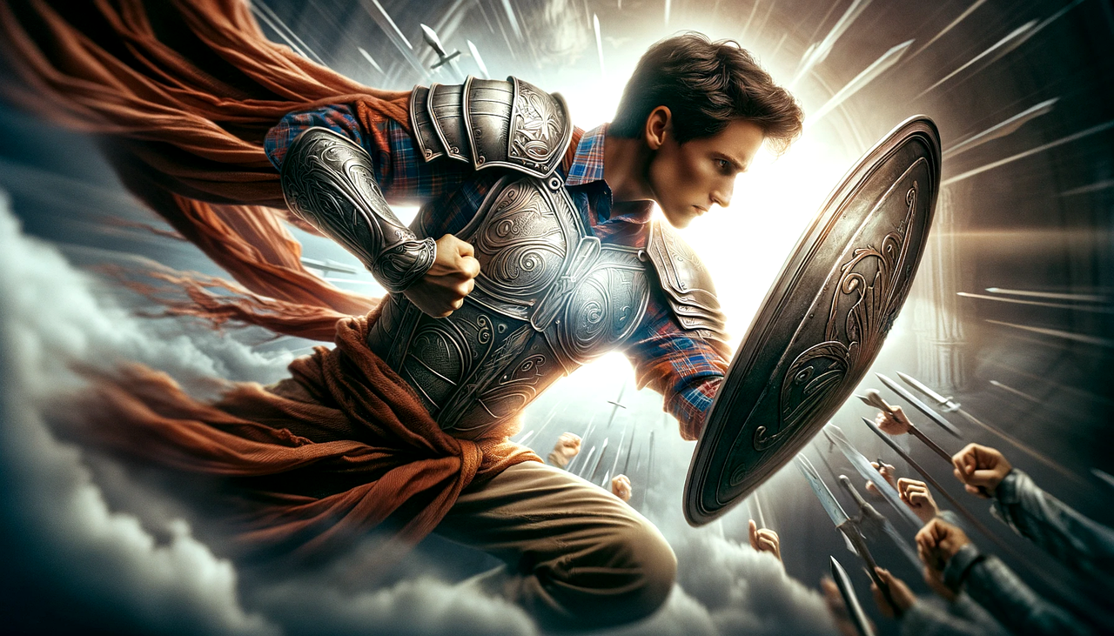
Write on a 3” x 5” card one thing you learned today that will help you do spiritual warfare.
Share with your table mates.

Slide 31
In all circumstances, take up the shield of faith, with which you can extinguish all the flaming darts of the evil one; ¹⁷ and take the helmet of salvation, and the sword of the Spirit, which is the word of God
Ephesians 6:16-17

