Slide 1

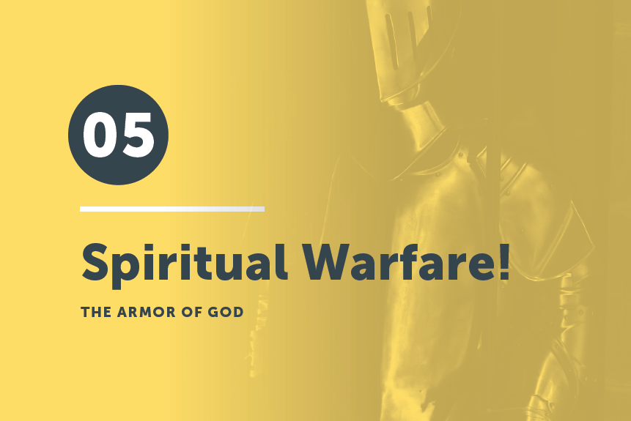
Part 2

Slide 2

In all circumstances take up the shield of faith, with which you can extinguish all the flaming darts of the evil one; ¹⁷ and take the helmet of salvation, and the sword of the Spirit, which is the word of God
Ephesians 6:16-17

Slide 3

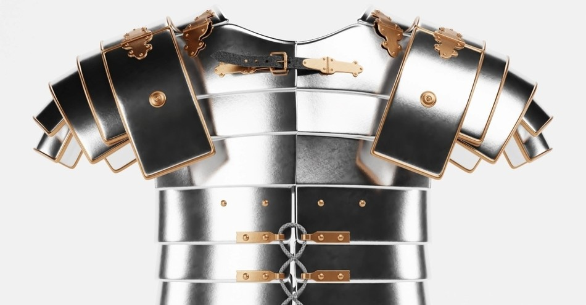
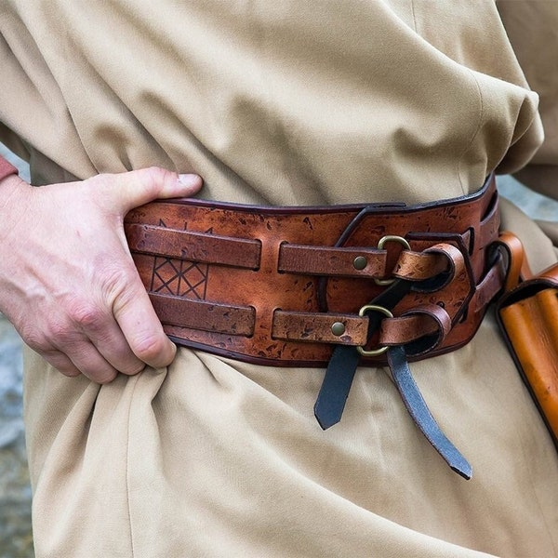
Birds of a Feather . . .
Find someone in the room who likes the same junk food as you do.
Then, ask, “What do you remember about putting on . . .”
Image: ar.inspiredpencil.com
Photo credit: Etsy
Photo: Christianity.com
The Belt of Truth
The Breastplate of Righteousness

Slide 4
Birds of a Feather . . .
Now find someone wearing the same color shoes as you are.
And ask, “What do you remember about putting on . . .”
Image: ar.inspiredpencil.com
Photo credit: Etsy
Photo: Christianity.com
The Belt of Truth
The Breastplate of Righteousness

Slide 5

Read Ephesians 6:10-18 again.

Slide 6
“Whose armor is it and whose fight is it?”
Yes, the armor is God’s armor, and it is God’s fight.
But that doesn’t mean we are to be passive.
God wants us to participate in the fight, or He wouldn’t have clothed us for the fight.

Slide 7
To Your Corners!
Count off by, “Shoes,” “Shield,” “Helmet,” “Sword.”
2. Go to your Corner (taking your Bibles and worksheets).
Take turns reading the “looking deeper” sheet about the piece of armor, looking up verses when appropriate.
4. Talk with each other about what you
learned and how you might apply it.
5. Pray the prayer to put on that piece.
6. Move to the next corner and repeat.

Slide 8
Read Colossians 3:12-14 and compare
the armor of God with the clothing of Christ.

Slide 9
Both the Ephesians passage and the Colossians passage use the Greek word enduo –
“to put on, to clothe, or dress.”

Slide 10
Note: You can’t put on the armor of God until . . .
you are already clothed!
Also, the armor of God in Ephesians has to do with salvation (look for terms that bear that out) . . .

Slide 11
. . . And the clothing of God has to do with sanctification.
The armor becomes available to us at salvation
and is to be used in spiritual warfare.

Slide 12
So, we need to clothe ourselves with the clothing of Christ (continuing with our sanctification process) . . .
and take advantage of the armor of God
to protect us as we participate in God’s battle.

Slide 13
Read 2 Chronicles 20:15.
Notice that the battle is God’s, not ours.

Slide 14
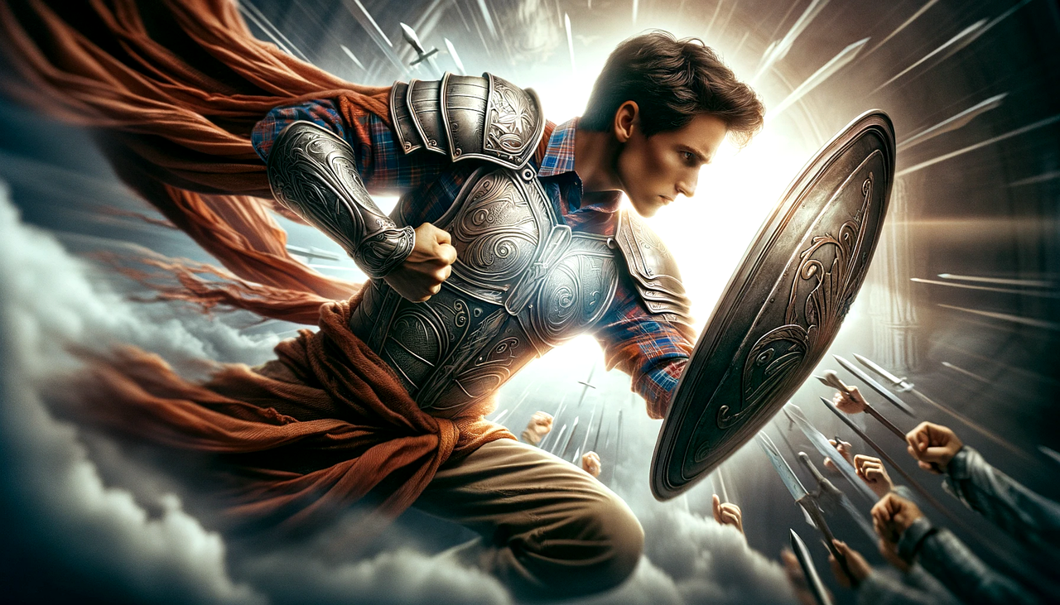
Write on a 3” x 5” card one thing you learned today that will help you do spiritual warfare.
Share with your table mates.

Slide 15
Praying at all times in the Spirit, with all prayer and supplication. To that end, keep alert with all perseverance, making supplication for all the saints.
Ephesians 6:18

