Slide 1
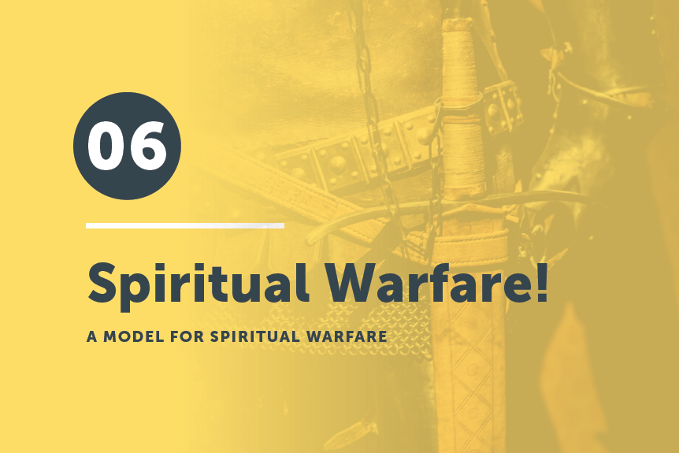


Slide 2
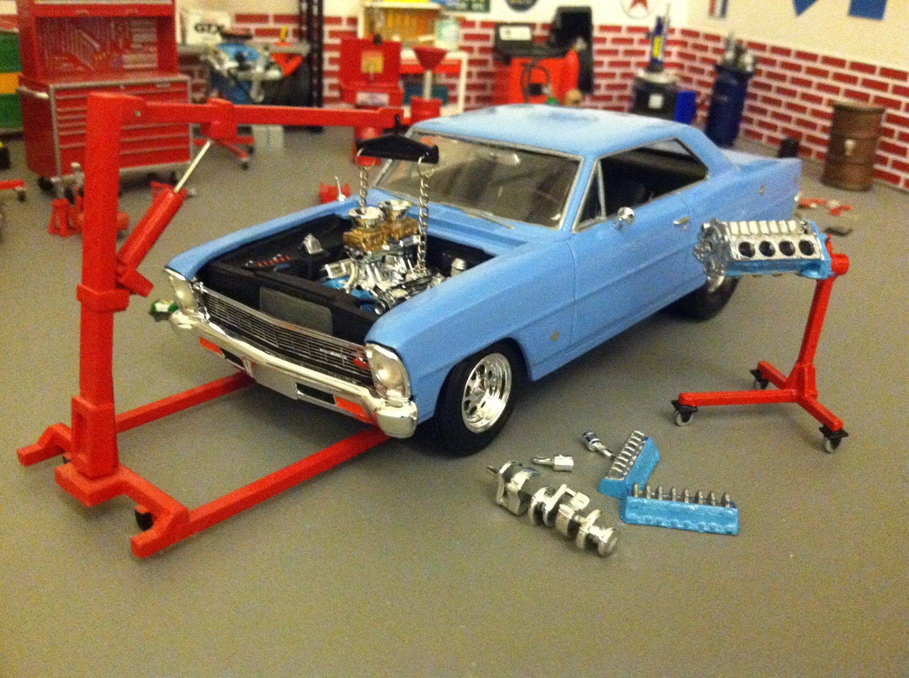
Let’s Talk
About
Models
Cool, but will this engine work?

Slide 4

And also for me, that words may be given to me in opening my mouth boldly to proclaim the mystery of the gospel . . . that I may declare it boldly, as I ought to speak.
Ephesians 6:19 & 20b

Slide 5
Think back to when we started this series. What were the three enemies?
The _______, the _______ and the _______.
The Armor of God helps us especially when dealing with the Devil. James gives us some help when dealing with the other two enemies.
World
Flesh
Devil

Slide 6
Read James 4:1-6 and underline or highlight all the words that deal with fighting.

Slide 7

What causes quarrels and what causes fights among you? Is it not this, that your passions are at war within you? ² You desire and do not have, so you murder. You covet and cannot obtain, so you fight and quarrel. You do not have, because you do not ask. ³ You ask and do not receive, because you ask wrongly, to spend it on your passions. ⁴ You adulterous people! Do you not know that friendship with the world is enmity with God? Therefore, whoever wishes to be a friend of the world makes himself an enemy of God^{. 5} Or do you suppose it is to no purpose that the Scripture says, “He yearns jealously over the spirit that he has made to dwell in us”? ⁶ But he gives more grace. Therefore, it says, “God opposes the proud but gives grace to the humble.”

Slide 8

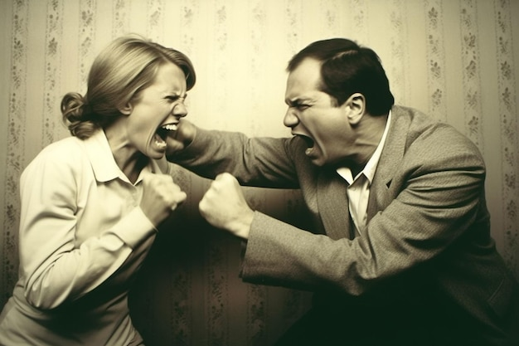
Wow! That’s a lot of fighting!
What causes the fighting?
Our passions, desires; coveting
Who can help?
God
How does He help?
He gives more grace . . .
To whom does He give help?
The humble

Slide 9
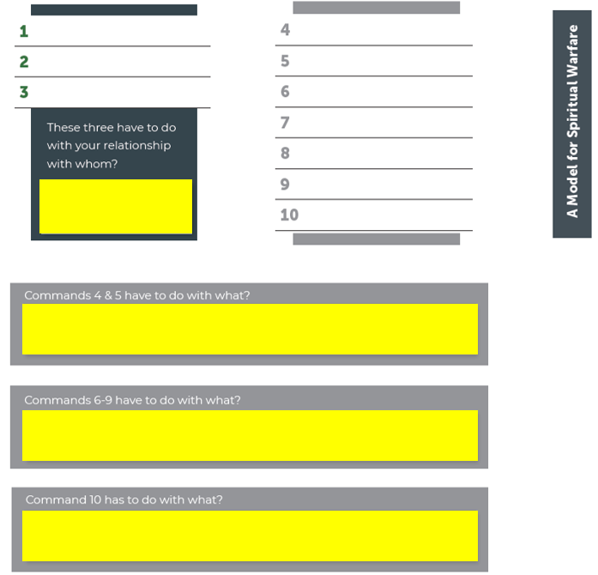
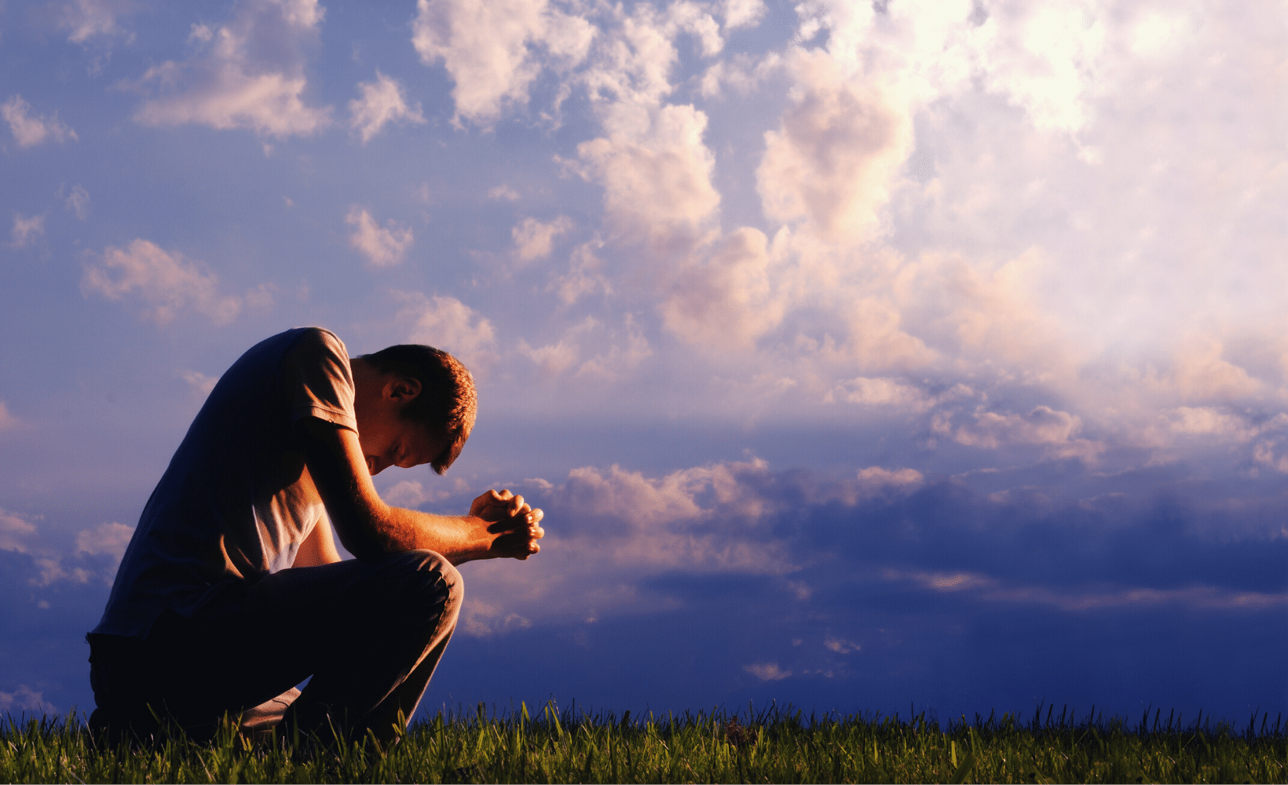
Find 10 commands in verses 7-10 and list them below.
Submit
Cleanse
Resist
Purify
Be Afflicted
Draw Near
Mourn
Relationship with . . . ?
Weep
Turn
God
Humble
Repentance
Character
Confession

Slide 10
With which command do you struggle the most?
How can you pray for each other?

Slide 11

So, we need to clothe ourselves (Colossians 3—continuing with our sanctification process) . . .
And put on the armor of God (Ephesians 6—to protect us as we participate in God’s battle) . . .
And follow these commands (James 4) . . .
Submit to God
Cleanse
Resist the Devil
Purify
Draw Near to God
Be Afflicted
Mourn
Weep
Turn
Humble

Slide 12
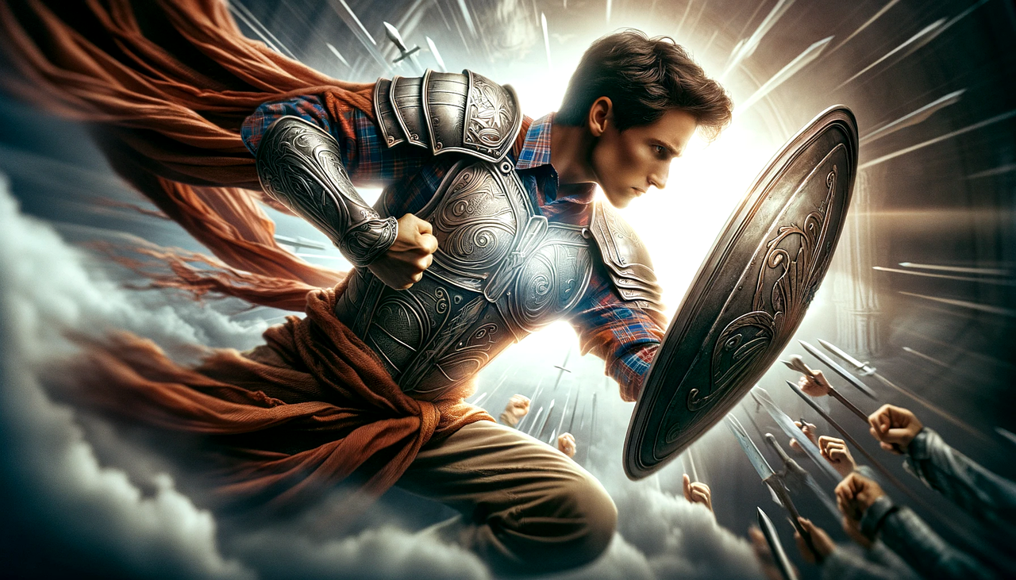
Write on a 3” x 5” card one thing you learned today that will help you do spiritual warfare.
Share with your table mates.

Slide 13
and also for me, that words may be given to me in opening my mouth boldly to proclaim the mystery of the gospel . . . that I may declare it boldly as I ought to speak.
Ephesians 6:19-20

