Slide 1
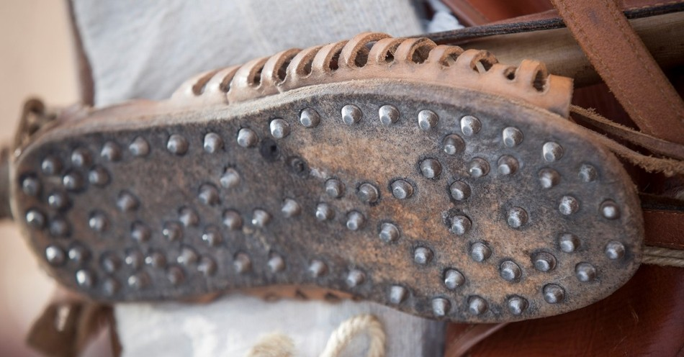
Let’s we look a little deeper at . . .
Shoes of Readiness
God is a god of peace (1 Thes. 5:23; 2 Cor. 13:11)—peace is an attribute of God (Gal. 5:22). Eirēnē (the word for peace in Greek) means tranquility, concord, unity, or oneness.
The good news of the gospel is that forgiveness of sins and access to and oneness with God
come through faith in Christ.
This oneness with God brings
peace with God.
Photo: Christianity.com

Slide 2
Let’s we look a little deeper at . . .
Shoes of Readiness
Paul repeatedly reminds us to “stand” and “stand firm.” One of the easiest ways for the enemy to succeed in shaking us loose from standing firm is to tempt us with worry. When we carry anxiousness and worry with us, we are robbed of peace.
But the gospel of peace keeps
our feet anchored and
standing firm.
Photo: Christianity.com

Slide 3
Let’s we look a little deeper at . . .
Shoes of Readiness
The enemy wants to keep the people of God quiet. So, he plants seeds of doubt in us about how well we speak, or if anyone will even listen to us.
But if we ask God, He will provide the strength and boldness we need to share our faith stories
and to praise Him publicly
without worry.
Photo: Christianity.com

Slide 4
Practical Application
Ask God daily to remind you of His gospel work on your behalf.
Remember that it is His work that secures your salvation and identity—not yours.
Immerse yourself in Scripture telling you the truth of your status in Christ.
Don’t listen to the voices
that steal your sense of
security in Christ.
Photo: Christianity.com

Slide 5
Pray to Put On the Shoes of Readiness
Lord, I pray that my feet would be fitted with the readiness given by the gospel of peace. Help me step into that readiness and walk firmly confident in that peace which comes from my relationship with You. Help me to share the gospel with others that they may have peace.
Photo: Christianity.com

Slide 6
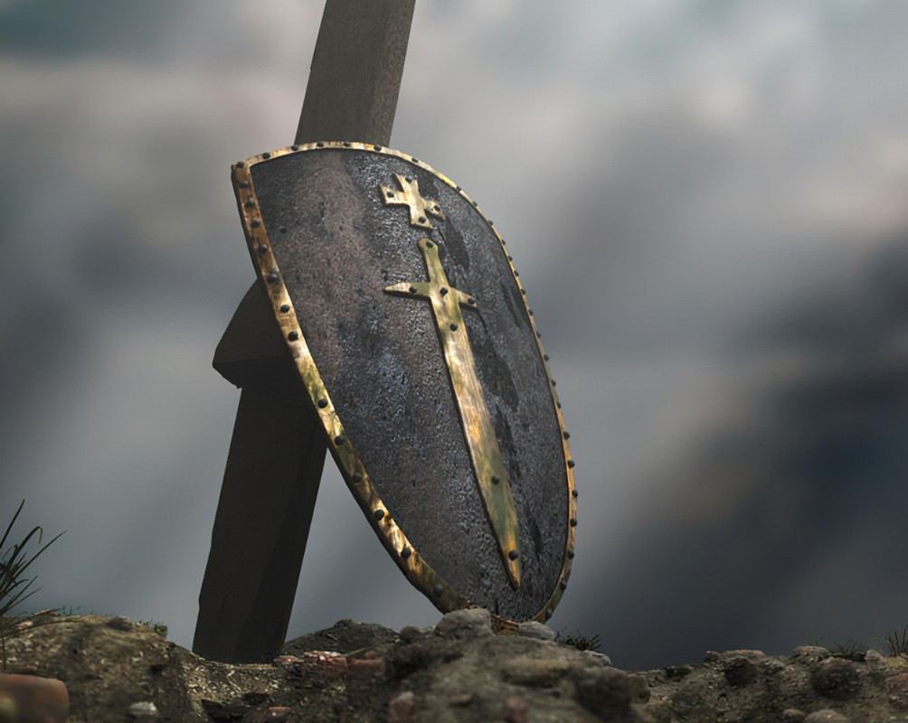
Looking a little deeper . . .
Shield of Faith
When Paul wrote this passage, Roman soldiers carried shields that were covered with heavy animal hide. Before a battle, they would dip their shields into the water so that when fiery darts hit them, the wet hide would extinguish
the darts.
ar.inspiredpencil.com

Slide 7
Looking a little deeper . . .
Shield of Faith
Similarly, a Christian’s shield of faith needs to be regularly dipped in the water of God’s word to be replenished and fully functional – because “faith comes by hearing and hearing by the word of God” (Romans 10:17).
ar.inspiredpencil.com

Slide 8
Looking a little deeper . . .
Shield of Faith
The devil's plan to derail our faith can include using situations and even other people. Our personal weaknesses can leave us open to temptations, discouragement or wrong behavior.
But when we admit our need for His
help, God will make us tougher to make
it through those trials.
ar.inspiredpencil.com

Slide 9
Practical Application
Feeling less confident than you would like? Ask the Lord to increase your faith (Mark 9:24).
Find verses that feed your faith and fill your world with them (memorize, put on Post-its, etc.).
Fix your faith in God’s righteousness,
not in circumstances.
ar.inspiredpencil.com

Slide 10
Pray to Take Up the Sheild of Faith
Lord, taking up the shield of faith, I depend on You completely. Help me not to doubt. Or worry. I am trusting in You, the Faithful One, and in Your promises to which You are always faithful. I trust You to provide for my needs. More importantly, I trust You to quench every fiery dart the enemy throws
my way. I will not be shaken, rather, I will
trust in you each day regardless of
my circumstances.
ar.inspiredpencil.com

Slide 11
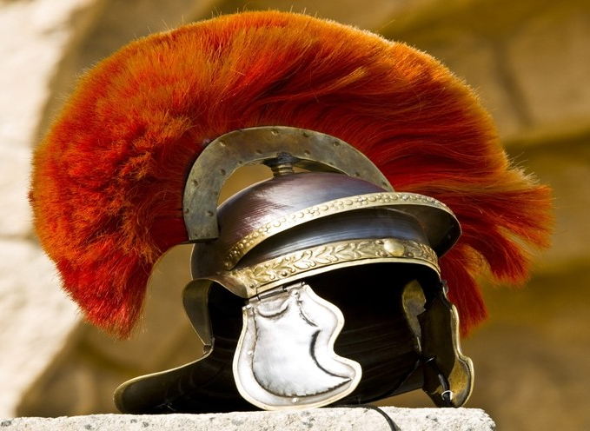
Looking Deeper . . .
Helmet of Salvation
“And this is eternal life, that they know you, the only true God, and Jesus Christ whom you sent.” (John 17:3)
Salvation comes the moment
we place our trust in Jesus’
death and resurrection as the
payment for our sin. However,
salvation is also worked out
through a lengthy process of
sanctification. (Phil. 1:6, 2:12)
christianity.com

Slide 12
Looking Deeper . . .
Helmet of Salvation
The struggle with Satan often starts in our thought life. Any faulty ideas, anxieties or fears we may be holding onto can be amplified and used against
us. But if we call on Him,
God will renew us so that
our eyes and minds will stay
focused on Him throughout
the day.
christianity.com

Slide 13
Looking Deeper . . .
Helmet of Salvation
The helmet of salvation (like the breastplate of righteousness) rests on the work of Christ to save us but also involves us as we walk with the Lord and allow Him to work that salvation
into our thoughts. The battlefield of
our mind is the primary place
spiritual battle is fought. The Lord
works His freeing truth into our
perspectives while the enemy
fights for strongholds to bind us
(John 10:10).
christianity.com

Slide 14
Practical Application
Surrender thoughts that don’t align w/Scripture. “Set your minds on things above, not on earthly things.” (Colossians 3:2)
Follow the Lord’s character and faithfulness in Scripture in your life experience.
Wash your mind with the renewing
of God’s Word. “Do not conform
to the pattern of this world but be
transformed by the renewing of
your mind. Then you will be able
to test and approve what God’s
will is—his good, pleasing, and
perfect will.” (Romans 12:2)
christianity.com

Slide 15
Pray to Put on the Helmet of Salvation
Lord, I know my salvation in Christ is a gift and I put on the helmet of salvation. I believe Jesus died, paying the penalty for my sins and rose from the grave, saving me from eternal death. I know I serve a living God, a risen Savior, and I place my faith fully in His redemptive work accomplished on
the cross and secured in His
resurrection. Thank You. Help me to
share your salvation with the world.
christianity.com

Slide 16
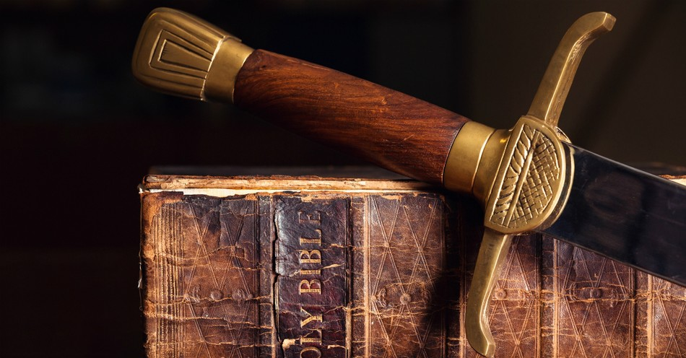
Looking Deeper . . .
Sword of the Spirit
Paul explains this piece of armor: it is the Word of God. This is the only piece of armor that is both defensive and offensive. (Would you throw your shoe at the enemy?)
Jesus modeled this well
when tempted. Each time
Satan tempted Him, Jesus
used the sword of
the Spirit (see Luke 4:1-13).
christianity.com

Slide 17
Looking Deeper . . .
Sword of the Spirit
The enemy hopes to neutralize the power we have through Christ. He aims to confuse, intimidate or scare us, hoping we'll forget God's Word. But if we seek Him, God will fill us up with the confidence to declare
Scripture and claim His
promises for our lives.
christianity.com

Slide 18
Practical Application
When the devil tempted him three times, Jesus responded with the truth of God’s Word – every time.
To do that, we must first be in God’s Word; study it.
Then, we must memorize it. How can we respond to Satan with God’s Word if we don’t
know it; if we don’t have
His Word at hand ready
to wield?
christianity.com

Slide 19
Pray to Take up the Sword of the Spirit
Lord, I take the Sword of the Spirit (Your Word), which reminds me of who you are, helps me be aware of my sin, and to know your truth. I will use your Word to fight against the Devil, his lies, and his angels. May your Word be a lamp to my feet and a light to my
path; may it purify my
thoughts and intentions.
Today and every day, I will
read, remember, and relish
what your Word says so
that the Gospel will
reverberate from my life and
help bring others to You.
christianity.com

Slide 20
Shoes

Slide 21
Shield

Slide 22
Helmet

Slide 23
Sword

