Slide 2
Review Galatians 5:25-26
“If we live by the Spirit, let us also keep in step with the Spirit. Let us not become conceited, provoking one another, envying one another.”

Slide 3
Read Ephesians 5:1-2.
Who is our example of walking in love?
Let’s watch for followers of Jesus who walk in love, also.
Jesus.

Slide 4
Can anyone remember a song, poem, or a statement about love?
Love
Is something
No one can touch
But Love touches
Everyone.

Slide 5
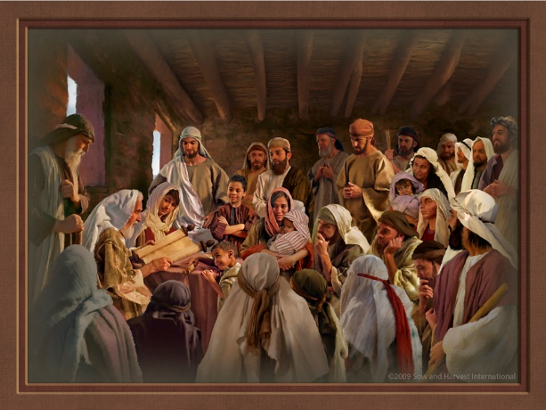
Read Acts 1 & 2
(attention to 1:14 & 2:41-47).
What does this passage tell us?
How should I respond to God?
How should I change the way I relate to people?

Slide 6
In Ephesians, we have already been talking about how we should walk as opposed to how we should not walk.
This story, in the book of Acts, emphasizes the fact that the people walked in unity.

Slide 7
Read Ephesians 4:1-6.
There’s our exhortation to walk worthy of our calling.
What does this passage tell us?

Slide 8
According to verses 2 and 3,
what is part of a worthy walk?
Humility
Gentleness
Patience
Bearing with one another in love
Eager to maintain the unity of the Spirit in the bond of peace.

Slide 9
Play around a bit with the 7 “ones” in Eph 4:4-6 and see if you can make a diagram or sketch which would illustrate the content of those verses.
(Use the back of your worksheet or draw on a flipchart)

Slide 10
The early church was unified.
We are exhorted to maintain the unity of the Spirit in the bond of peace.
What practical steps can you take to walk in unity with people in your church?
In the Body of Christ outside your church?

Slide 11
I therefore, a prisoner for the Lord, urge you to walk in a manner worthy of the calling to which you have been called, with all humility and gentleness, with patience, bearing with one another in love . . . eager to maintain the unity of the Spirit in the bond of peace.
Ephesians 4:(1-2)3

