Slide 2
. . . eager to maintain the unity of the Spirit in the bond of peace.
Review Ephesians 4:3
(Can you quote verses 1-3?)

Slide 3
What was your favorite birthday or Christmas gift as a child?
As an adult?

Slide 4
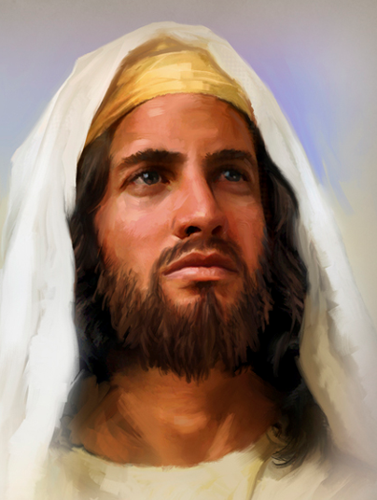
Read Ephesians 4:1-16.
Who is the person responsible for the ministry of the local church? In other words, who gave the gifts to the local church? (verse 11)

Slide 5
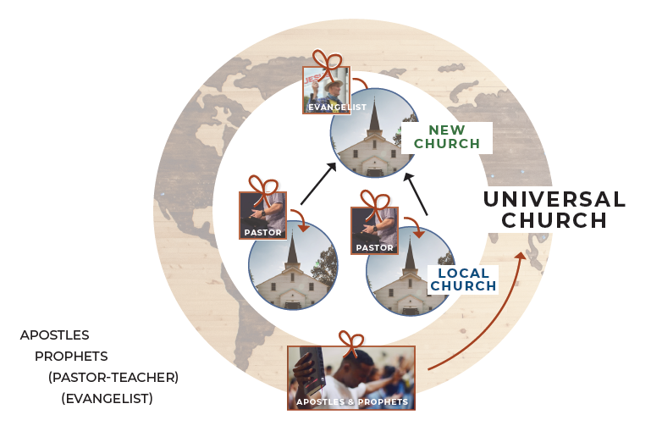
Study the graphic; see if you can explain it to your group.
.
.
.
&
The three categories of gifts were given by Jesus to the church.

Slide 6
Study the graphic; see if you can explain it to your group.
.
.
.
&
Apostles and prophets were given to the Universal Church to establish it in the beginning; to lay the foundation.

Slide 7
Study the graphic; see if you can explain it to your group.
.
.
.
&
Pastor-teachers are given to individual local churches, and . . .

Slide 8
Study the graphic; see if you can explain it to your group.
.
.
.
&
. . . evangelists are given to local churches to help build the churches and to eventually be sent out to start new churches.

Slide 9
Study the graphic; see if you can explain it to your group.
.
.
.
&
Evangelists could be considered what we call missionaries today.

Slide 10
Why were the gifts of men given (what was the purpose in giving them)?
To equip the saints (believers
who are part of the church) to
do the work of the ministry.
They are not to do all the ministry, but to equip the church members to do the work of the ministry. (Ephesians 4:12a)
.
.
&
.

Slide 11
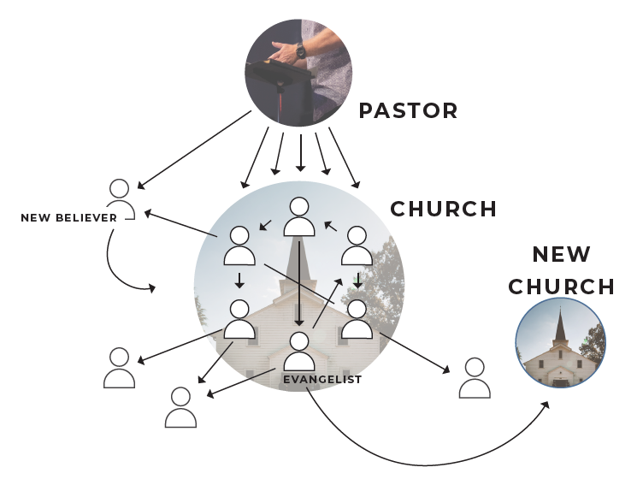
So, the personnel and the process might look something like this graphic.
At your table, explain to each other what you understand to be the meaning of the graphic.
(Be sure to explain the function of each arrow.)

Slide 12
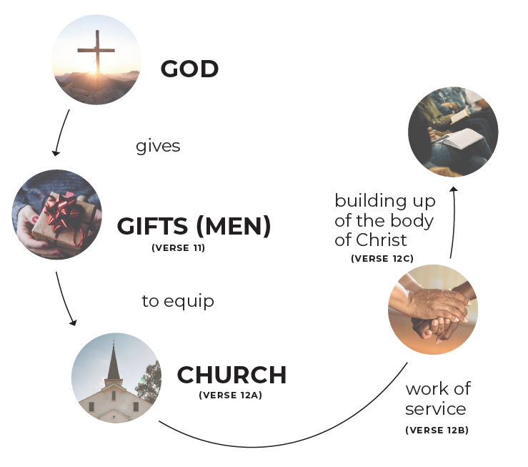
What is the purpose of the ministry?
The building up of the body—its multi-faceted growth.
(Ephesians 4:12b-13)

Slide 13
You may have noticed that in each of these questions,
a key word that starts with the letter ‘p’ shows up. Sometimes that helps people
remember concepts.
Next time we meet, we’ll
deal with the practicality of
the ministry.

Slide 14
But for now, the personality of the ministry needs to be noted: ME!
Every one of us needs to be involved in the ministry of the church. The graphic illustrating 4:13-16 shows that the gifts of pastor-teachers are given to equip us, the church, to do the work of the ministry.
Read the verses slowly
while walking thru the graphic.

Slide 15
And he (Jesus) gave . . .

Slide 16
And he (Jesus) gave
the apostles,
the prophets,
the evangelists,
the shepherd- teachers . . .

Slide 17
. . . to equip the saints . . .

Slide 18
. . . for the work of service . . .

Slide 19
. . . (building up the body of Christ)

Slide 20
The following two anonymous stories illustrate well what should happen in the church but often doesn’t.

Slide 21
There was an important job to be done, and Everybody was sure that Somebody would do it.

Slide 22
There was an important job to be done, and Everybody was sure that Somebody would do it. Anybody could have done it, but Nobody did it.

Slide 23
There was an important job to be done, and Everybody was sure that Somebody would do it. Anybody could have done it, but Nobody did it. Somebody got angry because it was Everybody’s job.

Slide 24
There was an important job to be done, and Everybody was sure that Somebody would do it. Anybody could have done it, but Nobody did it. Somebody got angry because it was Everybody’s job. Everybody thought that Anybody could do it.

Slide 25
There was an important job to be done, and Everybody was sure that Somebody would do it. Anybody could have done it, but Nobody did it. Somebody got angry because it was Everybody’s job. Everybody thought that Anybody could do it. But Nobody realized that Everybody wouldn’t do it.

Slide 26
There was an important job to be done, and Everybody was sure that Somebody would do it. Anybody could have done it, but Nobody did it. Somebody got angry because it was Everybody’s job. Everybody thought that Anybody could do it. But Nobody realized that Everybody wouldn’t do it. It ended up that Everybody blamed Somebody

Slide 27
There was an important job to be done, and Everybody was sure that Somebody would do it. Anybody could have done it, but Nobody did it. Somebody got angry because it was Everybody’s job. Everybody thought that Anybody could do it. But Nobody realized that Everybody wouldn’t do it. It ended up that Everybody blamed Somebody when Nobody did what Anybody could have done.

Slide 28
There was an important job to be done, and Everybody was sure that Somebody would do it. Anybody could have done it, but Nobody did it. Somebody got angry because it was Everybody’s job. Everybody thought that Anybody could do it. But Nobody realized that Everybody wouldn’t do it. It ended up that Everybody blamed Somebody when Nobody did what Anybody could have done. So, who did it?

Slide 29
There was an important job to be done, and Everybody was sure that Somebody would do it. Anybody could have done it, but Nobody did it. Somebody got angry because it was Everybody’s job. Everybody thought that Anybody could do it. But Nobody realized that Everybody wouldn’t do it. It ended up that Everybody blamed Somebody when Nobody did what Anybody could have done. So, who did it? Nobody!

Slide 30
Does that sound familiar?
Instead, this should be our attitude.

Slide 31
Does that sound familiar?
Instead, this should be our attitude.
I am only one.

Slide 32
Does that sound familiar?
Instead, this should be our attitude.
I am only one.
But I am one.

Slide 33
Does that sound familiar?
Instead, this should be our attitude.
I am only one.
But I am one. I can’t do everything—but I can do something.

Slide 34
Does that sound familiar?
Instead, this should be our attitude.
I am only one.
But I am one. I can’t do everything—but I can do something.
And because I can’t do everything, I won’t refuse to do the something I can do.

Slide 35
What is exciting is that God not only gives the Church pastor-teachers to equip us, but He also gives each of us individually gifts to help us do the ministry to which He has called us. We’ll look at those gifts next time . . .
I can do the work of the ministry!

Slide 36
If I speak in the tongues of men and of angels, but have not love, I am a noisy gong or a clanging cymbal. 1 Corinthians 13:1

