Slide 2
If I speak in the tongues of men and of angels, but have not love, I am a noisy gong or a clanging cymbal.
1 Corinthians 13:1

Slide 3
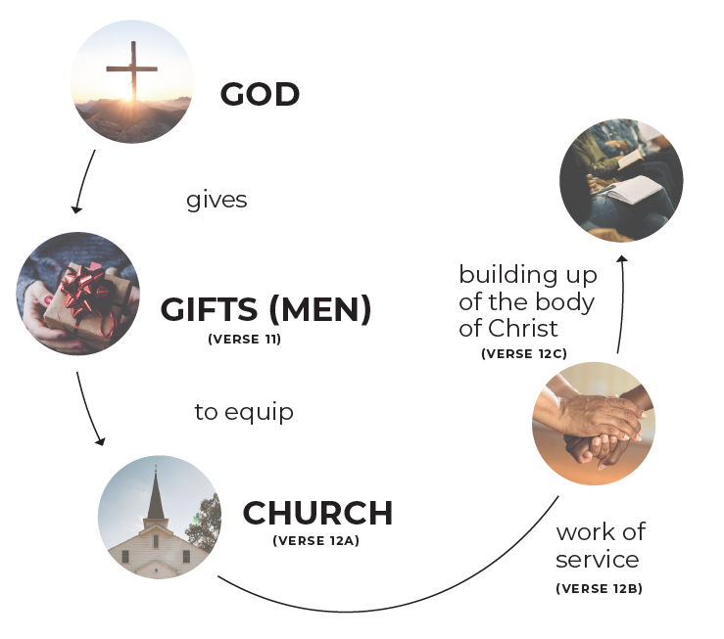
Last time, we looked at Ephesians 4 as we learned about spiritual gifts. Four passages deal with gifts in the NT
—two 4s and two 12s—
Ephesians 4
1 Peter 4
Romans 12
1 Corinthians 12

Slide 4
While the principal message of Ephesians 4 is that God gave gifts of men to the Church to minister spiritually (and the men were gifted in certain ways), the other passages inform about individual spiritual gifts given to
people so they can minister.

Slide 5
Remember, the gifts of men were given to equip the saints to do the work of the ministry. The saints also receive spiritual gifts to be used in ministering. Let’s talk about those gifts.

Slide 6
We will use the Observation, Interpretation, Application method.
We will observe, interpret, and apply the passages.
In your table groups,
read 1 Peter 4:8-11.
Make as many observations
as you can about
verses 10 and 11.

Slide 7
Verse 10 Verse 11
• “Each” receives a gift—they
are for everyone.
• To be used to serve others.
• We need to be good
stewards of what we’re given.
• Apparently, the gifts are
“varied”—several different gifts.
• Two categories of gifts—
Speaking & Serving gifts.
• Gifts are to be used
according to the grace and
strength which God gives.
• Gifts are for serving others,
but so that God will be
glorified through
Jesus Christ, the
gift giver.

Slide 8
Based on your observations, make some interpretations. In other words, what does this mean for you?

Slide 9
Let’s look at Romans 12:1-8 and 1 Corinthians 12:1-31 to see the spiritual gift lists.
Make some observations
about the passages.

Slide 10
Romans 12:1-8
• Before the gifts are mentioned, there is an appeal to present our
bodies to God as a living sacrifice. We should be in the Word
which will renew/transform our minds and thus, able to discern
God’s will. (Romans 12:1-2)
• Before the gifts are listed, the Romans are challenged not
to think too much of themselves. (Romans 12:3)
• The church is compared to a body with many different members.
(Romans 12:4)
• The gifts given are different, just as members of a body are
different. (Romans 12:6)
• Several gifts are listed. (Romans 12:6-8)

Slide 11
1 Corinthians 12
• As in 1 Peter 4, varieties of gifts—but it is the same Spirit (God)
that gives the gifts and empowers people to serve (v 4-6) as He
wills (v. 11).
• Service is mentioned again as in Romans and 1 Peter. (1 Cor. 12:5)
• Every church member receives at least one gift. (1 Cor. 12:6-7)
• The purpose of the gifts (manifestation—v 7) is “for the common
good” (compare to the purpose of serving others in 1 Peter).

Slide 12
1 Corinthians 12
• Several are listed (very few are the same as in Romans). However,
“utterance of wisdom and/or knowledge” could be associated w/
teaching and/exhortation. (1 Cor. 12:8-10)
• The Body is again the metaphor. (1 Corinthians 12:12-31)
• Examples are given showing the diversity (and equality?) of the
members of the Body. (1 Corinthians 12:14-20)
• Verses 21 to 31 appear to be teaching that one gift or gifted
person is not necessarily more important or special than another.

Slide 13
1 Corinthians 12 ends with a “cliff hanger.”
What is this more excellent way of which Paul is talking in verse 31?
(We’ll deal with that next time.)

Slide 14
But for now, let’s look at the final gifts passage (1 Peter 4:10-11) and place the gifts under the two categories given in 1 Peter 4:11.
Speaking Gifts Serving Gifts
Prophecy
Serving
Teaching
Contributing/Generosity
Leading
Mercy
Exhortation
Faith
Utterance of Wisdom/Knowledge
Gifts of Healing
Helping
Speaking of Languages
Working of Miracles
Interpretation of Languages
Administration

Slide 15
What are some practical steps (application) you might take now that you’ve learned about the gifts?

Slide 16
If I have the gift of prophecy and know all mysteries and all knowledge; and if I have all faith, so as to remove mountains, but don’t have love, I am nothing.
1 Corinthians 13:2

