Slide 2
And if I have prophetic powers, and understand all mysteries and all knowledge, and if I have all faith, so as to remove mountains, but have not love, I am nothing.
1 Corinthians 13:2

Slide 3
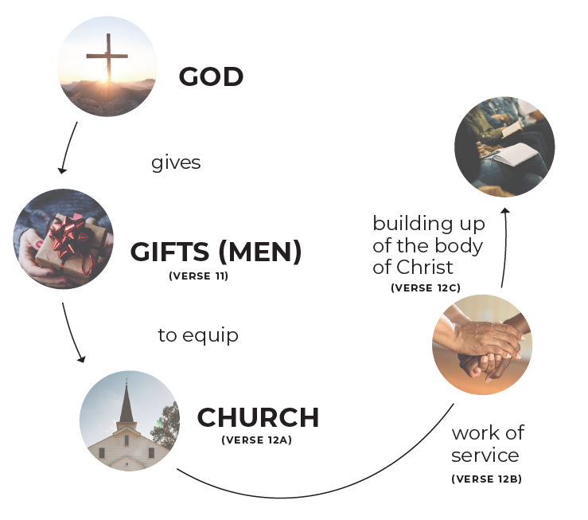
Recently, we looked at 1 Peter 4, Romans 12, and 1 Corinthians 12 and saw what they teach about spiritual gifts. As Paul finished Chapter 12 in 1 Corinthians, he said that there is a “more excellent way” in verse 31.
That way is developed and
illustrated in Chapter 13.

Slide 4
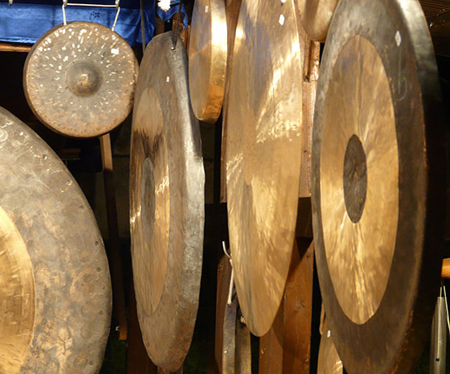
Read 1 Corinthians 13. Then respond.
What is the main point of verses 1-3?
Write a summary statement for verses 4-8a.
What is the main point of verses 8b-13?
What is most important?
(How should you use your gift?)
In love!

Slide 5
It is very clear from 1 Corinthians 13:8-10, that prophecies, tongues, and knowledge will pass away because they were (at the time of Paul’s writing) partial (v.9).
When would they be done away with? (v. 10)
“When what is
complete comes.”

Slide 6
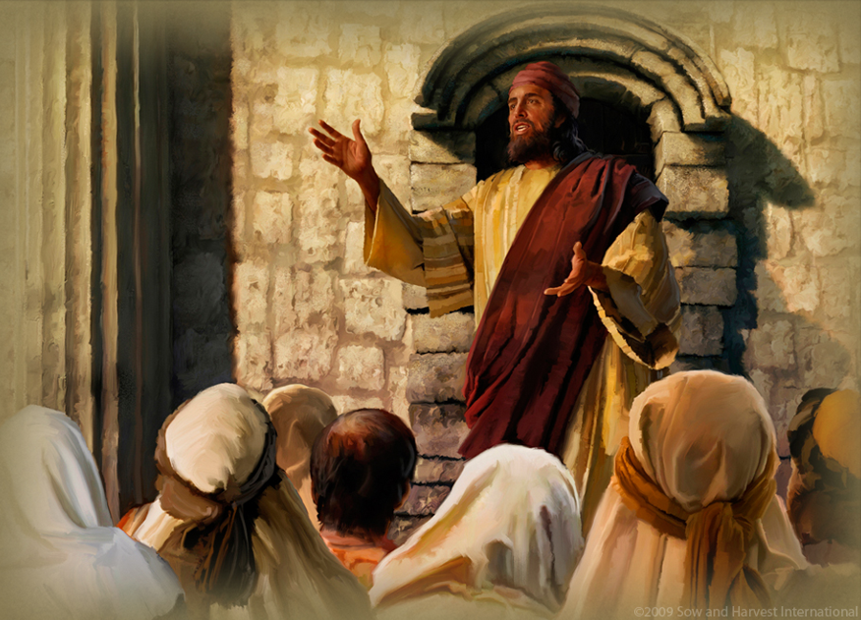
The word τέλειος (“perfect” in ESV and “complete” in NIV) means “something brought to completion, fully accomplished, fully developed, or
thorough; complete, entire.”

Slide 7
When the written Word of God was completed, these kinds of prophecies and knowledge would be “set aside” (καταργέω—rendered useless or
unproductive by something else)
and tongues would cease (παύω).

Slide 8
Thus, we believe sign gifts (e.g. tongues and prophecy) have ceased or been done away with for now, but that the other gifts are still in use by the
Spirit who gives each believer
one or more to be used in ministry.

Slide 9
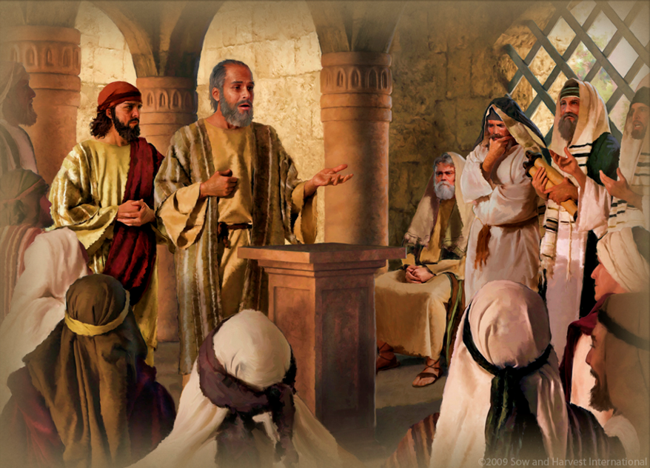
Read 1 Corinthians 14:9, 19-20, 40.
Which gift(s) is/are better? Why?
Proclaiming truth/being
understood is preferred
over tongues which are
not understood.
(1 Corinthians 14)

Slide 10
BUT HOW DOES ONE LEARN HIS/HER GIFT(S)?
First, let’s define “spiritual gift” based on what we’ve read in the gifts passages:
an ability given by God to serve Him.
The spiritual gifts were given to meet the true needs of members of the Body of Christ,
thus, building up the Body.

Slide 11
HOW DOES ONE LEARN HIS/HER GIFT(S)?
1. Inform yourself about the gifts. Study the passages. Note what the gifts
are and how they work.
2. Practice—do the ministries
associated with various
particular gifts.

Slide 12
HOW DOES ONE LEARN HIS/HER GIFT(S)?
3. Ask questions of people around you (in the Body) to determine how they see God
working through you.

Slide 13
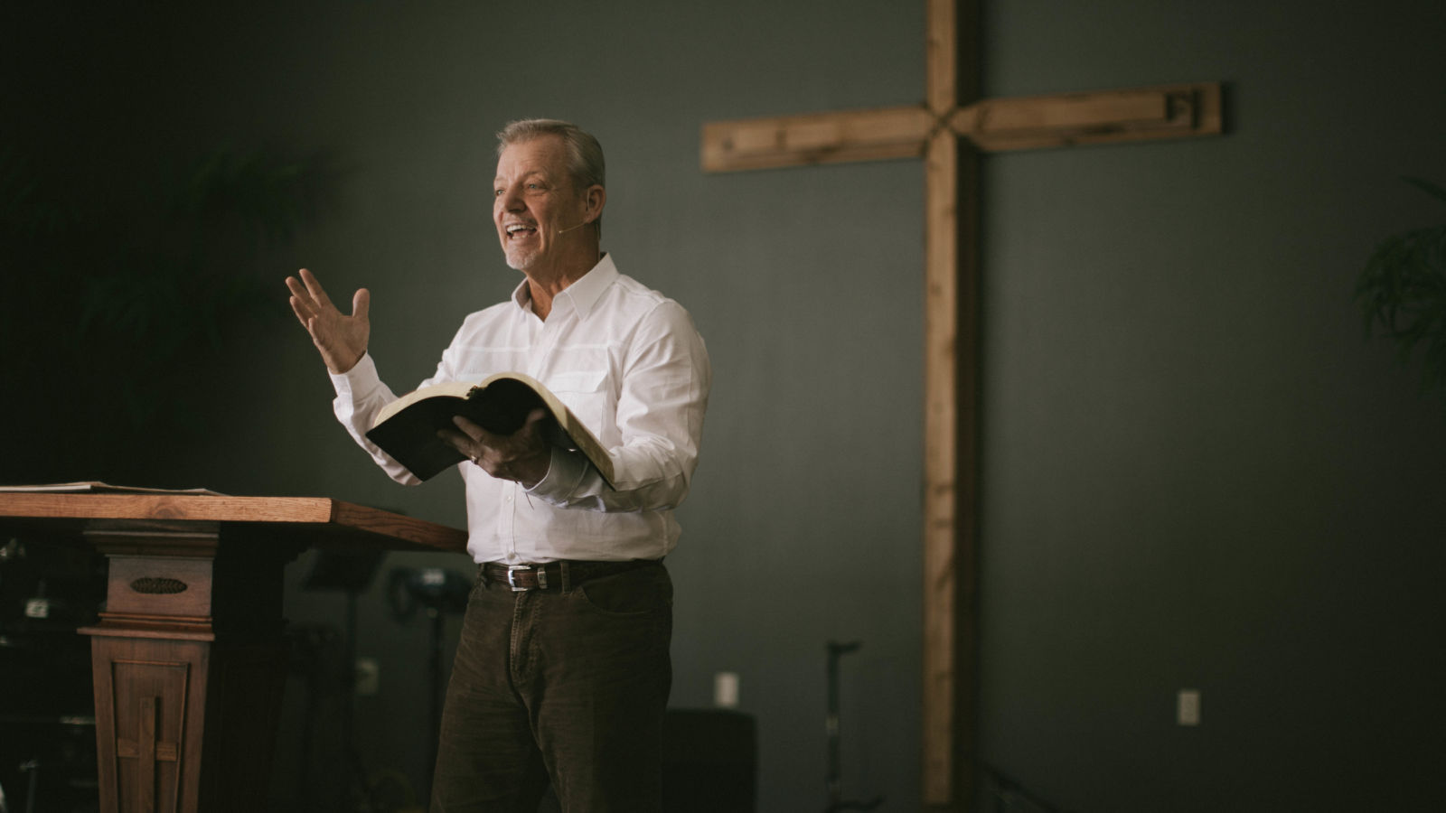
Since a God-given spiritual gift enables us to minister more effectively, then the areas in which people see God using you or where you are having more fruit, are likely to be your areas of giftedness.
Remember . . .
1. Inform
2. Practice
3. Ask

Slide 14
Appendix pages 59-62 will help you follow the above plan. Work through these pages over the next several weeks. Be sure to talk with someone about what you are learning and experiencing.

Slide 15
Two of the appendix pages give definitions of the gifts. Study them so that you get to know what they are! Then practice them and ask others how they see God using you in their lives.

Slide 16
If I give away all I have, and if I deliver up my body to be burned, but have not love, I gain nothing.
1 Corinthians 13:3

