Slide 1
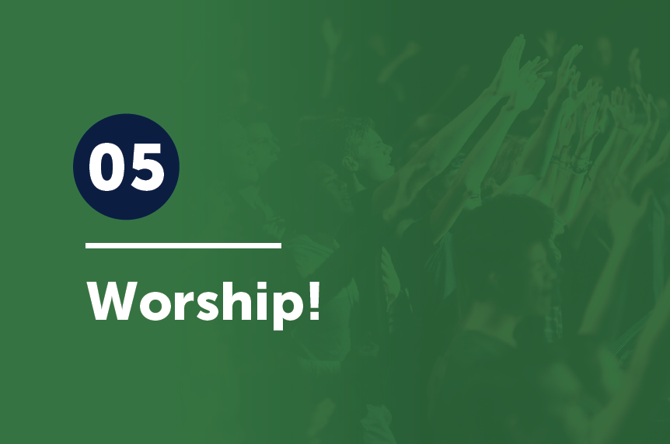

Slide 2
If I give away all I have, and if I deliver up my body to be burned, but have not love, I gain nothing.
1 Corinthians 13:3

Slide 3
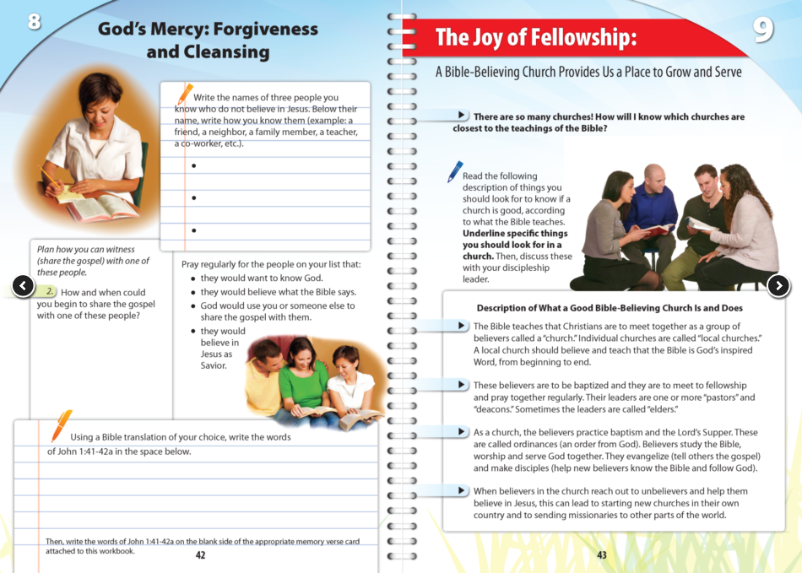
Lesson 9 “The Joy of Fellowship” in The Way to Joy, emphasized the importance of belonging to a Bible-believing church and attending regularly so you have a place to grow and serve. One main function of a local church is corporate worship, and most believers could probably tell you that.

Slide 4
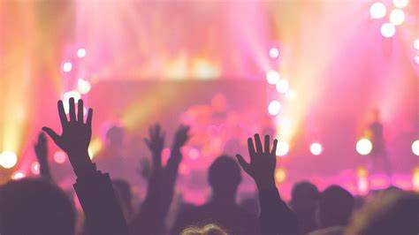
However, many of us do not worship well.
“Modern man worships his work,
works at his play,
and plays at his worship.” ¹
¹ Quoted in Donald Whitney, Spiritual Disciplines for the Christian Life (Colorado Springs; NavPress, 1991), 89.

Slide 5
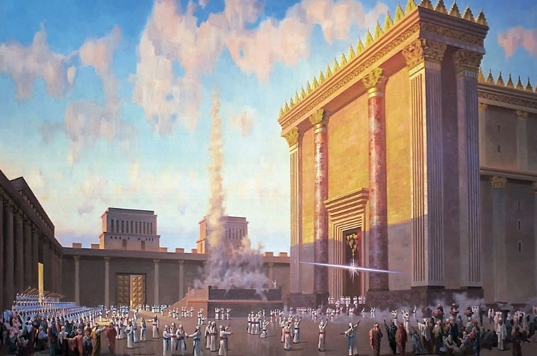
But we are commanded to worship (Deut. 6:13; Matt. 4:10).
And whether it’s done out of duty or out of love, worship should be an important part of our lives.
Read Psalm 95.
What observations can
you make from this text?

Slide 6
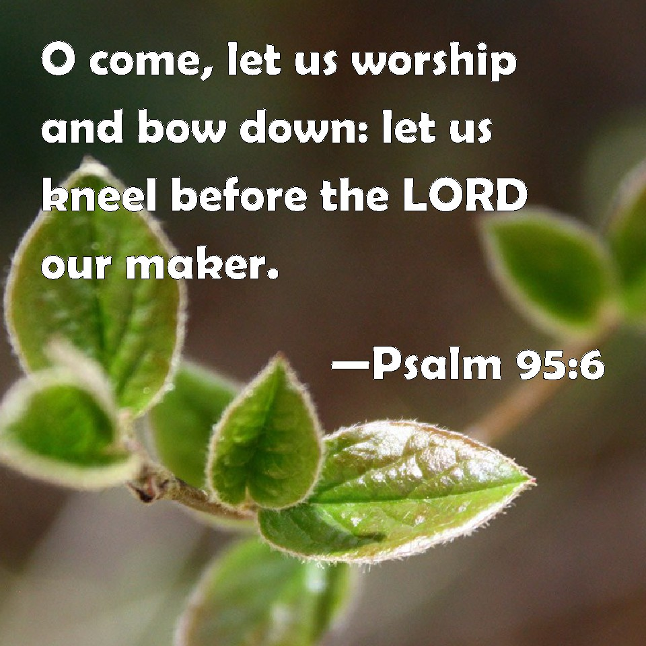
We naturally notice how the substance of a passage teaches us, but sometimes—especially in poetry like the Psalms— structure can teach us as well. The structure of Psalm 95 emphasizes the importance of worship along with the substance.
So, we will look at Psalm 95’s
Structure . . .
Substance . . . and then ask . . .
So?

Slide 7
Look at the psalm again.
What do you notice about
its structure?
Work on this as a table group.
³ For the Lord is a great God, and a great King above all gods. ⁴ In his hand are the depths of the earth; the heights of the mountains are his also. ⁵ The sea is his, for he made it, and his hands formed the dry land.
⁶ Oh come, let us worship and bow down; let us kneel before the Lord, our Maker! ⁷ For he is our God, and we are the people of his pasture, and the sheep of his hand.
Today, if you hear his voice, ⁸ do not harden your hearts,
as at Meribah, as on the day at Massah in the wilderness, ⁹ when your fathers put me to the test and put me to the
proof, though they had seen my work. ¹⁰ For forty years I loathed that generation and said, “They
are a people who go astray in their heart, and they have
not known my ways.” ¹¹ Therefore I swore in my wrath, “They shall not enter
my rest.”
¹Oh come, let us sing to the Lord; let us make a joyful noise to the rock of our
salvation! ² Let us come into his presence with thanksgiving; let us make a joyful noise to him with songs of
praise!

Slide 8
In relation to structure, we notice at least three things:
3 stanzas
(2 – 10 – 10)
1-2, 1-2
1-2-3 (Twice!)
Image: freeimages.com

Slide 9
There are three stanzas in this poem—
one short one and two long ones.
The first stanza is a call to worship:
(“Oh come!” and “Let us come.”)

Slide 10
Notice the physical participation requested in this call to worship: come . . .

Slide 11
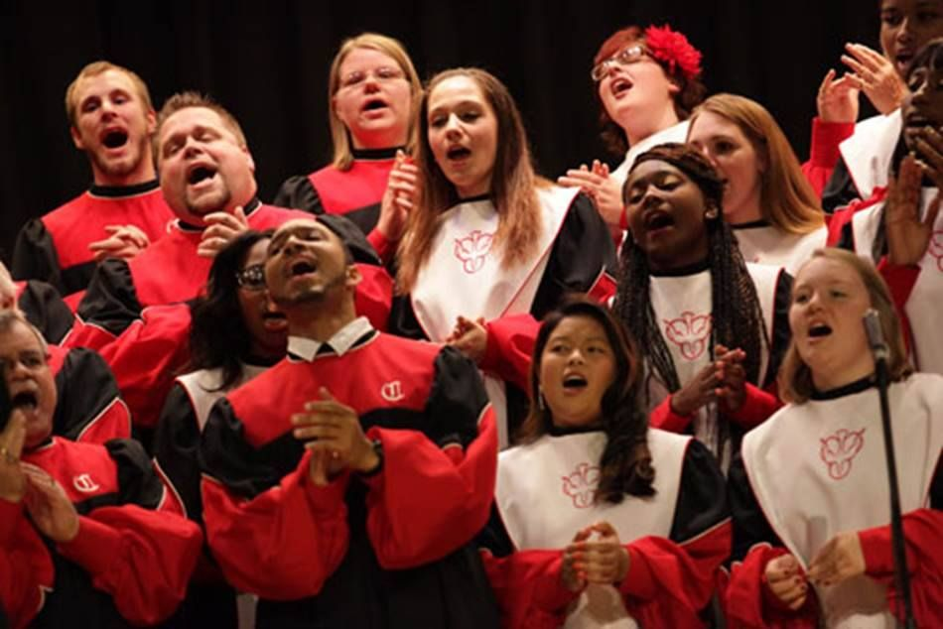
Notice the physical participation requested in that call to worship: come . . .
sing . . .

Slide 12
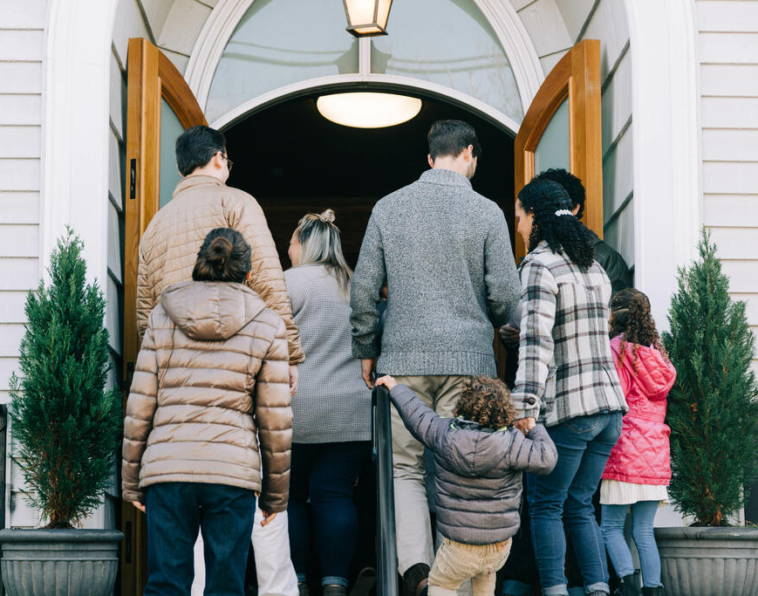
Notice the physical participation requested in that call to worship: come . . .
sing . . .
enter . . .

Slide 13
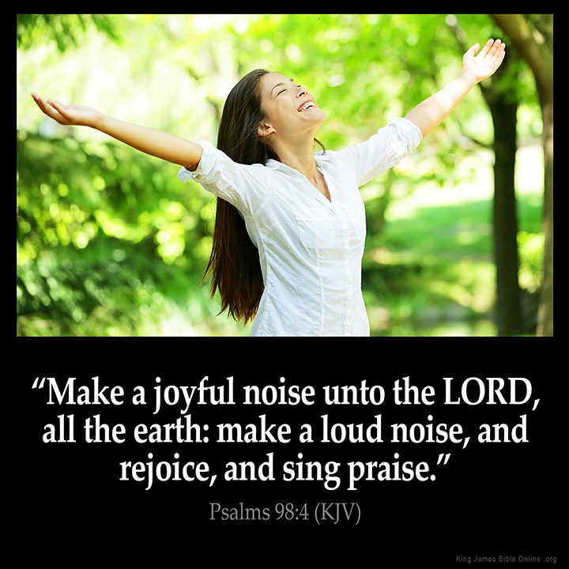
Notice the physical participation requested in that call to worship: come . . .
sing . . .
enter . . .
make a joyful noise . . .

Slide 14
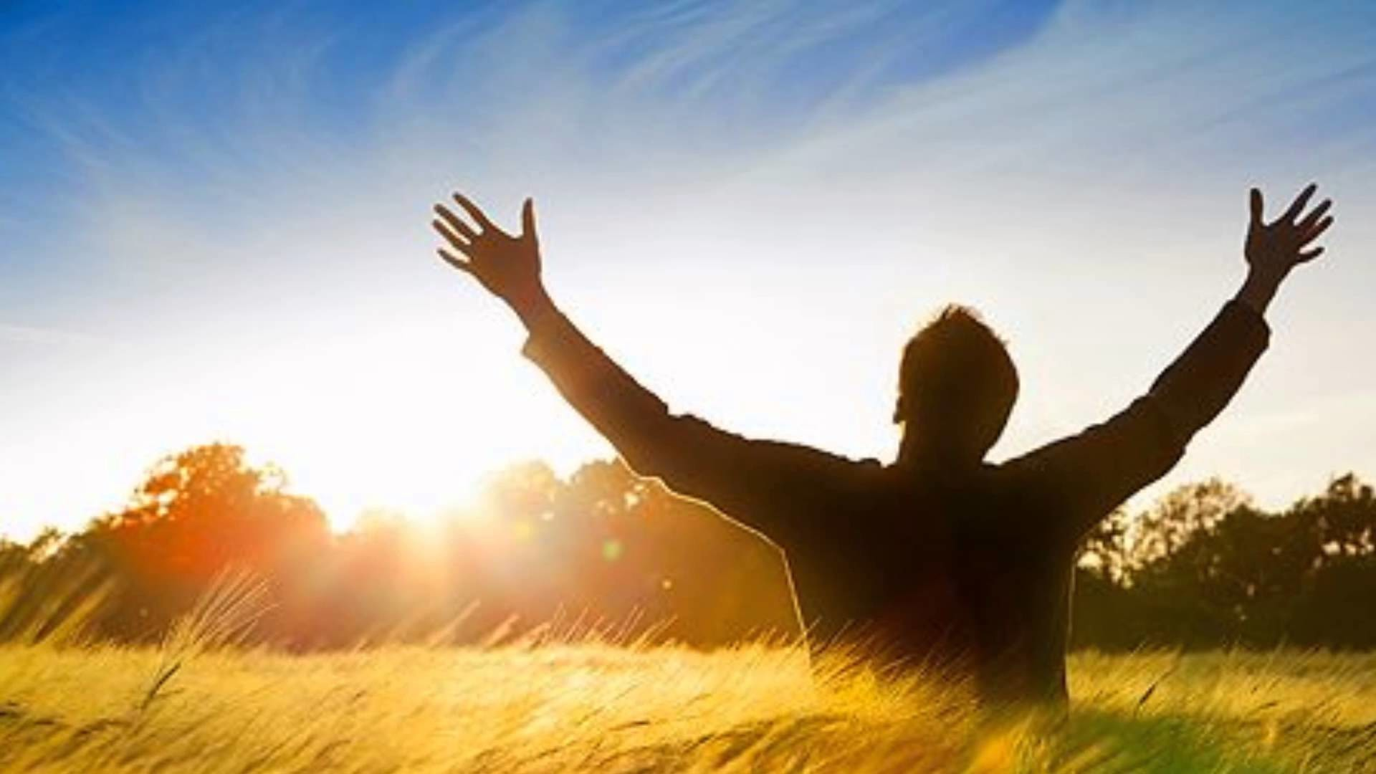
Notice the physical participation requested in that call to worship: come . . .
sing . . .
enter . . .
make a joyful noise . . .
worship . . .

Slide 15
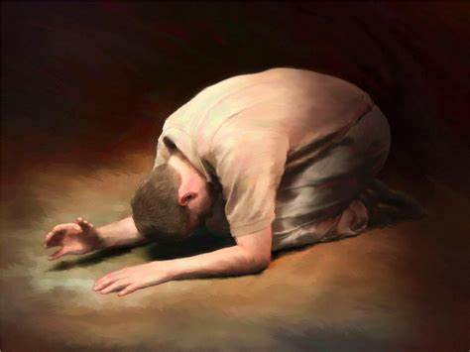
Notice the physical participation requested in that call to worship: come . . .
sing . . .
enter . . .
make a joyful noise . . .
worship . . .
bow down . . .
Image: kencarlson.org

Slide 16
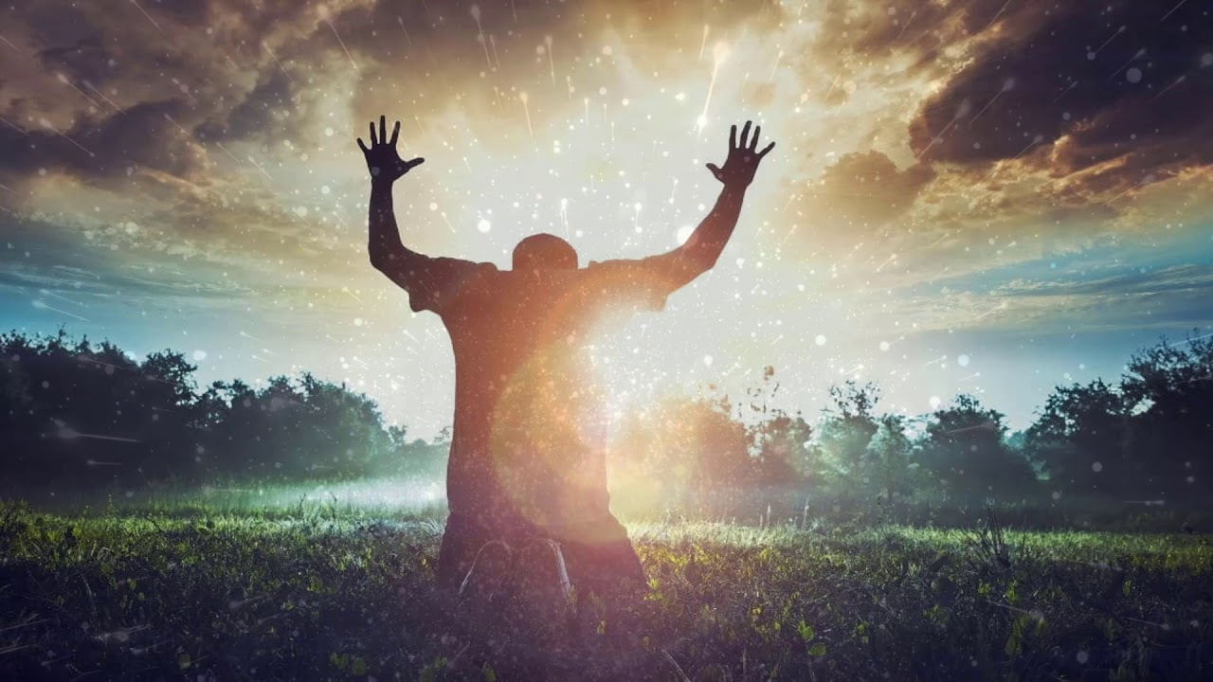
Notice the physical participation requested in that call to worship: come . . .
sing . . .
enter . . .
make a joyful noise . . .
worship . . .
bow down . . .
kneel.

Slide 17
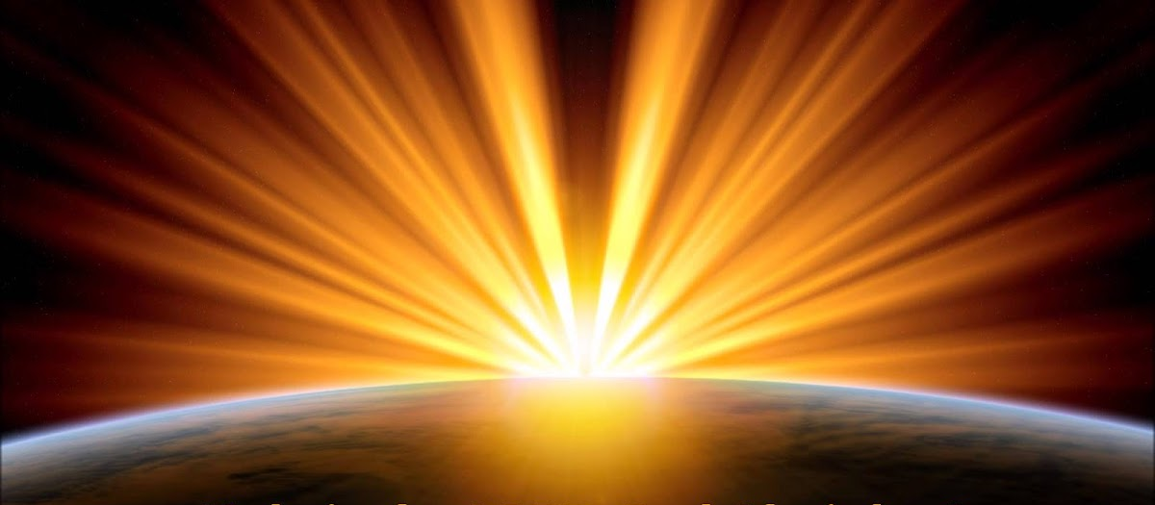
The next two stanzas tell why we should come, each one beginning with “For”.
“For the LORD is a great God . . .” and
“For He is our God.”

Slide 18
1-2 1-2
Call/Reason—
There is a call to worship and then a reason is given.
Then another call to worship and another reason given.
These go from general to specific.
Image: kencarlson.org

Slide 19
1-2 1-2
Call/Reason—
In the first call to worship, the reason given to worship is that God is great, He is the Creator.
Think of some songs/
hymns we sing dealing
with the idea that God
is Creator.
Image: kencarlson.org

Slide 20
1-2 1-2
Call/Reason—
In the second, we are to worship because we belong to Him, our Maker and our Shepherd.
Can we think of some
songs like this?
Image: kencarlson.org

Slide 21
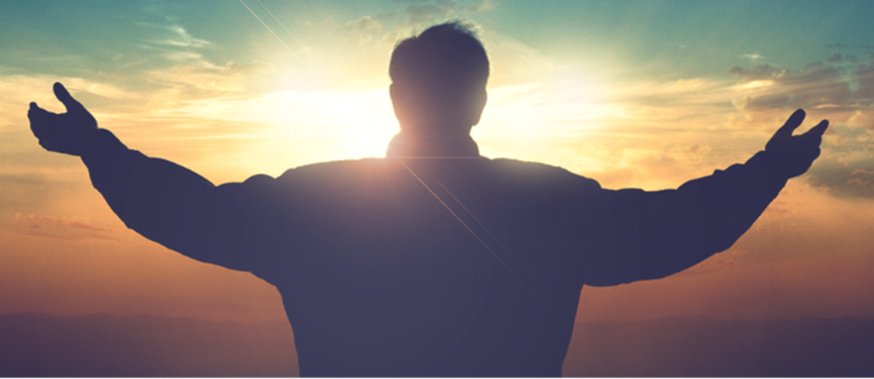
— 2 — 3 (Twice!)
3 Different Words, Showing Progress
v. 1 Let’s go... (Come on!)
v. 2 Let’s approach...
v. 6 Let’s enter...

Slide 22
3 Different Positions, Showing Worship
1.
2.
3.

Slide 23
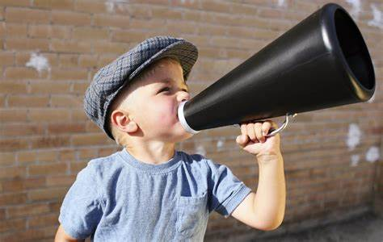
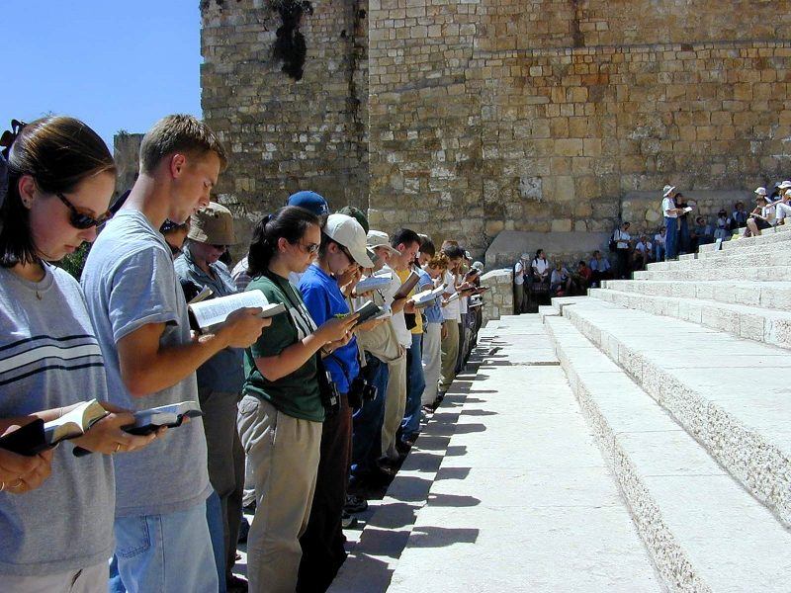
As Relates to Substance, notice three things.
1. Procession
2. Prostrate
3. Proclaim

Slide 24
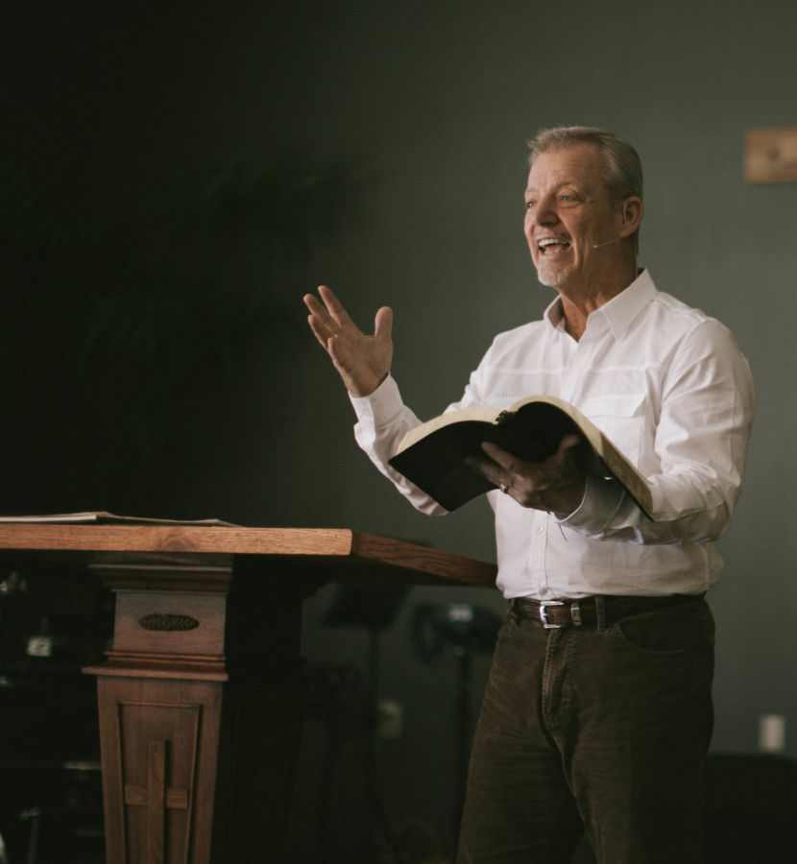
So . . .
We should put as much emphasis on our worship as on the message. “Come on! Let’s worship!”
B. We should start big but calm down
to hear God’s message.
C. We should obey (hear w/the intent to obey 7b)
(Believe and apply the truths we hear, Hebrews 3)

Slide 25
Love is patient and kind; love does not envy or boast; it is not arrogant or rude. It does not insist on its own way; it is not irritable or resentful;
1 Corinthians 13:4-5

