Slide 2
It does not rejoice in wrongdoing but rejoices with the truth.
1 Corinthians 13:6

Slide 3
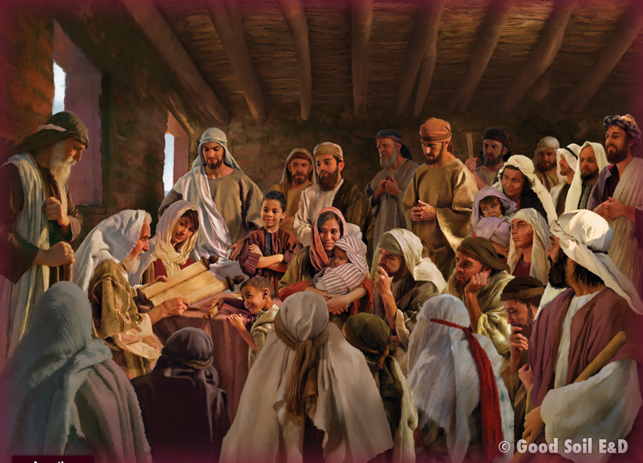
If the Antioch church in Acts 11-13 was a model evangelistic, mission-oriented church (and it was!), and if our church desires to be like or imitate that church, then it would help to know what the people were like in the Antioch church. So, let’s look at the church and its people.
Read Acts 11:19-30 & 13:1-4.

Slide 4
When Barnabas arrived in Antioch, what did he see in the people?

Slide 5
1. The grace of God was clearly seen in their lives (Acts 11:23); God had saved them gloriously—and Barnabas recognized it!
2. They experienced growth— numerical (Acts 11:21, 24, 26) and spiritual (v. 26—their conduct had changed).
3. They were generous! (Acts 11:28-30)
How is our church doing in
these areas?

Slide 6
What other observations can we make about the church and its leadership?

Slide 7
1. They understood and obeyed Jesus’ command even when
others didn’t.
They were telling non-Jews about Jesus—obeying the Great Commission(!)—when no one else would.
(Acts 11:19-20)

Slide 8
2. They were bold, innovative (see # 1), and gave of their best (13:4).
They gave Barnabas and Saul to God to be missionaries when
God asked for them.

Slide 9
3. They were cosmopolitan—look at the leaders listed in 13:1:
a. Simeon was black,
b. Lucius was from Northern Africa (an Arab?),
c. Manaen was Jewish royalty,
d. Saul was an intellectual Pharisee who had trained under the best (Gamaliel).
e. Barnabas was just a normal “Joe” (that was his name). He wasn’t an apostle or even a deacon, but he served willingly and “was a good man, full of the Holy Spirit and of faith” (11:24).

Slide 10
4. The leadership was also responsible.
When God asked for two of the five pastors, they responded positively and without hesitation. (13:3).

Slide 11
How are we doing? Are we like the Antioch church?
They . . .
. . . understood and obeyed Jesus’ command.
. . . were bold, innovative and gave of their best
. . . were cosmopolitan.
. . . were responsible.

Slide 12
How can we improve? What should we do? What practical steps might we take to become more like Antioch?
1. Being aware
2. Pray for opp’s and courage to speak up.
3. Engage w/people
4. Have some “first-liners”
5. Having questions you can ask.
6. Show appreciation (can open opp’s)
7. Be sensitive to new people at church.
8. Accountability partners

Slide 13
Remember, the Antioch church grew numerically and spiritually (Acts 13:21, 24, 26).
We should be, too.

Slide 14
Love bears all things, believes all things, hopes all things, endures all things. Love never ends.
1 Corinthians 13:7-8a

