Slide 2
Love bears all things, believes all things, hopes all things, endures all things. Love never ends.
1 Corinthians 13:7-8a

Slide 3
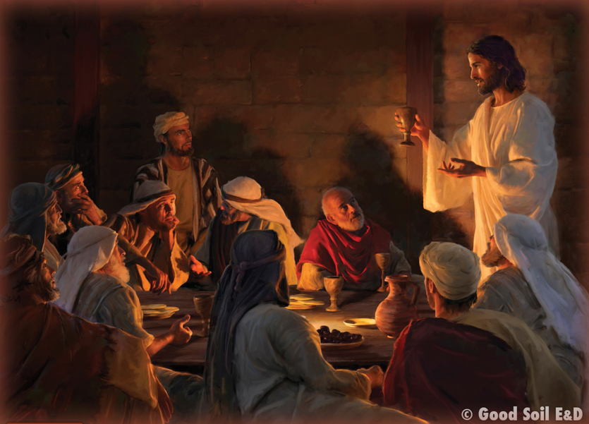
Read John 15:12. Jesus’ “one another” command occurs first (chronologically). Every other “one another” command in the rest of the NT is the work of the apostles to explain how we obey this overarching command. The primary command, therefore, is that we imitate Christ in loving one another.
Read John 13:1-35

Slide 4
How did Jesus demonstrate love before He gave the
commandment to love?
How did He demonstrate His love in an even greater way just a few hours later?
What are practical ways you can demonstrate the kind of love Jesus is talking about...to the body? ...to unbelievers?

Slide 5
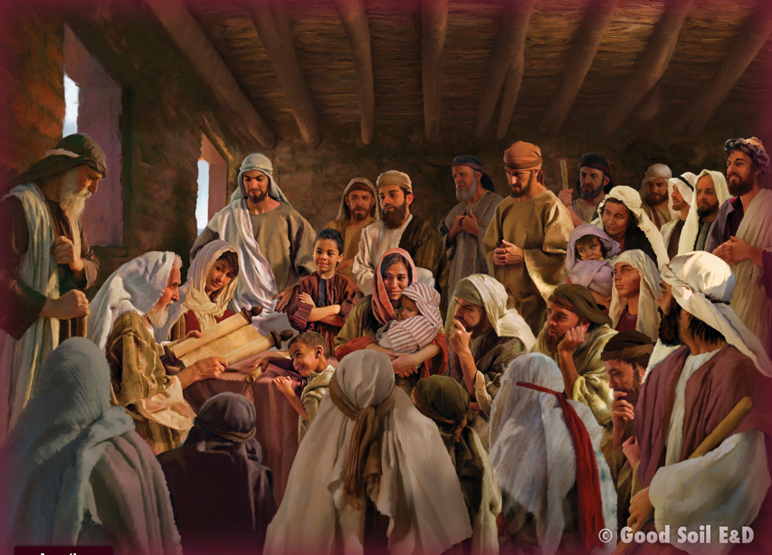
Approximately one third of the “one another” commands are about loving. Look at the list of “one another” commands, and pick several that explicitly say to love one another or seem to contribute to loving. Talk about them and then ask God to help you “one another” people around you by loving them.

Slide 6
Mark 9:50
John 13:14
John 13:34, 35, 15:12: 15:17
Romans 12:10; 16 (15:5)
Romans 14:13
Romans 15:7
Romans 16:16; 1 Peter 5:14
1 Corinthians 7:5
1 Corinthians 11:33
1 Corinthians 12:25
1 Cor 16:20; 2 Cor 13:12
2 Corinthians 13:12
Galatians 5:13
Galatians 6:2
Ephesians 4:2; Col 3:13
Ephesians 4:25
Ephesians 4:32
Ephesians 5:19
Ephesians 5:21
Colossians 3:9
Colossians 3:16
1 Thessalonians 3:12
1 Thessalonians 4:9
1 Thes 4:18; 5:11
1 Thessalonians 5:15
Hebrews 3:13
Hebrews 10:24
Hebrews 10:25
James 4:11; 5:9
James 5:16
1 Peter 1:22
1 Peter 4:8
1 Peter 4:9
1 Peter 4:10
1 Peter 5:5
1 J 3:11; 3:23: 4:7; 2 J 1:5

Slide 7
Here are some orientations for your interaction during the lesson content:

Slide 8
Observe: The full list of “one another” commands.
* What are some common themes that you observe?
* Which commands are repeated?

Slide 9
Interpret: How the commands fall under the heading of Jn 15:12
• How are the other commands (not spoken by Jesus) an effort to explain “how to obey” Jesus’ Command?
• What do the “one another” commands show us about the way Jesus loves the church?
• How did Jesus exemplify
“one another” love?

Slide 10
Apply: How must we obey?
• Which “one another” command is most natural?
• Which “one another” command is most difficult?

Slide 11
Apply: How must we obey?
• Which “one another” command is most like the way that
Jesus loved us? (Jn 15:12)
• Which “one another” command would make the most change
in our local church?

Slide 12
Apply: How must we obey?
• Which “one another” command would you like me to check
with you about next week?

Slide 13
This is my commandment, that you love one another as I have loved you.
John 15:12

