Slide 2
This is my commandment, that you love one another as I have loved you.
John 15:12

Slide 3
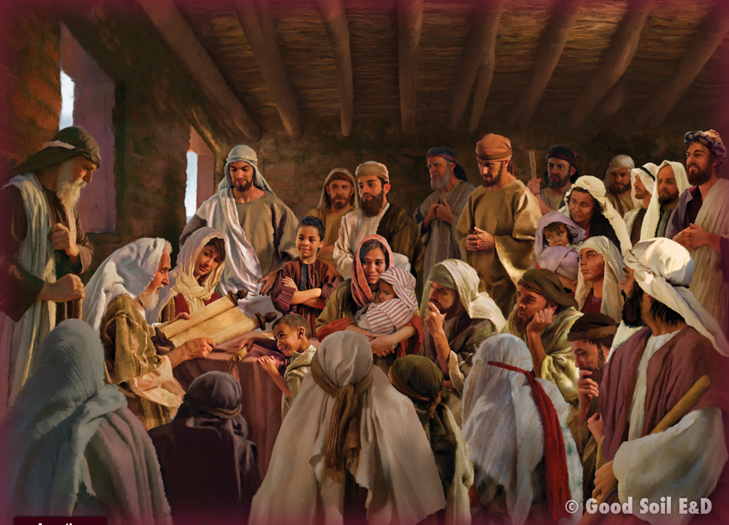
Today we will continue to look at the “one anothers” found in the New Testament. We will start by looking at an event from the early church in which we may see some obeying the one another command(s).
Read
Acts 4:32-5:11

Slide 4
Make a T-chart and list positive or negative observations you may find about the main characters in the story.
Positive +
Negative -
Barnabas
Ananias
Saphira

Slide 5
Was Barnabas practicing the “love one another” command?
How did he demonstrate love?

Slide 6
Were Ananias and Sapphira practicing the “love one another”
command?
Why or why not?

Slide 7
Mark 9:50
John 13:14
John 13:34, 35, 15:12: 15:17
Romans 12:10; 16 (15:5)
Romans 14:13
Romans 15:7
Romans 16:16; 1 Peter 5:14
1 Corinthians 7:5
1 Corinthians 11:33
1 Corinthians 12:25
1 Cor 16:20; 2 Cor 13:12
2 Corinthians 13:12
Galatians 5:13
Galatians 6:2
Ephesians 4:2; Col 3:13
Ephesians 4:25
Ephesians 4:32
Ephesians 5:19
Ephesians 5:21
Colossians 3:9
Colossians 3:16
1 Thessalonians 3:12
1 Thessalonians 4:9
1 Thes 4:18; 5:11
1 Thessalonians 5:15
Hebrews 3:13
Hebrews 10:24
Hebrews 10:25
James 4:11; 5:9
James 5:16
1 Peter 1:22
1 Peter 4:8
1 Peter 4:9
1 Peter 4:10
1 Peter 5:5
1 J 3:11; 3:23: 4:7; 2 J 1:5

Slide 8
About one third of the “one another” commands deal with unity. Look at the list of “one another” commands and pick several that you think contribute to unity.
Ask God to help you “one another” people around you and thus build unity.

Slide 9
About 15% of the “one-anothers” deal with humility.
Can you find them by looking at the list?
Can you put some of them
into practice this week?

Slide 10
Obviously, the “one anothers” have to do with the church.
But God wants us to love people outside the church as well.
How will you show love to unbelievers this week?

Slide 11
Little children, let us not love in word or talk but in deed and in truth.
1 John 3:18

Slide 12
Little children, let us not love in word or talk but in deed and in truth.
1 John 3:18

