Slide 1


Slide 2
What
for?
is a
Bridge

Slide 3


Slide 4
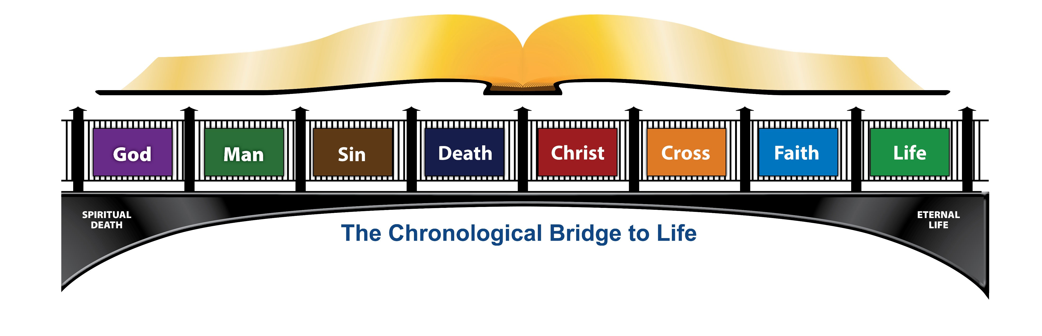

Slide 5


Slide 6


Slide 7


Slide 8


Slide 9
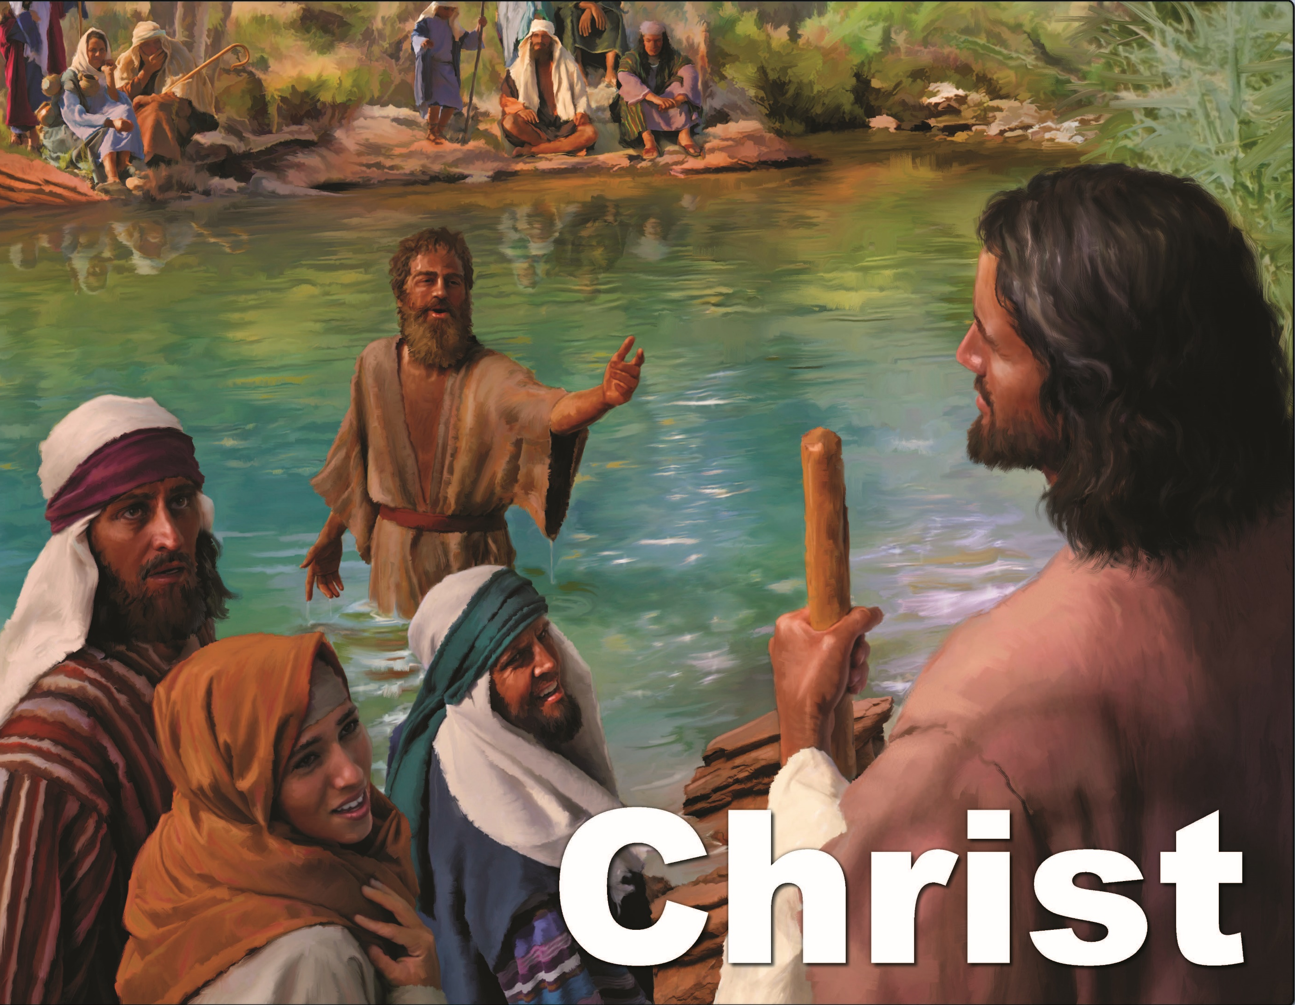

Slide 10
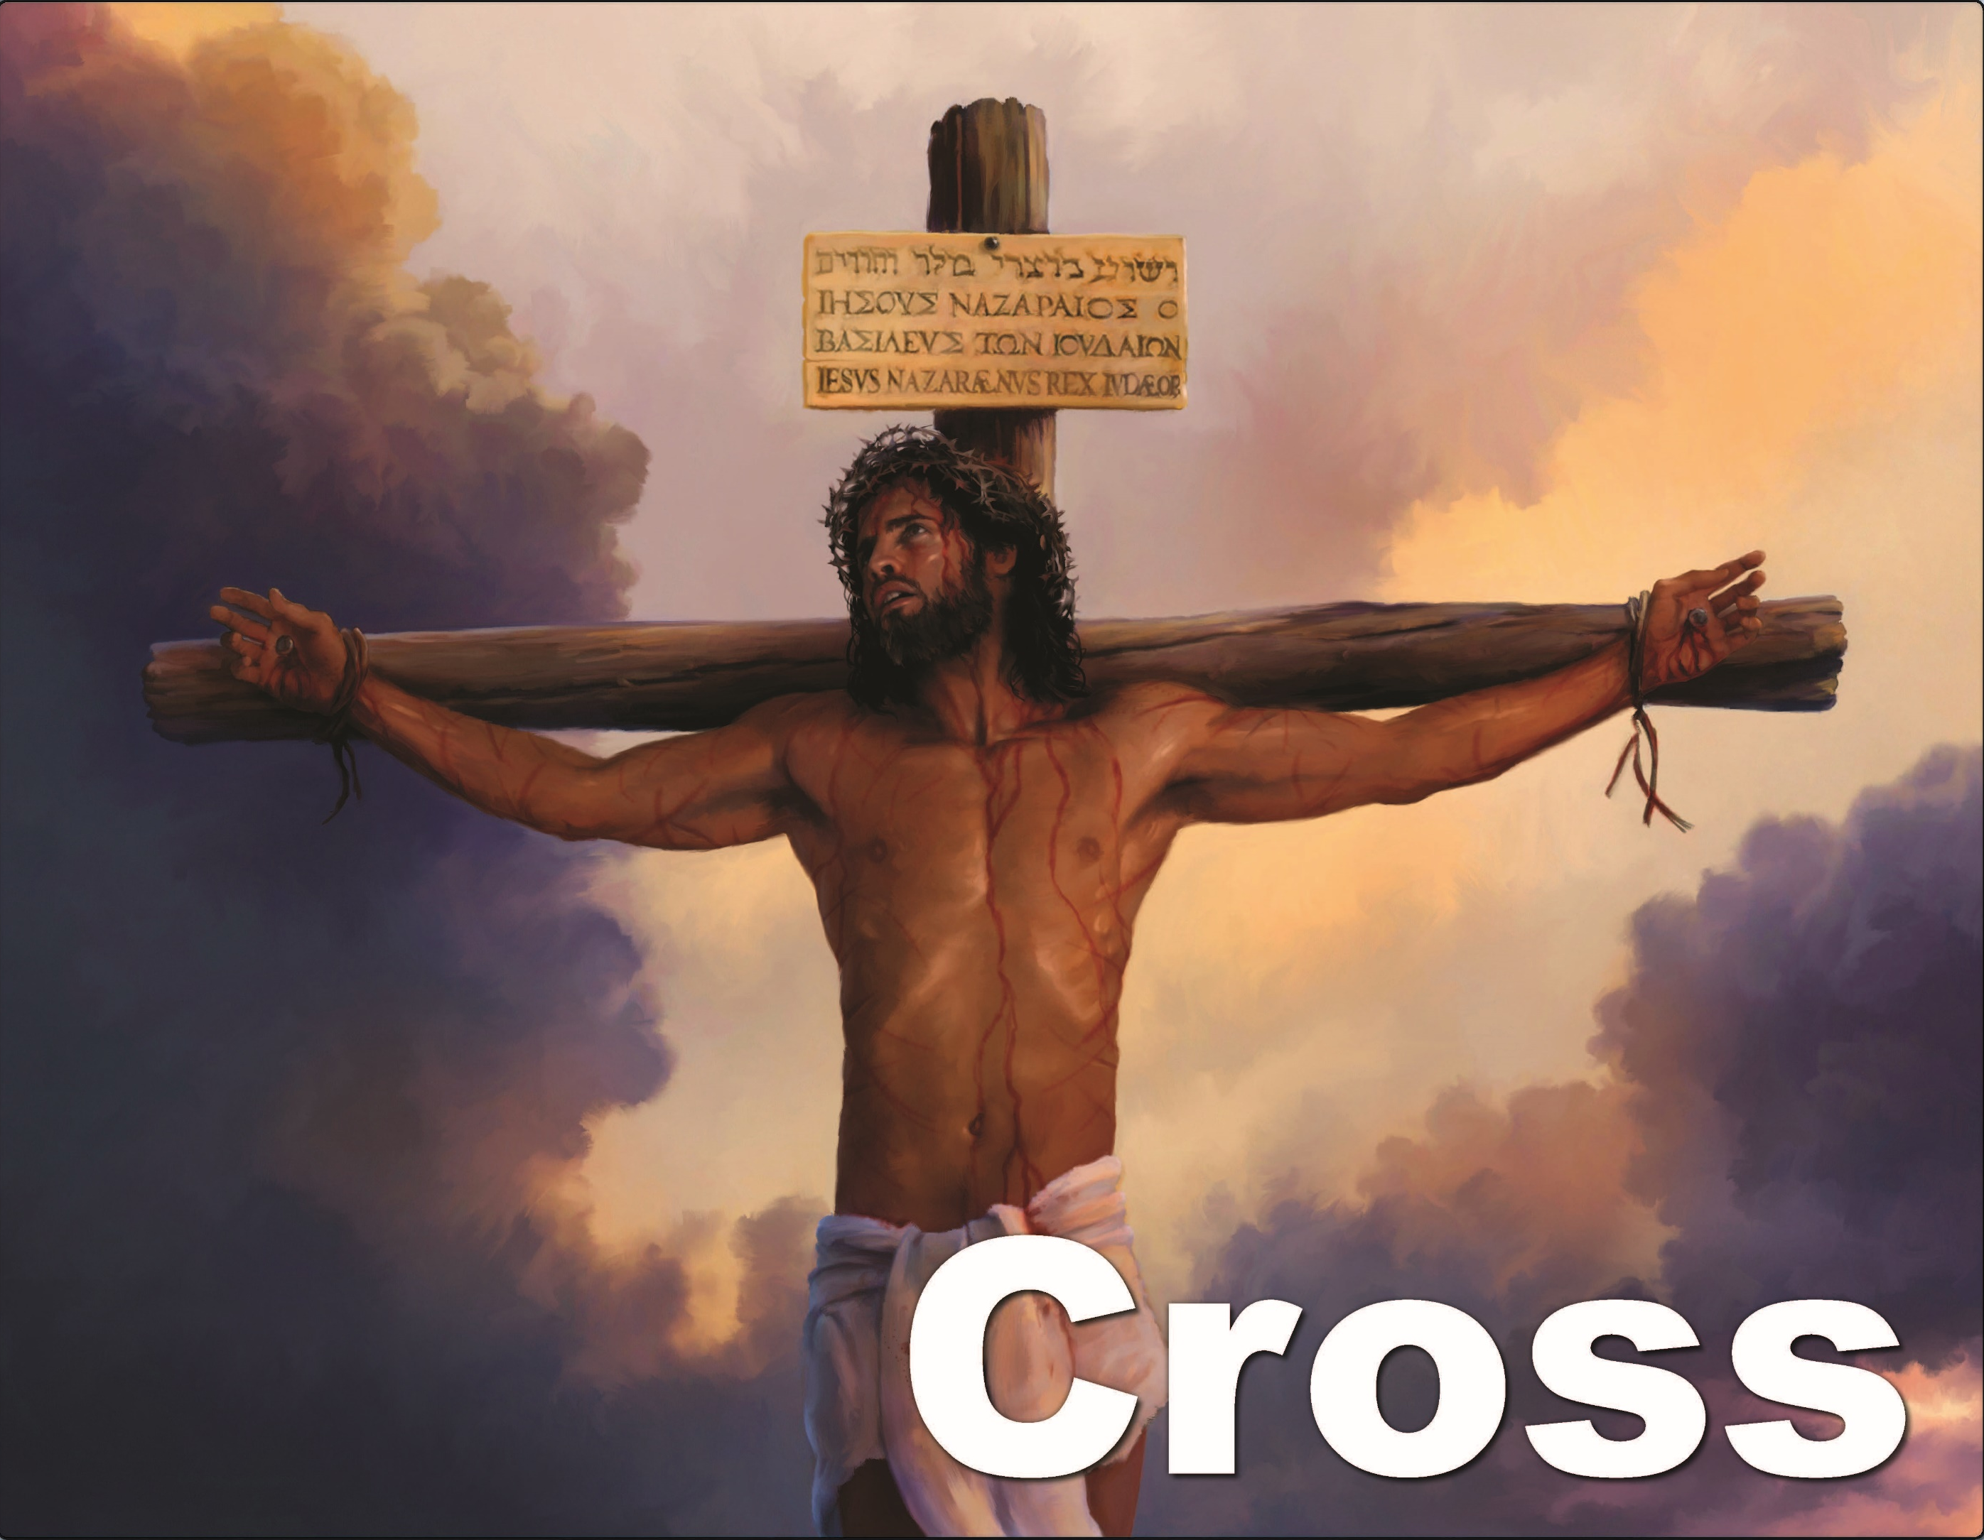

Slide 11
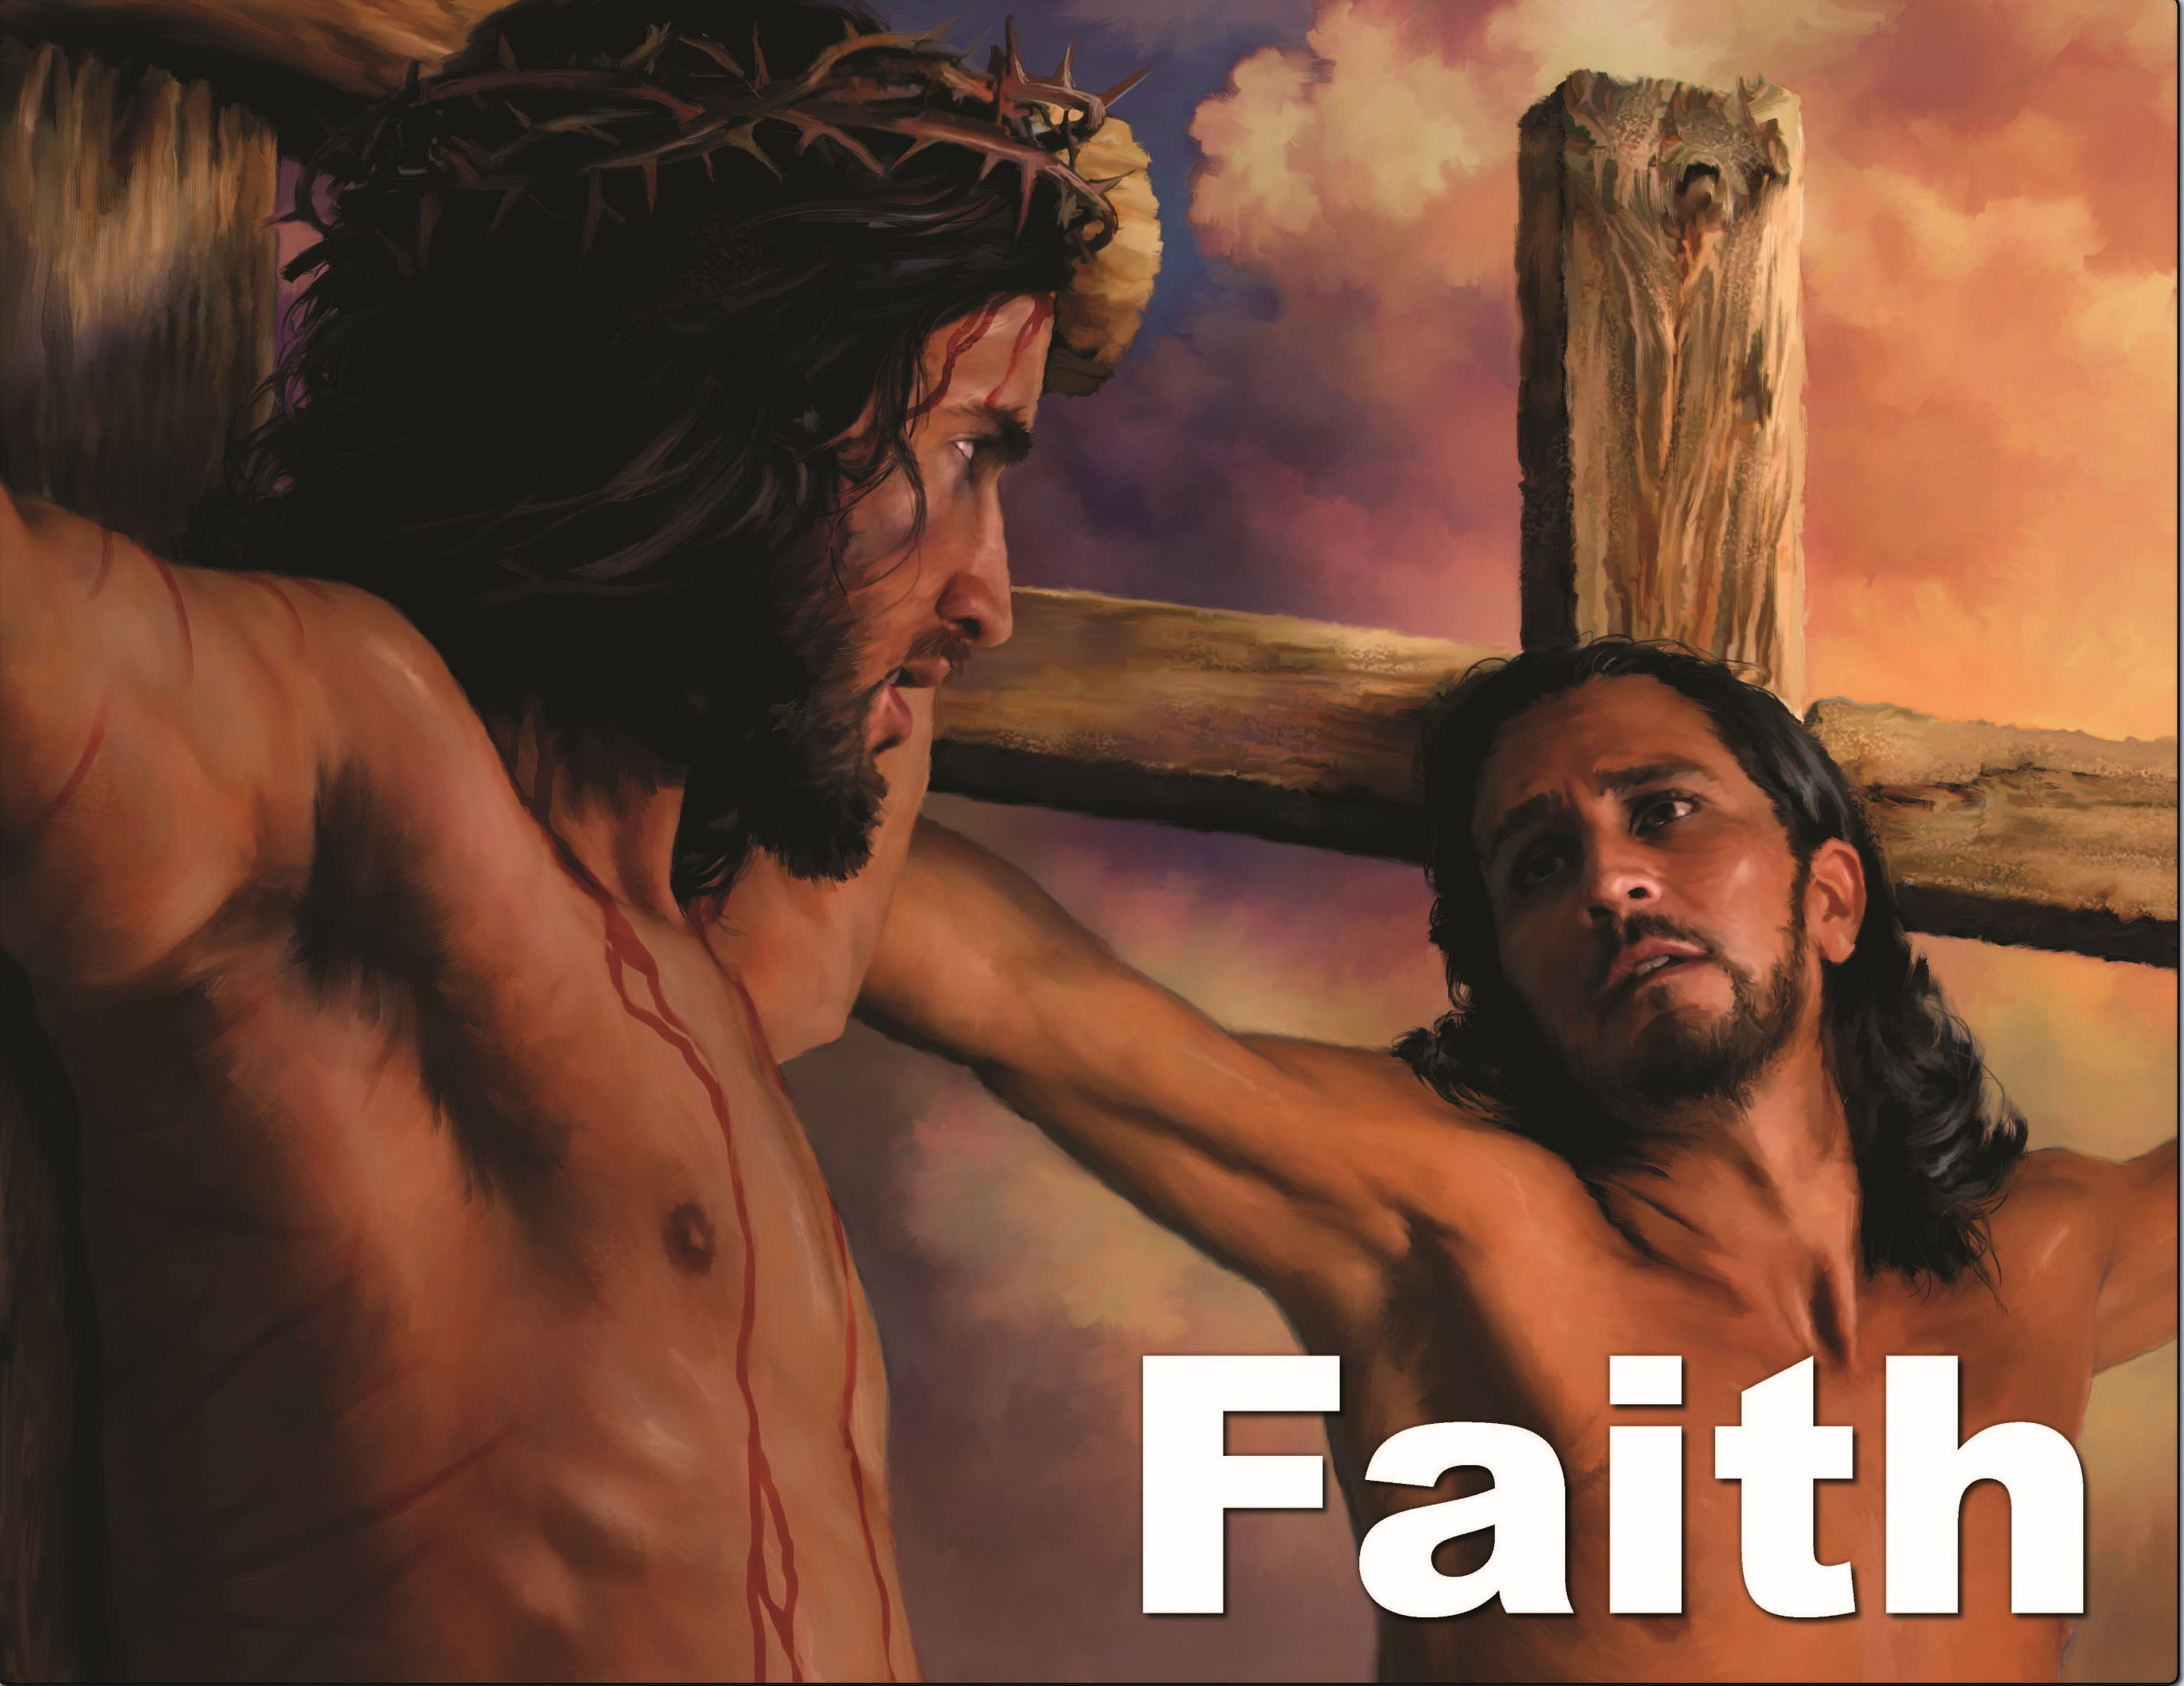

Slide 12


Slide 13
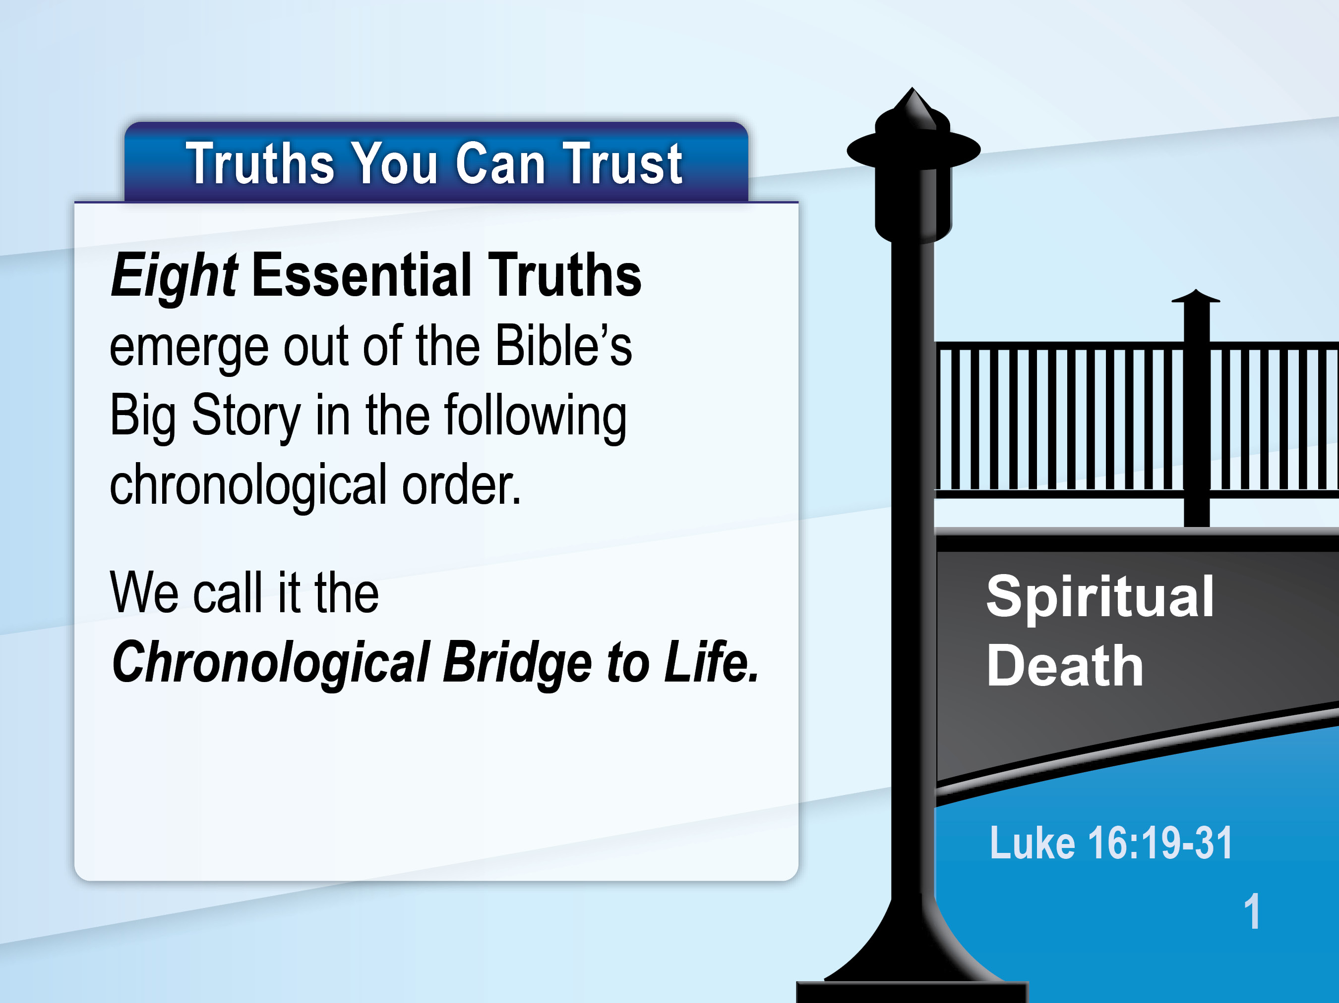

Slide 14
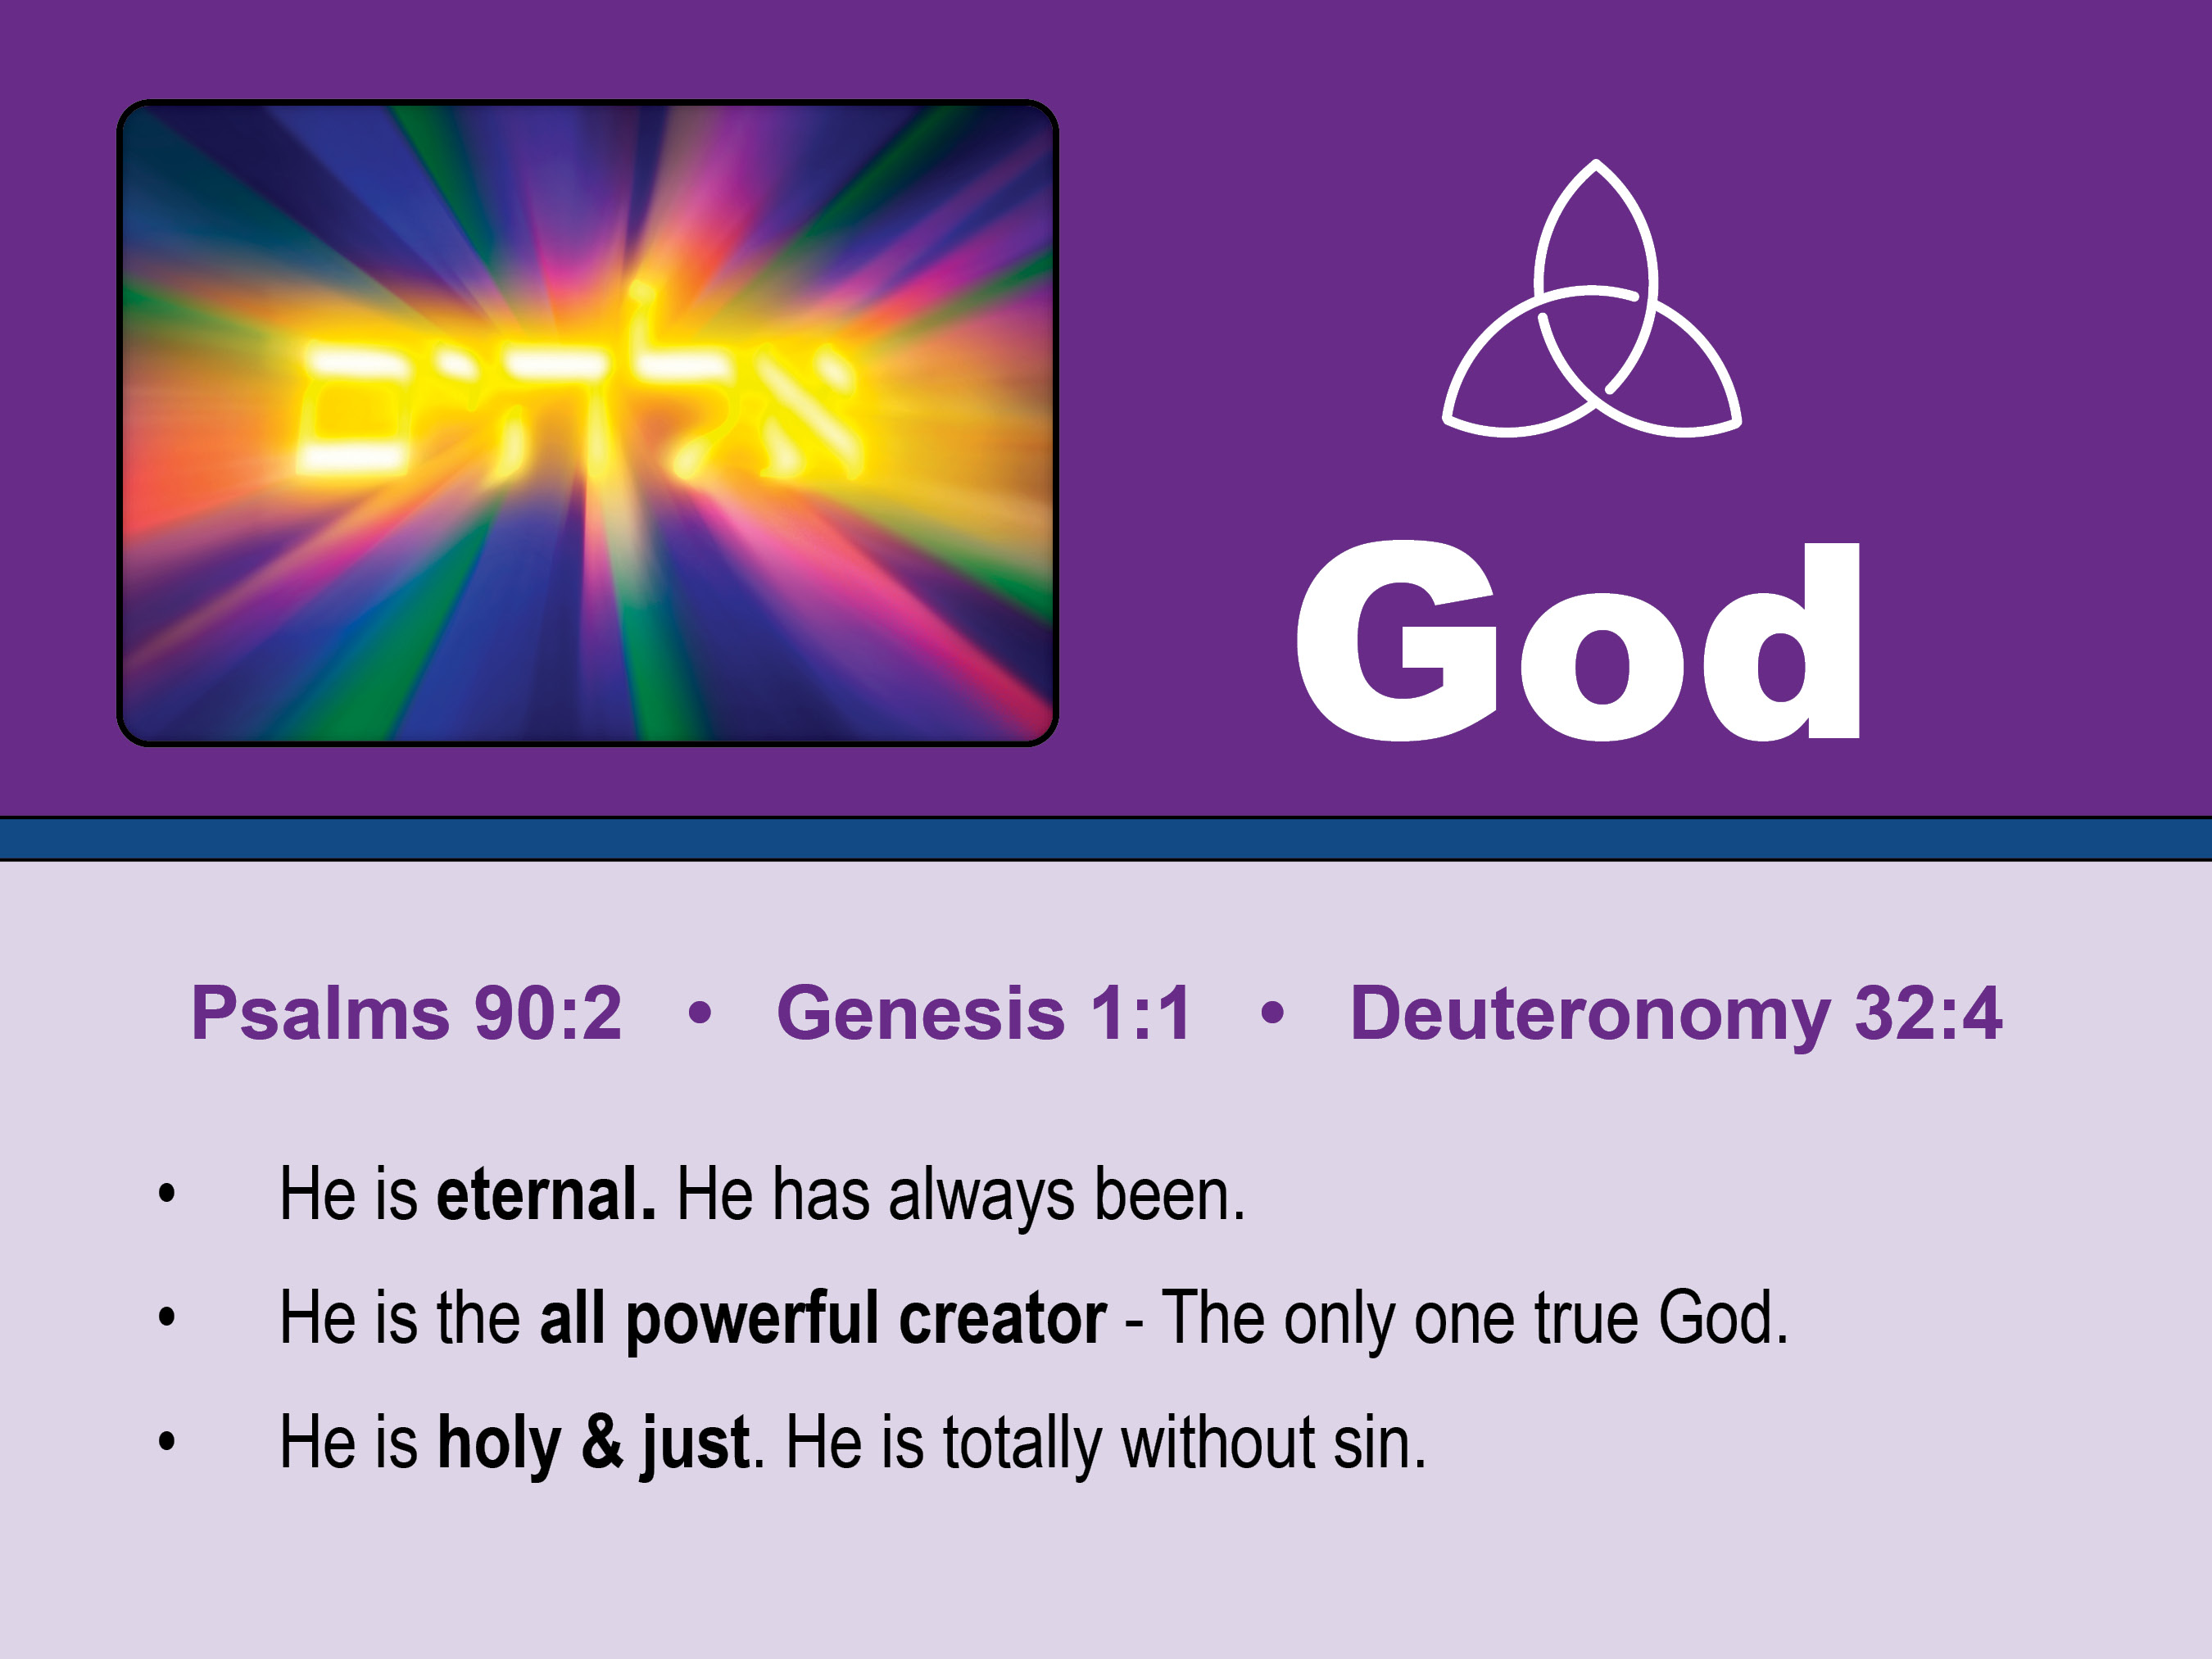
Before the mountains were brought forth, or ever you had formed the earth and the world, from everlasting to everlasting you are God. Psalm 90:2
God is Eternal. He has always existed.

Slide 15
He is the all-powerful creator,
the one true living God.
In the beginning God created the heavens and the earth. Genesis 1:1

Slide 16
He is holy and just,
He is totally without sin.
The Rock, his work is perfect, for all his ways are justice. A God of faithfulness and without iniquity,
just and upright is he. Deuteronomy 32:4

Slide 17
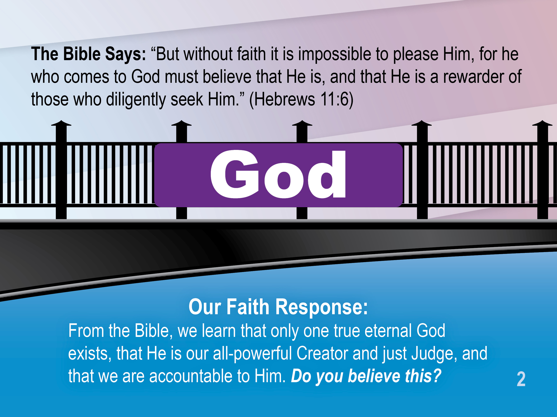

Slide 18
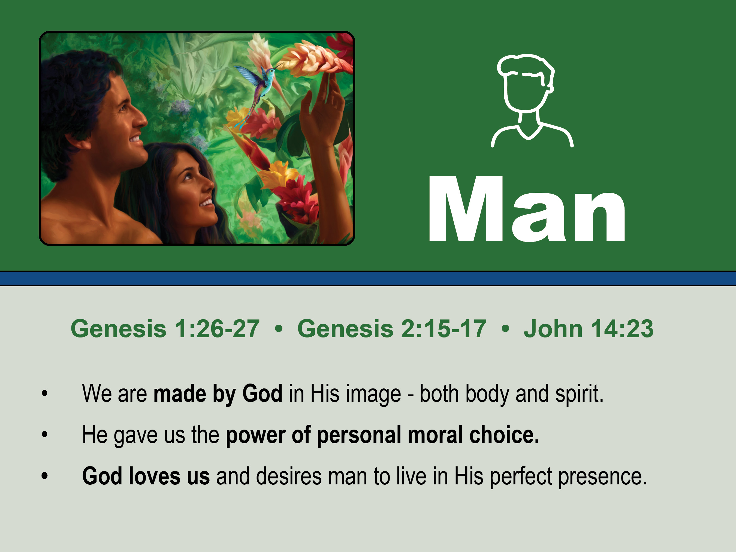
Then God said, “Let us make man in our image, after our likeness. And let them have dominion over the fish of the sea . . . Genesis 1:26-27
We are made in God’s image/body & spirit.

Slide 19
God gave us the power of personal,
moral choice; He lets us choose.
You may surely eat of every tree of the garden, but of the tree of the knowledge of good and evil you shall not eat . . . for . . . Genesis 2:15-17

Slide 20
God loves us and desires humans
to live in His perfect presence.
Jesus: “If anyone loves me, he will keep my word, and my Father will love him, and we will come to him and make our home with him.” John 14:23

Slide 21
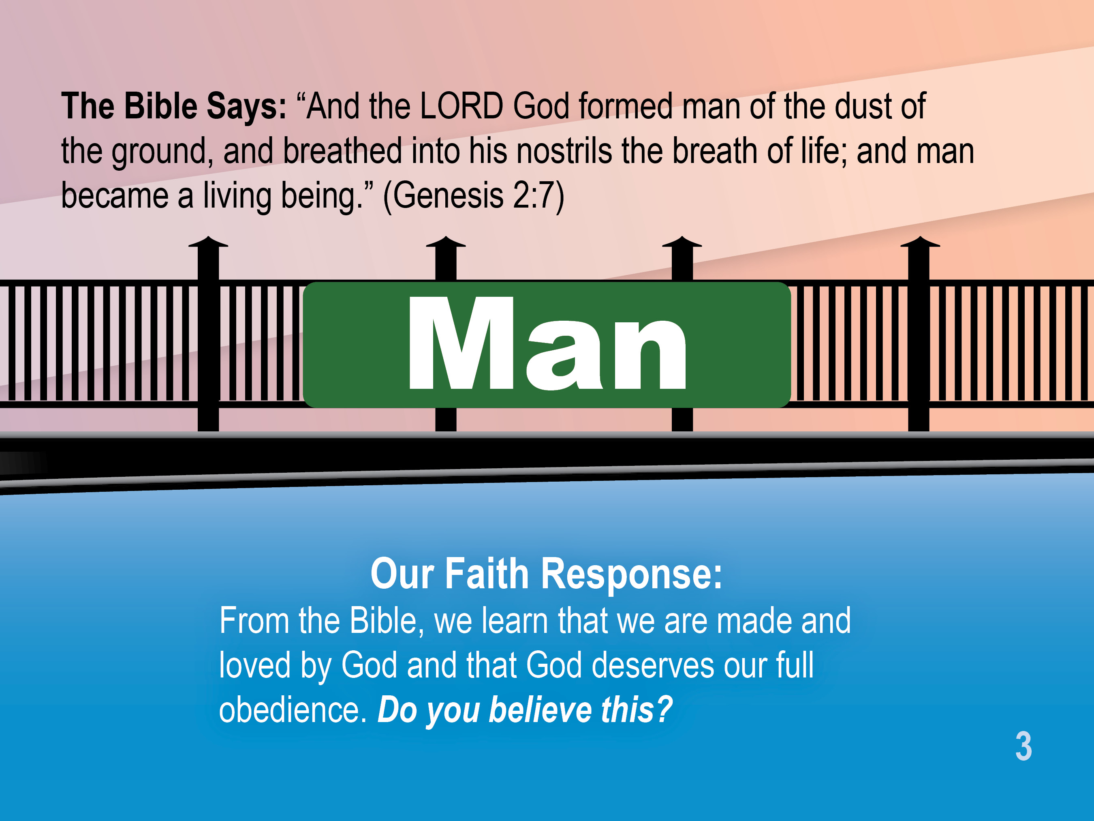

Slide 22
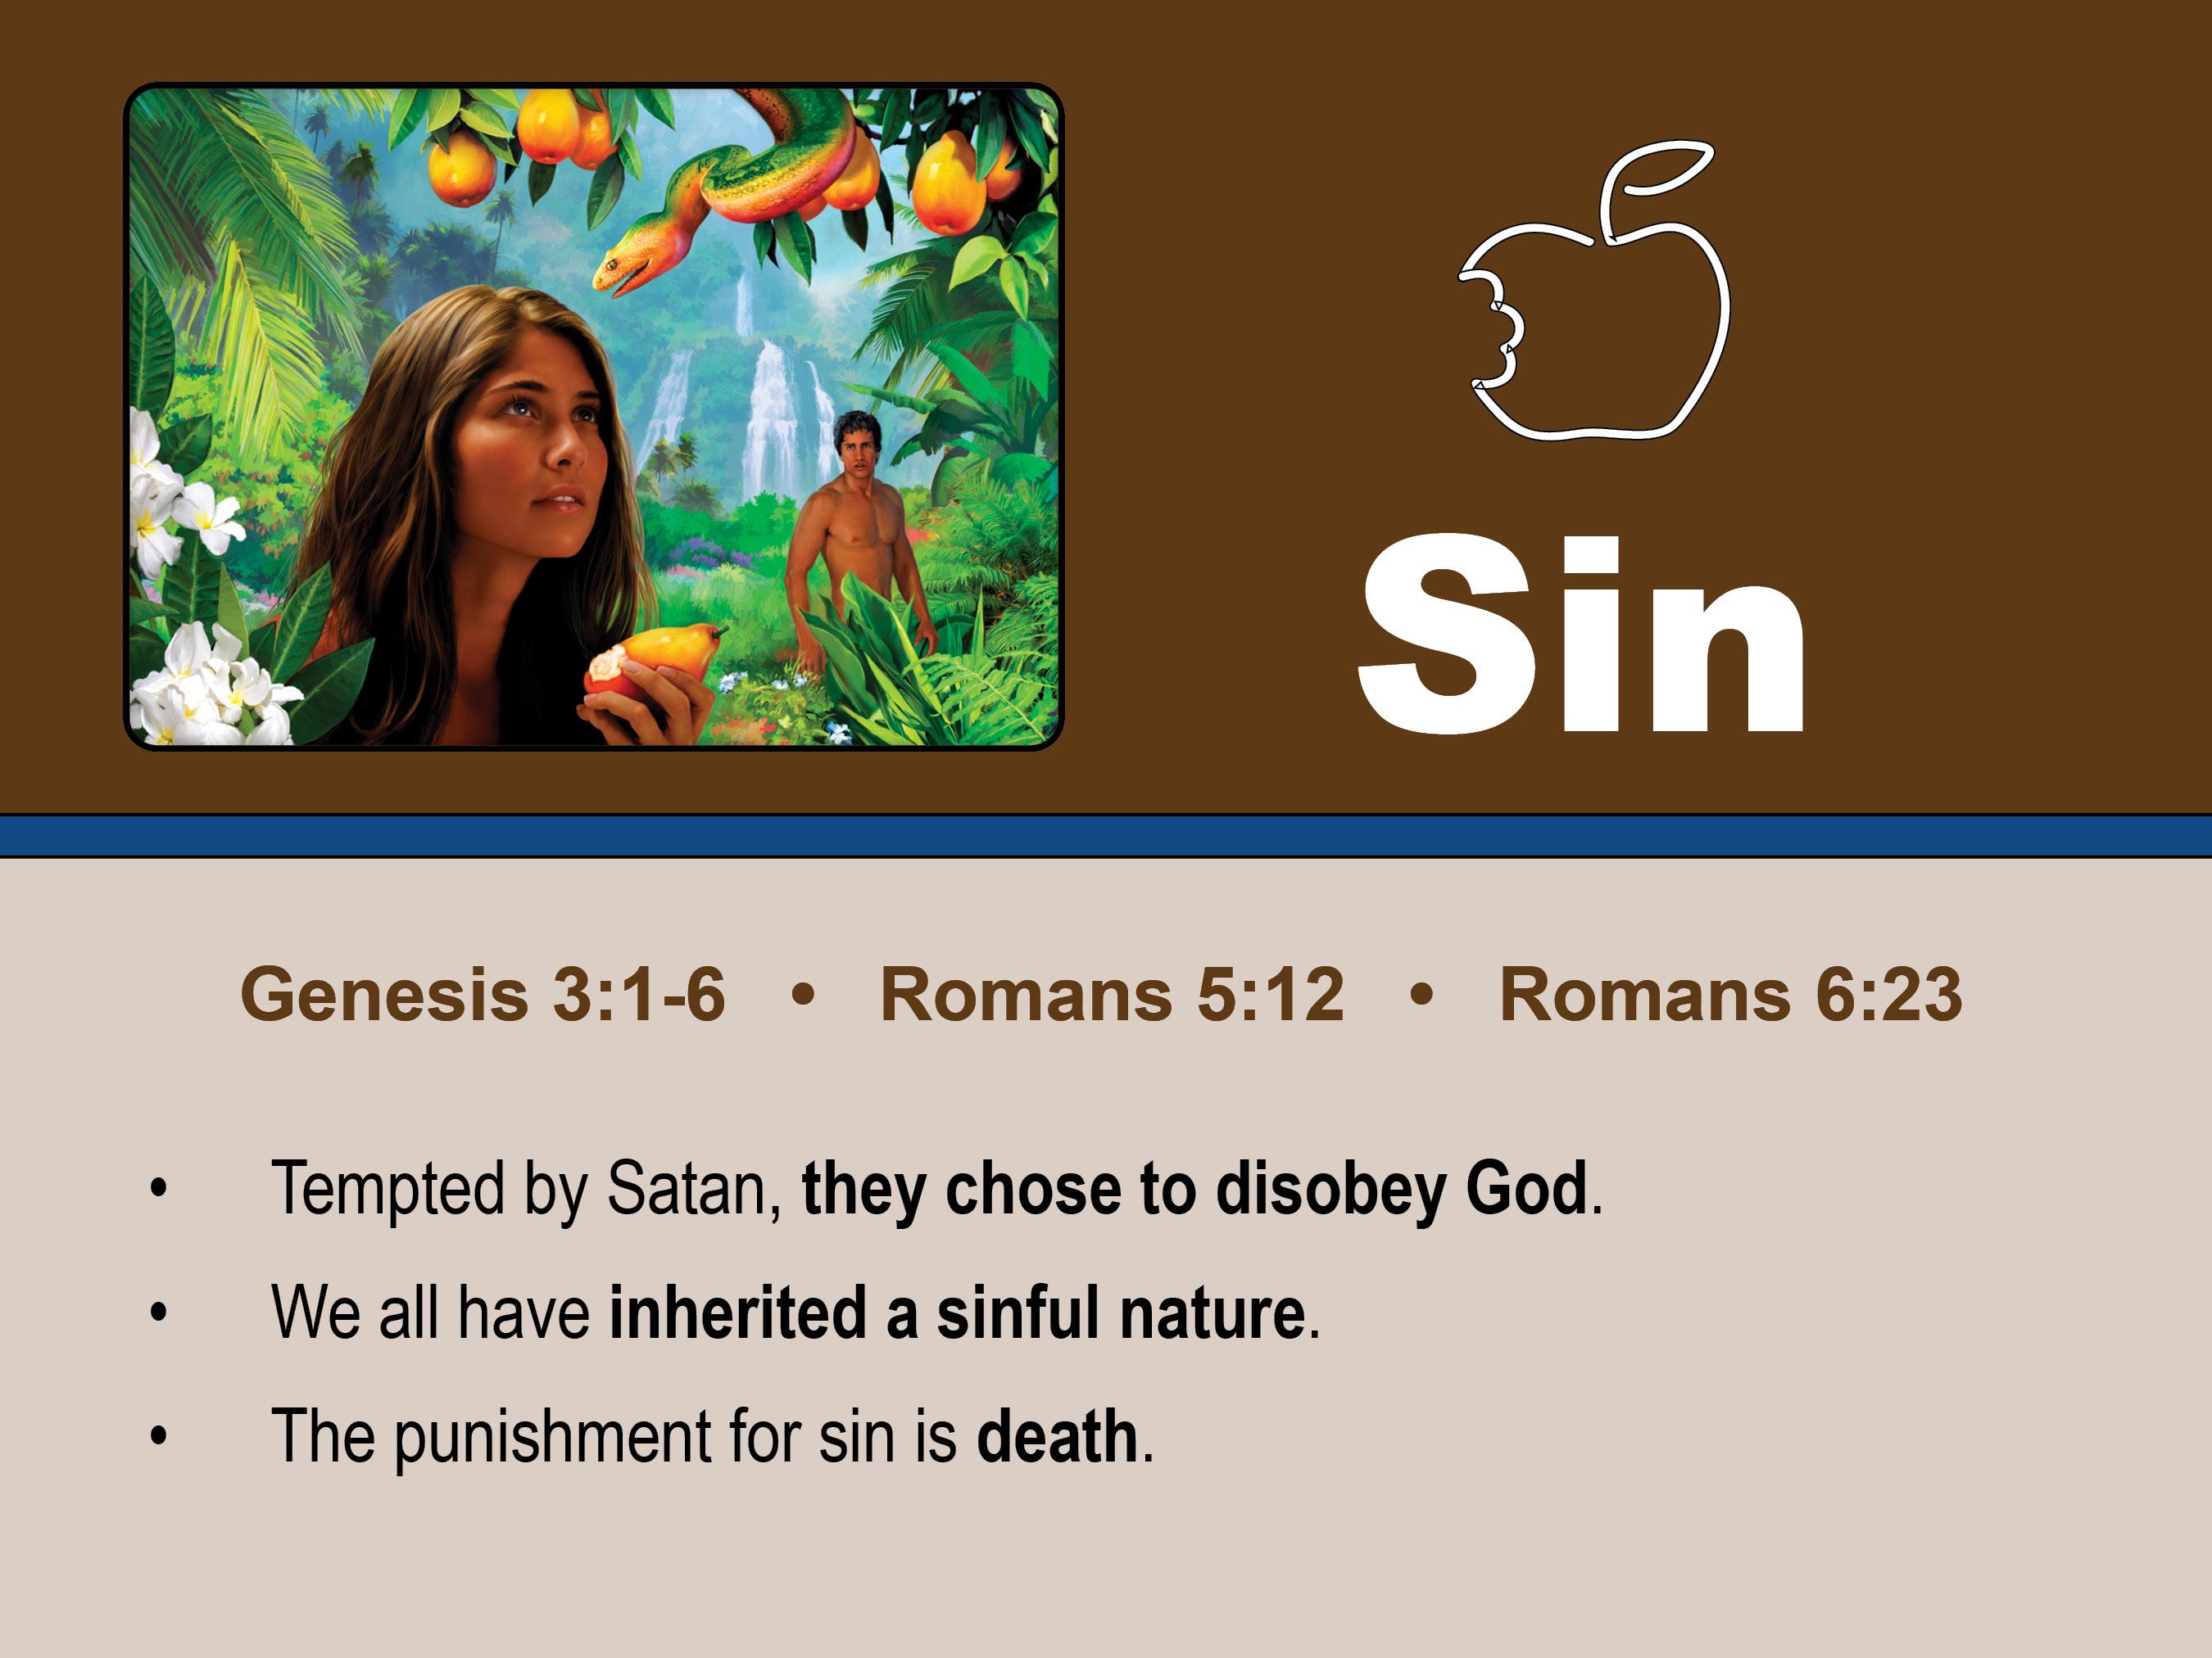
The serpent said to the woman, “Did God really say, ‘You can’t eat . . . You won’t die! God knows when you eat from that tree . . .” Genesis 3:1-6
Tempted by Satan, man (humans)
chose to disobey.

Slide 23
. . . just as sin came into the world through one man, and death through sin, and so death spread to all men because all sinned— Romans 5:12
We all have inherited a sin nature.

Slide 24
For the wages of sin is death, but the gift of God is eternal life through Jesus Christ our Lord.
Romans 6:23
The punishment for sin is death.

Slide 25
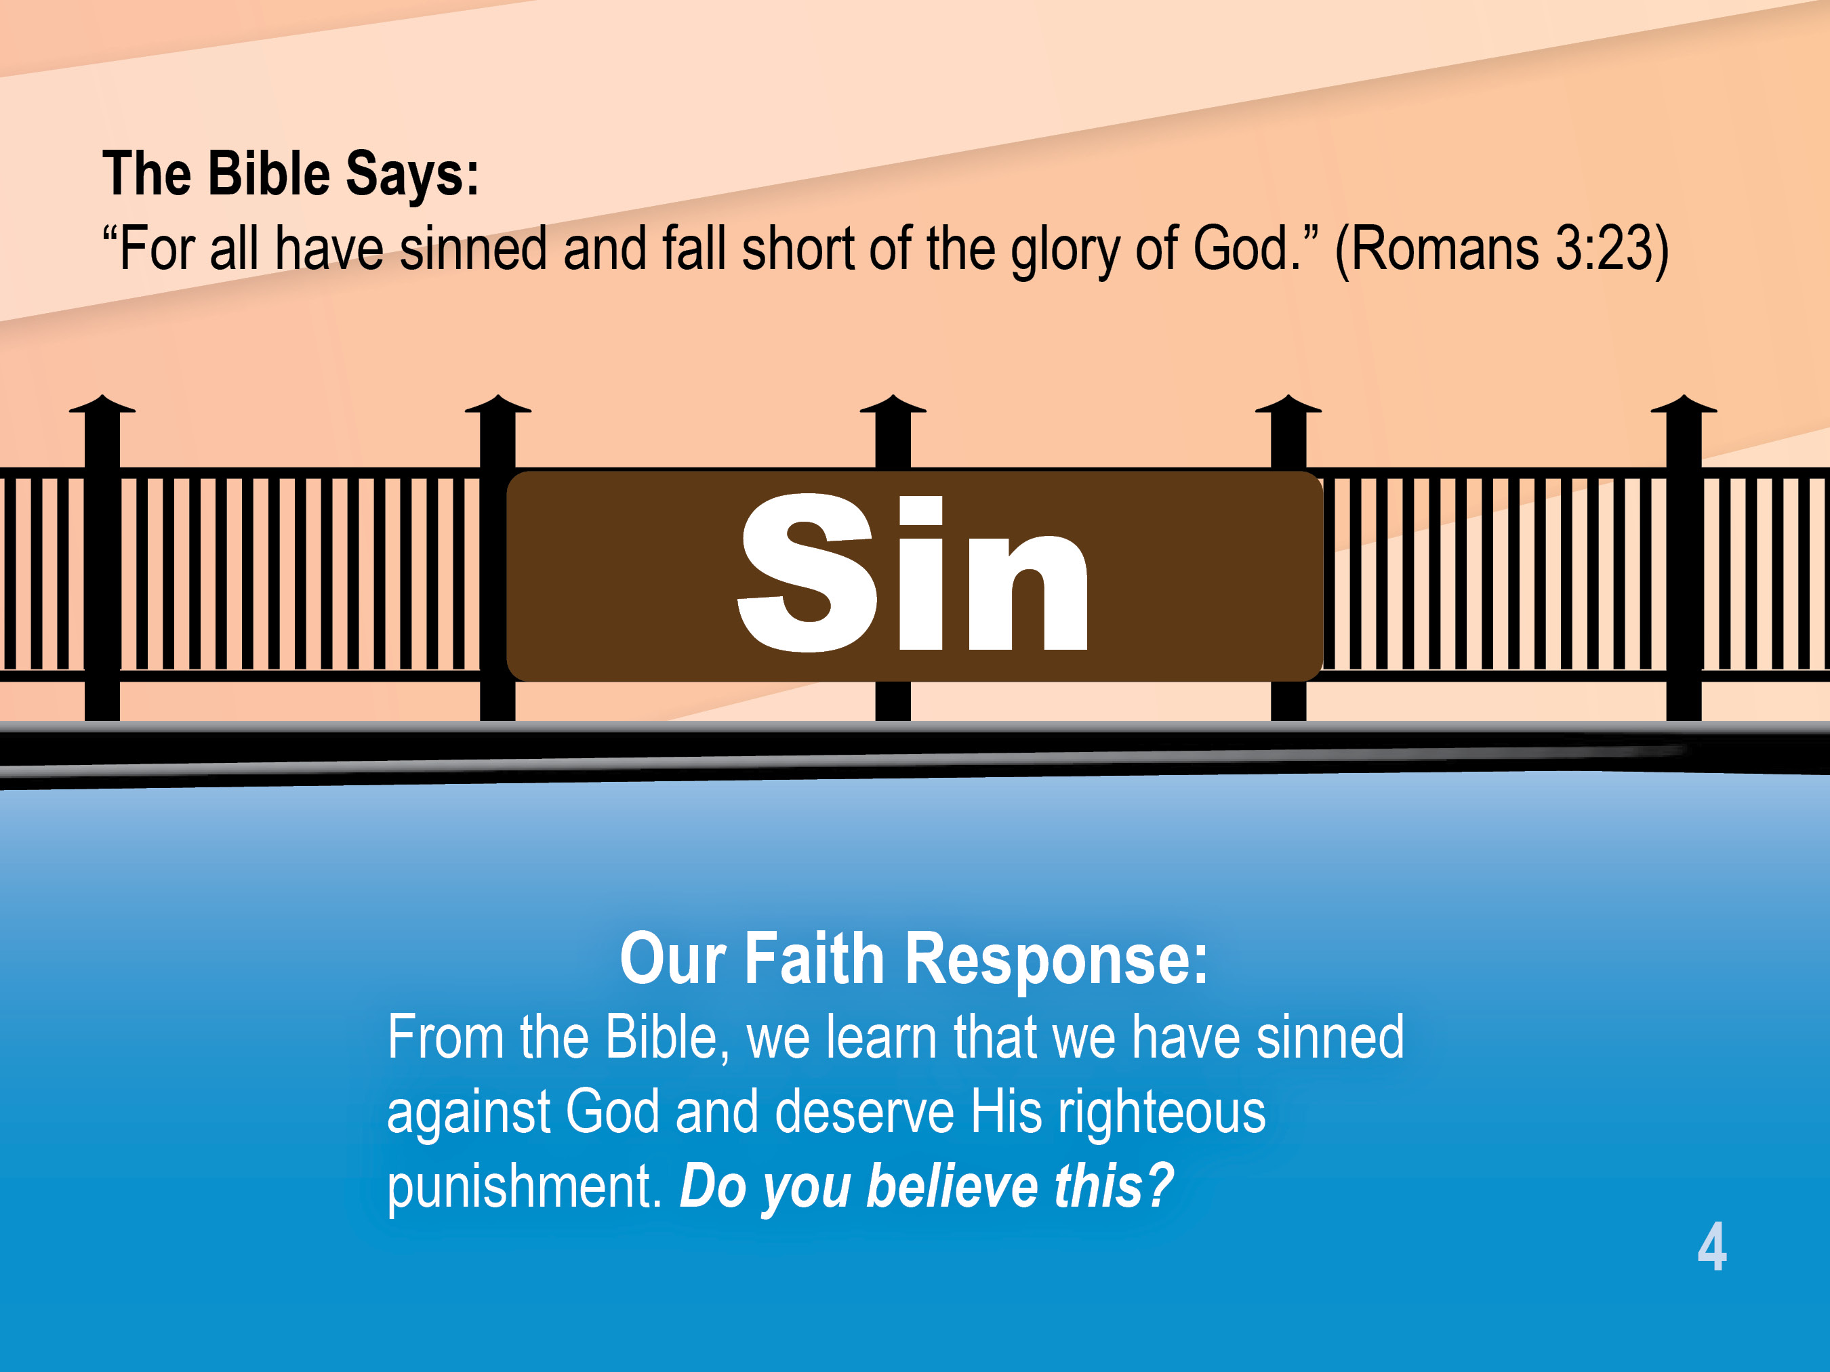

Slide 26
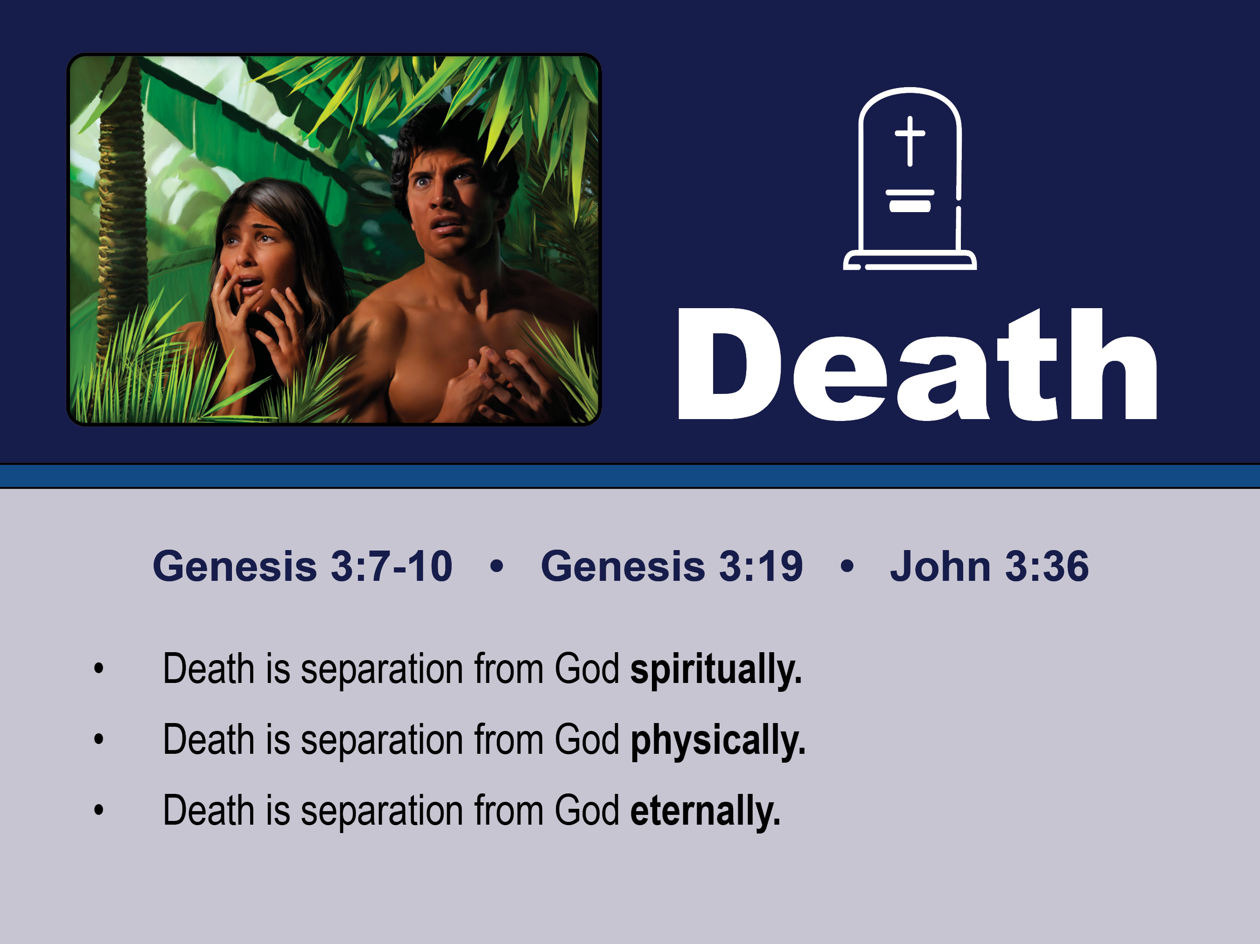
Then their eyes were opened and they knew they were naked . . . and they heard God in the garden and they hid. Genesis 3:10-17
Death is separation from God spiritually.

Slide 27
. . . just as sin came into the world through one man, and death through sin, and so death spread to all men because all sinned— Romans 5:12
Death is separation from God physically.

Slide 28
It’s your fault that the ground is cursed . . . Thorns and thistles will grow up with ease . . . and work and sweat . . . But still one day . . . and there you’ll end without a doubt. Genesis 3:17-19
Death is separation from God eternally.

Slide 29
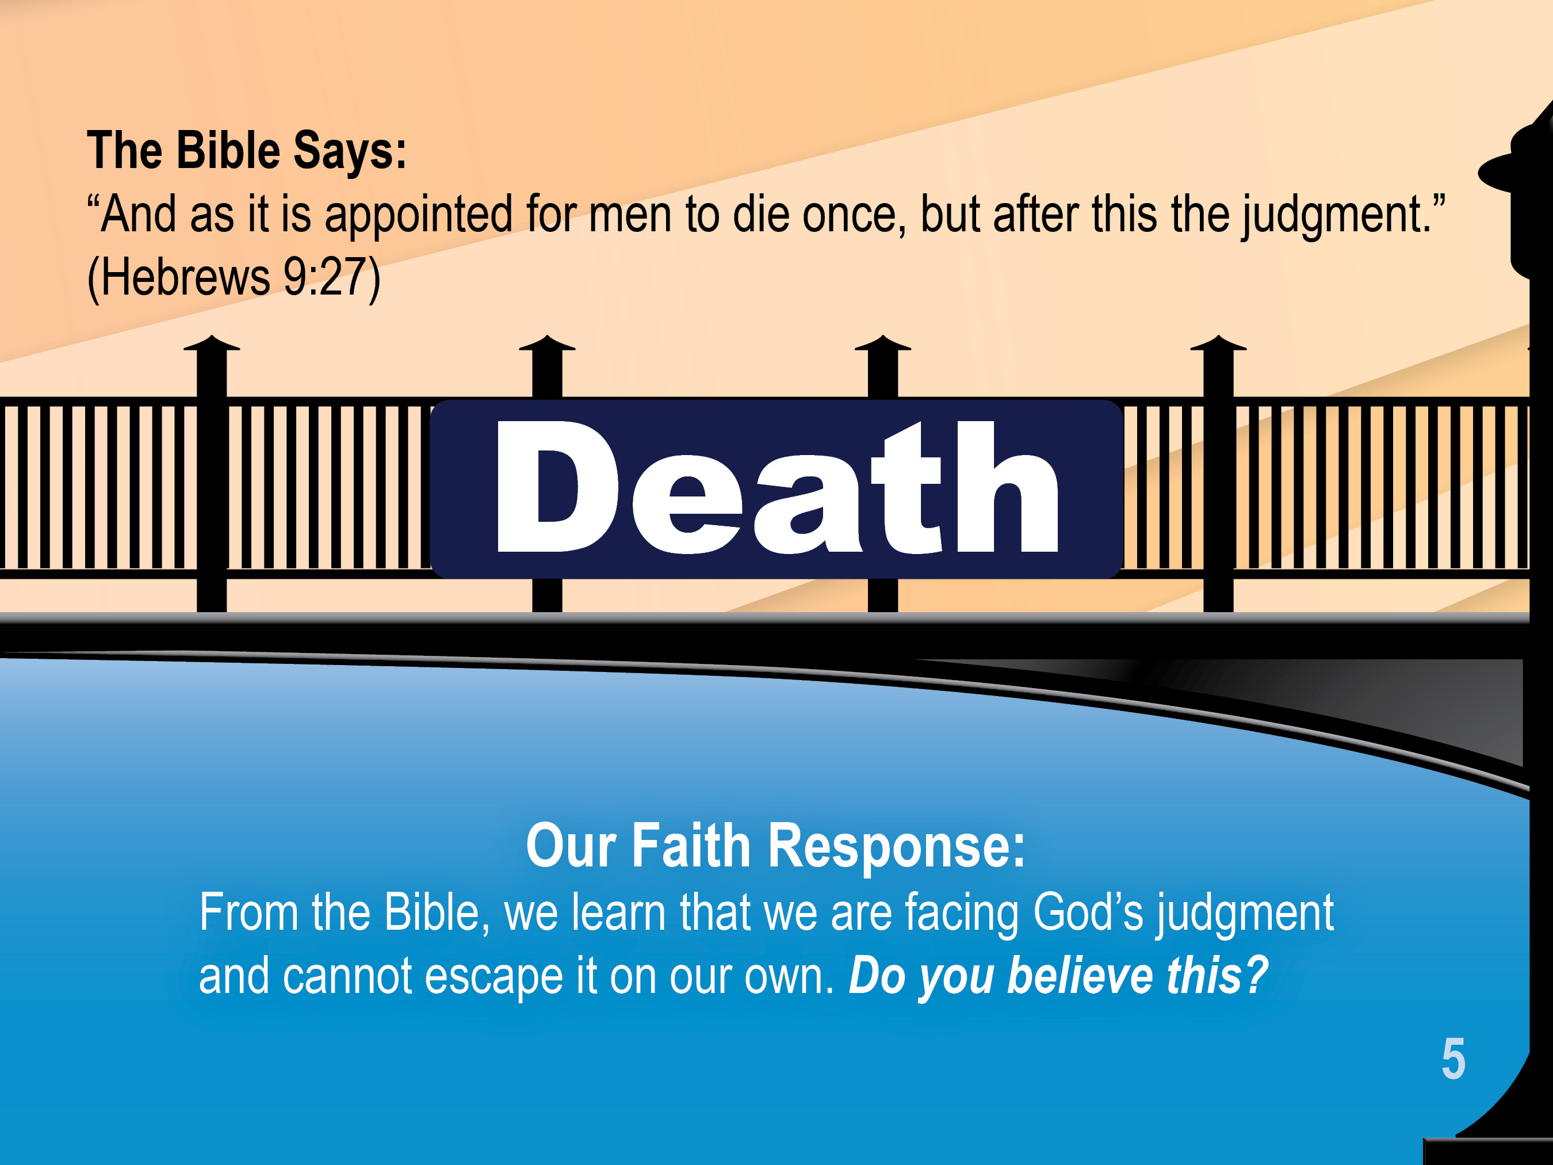

Slide 30
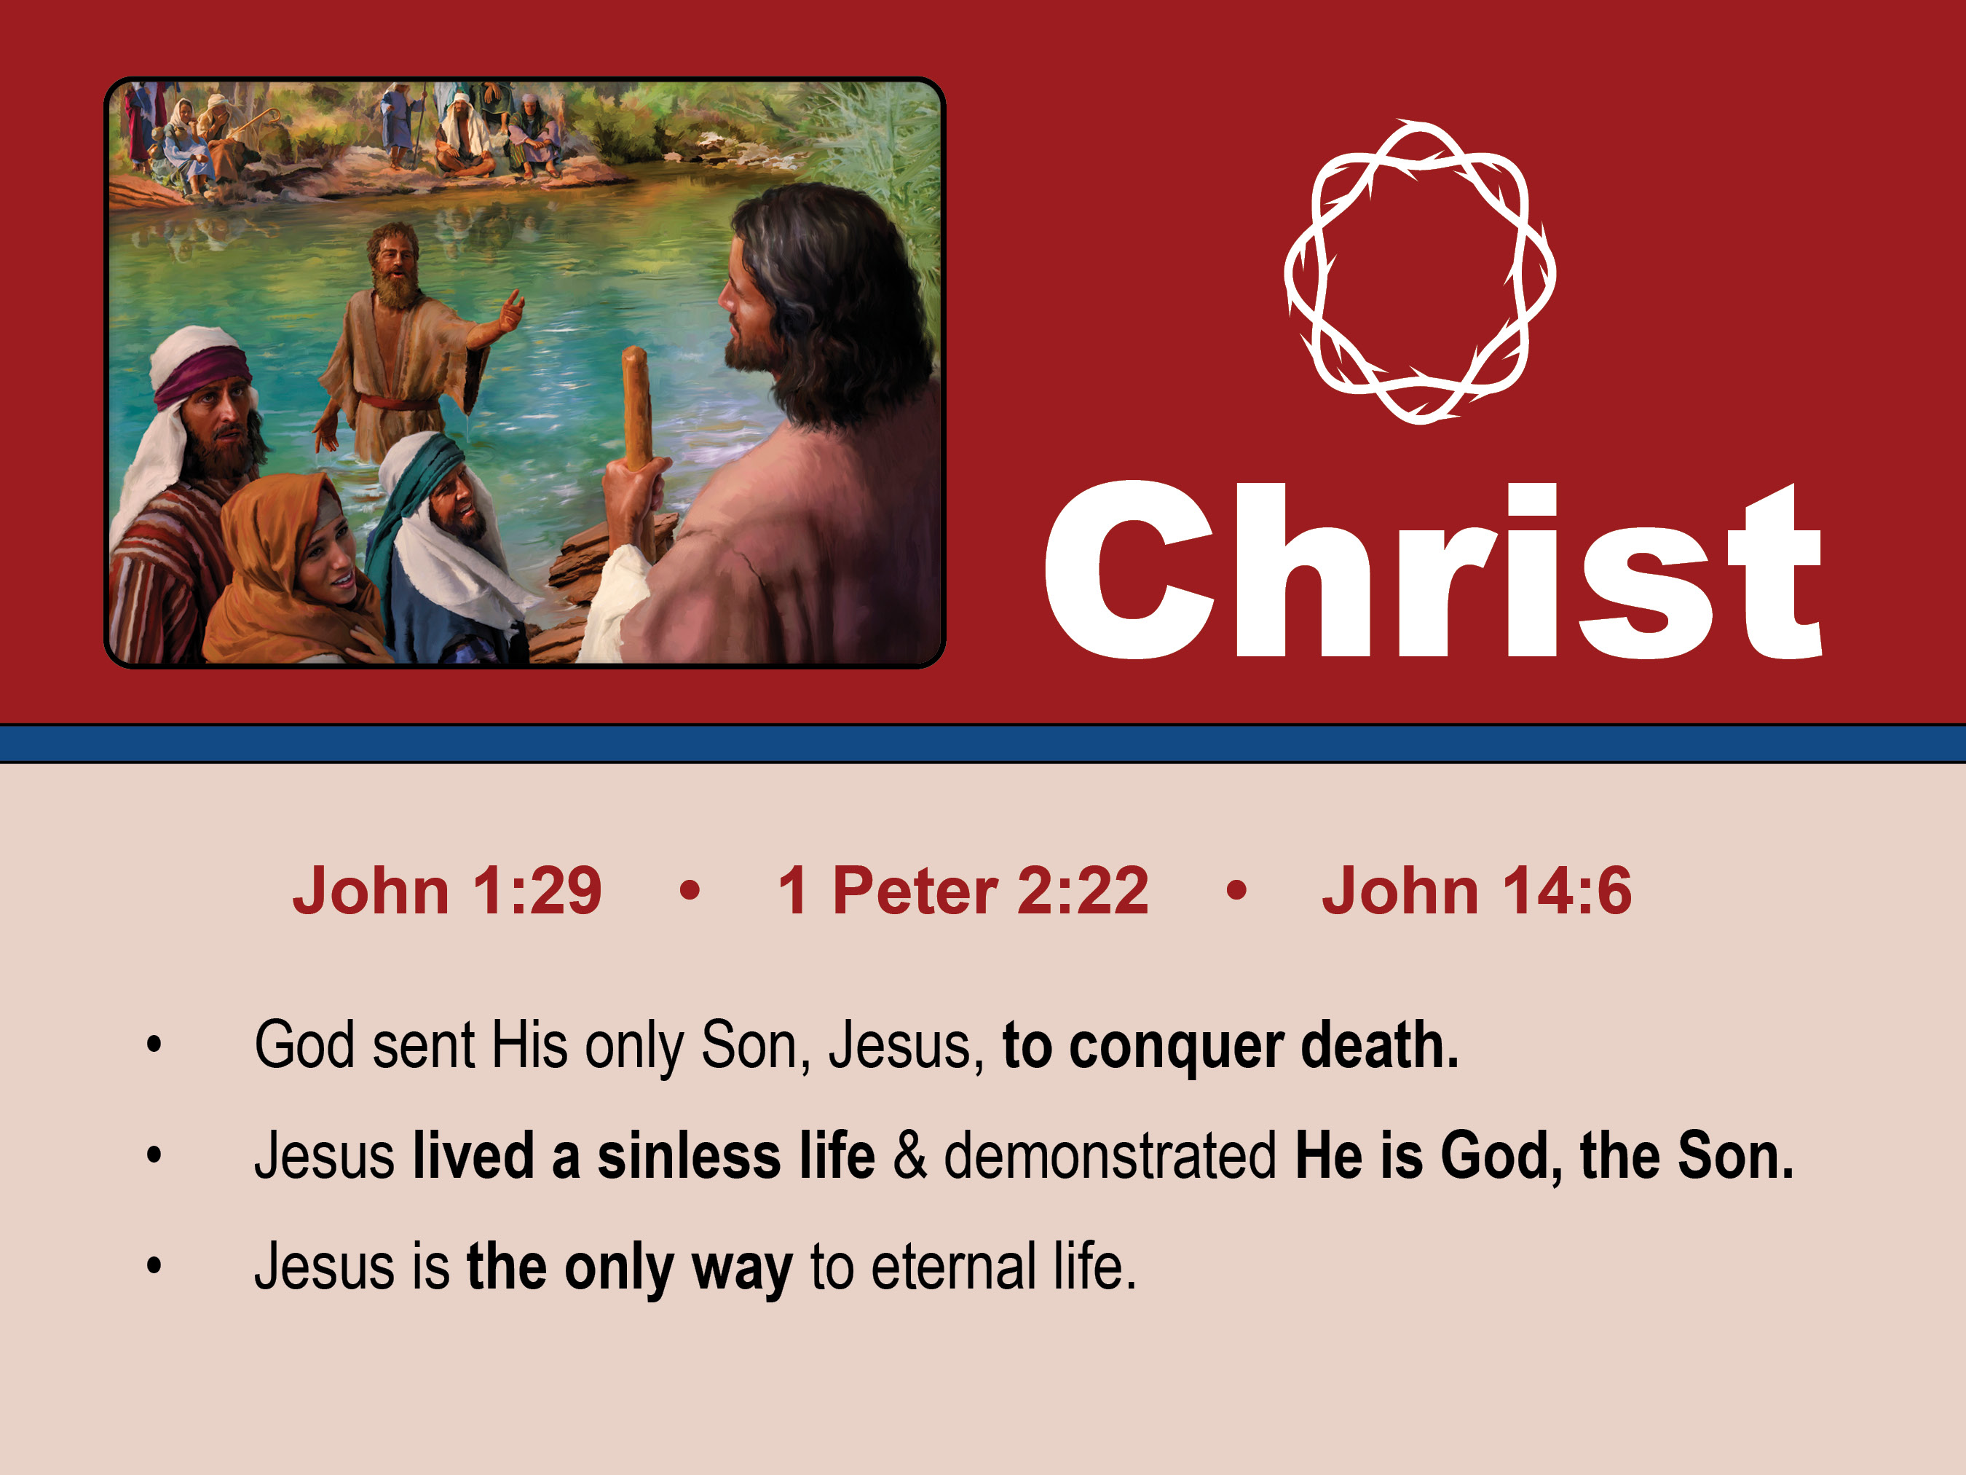
John saw saw Jesus coming toward him, and said, “Behold, the Lamb of God, who takes away the sin of the world!" John 1:29
God sent His only Son, Jesus, to conquer death.

Slide 31
Jesus lived a sinless life
and showed that He is God, the Son.
He committed no sin, neither was deceit found in his mouth. 2 Peter 2:22

Slide 32
Jesus said to him, “I am the way, and the truth, and the life. No one comes to the Father except through me. John 14:6
Jesus is the only way to eternal life.

Slide 33
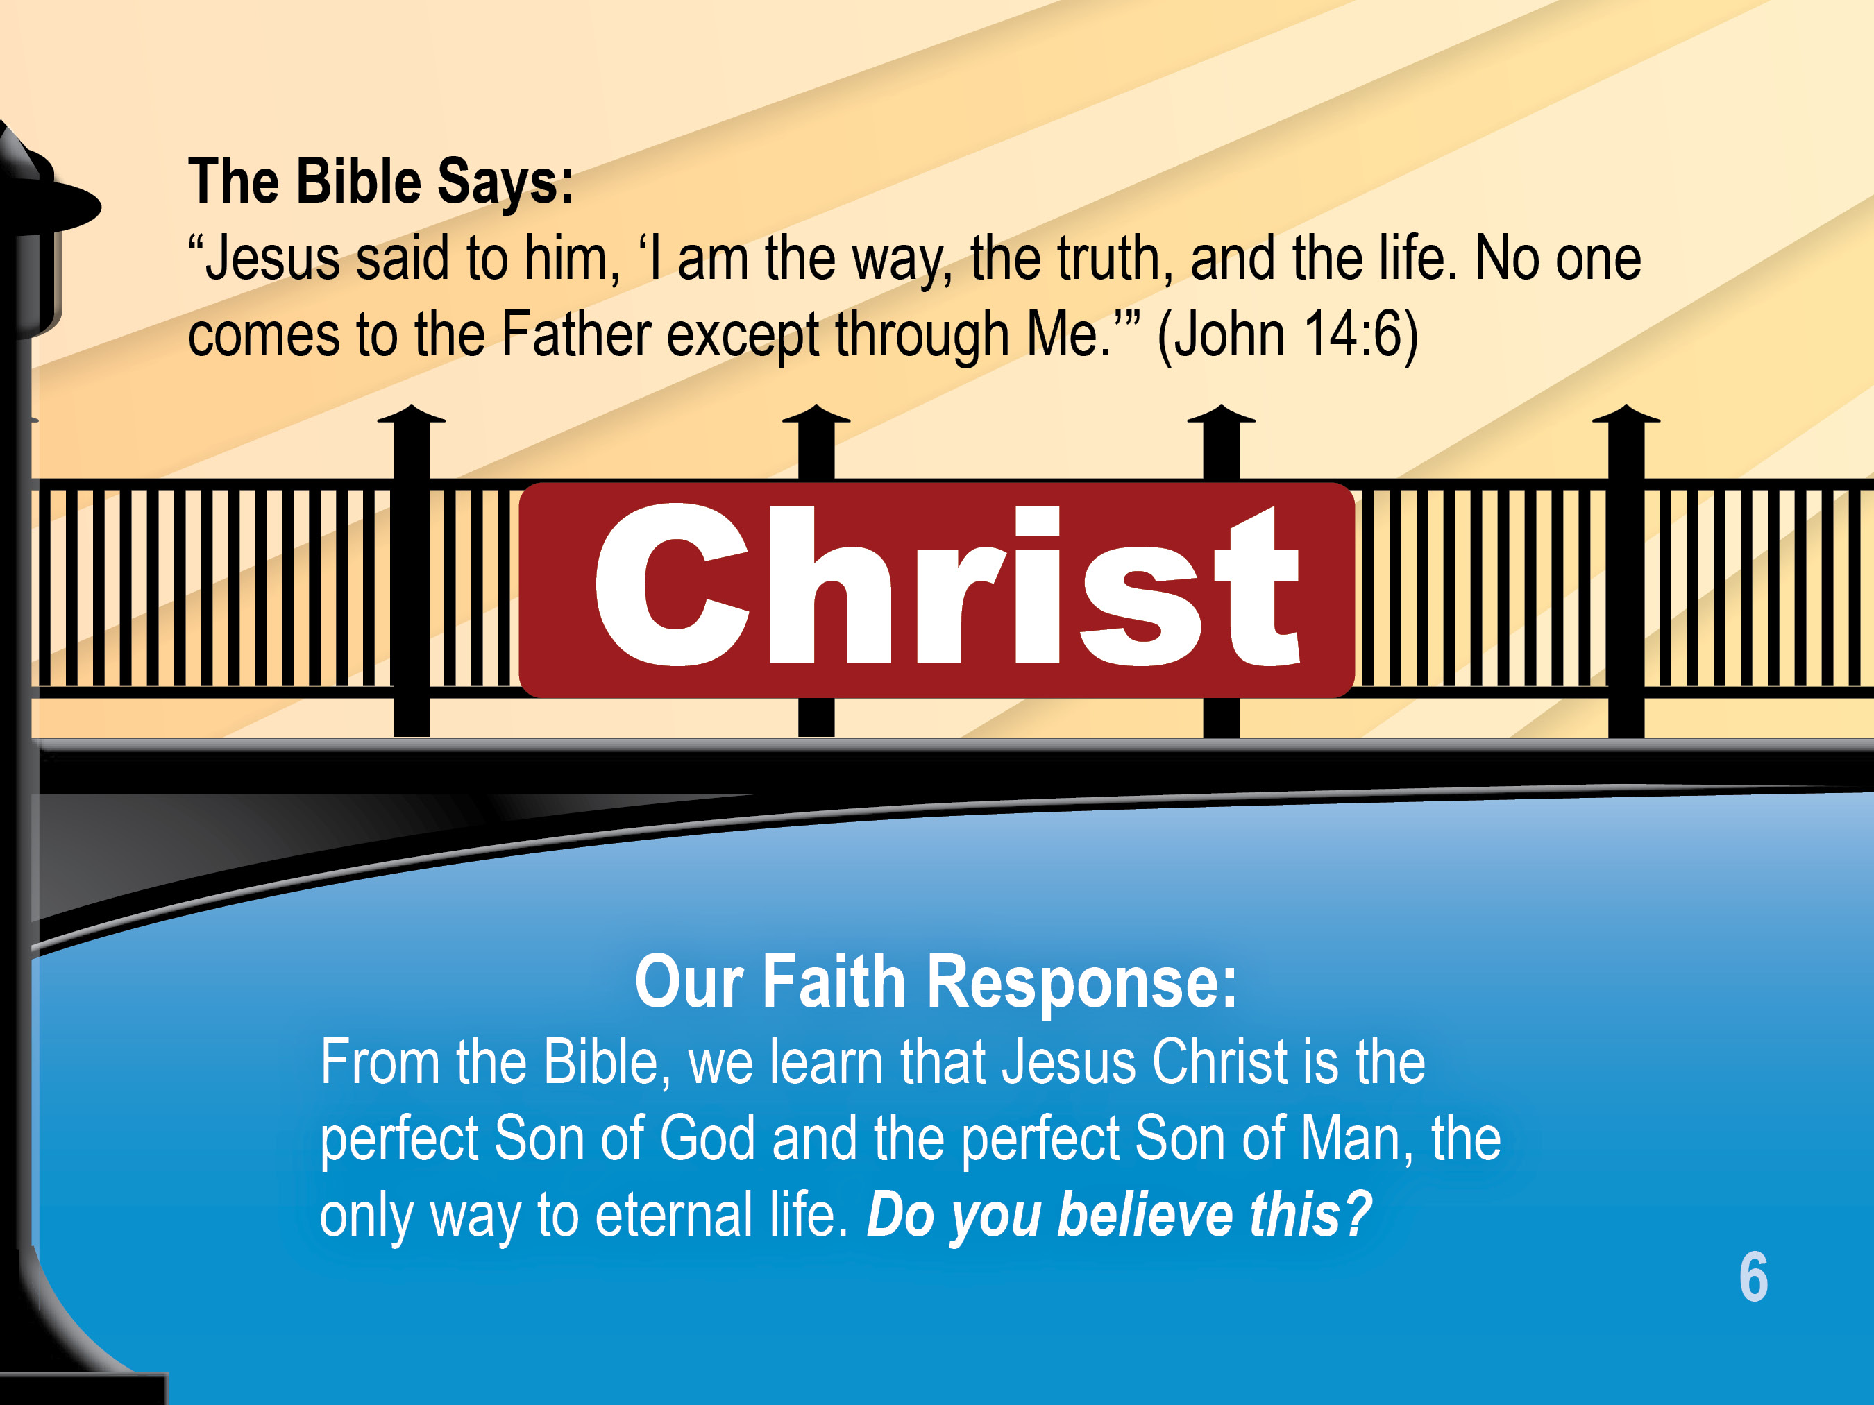

Slide 34
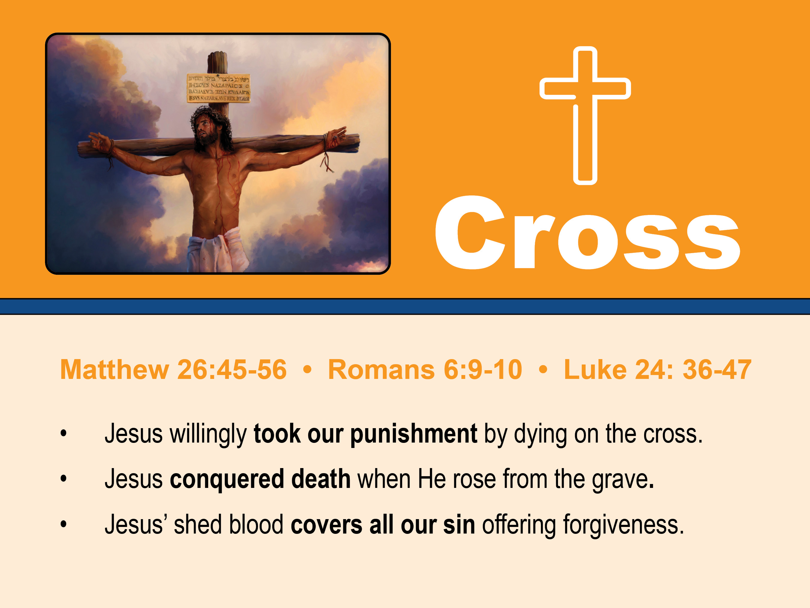
They . . . mocked him . . . they stripped him . . . and led him away and [hung Him on a cross.] Matthew 26-27
Jesus willingly took our
punishment by dying on the cross.

Slide 35
Christ, being raised from the dead, will never die again; death no longer has dominion over him. For the death he died he died to sin, once for all, but the life he lives he lives to God. Romans 6:9-10
Jesus conquered death when
He rose from the grave.

Slide 36
Thus it is written, that the Christ should suffer and on the third day rise from the dead, and that repentance for the forgiveness of sins should be proclaimed in his name to all nations, beginning from Jerusalem.” Luke 24
Then he said to them, “These are my words that I spoke to you while I was still with you, that everything written about me in the Law of Moses and the Prophets and the Psalms must be fulfilled.”
Jesus’ shed blood covers all our sin
offering forgiveness.

Slide 37
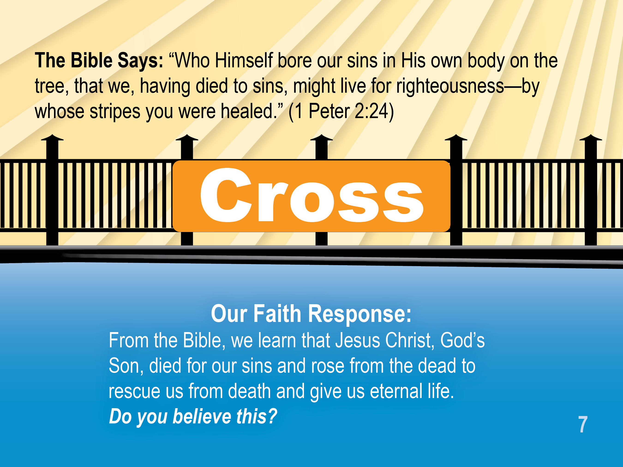

Slide 38
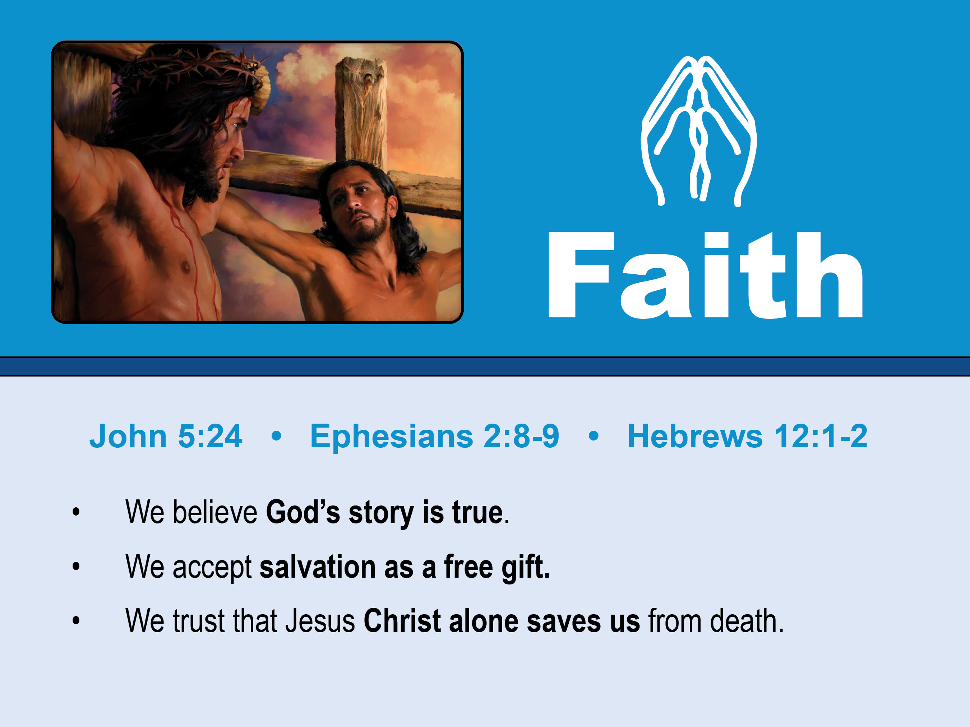
It’s true! Whover hears my word and believes him who sent me has eternal life. He . . . has passed from death to life. John 5:24
We believe God’s story is true.

Slide 39
For by grace you have been saved through faith. And this is not your own doing; it is the gift of God. Ephesians 2:8-9
We accept salvation as a free gift.

Slide 40
We trust that Jesus Christ
alone saves us from death.
. . . let us lay aside . . . sin . . . Looking to Jesus, the founder and perfecter of our faith . . . Hebrews 12:1-2

Slide 41


Slide 42

For God so loved the world that He gave His one and only Son that whoever believes in Him should not perish but have everlasting life. John 3:16
God promises eternal life
if we put our faith in Him.

Slide 43
My sheep hear my voice and . . . I give them eternal life . . . no one will snatch them out of my hand. My Father, who has given them to me, greater than all, and no one is able to snatch them out of the Father’s hand. I and the Father are one. John 10:27-29
Eternal life can never be taken from us
once we believe.

Slide 44
. . . There is no fear in love, but perfect love casts out fear. For fear has to do with punishment and whoever fears has not been perfected in love . . . John 4:13-19
We love Him because He first loved us.

Slide 45
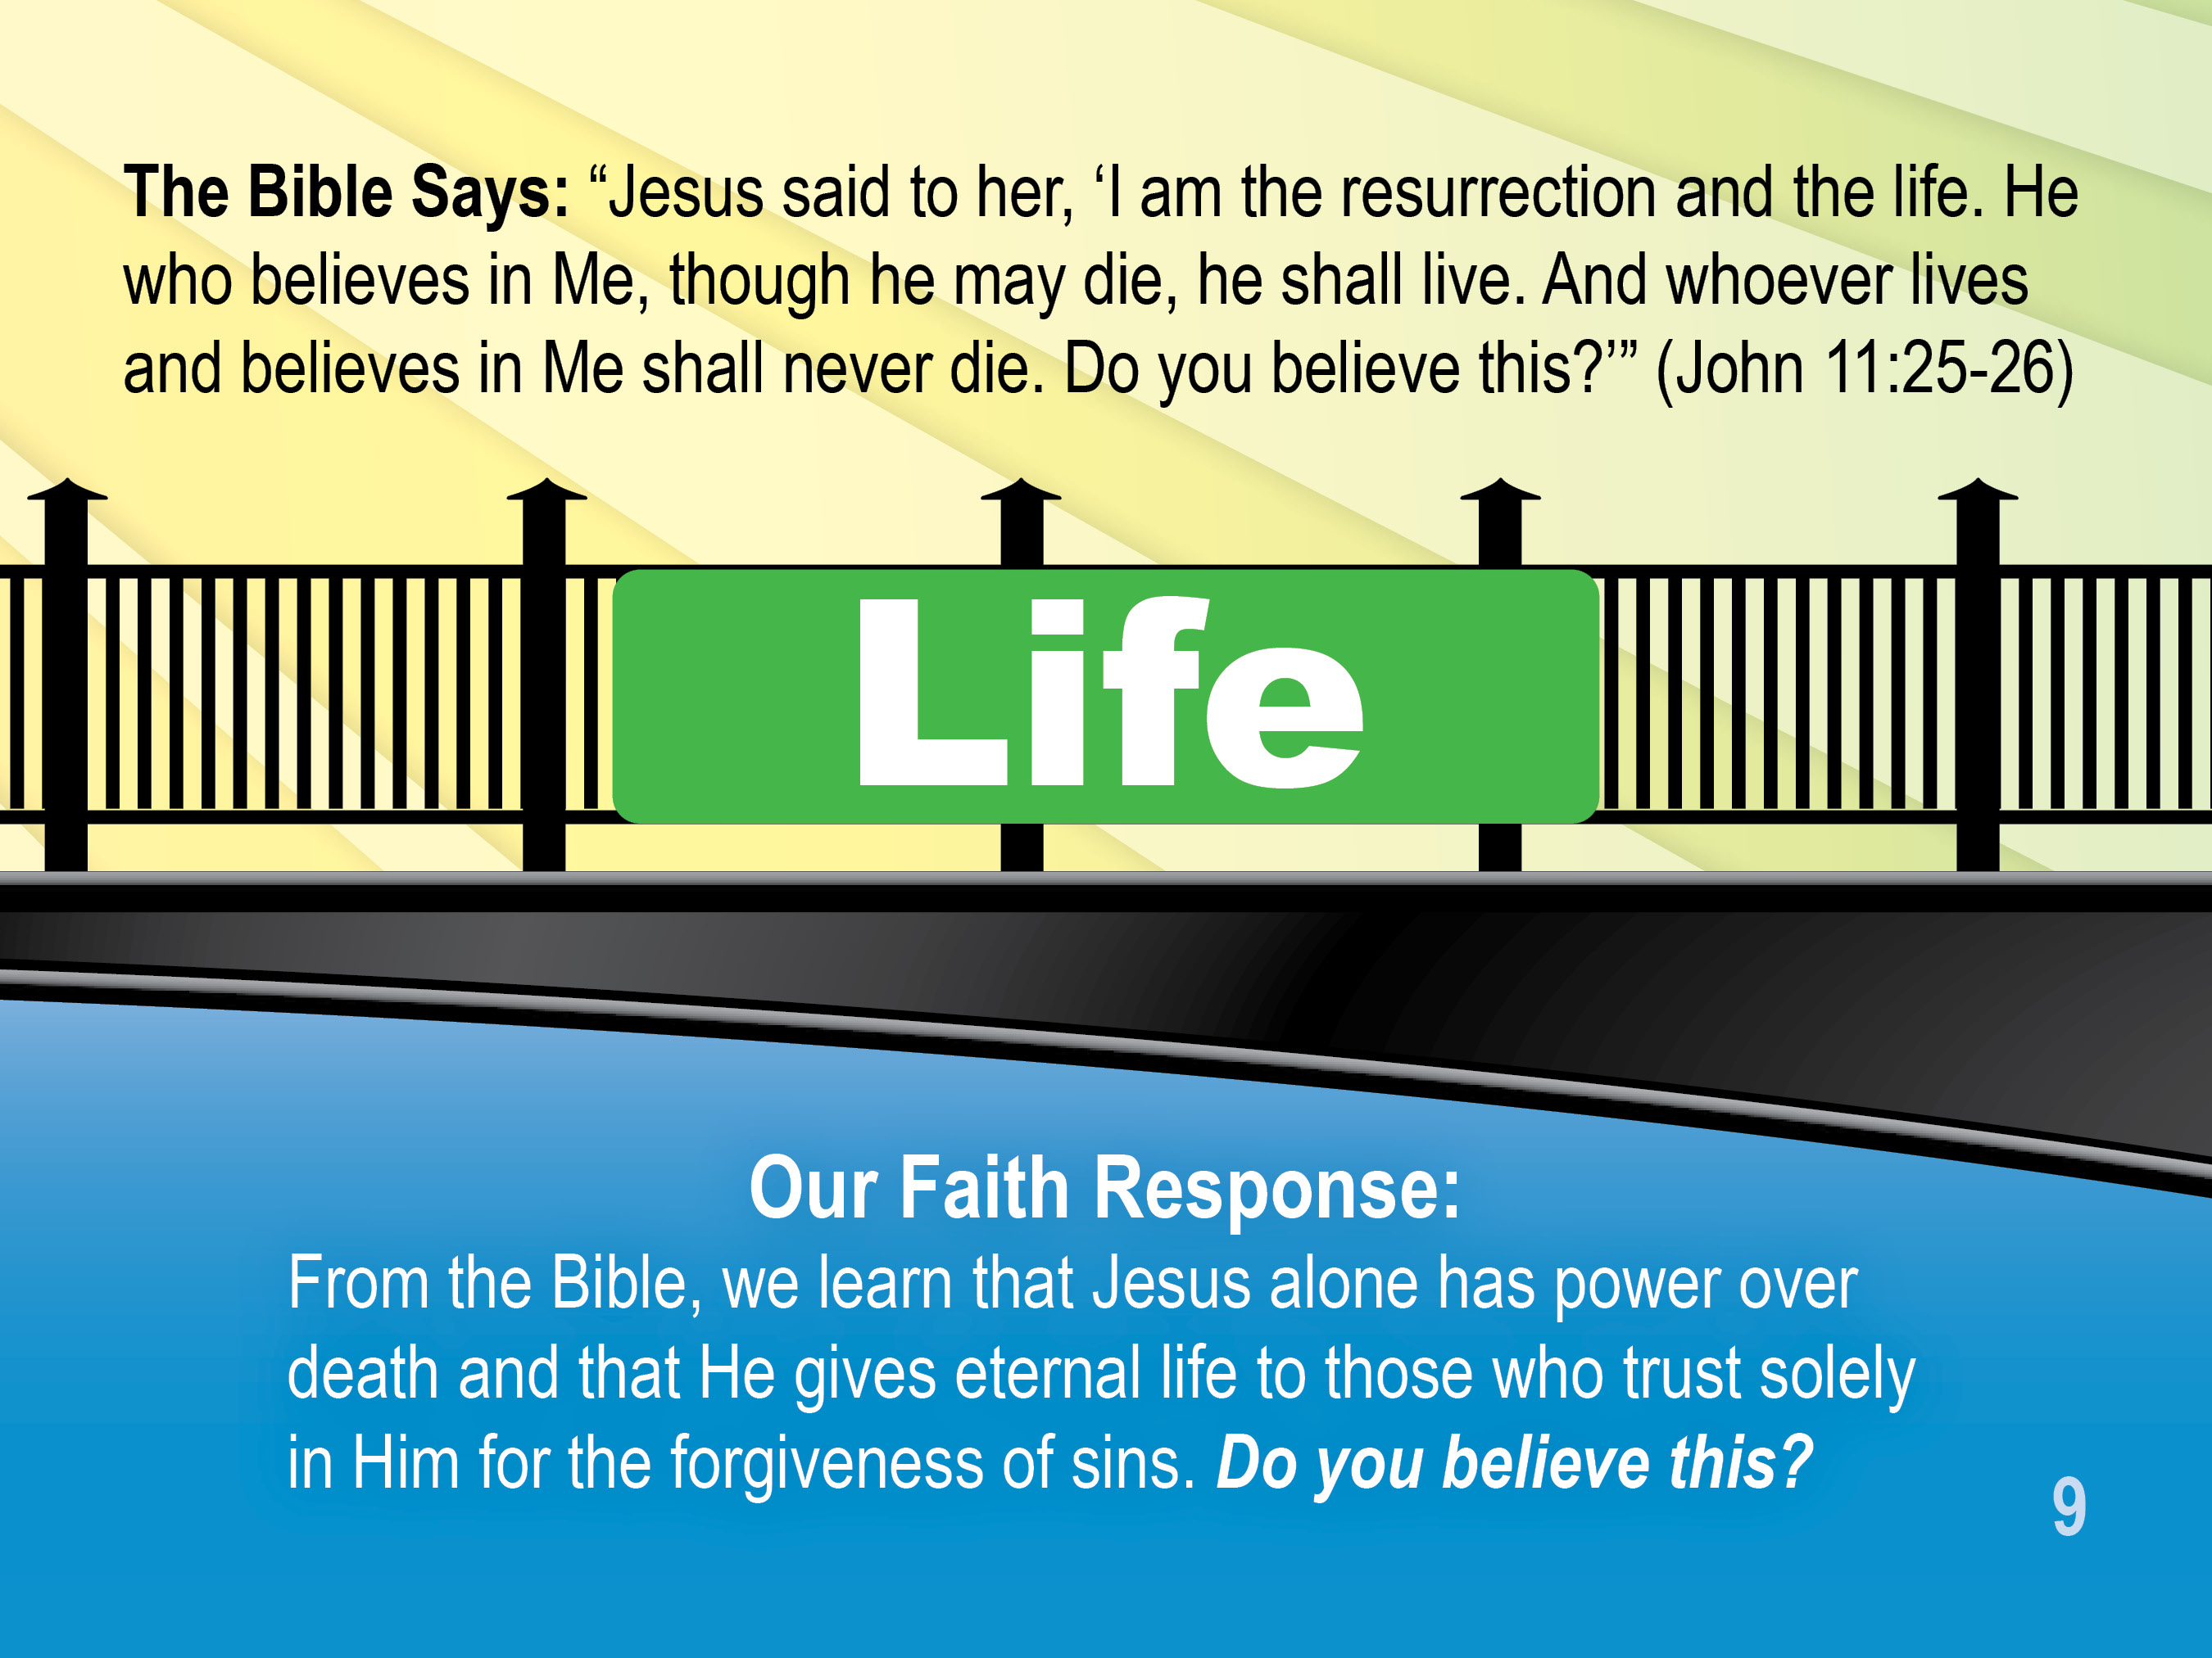

Slide 46

